Slide 1
S-101 ENC production in CARIS software
20th Meso American-Caribbean Sea Hydrographic Commission (MACHC) Meeting
Santo Domingo – República Dominicana
December 2-6, 2019
Presented by Juan Carballini – Regional Sales Manager

Slide 2
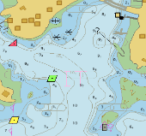
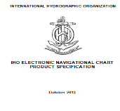
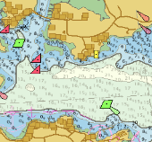
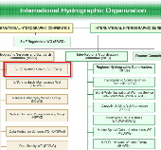
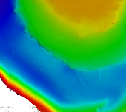
Topics
Introduction
S-101
Impact
S-101
Impact on ENC Producers
S-101
Production
CARIS HPD 4.0
S-57 data migration / conversion
S-100 / S-101 training opportunities
Summary

Slide 3
Introduction
Teledyne CARIS has been supporting S-100 based products for many years
S-101 ENC draft versions in S-57 Composer
S-102 bathymetric surfaces in Bathy DataBASE
In July 2019 CARIS Composer and HPD 4.0 were released with full support for S-101 ENC production
S-100 Module
IHO S-101 ENC product specification version 1.0.0

Slide 4
S-101 Impact
Many different groups will be impacted by the development of S-101 ENCs
Producers (Hydrographic Offices)
Distributors (RENCs, others)
ECDIS Manufacturers (OEMs)
Mariners (end users)

Slide 5
S-101 Impact on ENC Producers
Some of the impacts on ENC producers include
Need to familiarize with new S-101 standard
Many S-101 features are largely unchanged from S-57 but new techniques will be needed to encode new S-101 items
Information types
Complex attributes with sub-attributes
Cartographic text features
Metadata
Source: IHO S-101 Value Added Roadmap

Slide 6
S-101 Impact on ENC Producers (cont.)
Some of the impacts on ENC producers include
Changes in S-101 encoding method including
Changes to features included in S-101 Skin of the Earth
Lights become four separate features
Topmarks become complex attributes
New method for Bridges and Span features
Some S-57 features are not used in S-101 including
Collections, Tide/Tidal Stream prediction features no longer used
New object AIS features become two new AIS features
New information types replace caution areas
Source: IHO S-101 Value Added Roadmap

Slide 7
S-101 Impact on ENC Producers (cont.)
Requirement to support S-57 and S-101 ENCs
Two production lines may be required
Continuing S-57 ENC production
New S-101 ENC production
S-101 production options may include…
Current S-57 production line, plus convert S-57 to S-101 then complete in S-101?
New parallel S-101 production workflow?
New S-101 production then convert back to S-57?
Other…?
.000
Source: IHO S-101 Information Paper

Slide 8
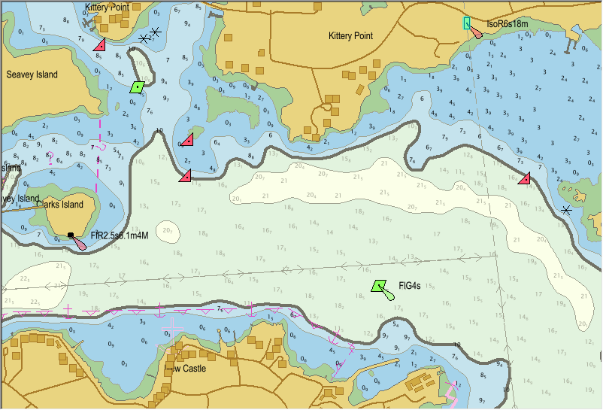
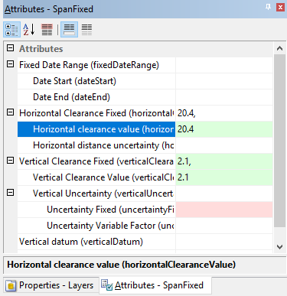
CARIS HPD - New Support for IHO S-100
HPD S-100 Databases
S-57 to S-101 Conversion
S-101 Feature Processing
S-101 ENC Product Creation
S-101 Exchange Sets
Updating S-101 ENCs
S-101 to S-57 Conversion
Migrate HPD to S-100

Slide 9
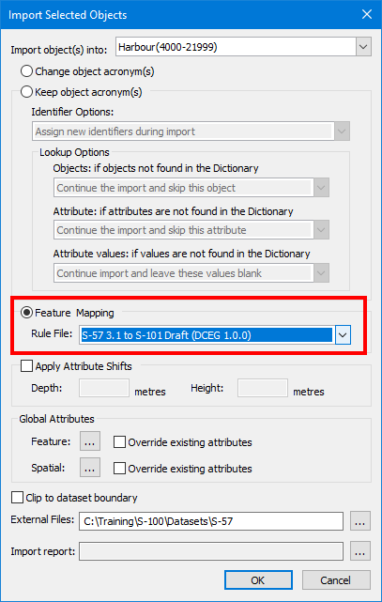
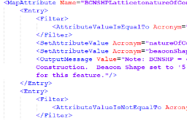
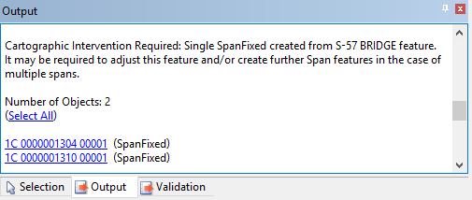
S-57 to S-101 Conversion
Import S-57 features into an S-100 database
Open S-57 ENC content
Automatic on-the-fly feature mapping to S-101
Note: mapping rules can be customized by users
Reports with hyperlinks to features show where further intervention may be required
Save results to the database

Slide 10
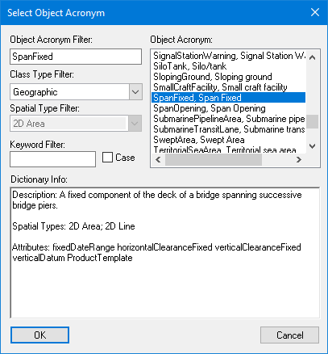
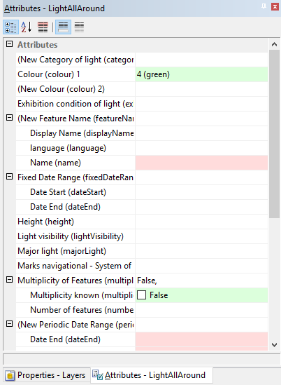
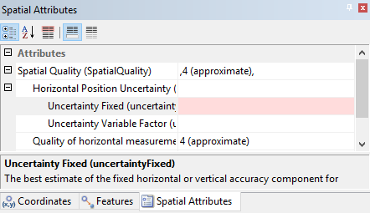
S-101 Feature Creation
Create new S-101 features interactively in Source Editor
Select S-101 acronym
Enter S-101 attribute values
S-101 simple and complex attributes are fully supported
Digitize their position
Other
Create S-101 feature associations
Digitize S-101 Information types

Slide 11
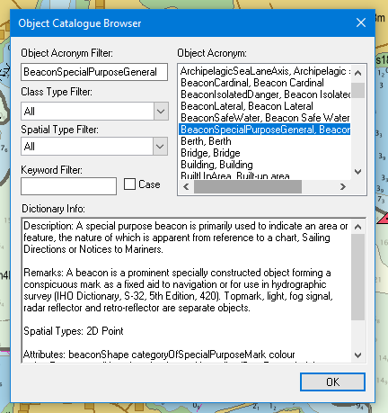
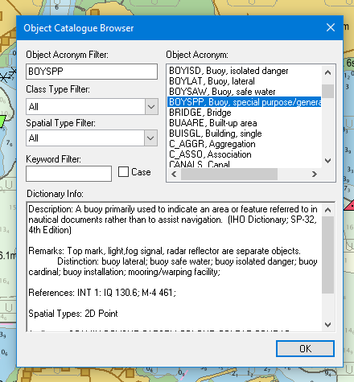
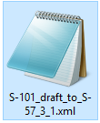
S-101 to S-57 Conversion
Convert S-101 to S-57
Export S-101 features to S-57
Automatic on-the-fly feature mapping from S-101 to S-57
Note: mapping rules can customized by users
Prompts where further intervention may be required

Slide 12
HPD S-57 to S-100 Database Migration
Version | 3.2 | → | 4.0 |  | 4.0 | → | 4.x | … | Future
HPD Data Model | S-57 Legacy Data Model | UPGRADE | S-57 Unified Feature Data Model | MIGRATION | S-100 Unified Feature Data Model | UPGRADE | S-100 Unified Feature Data Model | … | S-100 Unified Feature Data Model
Source Features | S-57 |  | S-57 |  | S-100 |  | S-100 |  | S-100
Products (S-57) | ✓ |  | ✓ |  | ✓ |  | ✓ |  | ✗
Products (S-100) | ✗ |  | ✗ |  | ✓ |  | ✓ |  | ✓

Slide 13
HPD 4.0 – S-101 ENC Production (Source data)
Video removed by the IHO due to space

Slide 14
HPD 4.0 – S-101 ENC Production (product)
Video removed by the IHO due to space

Slide 15
Training Opportunities
Free S-100 Workshops and User Group Meeting in 2020
ENC S-101 production and other S-100 derived products
Best practices for data (S-57) migration/conversion
3 different locations
Panama - September 15 to 17, 2020 in Spanish
The Netherlands - June 9-11, 2020 (tentative)
Singapore - July 2020
Dedicated on client site S-100 trainings
Introduction to S-100
ENC S-101 production
S-102 and other S-100 related products production

Slide 16
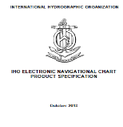
Summary: S-101
S-101 Edition 1.0.0 (Dec 2018) – for implementation, testing
Fully operational release Edition 3.0.0 not expected until 2022
S-101 will impact different stakeholders
Numerous other S-100 based products are proposed
CARIS users can produce S-101 ENCs
From a database application HPD 4.0
S-57 ENCs, paper charts and other products could be produced from the same S-100 data
From a standalone application Composer 4.0
From existing ENCs or from scratch
Different training options available
S-101
Next
Generation ENCs

