Slide 1
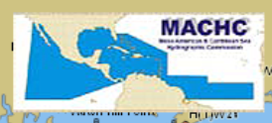
IIC Academy Cat B Training Program
[Global Delivery]
Alejandro Gerones
Geospatial Solutions Consultant
IIC Technologies Inc.
Derrick Peyton
CEO, IIC Technologies Inc.
MACHC 20
Santo Domingo
República Dominicana
Dic. 2-6, 2019
Notes:
Hello… here is IIC’s presentation of our Hydrographic Surveying Program presented to you for S-5B recognition

Slide 2
CONTENTS
IIC Academy Cat B-S5 Hydrographic Training Program: Global Delivery
Background
Motivation for New Path
Global Delivery Approach
Distance / On-line learning
Summary

Slide 3







A “Day in the Life” of IIC Technologies/IIC Academy
Hydrographic Surveys
Survey Data Processing
Education and Training
Navigation Services
Hydrographic
Database Services
Data Validation
& Maintenance

Slide 4
Motivation to Acquire IHO IBSC Cat B-S5 and S-8 Recognition
Situation
Candidates are remotely located and geographically dispersed
Goals
Continuous improvement
Training Solution
Modular
Travel costs are high for students, instructors and subject matter experts
Work, family, and lifestyle priorities need to be balanced
Continuing Professional Development (CPD) for Hydrographic Certification is compulsory (Canadian & Australian Hydrographic Certification Schemes)
Advancements in information and communication technologies facilitate distance learning
Competencies of employees
Quality deliverables to clients
Answer demands from the hydrographic community
Flexible
Distance Learning
Blended learning
Delivery over time
Notes:
[Read slide]

Slide 5
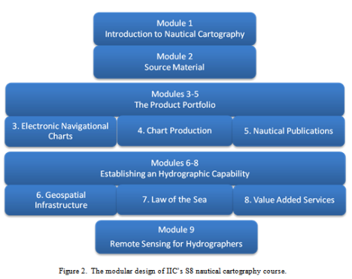
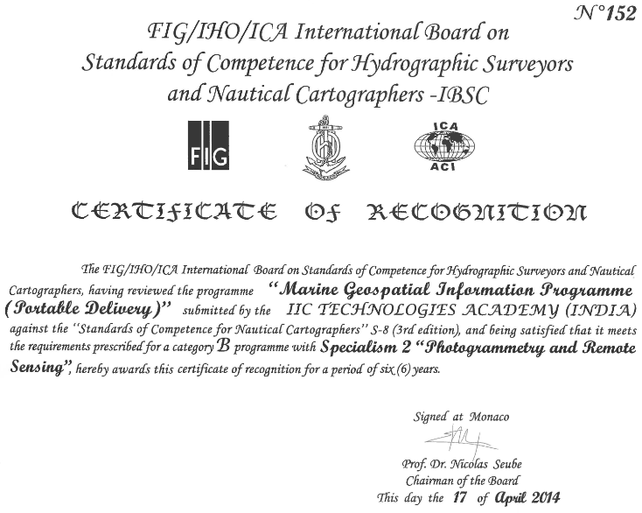
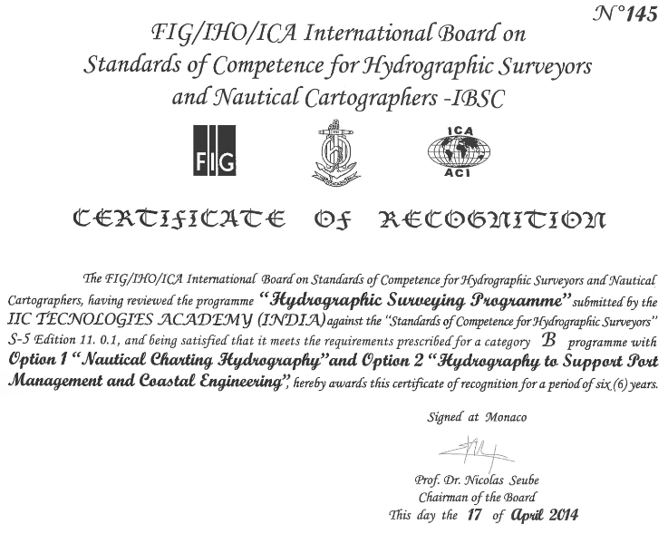
Approach = Site based + Global Delivery
2012
Category B-S8
2014
Category B-S8
(Portable Delivery)
2014
Category B-S5
Modular
Flexible
Blended
Delivery over time
2019
Category B-S5
(Global Delivery)

Slide 6
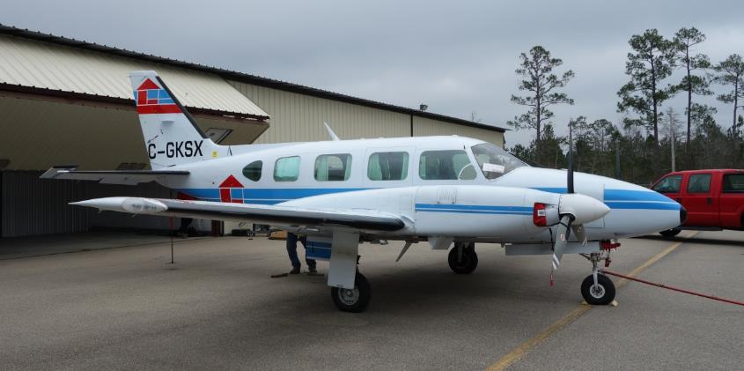
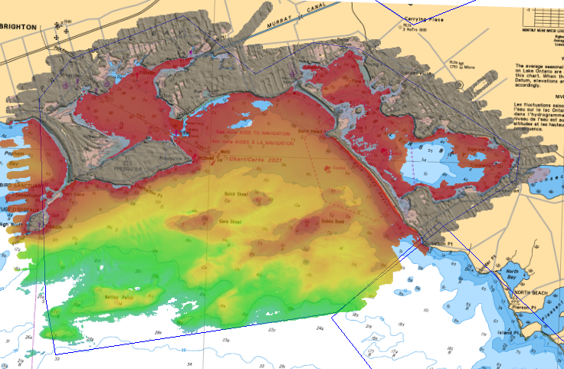
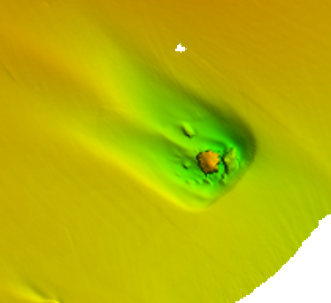
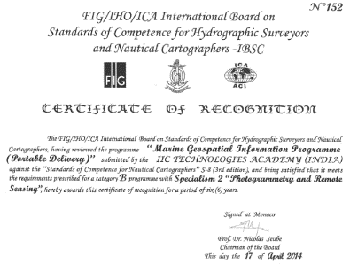

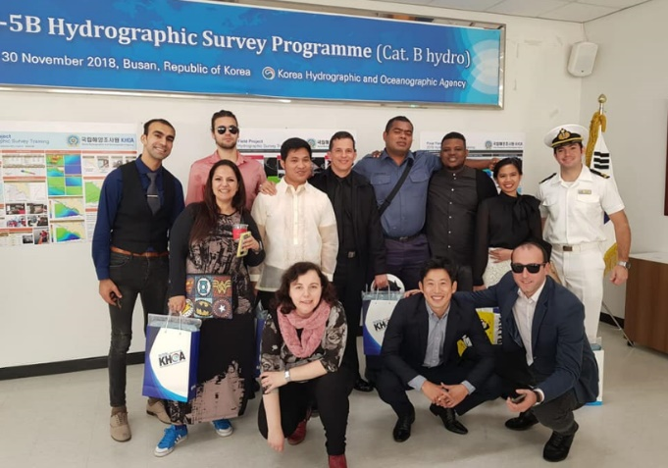
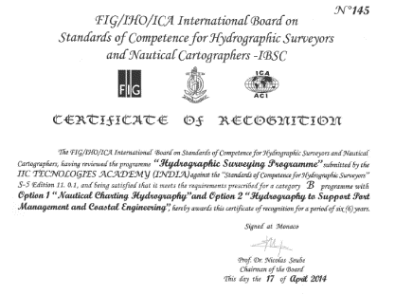


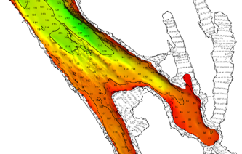
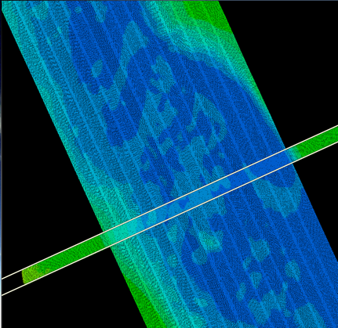
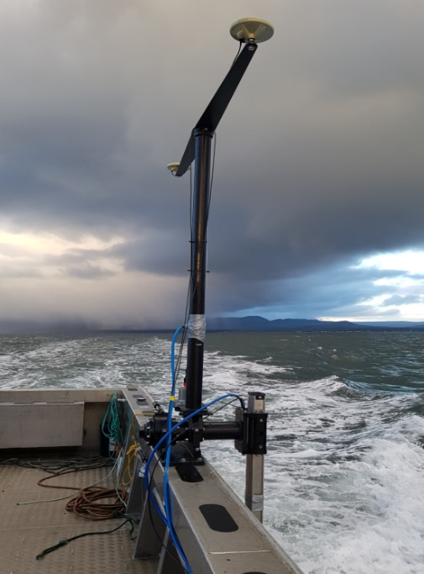
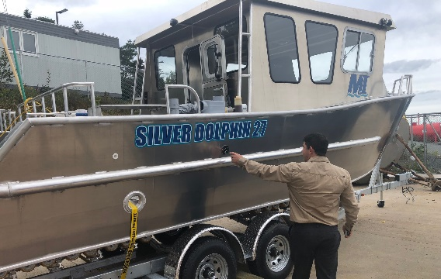
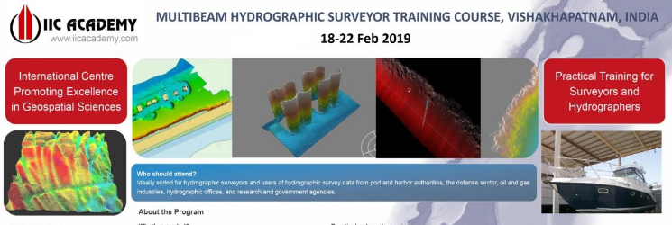
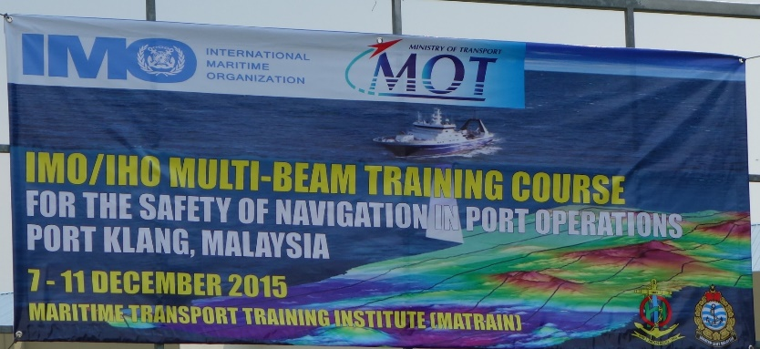
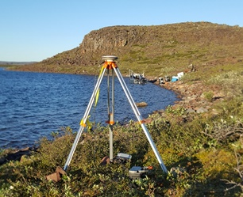
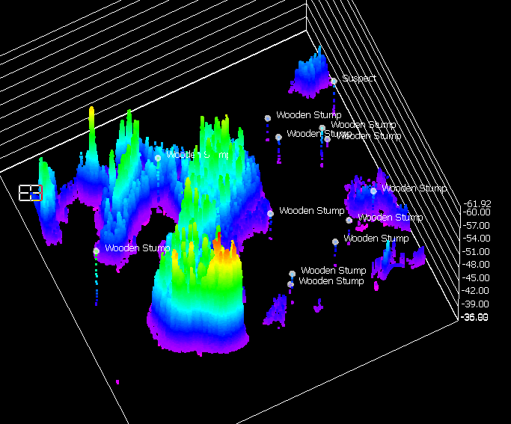
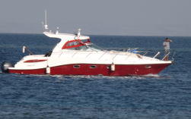



Success of S5 and S8 (Korea, Canada, USA, Oman, Malaysia….)
Short hydrographic surveying training sessions
Hydrographic Services
Training Services – IIC Academy
Global surveys and service deliveries
FIG/IHO/ICA recognized training programs
Short hydrographic surveying training sessions
Distance Learning
Notes:
This approach applies our experience in deploying surveys across the globe to our training capacities from our IIC Academy branch.
The illustrations shown on the left are from our many hydrographic surveys and processing projects (MBES, LiDAR), the equipment used is owned by IIC. Some of those are in remote locations like the Canadian arctic on the bottom center picture
On the right is a short list of IIC Academy activities since 2012:
- S-5 Cat B and S-8 cat B programs – catering KHOA, NGA, or the Royal Navy of Oman.
- Custom-made hydrographic surveying sessions, for example one to two weeks multibeam training course, at the IIC Academy in India or IMO/IHO multibeam training course
- and distance learning both internal to IIC and for clients such as KHRA, CHS or Canadian National Defence
NOTES:
Distance learning for CHS multidisciplinary hydrographer training (webinar, lesson learned webinar alone is not enough), internal IIC Technologies training (webinars + exercises)
[Additional info for internal purpose - no need to say:
Plane is through contract with Mark Kallus, Quebec
EM2040 mounting pole middle right is owned by us, built by USM
Vessels bottom is Empratory (UK office), silver dolphin is one we are looking to purchase, already using same model in survey in NflD
Middle Bottom picture is job in Baker Lake Nunavut, boat and coxswain hired locally, picture taken on an island on the lake where we had camp]

Slide 7
IIC Academy Hydrographic Training: Global Delivery
The challenge
provide a stimulating educational framework
that blends relevant theory with practical exercises
Limiting travel of the student individuals
optimizing investment in complex and expensive equipment that may only be used a few weeks per year.
GLOBAL DELIVERY
Deployable at any IIC or client selected location
APPROACH 1
Theory: in classroom, instructor-led
Practical training at selected location
    Final project at selected location
    APPROACH 2
      Theory: Web-based training
      Practical training at selected location
      Final project at selected location

Slide 8
Global Delivery Program Structure
Theory
Practical
Self-Guided
Final Project
Classroom lectures
Webinars
Mandatory readings
Concepts
Preparation for practice
Progressive: simple to complex
Software exercises
Hardware exercises
Field work
Reinforcing theory
Learn applied hydrographic surveying
Progressive: guided to independent
Homework
Recommended reading
Research done outside classroom
Reinforcing theory
Self-paced
Asking questions
Field work
Office work
Presentation
Applying lessons
Troubleshooting
Team work
Self-Directed
Notes:
The program structure is divided into the following activities

Slide 9
Program Overview Global Delivery
S-5 Modules
Theory
Classroom or Distance Learning
Practical
Final Field Project
POSITIONING
INTRODUCTION
UNDERWATER ACOUSTICS
WATER LEVELS
NAUTICAL SCIENCE
WATER LEVELS
COMPUTATION TOOLS
ENVIRONMENT
QA/QC
NAUTICAL SCIENCE
REMOTE SENSING
HYDROGRAPHIC PRACTICE
ENVIRONMENT
HYDROGRAPHIC PRACTICE
POSITIONING
HYDROGRAPHIC DATA MANAGEMENT

Slide 10
Program Overview Global Delivery
S-8 Modules
Theory
Classroom or Distance Learning
Practical
Classroom or Distance Learning
Final Field Project
Foundations of Marine Geospatial Information
Foundations of Marine Geospatial Information
Data Assessment, Chart Compilation and Production
Data Assessment, Chart Compilation and Production
Marine Environment: Physical Characteristics of the Ocean and Legal Issues
Marine Environment: Physical Characteristics of the Ocean and Legal Issues
Marine Spatial Data Infrastructures
Marine Spatial Data Infrastructures
Remote Sensing

Slide 11






Web-based Learning Approach Component
Webinars
Presentations
Contents
Videos
Quizzes
Short Tests
Assignments
Exercises
Forum
Tutoring
(if required)
Instructor led
Self-paced reading
Instructor monitors progress time
Self-paced
Instructor monitors re-takes
Instructor validates results
Interaction with instructor
Instructor corrects and guides
Instructor moderated
Instructor assesses student participation
Instructor led
Individual students or small groups
Notes:
Web-based training combined instructor-led sessions (webinars) with self-paced readings and exercises.
Instructors actively monitor progress and interact with students throughout the training period
NOTE:
[Vero] In distance learning sample “Intro to IIC distance learning platform” we underline that students are receiving a training package by mail too: chart, data, software. Not repeating here unless aksed
…

Slide 12
Academic Integrity
Academic Integrity Policy : ensuring honesty and purpose
  Communicate the policy
  Clear outline of expectations
  Test on the policy knowledge
Monitoring
  Forum participation and engagement in activities
  Monitor online quiz results
  Tests during in-person practical
Examination
  Pool of questions to create unique exams
  Proctors and/or use of IT solutions

Slide 13
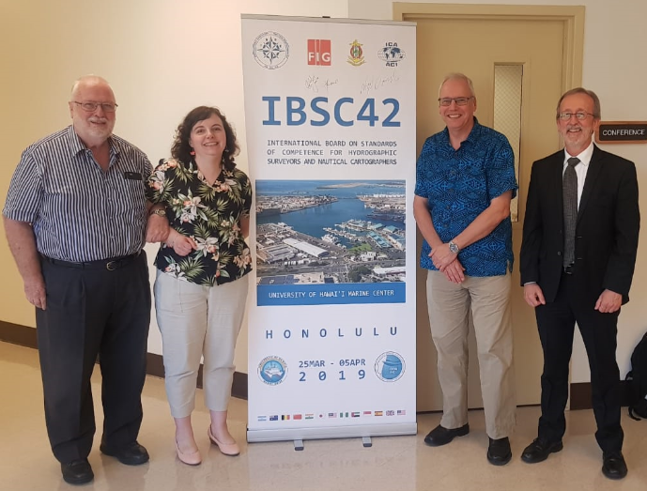

IBSC Recognition… with conditions

Slide 14
Summary
IIC Academy had been recognized for Cat B-S5 and S8 programs
Significant experience has been gained by delivering the program to many charting agencies and to IIC employees
Work, family, lifestyle priorities coupled with advances in information and communication technology facilitate distance / on-line learning
IIC Academy Hydrographic Training: Global Delivery is a distance / on-line learning program that is modular, flexible and blended
The blended approach includes a quality practical component being delivered in partnership with a vetted partnering institution

Slide 15



¡Gracias!
Alejandro Gerones
Alejandro.Gerones@iictechnologies.com
www.iictechnologies.com

