Slide 1
20th Meeting of the Meso America – Caribbean Sea Hydrographic Commission Santo Domingo, Dominican Republic, 2 December November – 6 December 2019 National Report by
The Republic of Suriname

Slide 2
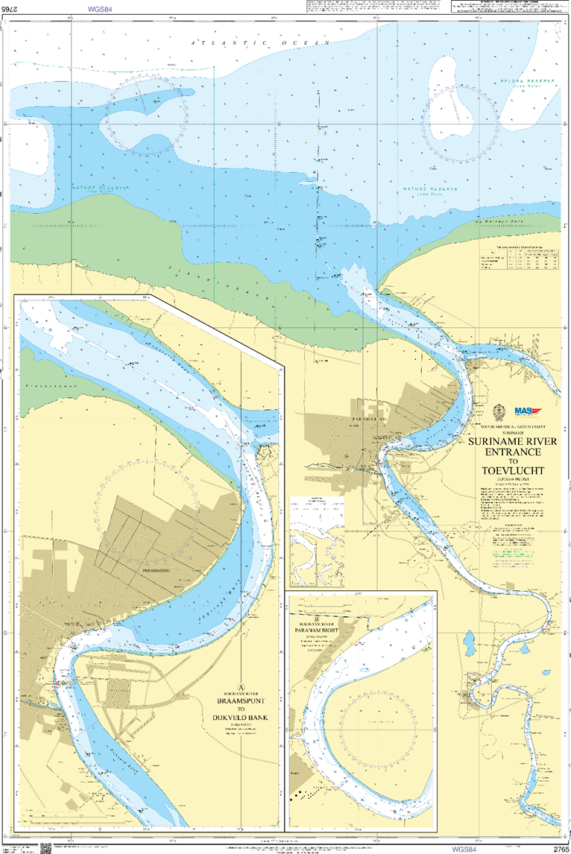
Top achievements during the year
Surveys and Charts
Resurvey of the Suriname River from the entrance up to Paranam and the entrance of the Commewijne River to Alkmaar in preparation of dredging project. Total length of Suriname river 50 nautical miles.
Special attention is given to the critical area in the entrance of the Suriname River between S6-S10. Due to the sedimentation, a monthly survey is done in this area for monitoring.
Chart 2765 of Suriname river indicated the survey area.

Slide 3
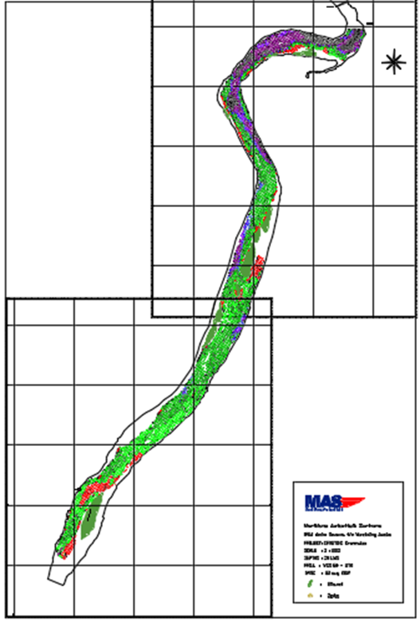
Top achievements during the year
New survey for port development southern part of Suriname river. Length of river part is 8km and the survey will be used to develop a new chart.
Survey of the Southern Suriname River 2019

Slide 4
Top achievements during the year
ENC and Chart | Year | Publication | Producer | Status
Paper Chart SR2218/GB2765 | 2020 | Update | Suriname/ UKHO | New data available. Planning
ENC SR402218, SR52218A, and SR52218B | 2020 | Update | UKHO | New data available. Planning
Paper Chart 2014 | 2020 | New edition | Suriname | Planning
Paper chart 2764/INT4191 | April 2019 | New Edition | Suriname/ UKHO | Finalized
ENC SR302014 | End 2019 - 2020 | Update | Suriname/ UKHO | Planning
Paper Chart 2017 | End 2019 – 2020 | New edition | Suriname/ UKHO | Planning. Working on draft specifications.
ENC 2219 | 2019 | New edition | Suriname | Finalized
Paper Chart 2219 | 2019 | Update | Suriname | Finalized
New Paper Chart 2220 (Cottica rivier bends lager scale charts) | 2020 | New edition | Suriname | On hold.
Paper Chart 2766 | 2020 | Update | UKHO | New data required
ENC SR402766, SR5C2766, SR5D2766 | 2020 | Update | UKHO | New data required
ENC ISPS ports band 6 | September 2019 - 2020 | New edition | Suriname | Ongoing. 3 ENCS already compiled. Currently updating.
ENC for PPU | 2019 | New edition | Suriname | ongoing

Slide 5
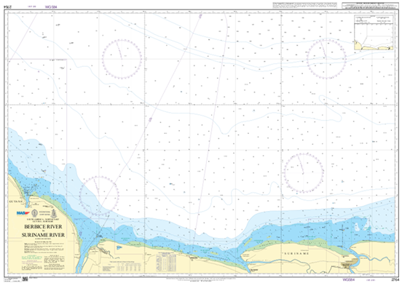
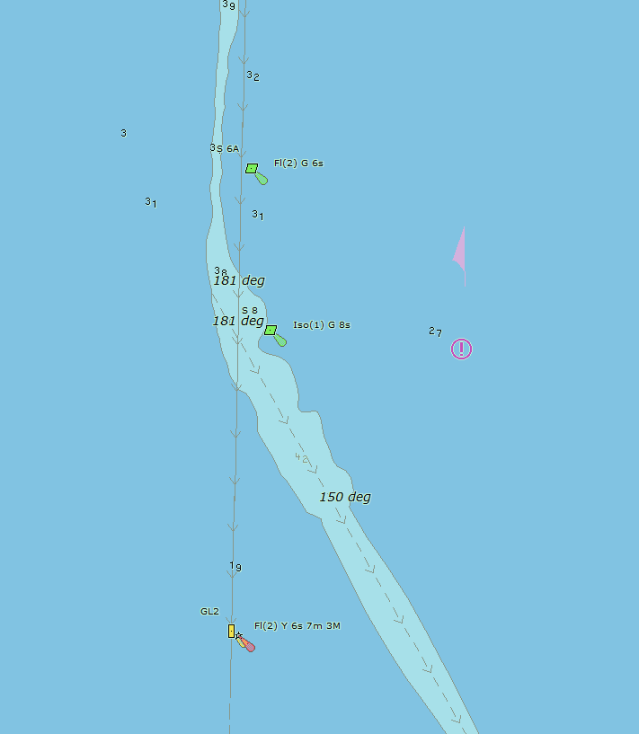
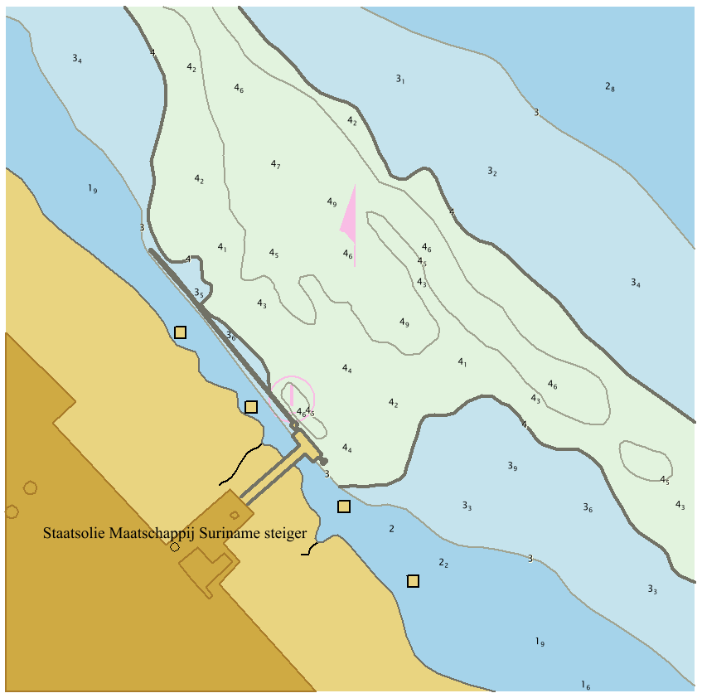
Top achievements during the year
2764/INT 4191
ENC Band 6
ENC for Potable Pilot Unit

Slide 6
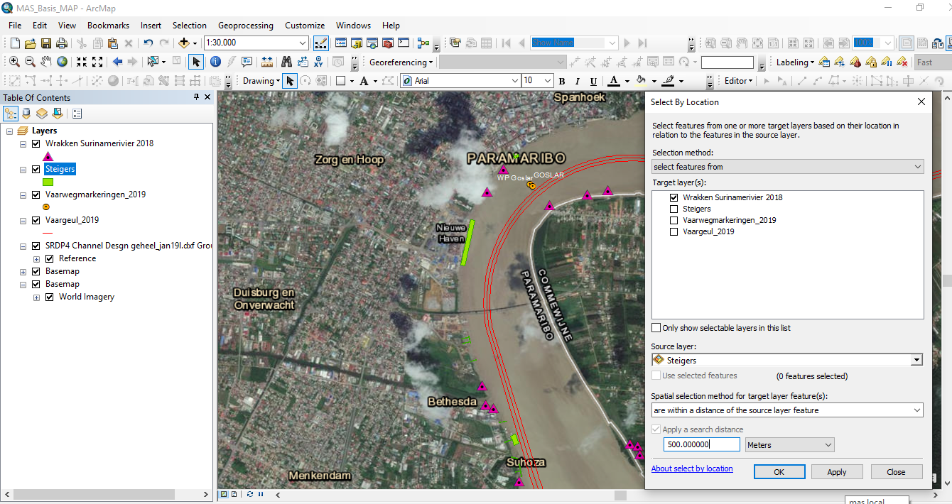
Top achievements during the year
2. MSDI- Phase 2 - National maritime data base

Slide 7
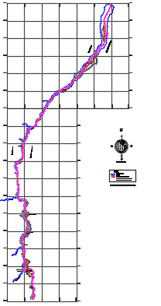
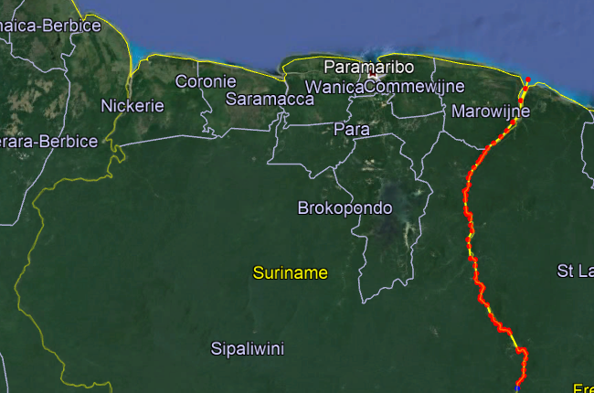
Top achievements during the year
3.Riverbounndary with France-
Length of 180 NM

Slide 8
Top challenges and/or obstructions
Tidal analysis, require assistance in LAT determination
Require assistance in MSI ;
An expert required for a one-week workshop for government institutions contributing to MSI
An expert required to assist in drafting a national MSI plan (information flow and physical infrastructure for MSI information or other means available
Area A1 –VHF coast stations (about 20-30 NM)
Area A2 –MF coast stations (about 100NM ) and NAVTEX
3. Require assistance in Maritime disaster response management
An expert required for a one-week workshop on Maritime disaster management for government institutions resulting in a Maritime disaster plan

Slide 9
Top Plans that affect the region
Capacity building offered
Center of expertise for the Caribbean
The need for providing adequate hydrographic services for ships navigating in the Caribbean region in accordance with applicable international instruments was recognized and highlighted at the Jamaica High-Level Symposium 2013 (HLA) for ministers in the Maritime transportation.
At the Senior Maritime Administrators (SMA) workshop , Barbados 2017 ,it was recommended that a Regional Hydrographic Center needed to established .
One of the main goal is to set up a Center of expertise, with the well-trained people and required equipment that will be available for the Caribbean .
If supported Suriname is willing to take lead to be the Center of expertise.

Slide 10
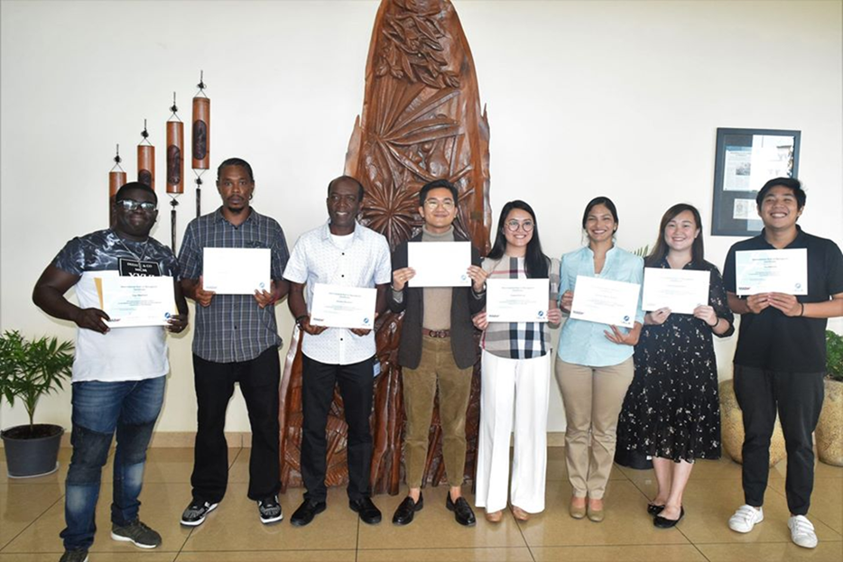
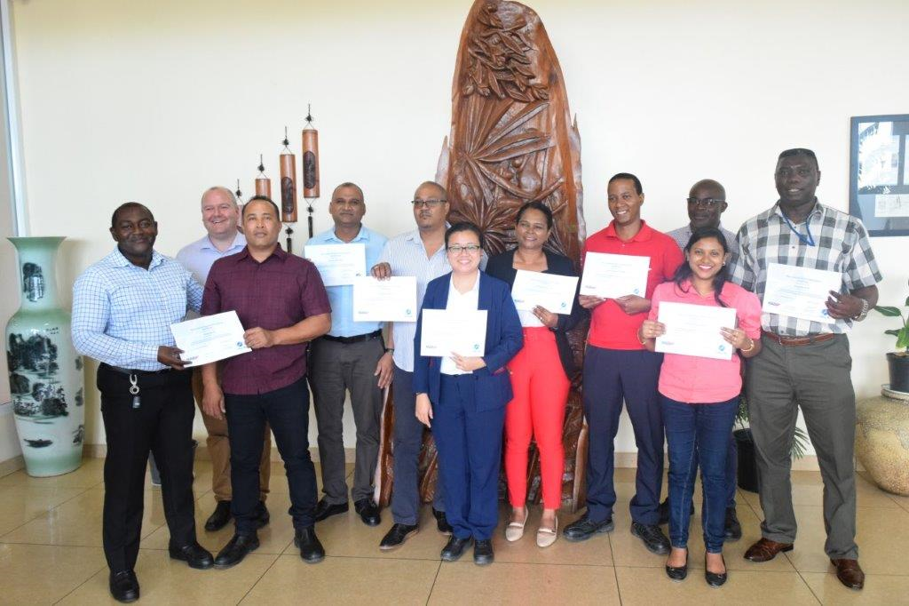
Top Plans that affect the region
Capacity building offered:
2. IALA -Level 1 Aids to Navigation Manager Course 2019 offered by the Suriname Aton Academy (SAA) and IALA Worldwide Academy (IALA WWA) was held from October 14th until November 6th in Paramaribo, Suriname.
There were participants eight participants in to total from Belize (1), Columbia (1), Philippines (4), Sint Vincent (1) and Suriname (1).
The IALA -Level 1 Aids to Navigation Manager Course 2021 is planned for October – November 2021.
In July 2019, the trainers did the IALA train the trainer course and are currently finalizing a pedagogical training which started in June 2019.

Slide 11
Top 2 recommendations for MACHC plenary (Criteria: Greatest collective regional impact, return on investment, potential for leveraging resources/partnerships)
What is your greatest capacity building priority to recommend for IHO CB funding consideration (Phase 1)?
-High-level visit (political awareness)
What is your greatest capacity building priority (Phase 2 or Phase 3) for which to seek other partnership/funding opportunities outside of IHO CB?
Center of expertise for the Caribbean
The need for providing adequate hydrographic services for ships navigating in the Caribbean region in accordance with applicable international instruments was recognized and highlighted at the Jamaica High-Level Symposium 2013 (HLA) for ministers in the Maritime transportation.
At the Senior Maritime Administrators (SMA) workshop , Barbados 2017 ,it was recommended that a Regional Hydrographic Center needed to established .
One of the main goal is to set up a Center of expertise, with the well-trained people and required equipment that will be available for the Caribbean .
If supported Suriname is willing to take lead to be the Center of expertise.

Slide 12
IHO Capacity Building Phase Reference

Slide 13
Reference: IHO Capacity Building Strategy Phases of Development
Phase 1
Collection and circulation of nautical information, necessary to maintain existing charts and publications up to date.
Phase 2
Creation of a surveying capability to conduct:
Coastal projects
Offshore projects
Phase 3
Produce paper charts, ENC and publications independently.
Notes:
National Activities
Phase 1
Form National Authority (NA) and/or National Hydrographic Coordinating Committee (NHCC).
Create/improve current infrastructure to collect and circulate information
Strengthen links with charting authority to enable updating of charts and publications
Minimal training needed
Strengthen links with NAVAREA Coordinator to enable the promulgation of safety information
Phase 2
Establish capacity to enable surveys of ports and their approaches
Maintain adequate aids to navigation
Build capacity to enable surveys in support of coastal and offshore areas
Build capacity to set up hydrographic databases to support the work of the NA/NHCC
Provide basic geospatial data via MSDI
Requires funding for training, advising & equipment or contract survey
Phase 3
The need shall be thoroughly assessed. Requires investment for production, distribution and updating
Alternatively, bi-lateral agreements for charting can provide easier solutions in production and distribution (of ENC through RENCs) and rewards.
Further development of MSDI

