Slide 1
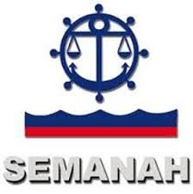
20th Meeting of the Meso America – Caribbean Sea Hydrographic Commission National Report by
HAITI

Slide 2
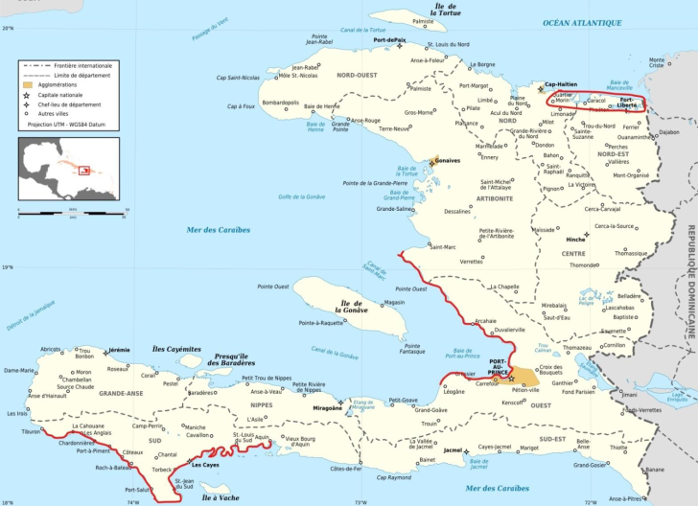
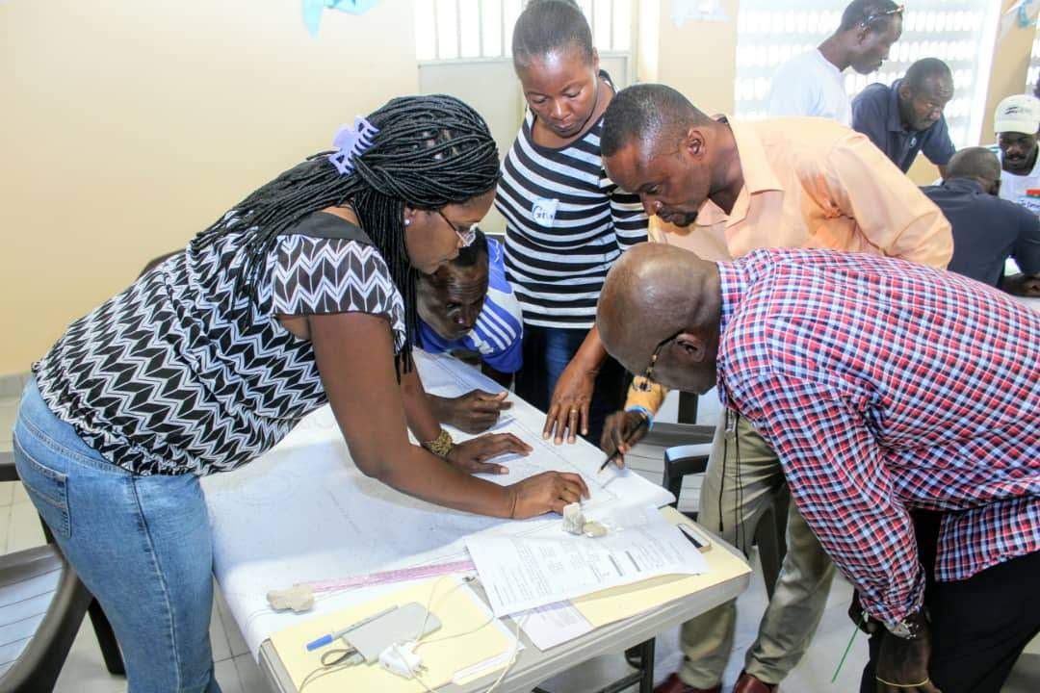
Top achievements during the year (3 maximum)
LIDAR Bathymetric survey by the FUGRO company in 3 coastal areas : Port-au-Prince Bay, the Gonâve coasts and protected areas in Grande-Anse . The total length of the areas of interest is 580km.
Ratification process of the IHO Convention is underway.
MSI
Realization of 3 training sessions for fishermen and other users of the sea of the North-West region, Gonave and Les Cayes;
The MSIs collected by Haiti are continuously being broadcast by NOAA;
Creation of a National Emergency Line for Search and Rescue (8722).

Slide 3
Top challenges and/or obstructions (3 maximum)
Strategic plan for the development of hydrography and oceanography taking into account the budget constraints of the country and the contributions of our international partners;
Delimitation of The Maritime Boundary Between Haiti and Dominican Republic;
Use Telephone communication for receiving and transmitting Maritime Safety Information MSI.

Slide 4
Top 2 recommendations for MACHC plenary
What is your greatest capacity building priority to recommend for IHO CB funding consideration?
Maritime Safety Information training
What is your greatest capacity building priority (Phase 2 or Phase 3) for which to seek other partnership/funding opportunities outside of IHO CB?
Courses for French speakers.
Participation in a CAT A or CAT B program.

Slide 5
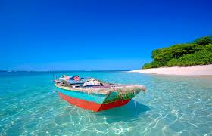
THANK YOU
FOR ATTENTION!

