Slide 1
20th Meeting of the Meso America – Caribbean Sea Hydrographic Commission National Report by PANAMA
[MACHC Member or Associate Member State]

Slide 2
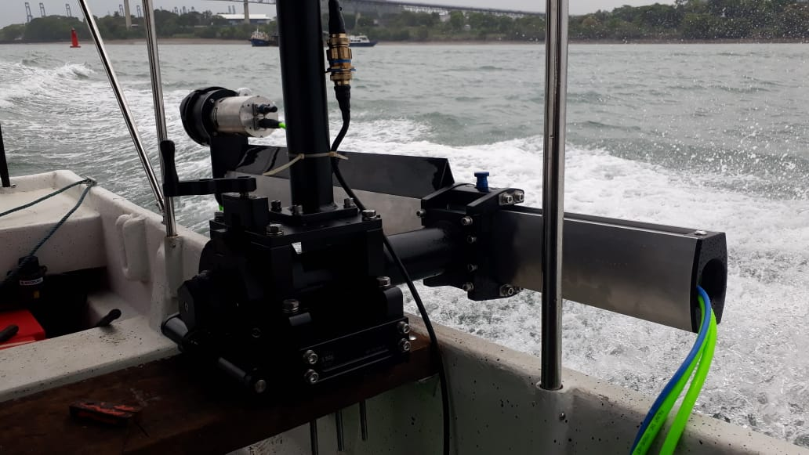
Top achievements during the year (3 maximum)
New hydrography equipment for our field work M3-PHS (Components)
Seapath 130 sensor
M3 Sonar® Interface Unit
MRU
miniSVS sensor
M3 Sonar
M3 Sonar Processor laptop to run M3 software and Hypack Survey & Hysweepsoftware.

Slide 3
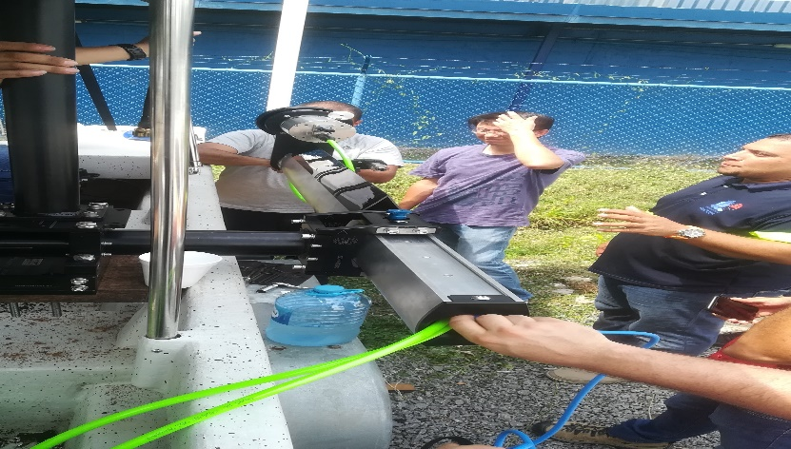
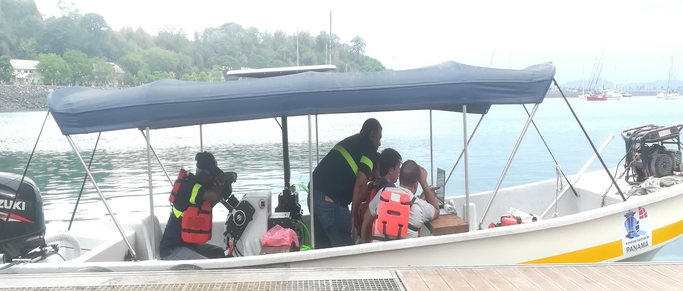
Top achievements during the year (3 maximum)
The AMP manages a training program for the installation of the M3 Sonar PHS.
Which was taught by Kongsberg in the month of April of the current year and was attended by 6 members of our technical team.

Slide 4
Top challenges and/or obstructions (3 maximum) (Such as capacity building gaps)
Approval by the (MEF) Ministry of Economy and Finance, for the creation of the Department of Hydrography of the Maritime Authority of Panama.
Installation of hydrographic equipment.
Training of technical personnel, for the use of (M3 Sonar PHS) Portable hydrographic system.
Execution of the National Bathymetric Plan starting with coastal surveys in 2019.

Slide 5
Top Plans that affect the region (3 maximum) (Charts, surveys, training, other)
Need better training
Lack of better hydrographic equipment
Technical reinforcement visits from most experienced countries

Slide 6
PANAMA HYDROGRAPHIC AND OCEANOGRAPHIC
Survey Planning
Vacamonte
Area: 384,979.9 m²
Bahia las Minas
Area:1,280,944.9 m²
Aguadulce
Area: 976,801.2 m²

Slide 7
PANAMA HYDROGRAPHIC AND OCEANOGRAPHIC
M3-PHS Our hydrographic equipment test

Slide 8
AUTORIDAD MARITIMA DE PANAMA
thanks you!

