Slide 1
20th Meeting of the Meso America – Caribbean Sea Hydrographic Commission National Report by
France

Slide 2
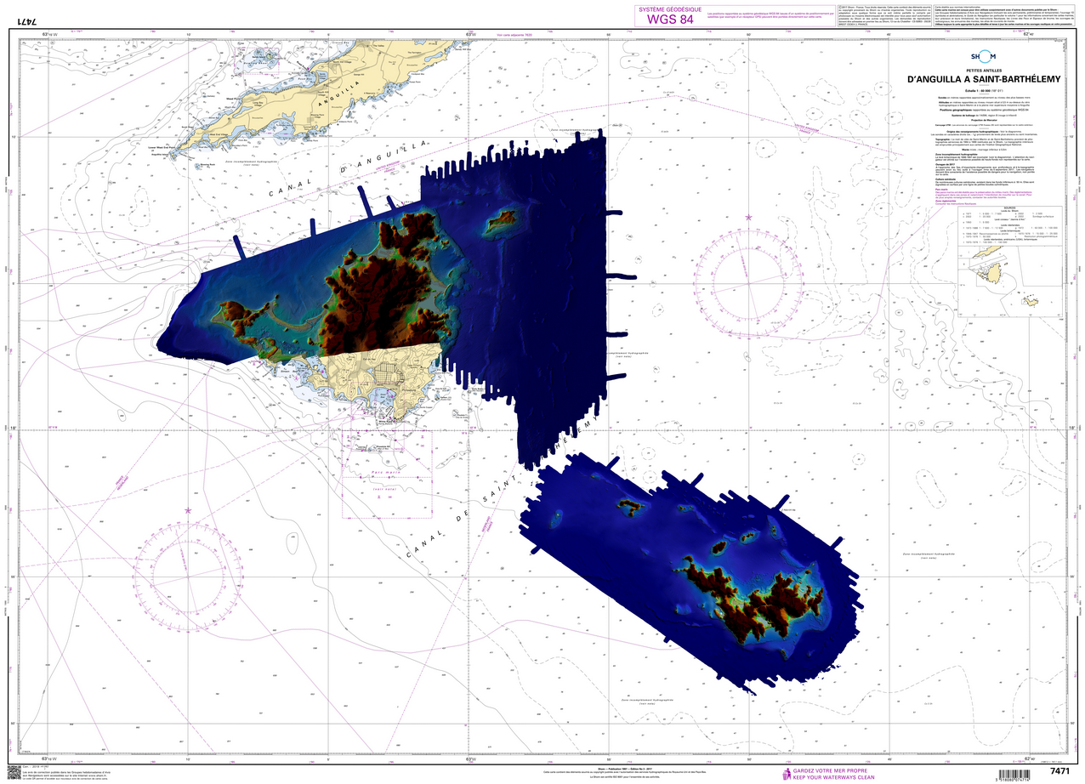
Top achievements during the year (3 maximum)
Combined topo-bathy lidar survey of the French Collectivities of Saint-Martin & Saint-Barthélemy (March 2019)
Ongoing project (Bathysat) in the field of SDB
Ongoing development of tools and methodologies for risk analysis : chart adequacy using SDB, “Deseasion platform”, a multicriteria decision tool, for hydrographic risk assessment and cost-benefit analysis
Notes:
The objective of the project is to improve performance and quantify vertical uncertainties in accordance with the specifications of the new version of the S-44. The results of the study should make it possible to extend the use of the SDB to remote areas for which there are no field data.

Slide 3
Top challenges and/or obstructions (3 maximum) (Such as capacity building gaps)
An agreement with the Hydrographic Service of the Royal Netherlands Navy, to cover the whole Island of Saint-Martin / Sint Maarten on a single lidar survey, could not be reached before the start of the Shom’s survey.

Slide 4
Top Plans that affect the region (3 maximum) (Charts, surveys, training, other)
Continuation of efforts to restore hydrographic knowledge following Cyclone Irma
Immediate “response phase” (2017) : cartographic actions and expeditionary surveys
Long term “recovery phase” :
Lidar survey of Saint-Martin & Saint-Barthélemy islands, conducted in March 2019
“Chart adequacy” study on Saint Martin island using SDB
Conventional hydrographic surveys, scheduled for 2020
Shom tide gauge network will be renovated in 2020
Improved and extended storm surges and waves forecasts in 2020.

Slide 5
Top 2 recommendations for MACHC plenary (Criteria: Greatest collective regional impact, return on investment, potential for leveraging resources/partnerships)
What is your greatest capacity building priority to recommend for IHO CB funding consideration (Phase 1)? (Select one)
n/a
What is your greatest capacity building priority (Phase 2 or Phase 3) for which to seek other partnership/funding opportunities outside of IHO CB?
n/a

Slide 6
Save the date !
You are all invited to Paris on November 19th 2020 to celebrate the 300th anniversary of French hydrography
https://www.shom.fr/fr/300_ans

