Slide 1
20th Meeting of the Meso America – Caribbean Sea Hydrographic Commission National Report by
JAMAICA

Slide 2
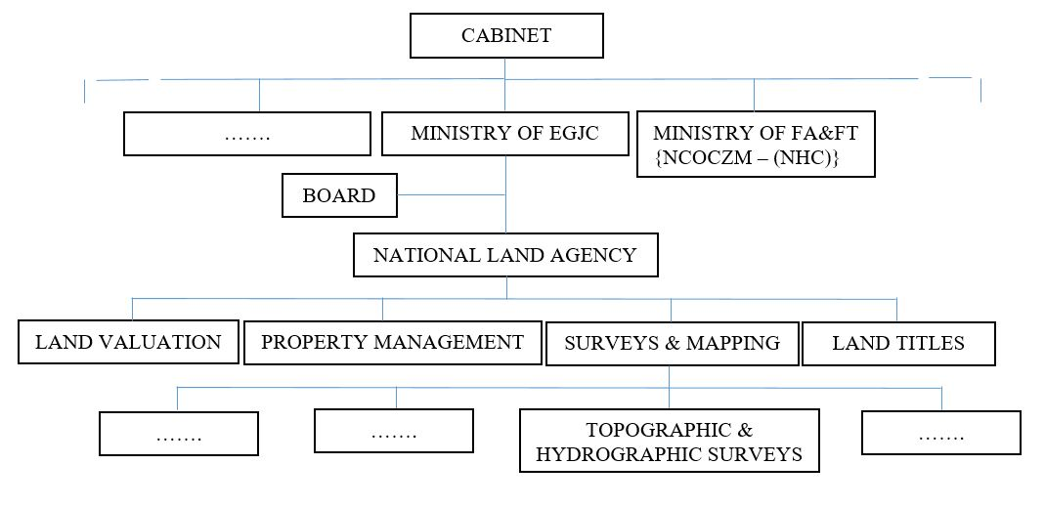
Jamaica Hydrography: Organizational Structure

Slide 3
Top achievements during the year (3 maximum)
UKHO (CME program) donated full suite of multibeam survey equipment
Nine (9) persons received theoretical and practical training in data acquisition and processing
Significant logistical support received from NHC stakeholders, the MAJ and PAJ
One officer completed Cat. B training

Slide 4
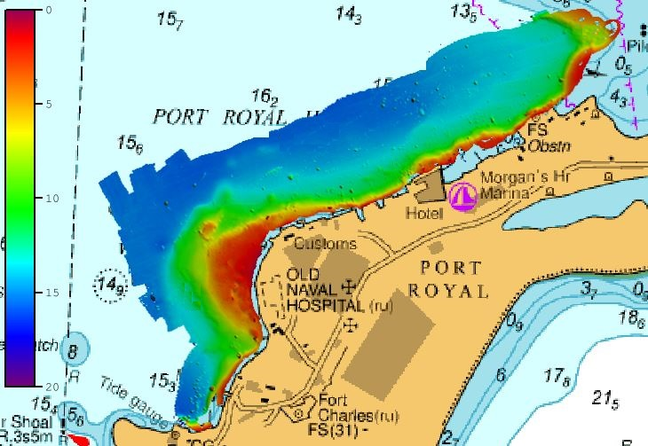
Top achievements during the year (3 maximum)
Fort James Uncharted wrecks
Hydrographic Survey of Port Royal, Kingston Harbour

Slide 5
Top challenges and/or obstructions (3 maximum) (Such as capacity building gaps)
Repairs to JDFCG vessel delaying hydrographic survey projects but almost complete
Procurement of a dedicated RTK system for hydrographic surveys underway, as National Network RTK unsuitable
Improved NHC stakeholder participation needed to support development of hydrographic capacity.

Slide 6
Top Plans that affect the region (3 maximum) (Charts, surveys, training, other)
One officer pursuing Cat. A Oceanography/Hydrography Course at University of New Hampshire
Recent donation of equipped survey vessel to Caribbean Maritime University by private contractor

Slide 7
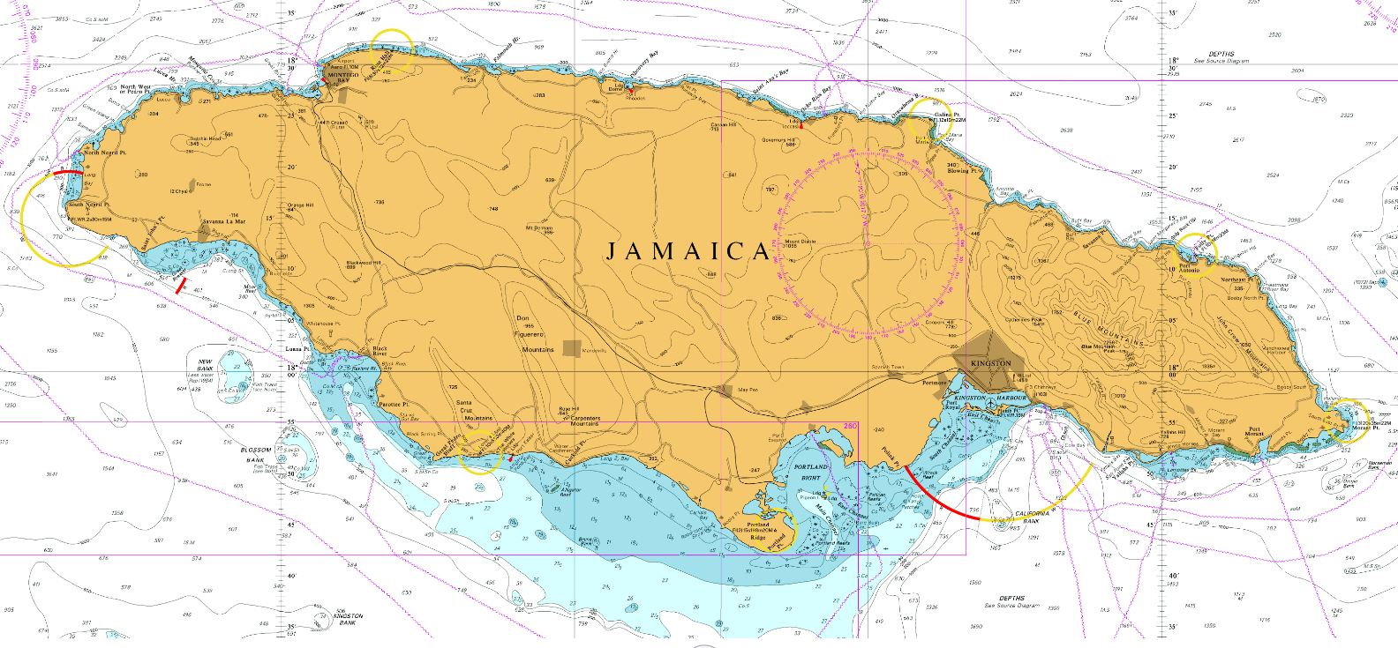
Top Plans that affect the region (3 maximum) Planned surveys
Mosquito Cove as a hurricane shelter for vessels
②
①
Bowden Harbour, St. Thomas:
Aquaculture

Slide 8
Top 2 recommendations for MACHC plenary (Criteria: Greatest collective regional impact, return on investment, potential for leveraging resources/partnerships)
What is your greatest capacity building priority to recommend for IHO CB funding consideration (Phase 1)? (Select one)
High-level visit (political awareness)
Technical visit (assessment of national capabilities and awareness)
Maritime Safety Information training
Hydrographic Awareness Seminar (pre-MACHC meeting)
What is your greatest capacity building priority (Phase 2 or Phase 3) for which to seek other partnership/funding opportunities outside of IHO CB?
Category A nautical Cartographer training
An example of a Phase 2 training is the recently funded 2020 Tides and Water Levels course for Spanish speakers or anything else related to hydrographic surveying or charting; other examples can include participation in a CAT A or CAT B program. See slide 7 for reference below.

Slide 9
IHO Capacity Building Phase Reference

Slide 10
Reference: IHO Capacity Building Strategy Phases of Development
Phase 1
Collection and circulation of nautical information, necessary to maintain existing charts and publications up to date.
Phase 2
Creation of a surveying capability to conduct:
Coastal projects
Offshore projects
Phase 3
Produce paper charts, ENC and publications independently.
Notes:
National Activities
Phase 1
Form National Authority (NA) and/or National Hydrographic Coordinating Committee (NHCC).
Create/improve current infrastructure to collect and circulate information
Strengthen links with charting authority to enable updating of charts and publications
Minimal training needed
Strengthen links with NAVAREA Coordinator to enable the promulgation of safety information
Phase 2
Establish capacity to enable surveys of ports and their approaches
Maintain adequate aids to navigation
Build capacity to enable surveys in support of coastal and offshore areas
Build capacity to set up hydrographic databases to support the work of the NA/NHCC
Provide basic geospatial data via MSDI
Requires funding for training, advising & equipment or contract survey
Phase 3
The need shall be thoroughly assessed. Requires investment for production, distribution and updating
Alternatively, bi-lateral agreements for charting can provide easier solutions in production and distribution (of ENC through RENCs) and rewards.
Further development of MSDI

Slide 11
End of Presentation
Thank you!
Questions ?

