Slide 1


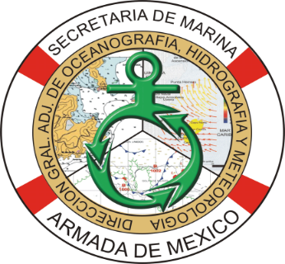
JOINT DIRECTORATE OF OCEANOGRAPHY, HYDROGRAPHY AND METEOROLOGY
DECEMBER 2019

Slide 2
CONTENT
Organization of the Joint General Directorate of Oceanography, Hydrography and Meteorology (DIGAOHM).
Hydrographic Surveys.
New nautical charts and updates.
Maritime Safety Information(MSI).
Capacity Building.
Other activities.

Slide 3
I. Organization of the Joint General Directorate of Oceanography, Hydrography and Meteorology (DIGAOHM)
DIRECCIÓN GENERAL ADJUNTA DE OCEANOGRAFÍA, HIDROGRAFÍA Y METEOROLOGÍA
DIRECCIÓN DE HIDROGRAFÍA
SUBDIRECCIÓN DE HIDROGRAFÍA Y CARTOGRAFÍA
SUBDIRECCIÓN DE LEVANTAMIENTOS HIDROGRÁFICOS
SUBDIRECCIÓN DE INFORMACIÓN PARA LA SEGURIDAD A LA NAVEGACIÓN
DEPARTAMENTO DE CARTOGRAFÍA
DEPARTAMENTO DE PLANEACIÓN Y PROCESAMIENTO HIDROGRÁFICO
DEPARTAMENTO DE ASUNTOS HIDROGRÁFICOS EXTERNOS
DEPARTAMENTO DE COORDINACIÓN LOGISTICA
DEPARTAMENTO DE CONTROL DE EQUIPO HIDROGRÁFICO
DEPARTAMENTO DE CONTROL DE EQUIPO INFORMÁTICO
DEPARTAMENTO DE AYUDAS A LA NAVEGACIÓN Y CONTROL DE PUBLICACIONES
DEPARTAMENTO DE DISEÑO E IMPRESIÓN

Slide 4
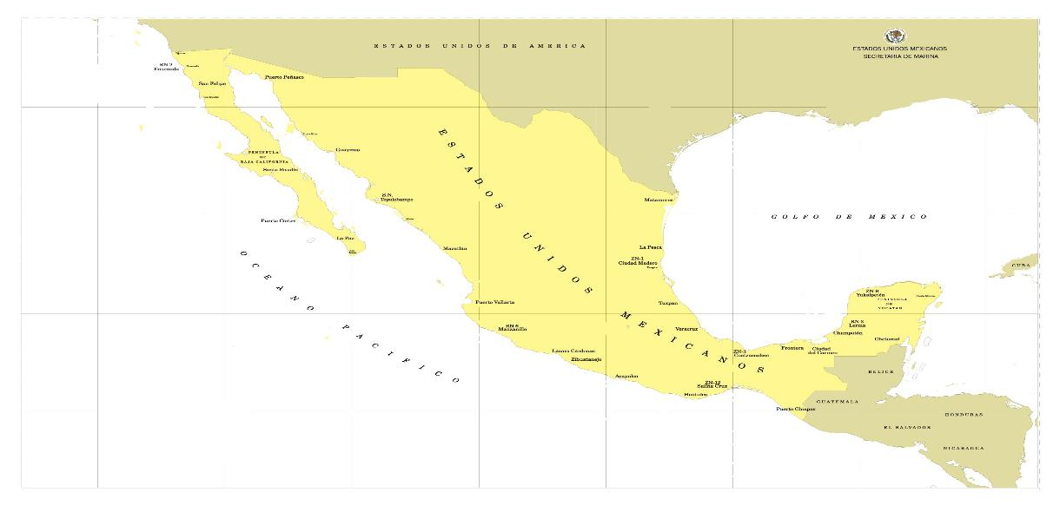
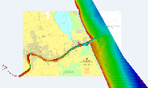
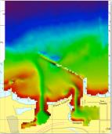
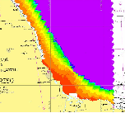

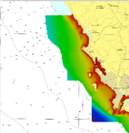
II. Hydrographic Surveys.
HYDROGRAPHIC CAMPAIGNS CARRIED OUT DURING 2019
“Tuxpan”
“Rio Náutla a Rio Tecolutla”
“Dos Bocas”
“Guaymas”
“Mazatlán”

Slide 5
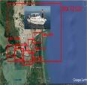
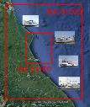
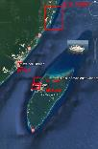

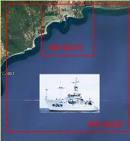

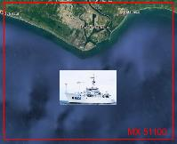
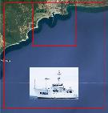
II. Hydrographic Surveys.
HYDROGRAPHIC SURVEYS PROPOSED FOR 2020
“Tampico y Altamira”
“Tuxpan proximities”
“Alvarado”
“Playa del Carmen and Cozumel”
“Dos Bocas Proximities”
“Manzanillo Proximities”
“Lazaro Cárdenas Proximities”
“Salina Cruz Proximities”

Slide 6
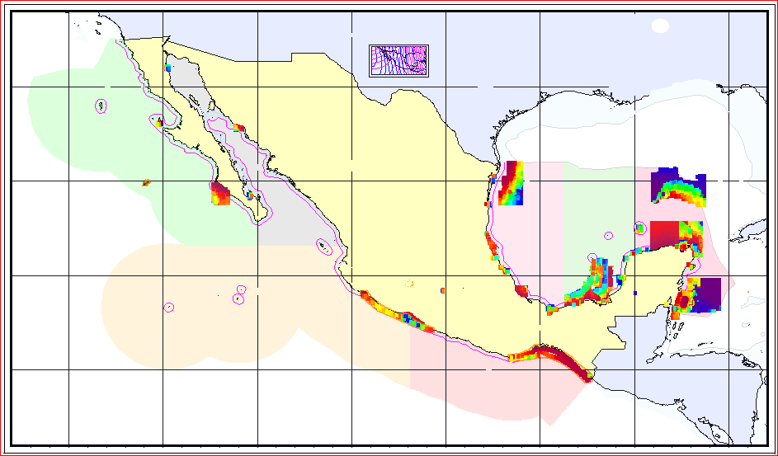
Current situation Bathymetric Database
EEZ area covered : 7%

Slide 7
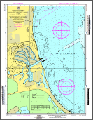
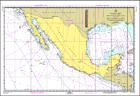
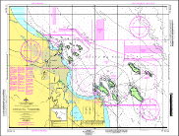
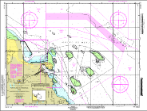
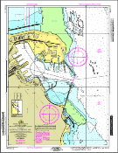
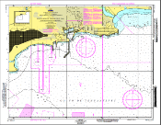
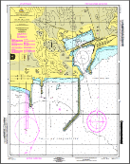
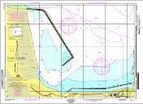
III. New nautical charts and updates.
07 Electronic Nautical Charts (ENC).
08 New Paper Nautical Charts.
03 Electronic Nautical Charts (ENC) updated.
01 Nautical Charts Printed updated.
SM 001 | MX92203 | MX82100 | MX82110
MX82111 | MX82112 | MX62210 | MX62211

Slide 8
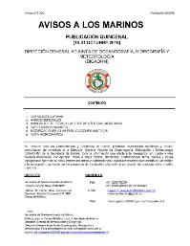
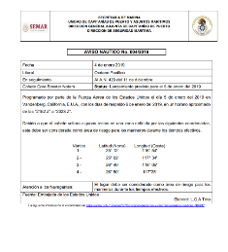
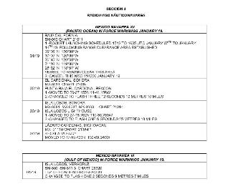
IV. Maritime Safety Information (ISM).
In 2019, 21 fortnightly Notice to Mariners publications were issued, and 191 nautical warnings from the Gulf of Mexico area and 111 from the Pacific sent to the NAVAREA regional coordinator..
Dissemination of maritime safety information that affects the Mexican Marine Zones through the fortnightly publication of Notice to Mariners and Nautical Warnings via NAVAREA coordinator zones IV and XII (NGA).
As of January 1, 2019, the ISM is disseminated as follows:
  Fortnightly publication of Notices to Mariners on the website: http://digaohm.semar.gob.mx/hidrografia/avisosalosmarinos.html
  Nautical Warnings available on the website: https://www.gob.mx/semar/unicapam/acciones-y-programas/avisos-nauticos-160787
  Weather bulletins and forecasts available on the website: http://meteorologia.semar.gob.mx/

Slide 9
V. Capacity Building.
Since 2015 the Marine Secretariat together with the Mexican Agency for International Development Cooperation (AMEXCID) carry out the project for the Strengthening of Hydrographic Capacities in Mesoamerica and the Caribbean Sea (FOCAHIMECA).
25 countries of the MACHC Region are beneficiaries of this project. To the date, the project has funded 11 students to take the specialty of hydrography in Mexico. The class is expected to start on July 2020
On January next year three students from Colombia, Guatemala and Republica Dominicana will finish the specialty on hydrography.

Slide 10
VI. Other Activities.
On August 29, 2017, the Marine Secretariat promote creation of the Technical Committee Specialized in Marine Information (CTEIM), under the National System of Statistic and Geographic Information, with the aim of promoting that marine information in Mexico is generated, processed and disseminated, in compliance with national and international standards, that contribute to its homogeneity and interoperability.
The CTEIM is chaired by the Marine Secretariat and integrated by diverse government agencies in charge of producing marine information, as well as academic and research institutions.
The first task of CTEIM was to prepare a diagnosis of needs and sources of marine information, to be based on the work program and direct efforts to meet the information needs detected. Other result of the diagnosis was a list of web pages where marine information can be consulted.

Slide 11
JOINT DIRECTORATE OF OCEANOGRAPHY, HYDROGRAPHY AND METEOROLOGY
DECEMBER 2019

