Slide 1
Update on IALA and the academy
MACHC-20 Dominican Republic

Slide 2
Stealth designed AtoN
Not detectable by the eye
Not detectable by a ships radar
Constructed on a concrete structure

Slide 3
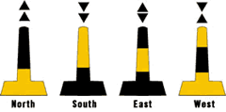
Pelicans as a topmark

Slide 4
A RED lateral mark
IALA WWA Recommendation: to clean the buoys and put bird deterrents on it

Slide 5
The status after a two years
The red lateral mark turned into a safe water mark after cleaning only half of it!

Slide 6
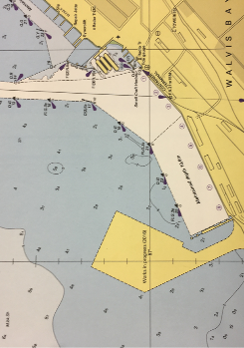
But there are also very good examples!

Slide 7
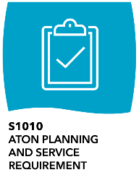
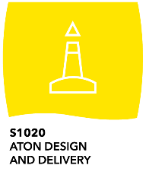
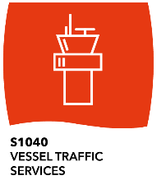
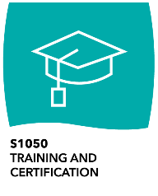
IALA Standards – an integrated framework
200+

Slide 8
Standards
IALA Standards may contain normative and informative provisions.
Normative provisions are those with which it is necessary to conform in order to claim compliance to the Standard.
Informative provisions are those which specify additional desirable practices but with which it is not necessary to conform in order to claim compliance to the Standard.

Slide 9
IALA Standards – an integrated framework
Risk Management
Operational Procedures
Infrastructure and Technology
Training and Certification
Use the Standards and their associated Recommendations, Guidelines and Model Courses to plan your AtoN and VTS provision.
Use the Standards to demonstrate why you have or have not implemented certain measures.
Use the Standards to demonstrated compliance with SOLAS Chapter V Regulations 12 & 13.
Use the Standards to serve the mariner with harmonized AtoN and VTS delivery.
200+

Slide 10
The World-Wide Academy

Slide 11
Where can the Academy support you? T
Training of AtoN/VTS personnel, bringing staff to be compliant with IALA training Standard for certified AtoN/VTS personnel
Technical Needs Assessment Missions and Reviews aiming at assisting the government to understand what is needed in order to re-establish Aids to Navigation around the coastline up to international standard and making ports safe for vessels to call.
Long standing partnership with Competent Authorities, Service Providers, WWA Alumni etcetera
Membership of IALA, which will enable your experts to attend IALA committees, conferences, workshops and seminars.

Slide 12
Status of the IGO project The Process
First discussions in the Legal Advisory Panel (LAP) 2010 and with the French Government shortly after
Draft Convention Text developed by Council assisted by LAP and with participation of all National Members 2012-2016
General Assembly Resolution May 2014
Preparatory Diplomatic Conference, Paris, April 2017
Preparatory Diplomatic Conference, Marrakech, February 2018
Preparatory Diplomatic Conference, Istanbul, March 2019
Diplomatic Conference, Malaysia, early in 2020

Slide 13
Questions?
Contact: gerardine.delanoye@iala-aism.org

