Slide 1
MACHC Capacity Building Report

Slide 2
CB Activities 2019
Technical Visit to Guatemala (March 2019)
Phase 1 skills Course (moved to 2020)
Seminar on Raising Hydrographic Awareness (Preceded MACHC20)
With MSDI Workshop

Slide 3
CB Activities undertaken in 2019
Cat A Hydrography – USM, USA (August 2019 – August 2020)
MEXICO – Mr Adrian Montufar Arroyo
Cat B Marine Geospatial Information - Korea (July 2019 – Dec 2019)
SURINAME – Mrs Christy Warmoen
VENEZUELA – Mr Yamtran Chang Sulbaran
Cat B Marine Cartography & Data Assessment - UK (Sep 2019 – Dec 2019)
TRINIDAD & TOBAGO – Mr Suruj Rakesh Babwah
Training for Trainers – Korea (July 2019)
COLOMBIA – Mr Javier Gomez

Slide 4
CB Submissions 2020
4 Submissions to CBSC (as agreed at MACHC19) for consideration for the 2020 Work plan were:
Seminar on Raising Hydrographic Awareness
MBES Processing
MSI Training - Funded
Tides and Water Levels Workshop for Spanish Speakers - Funded
(Co sponsored by the Intergovernmental Coordination Group for the Tsunami and other Coastal Hazards Warning System for the Caribbean and adjacent regions)

Slide 5
Current CB Opportunities
Circular Letter 49/2019 – Cat A Hydrography, USM (USA)
Closing date for nominations 17 February 2020

Slide 6
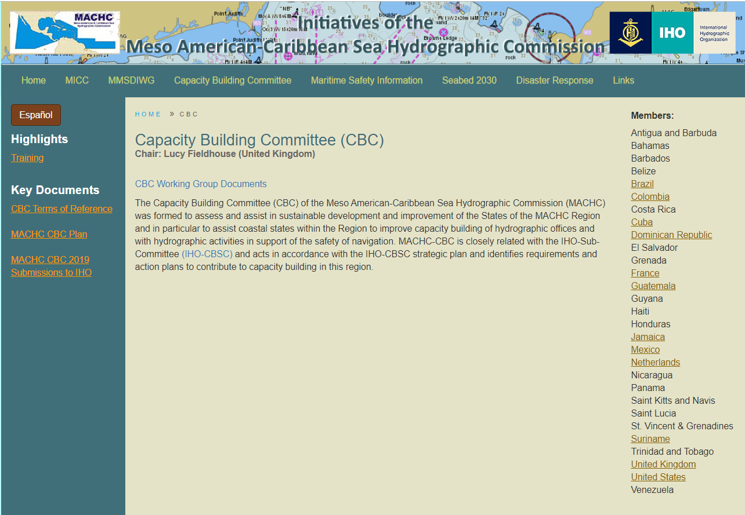
MACHC Website - CBC
https://www.iho-machc.org/cbc.html

Slide 7
IHO – CBSC17
Genoa, Italy - May 2019
IHR – Important to submit papers and champion the work that you are doing
C-55 – Important to keep up to date. Utilised in IMO audits (IMSAS)
Funding - Capacity Building fund limitations
2020 CB fund 86,000 Euros
Notes:
At CBSC17 it became apparent that the Capacity Building fund has been reduced due to a lack of surplus funds from previous years. funding has fallen from 200,00 euros in 2018 to 86,000 euros in 2020. This reduced capacity building fund will affect us going forward and so we need to ensure that we are coordinated in our requests

Slide 8
CB Submission Timeline
Next Meeting: CBSC18 Gdansk, Poland June 2020
Time line for Submissions
February | Final requests for CB activities to CB Coordinator
April | Submitted via the CB Coordinator to the Capacity Building Sub Committee in April for consideration
June | Finalised Capacity Work plan CBSC18 Gdansk, Poland
Notes:
.
Taking into consideration the reduced CB Fund For future activities we need to consider how the Capacity Building Sub committee prioritises activities, it takes into account how the activity aligns with its strategy (Emphasis on building phase 1 capability) but it also takes into consideration the number of participants that will benefit and also if funding is also being contributed through other organisations. So in the plan for the region we need to identify wider funding opportunities and new ways to enhance the activities such as learning capability I am also aware that SHOM are developing some MSI e learning too.
Looking to Requests for CB activities for 2021 these must be finalized by February so that I am able to submit them for consideration by the Capacity Building Sub Committee.
Reviewing the national reports there is a focus on the hydrographic and cartographic training however we must remember that unless you are an IHO Member these phase 2 and phase 3 activities are not available.
To secure the IHO funding we must ensure that Phase 1 is considered where necessary so requests for Technical Visits, MSI courses and Seminars such as the one held on Monday and that assists participation at the plenary will be given a higher priority.
For Member states remember that the phase 2 and phase 3 opportunities that are funded through other organisations, primarily the Nippon foundation and the Republic of Korea will be available and can be applied for via the IHO CLs.

Slide 9
Thank you

