Slide 1
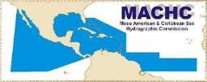
20th MEETING OF THE MESO AMERICAN & CARIBBEAN SEA HYDROGRAPHIC COMMISSION (MACHC 20)
COCATRAM
Regional Projects / Training Priorities
Santo Domingo, Dominican Republic December 02 - December 6, 2019
© 2019

Slide 2
WHAT COCATRAM IS?
A specialized Organization
that is part of the institutionalism of the Central American Integration System
(SICA)
The Technical
Secretariat of
COMITRAN is
the Secretariat for
Central American
Economic Integration
It Responds to the policies and
guidelines of the Council of Ministers responsible for the Transport in Central America
(COMITRAN)
Of permanent
nature,
own Directory and
based in
the city of Managua, Nicaragua, C.A.
© 2018

Slide 3
PERMANENT NETWORKS
REPICA
Central American Network of Maritime and Port Women
Central American Port Forum, REPICA
REDMARPOR
Marítime & Ports
Statistics Network
ROCRAM-CA
Regional Network
of Port Protection
Operative Regional
REDCAFOR
Cooperation Network of
Maritime Authorities in
Central American
Network of Maritime
Central America
And Dominican
And Port
Training
Centers
Republic
© 2018

Slide 4
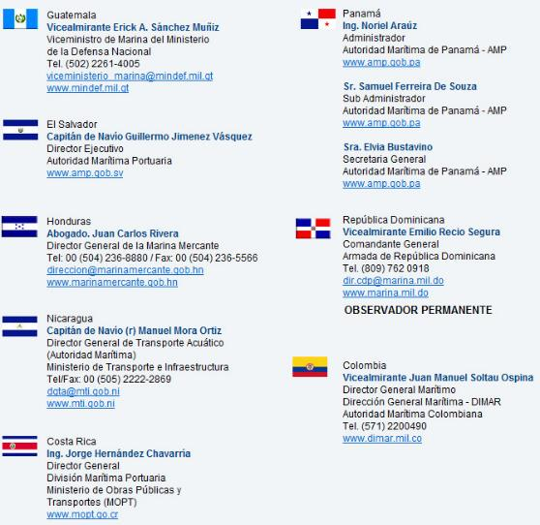
ROCRAM-CA
PERMANENT OBSERVER
© 2019

Slide 5
© 2019

Slide 6
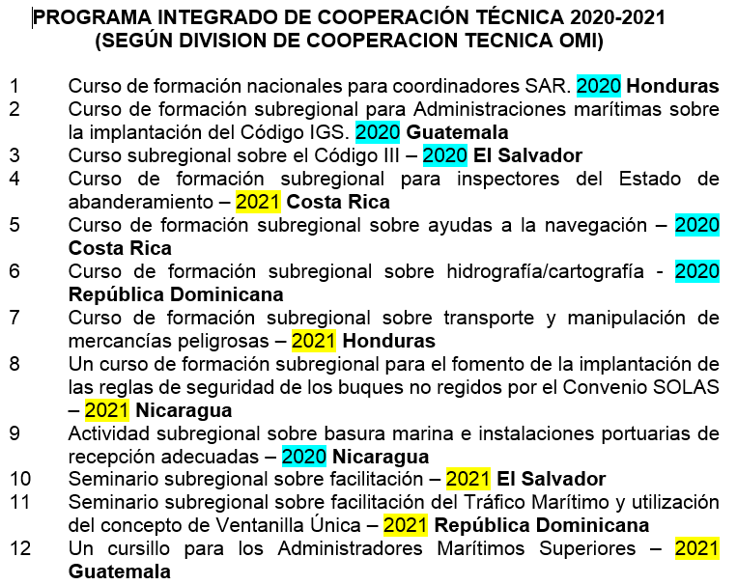
5. Subregional Training Course on Navigation Aids – 2020 Costa Rica
6. Subregional Training Course on Hidrography / Cartography – 2020 Dominican Republic
© 2019

Slide 7
Rear Admiral José Antonio Lemus PPT COCATRAM
© 2019

Slide 8
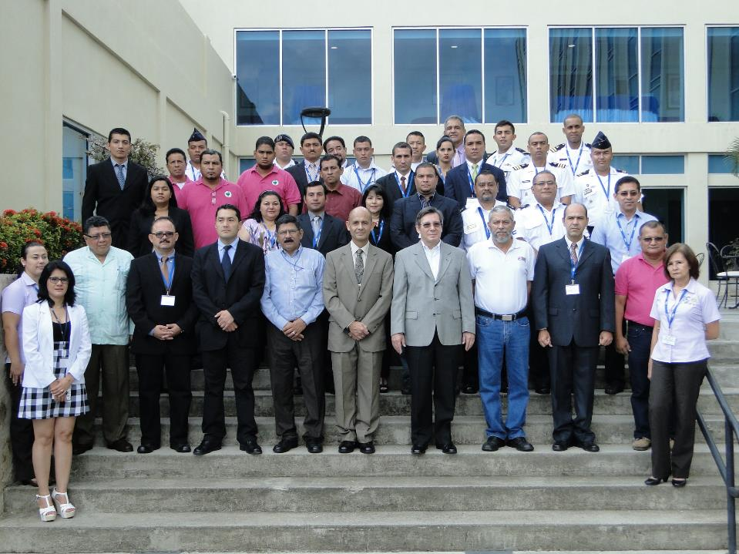
Barcelo Hotel - Managua, Nicaragua 2014
© 2019

Slide 9
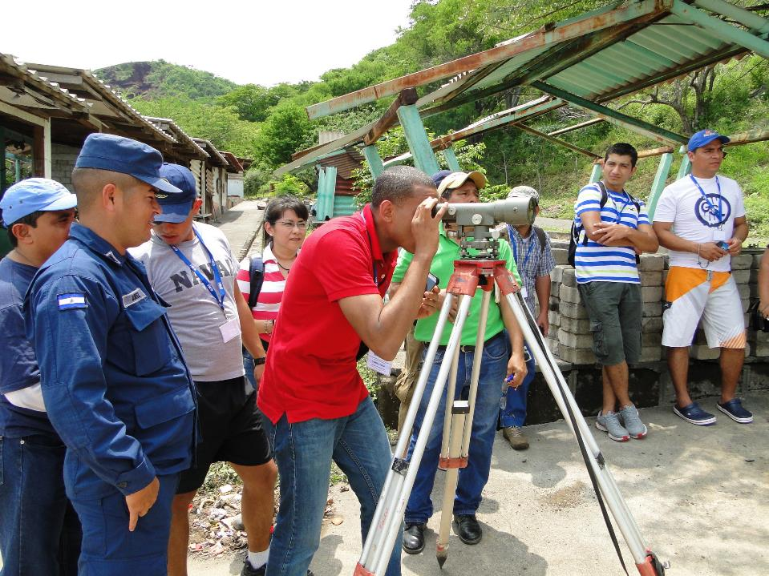
Practical Exercise at Xiloa Lagoon
© 2019

Slide 10
Thank you
www.cocatram.org.ni
© 2019

