Slide 1
The Caribbean Regional Track of the Pilot Program for Climate Resilience
CIF
PPCR Global
CRT-PPCR
Ainsley A Henry
Program Manager
PMU – MORI – UWI
December 2019
Investment Plan for the Caribbean Regional Track of the Pilot Program for Climate Resilience

Slide 2
Climate Investments Funds (CIF): Clean Technology Fund (CTF) and Strategic Climate Fund (SCF)

Slide 3
CIF Programming

Slide 4
Donors and MDBs
Since the CIF was established in 2008, 14 donor countries have contributed over $8 billion in support of scaling up mitigation and adaptation action in developing and middle-income countries. These resources are held in trust by the World Bank and disbursed as grants, highly concessional loans, and risk mitigation instruments to recipient countries through multilateral development banks (MDBs).
Asian Development Bank

Slide 5
PPCR Global

Slide 6
ACHIEVED RESULTS

Slide 7
Caribbean Pilot Program for Climate Resilience (PPCR)
Regional Program for the Caribbean
(US$60 – 75 million for the region) Grants and concessional loans available for investment in scaling up adaptation measures
Activities proceeding along two tracks:
Country-based investments in highly vulnerable countries: Haiti, Jamaica, Dominica, St. Lucia, St. Vincent and the Grenadines and Grenada.
Region-wide activities involving regional organizations (e.g. UWI, CDEMA, CIMH, CARPHA, CFRM, CARDI and CCCCC)
Haiti program
Jamaica program
Dominica program
Regional program
St. Lucia program
Grenada program
St. Vincent & Grenadines program
Notes:
Under the Pilot Program for Climate Resilience (PPCR) over US$ 29 million in concessional funds have been set aside to contribute to financing for innovative programs and projects that engage the private sector in activities associated with reducing countries’ exposure to climate risk and uncertainty.

Slide 8
INVESTMENT PLAN FOR THE CARIBBEAN REGIONAL TRACK OF THE PILOT PROGRAM FOR CLIMATE RESILIENCE (PPCR)
Regional Program
Objective: To help improve regional processes of climate relevant data acquisition, storage, analysis, access, transfer and dissemination, and to pilot and scale up innovative climate resilient initiatives.
Financing: Grant (~ US$10.39 million) executed by Mona Office for Research and Innovation – UWI.
Participating countries: Direct interventions in Jamaica, Haiti, St. Lucia, St. Vincent and the Grenadines, Dominica and Grenada plus others to benefit through activities co-implemented by regional agencies UWI, CCCCC, CIMH, CARPHA, CRFM and CARDI
Four components and knowledge management: (i) Improving geospatial data and management for adaptation planning, sea level rise and storm surge impact analysis; (ii) Consolidating and expanding the regional climate network and global platform linkages; (iii) Downscaling and expanded climate projection models and high resolution maps; (iv) Applied adaptation initiatives – health, water, agriculture and marine

Slide 9
COMPONENT 1 – Improving Geospatial Data Management and Management for Adaptation Planning, Sea Level Rise and Storm Surge Impact Analysis
Data acquisition for selected highly vulnerable areas in the pilot countries
Production and transfer of geo-spatial outputs to key national and regional repositories (Bathymetry, Topography, Digital Elevation Models and Aerial Imagery)
Objective: To improve accessibility to high quality current Bathymetric and near shore topographic data;
To support Climate Change analysis related to sea-level rise, storm surge and flooding
To inform on-going and future coastal land-use and adaptation planning at the regional and national levels
Investment Plan for the Caribbean Regional Track of the Pilot Program for Climate Resilience

Slide 10
COMPONENT 2 – Consolidating and Expanding the Regional Climate Network and Global Platform Linkages
A1 – Capacity Building for National Meteorological Services:
DOM, GND, HAI,JAM, SLU & SVD Completed
A2 - Priority Climate Product and Climate Services Developed
National Sector Consultations held in DOM, GND, JAM, SLU &SVD
Roadmap consultancy – underway, completion June 2020
Climate Products and Services for priority sectors in 4 countries developed
A3 – Installation of 24 weather stations in 4 PPCR countries
Weather stations procured and in countries (DOM, GND, SLU & SVD); Installation scheduled January 2020
A4 - Installation of Backup/Failover systems for Caribbean Climate Data
System Hardware acquired and installed in Barbados, Trinidad and Belize (October 2019)
Investment Plan for the Caribbean Regional Track of the Pilot Program for Climate Resilience

Slide 11
COMPONENT 3 – Downscaling and Expanded Climate Projection Models and High Resolution Maps
A1 – Global Climate Projections “downscaled”
“Strategic Platform for Advanced Research and Knowledge Sharing” – SPARKS supercomputing facility acquired
Global Climate Models downscaled to 10 km² resolution at multiple time scales
Information used/published widely e.g. contributing to the State of the Caribbean Climate etc.
A2 – Development of Portal to access Regional and Sub-regional Climate Models
“Caribbean Regional Ensemble Sharing Tool” - CREST developed –Launch date Q1 - 2020
Investment Plan for the Caribbean Regional Track of the Pilot Program for Climate Resilience

Slide 12
COMPONENT 3 – Downscaling and Expanded Climate Projection Models and High Resolution Maps
A3 – Development of “Regional Coastal Zone Integrated Information Management System (RCIIMS)”
November 2020 completion
A4 – Coastal Scenarios for 3 Vulnerable Areas Developed
September 2020 Completion
Investment Plan for the Caribbean Regional Track of the Pilot Program for Climate Resilience

Slide 13
Component 4.1 – Early Warning Systems Health
A1 – Develop Early Warning Systems for mosquito borne diseases for Haiti, Jamaica & Saint Lucia
Health Audit of Climate and Vector Borne Diseases Data- January 2020
completion Vector Borne Disease and Gender Dynamics Study – December 2020
Integrating Climate Variability into the Surveillance, Prevention and Control of Vector Borne Diseases – November 2020 Completion
Investment Plan for the Caribbean Regional Track of the Pilot Program for Climate Resilience

Slide 14
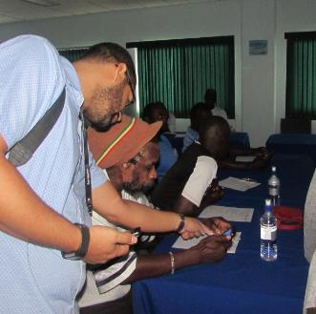
Component 4.2 – Early Warning Systems Fisheries (Marine)
A1 – Develop and deploy an ICT Early Warning and Emergency Response System
Mobile phone app – Fisheries Early Warning and Emergency Response (FEWER) developed and deployed in DOM, SVD, SLU (2018), CDEMA engaged for for hosting and sustainability (July 2019)
Capacity building - 120 participants, 63 fishers and 57 administrators February – March 2018
A2 &3 – Regional fishery-related ecological and socio-economic impacts assessment; and Fishery Assessment and Regional Fisheries and Environmental Database developed
February 2020 Completion
Investment Plan for the Caribbean Regional Track of the Pilot Program for Climate Resilience

Slide 15
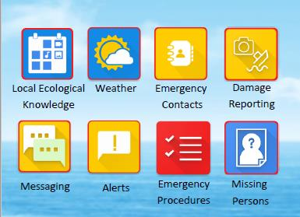
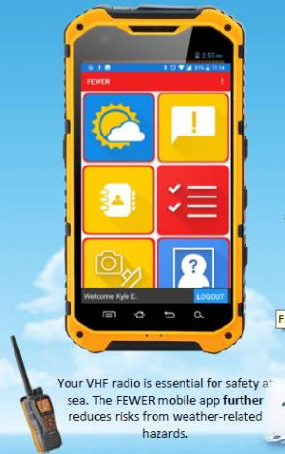
Component 4.2 – Early Warning Systems Fisheries (Marine): FEWER APP

Slide 16
Component 4.3 – Climate Resilient Agriculture
A1& 2 – Establish/Refurbish Gene and Seed Bank: - Seed Bank at Bodles, St Catherine, Jamaica upgraded; Upgrade of Gene Bank Facility at Orange Hill, St Vincent Q2 - 2020 completion
A3 – Establish/Construct Weaning and Hardening Facilities: Construction scheduled for January 2020 in SLU, JAM, DOM, GND
A4 – Capacity Building Towards Climate Resilient Agriculture:- Crop Modelling (Trinidad 23-27 April 2018); Modules in Crop Simulation Modeling, Climate Change and Livestock Impact Assessment (Jamaica 16-27 July 2018); Seed Management and Seed Science Technology for CARDI (Guyana, Belize and Trinidad ) & Jamaica (Govt) - (IOWA October 2019);
A5 – Enhance technological capacity of CARD:- 3 Seed Batch Dryers (Jamaica, Antigua and Belize); 10 modelling computers
A6 – Establishment of Validation Plots: - In situ experimentation to provide crop modelling data
A7 – Molecular Characterisation:- Laboratory experimentation on crop with climate resilient traits
Investment Plan for the Caribbean Regional Track of the Pilot Program for Climate Resilience

Slide 17
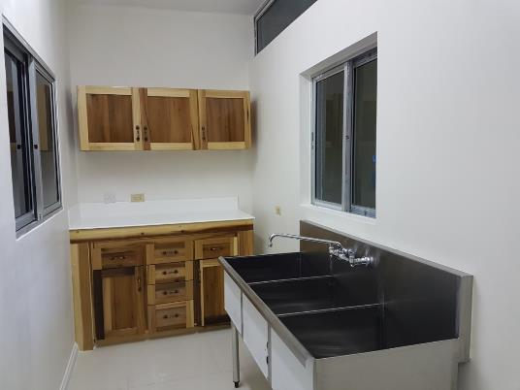
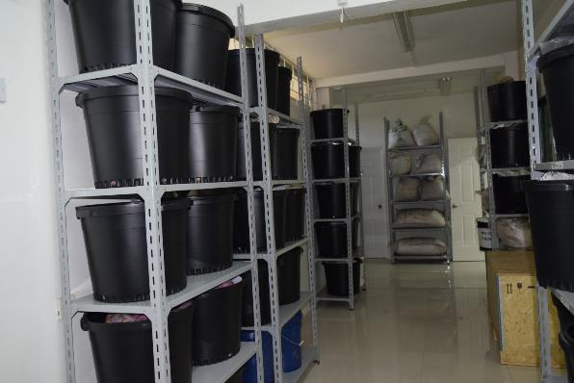
Component 4.3 – Climate Resilient Agriculture (Sections of upgraded Seed Storage Facility
Investment Plan for the Caribbean Regional Track of the Pilot Program for Climate Resilience

Slide 18
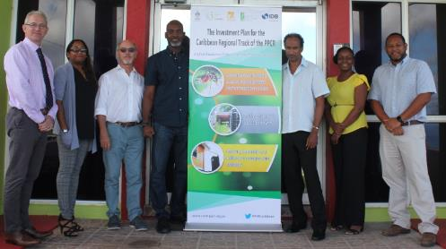
Component 4.4 – Rainwater Harvesting(RWH) Systems
Assessment, Mapping, Manual Development and Training
National Stakeholder Consultations and Climate Risk Vulnerability Assessments completed 2019
Updated guidance and financial incentives recommendations December 2019 completion
Training of 80 rainwater harvesting professionals across the region December 2019
Refurbishing/Installation of RWH systems in three vulnerable communities
Q3 – 2020 Completion
Investment Plan for the Caribbean Regional Track of the Pilot Program for Climate Resilience

Slide 19
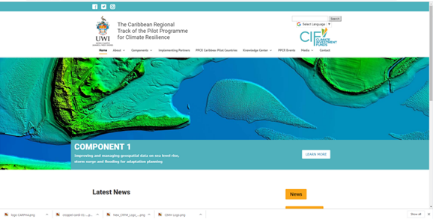
Gerard Alleng
Climate Change Senior Specialist
Climate Change & Sustainability Division
Email: gerarda@iadb.org
Washington D.C.
Ainsley A Henry
Program Manager
Program Management Unit
Mona Office for Research and Innovation
Email: ainsley.henry@uwimona.edu.jm
Connect with us: www.caribppcr.org.jm | Facebook| Instagram| Twitter: @caribclimateact
Investment Plan for the Caribbean Regional Track of the Pilot Program for Climate Resilience

