Slide 1
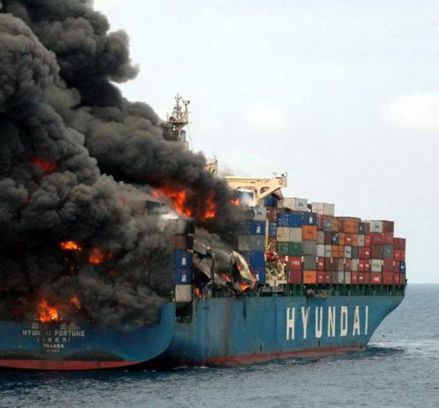
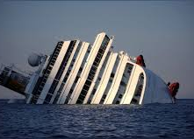
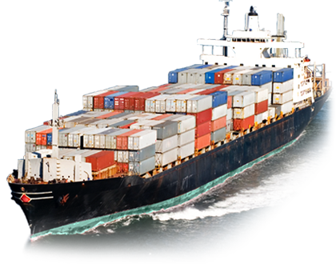
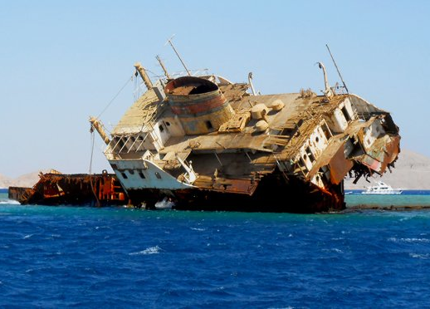
Global Statistical Analysis of Historical Marine Incidents
Amrika Maharaj, PhD Candidate
The University of the West Indies
amrika.maharaj@hotmail.com

Slide 2
Learning Objectives
Introduction to shipping for the Caribbean
Causes of Maritime Accidents
Quantitative Analysis of Maritime Causalities and Incidents
Maritime Accidents by Geographical Area

Slide 3
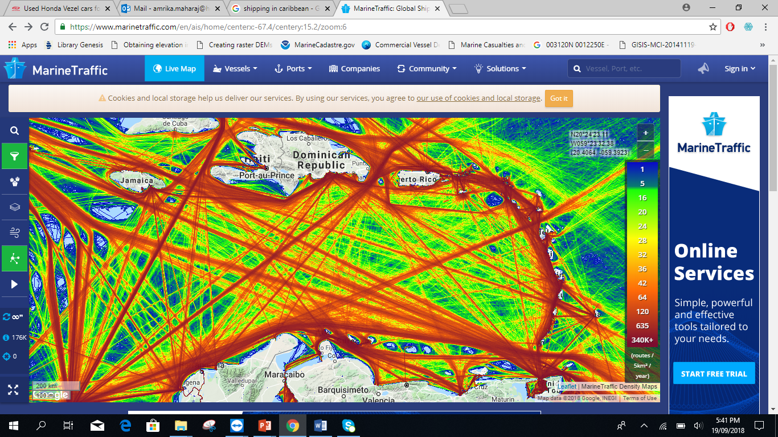
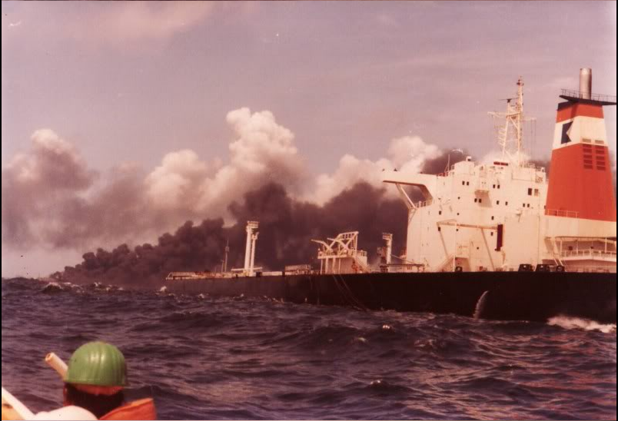
Introduction to the Study
The Maritime environment represents a wide range of shipping activities.
The shipping activities become more complex as large-scale offshore operations and maritime activities continue to increase.
Figure 1 : Marine Traffic density across the Caribbean
MarineTraffic 2017
Marine traffic
Research into Risk Assessment of Maritime Navigation
Causation factors influencing vessel incidents
Figure 2: Oil spill accident along the coast of Tobago, 1979.

Slide 4
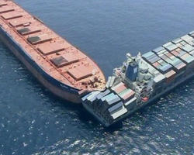
Causes of Maritime Accidents
Generic causes of Maritime Accidents:
Meteorological Conditions
Mechanical and Technical Issues
Human Errors
Malfunctioning aids to navigation
Inadequate charting (Bathymetry & Navigational Hazards)
Navigational Complexity
Visser n.d
Figure 3: Vessel Incident

Slide 5
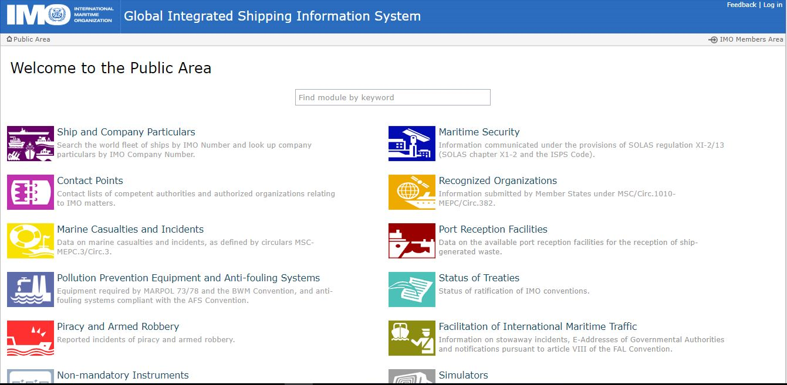
Quantitative Analysis of Maritime Causalities and Incidents

Slide 6
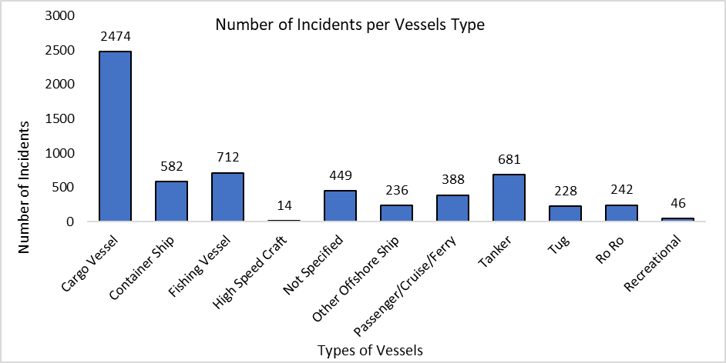
Number of Incidents per Vessel Type
Figure 4

Slide 7
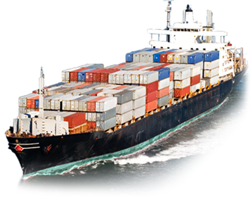
Number of Maritime Causalities and Incidents
9 Foundered
10 Collisions
14 Groundings
11 Capsize
13 Mechanical and Technical Failure

Slide 8
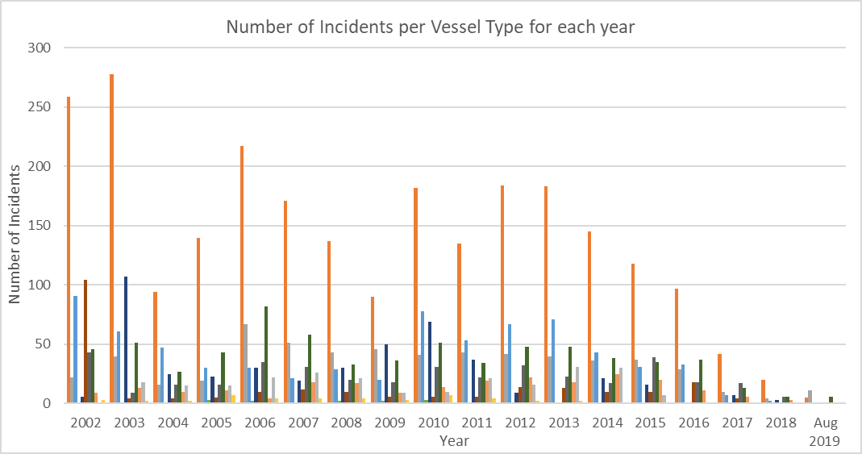
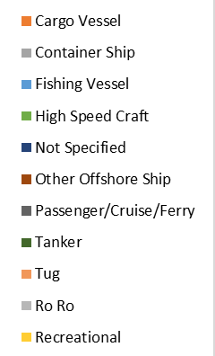
Number of Incidents per Vessel Type for each year
Figure 6
8

Slide 9
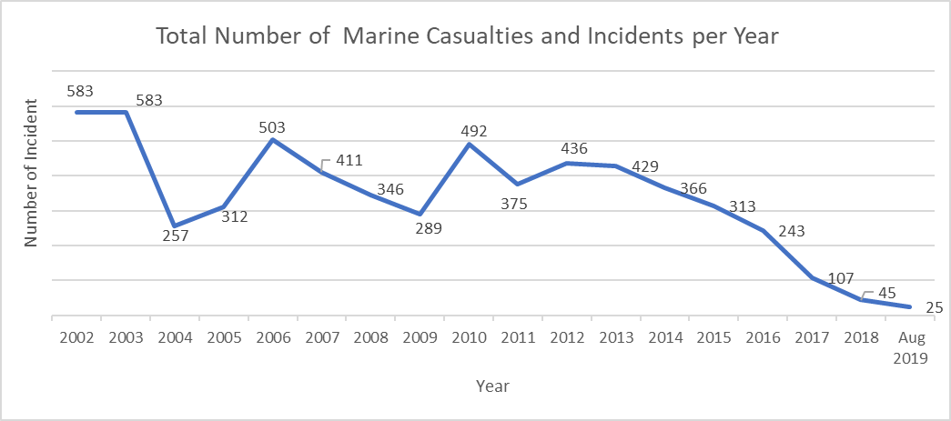
Total Number of Marine Causalities and Incidents per Year
Figure 7
9

Slide 10
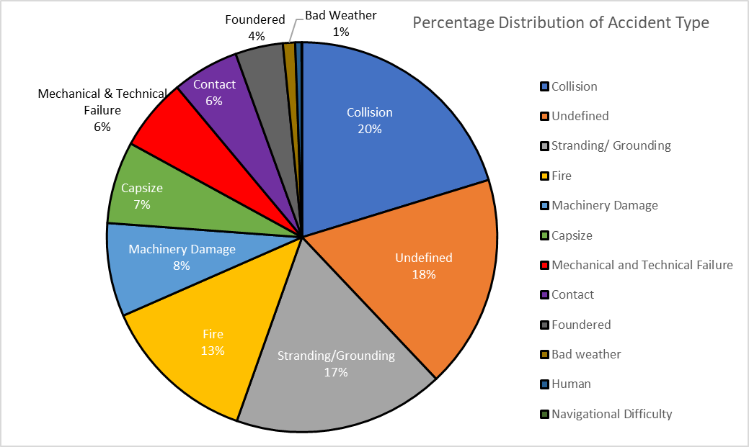
Distribution of Accident Type
Figure 8
10

Slide 11
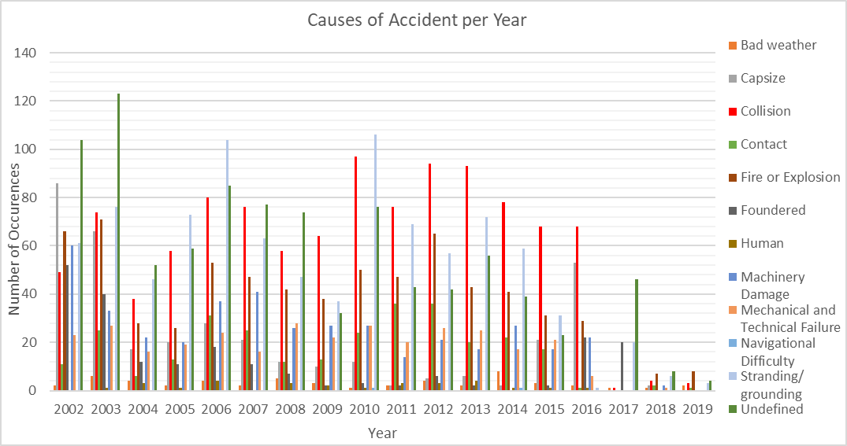
Causes of Accidents per Year
Figure 9
11

Slide 12
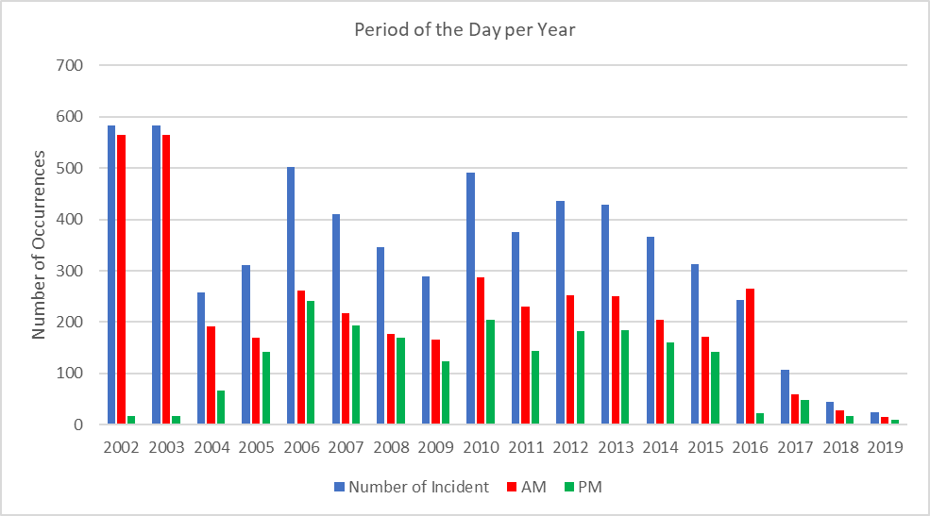
Number of Incidents per Period of the Day
Figure 10
12

Slide 13
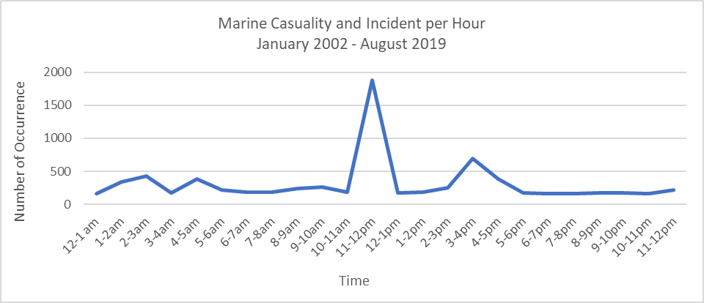
Marine Causality and Incidents per Hour
Figure 11

Slide 14
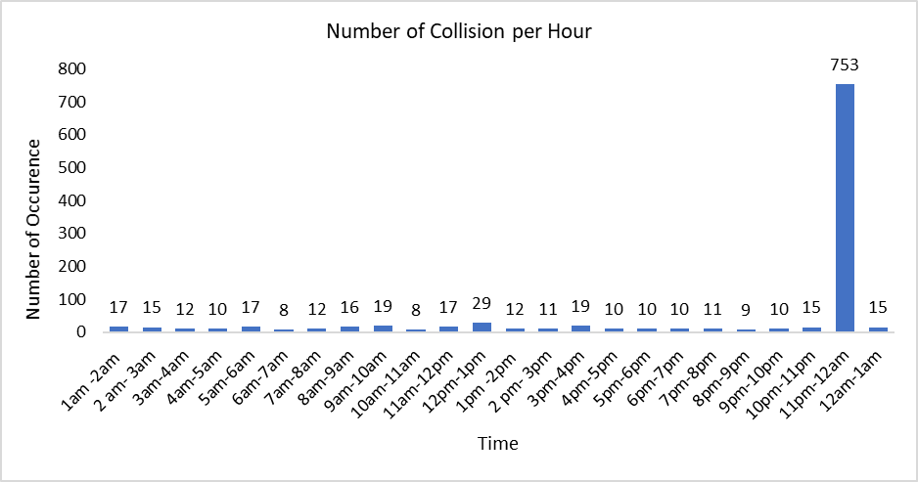
Number of Collision per Hour
Figure 12

Slide 15
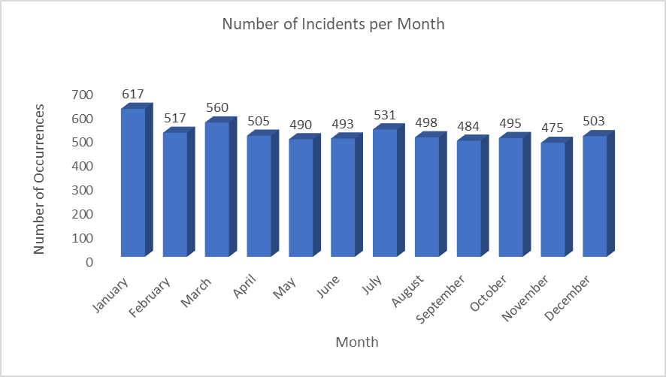
Quantitative Analysis of Maritime Causalities and Incidents
January has the highest number of events with 617 occurrences.
Figure 13

Slide 16
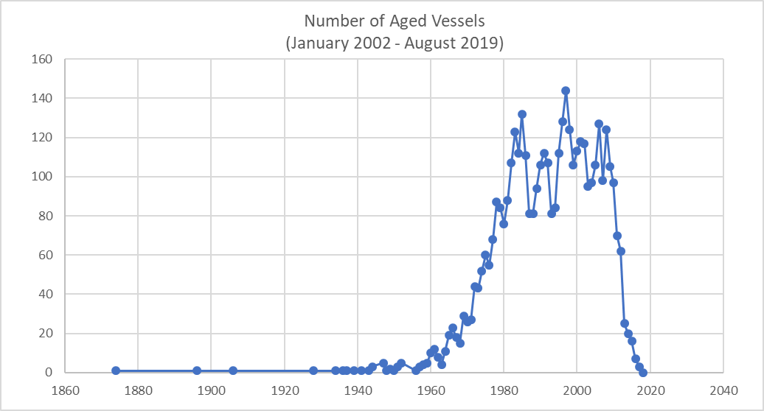
Number of Aged Vessels
Figure 14

Slide 17
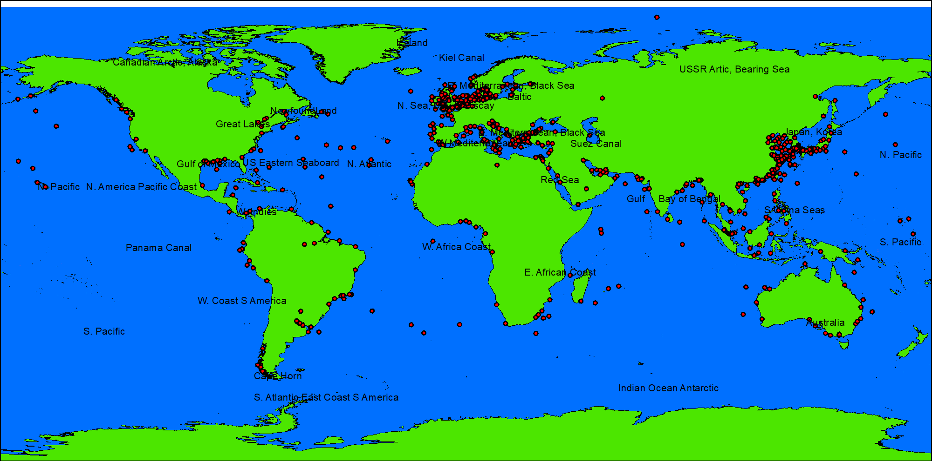
Location of Collision Incidents

Slide 18
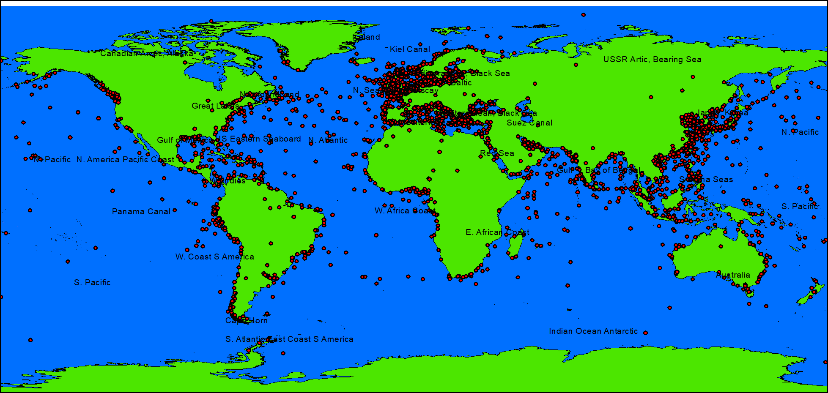
Location of Stranding/Grounding Incidents

Slide 19
Summary
From the analysis, it was determined that :
The cause of majority of these incidents resulted from Collision.
The major type of vessels that were involved in all accidents were cargo vessels, followed by fishing and tanker vessels.
The type of vessels that were involved in Collision were mostly cargo vessels.

Slide 20
Summary
The correlation between the causation factor and the location suggested that most incidents occur in the South China Sea, Bay of Biscay and the Black Sea.
It was observed that most accidents occurred during the early morning
time period rather than the PM time period.
The time of the incidents occurred mainly between 11pm– 12am.
Age of vessel

Slide 21
Conclusion
It is important that proactive consideration of these potential high risk areas are taken to avert the risk of shipping accidents in the future in these highly sensitive and bio-diverse areas.

