Slide 1
http://bit.ly/MACHC-Story_2019

Slide 4
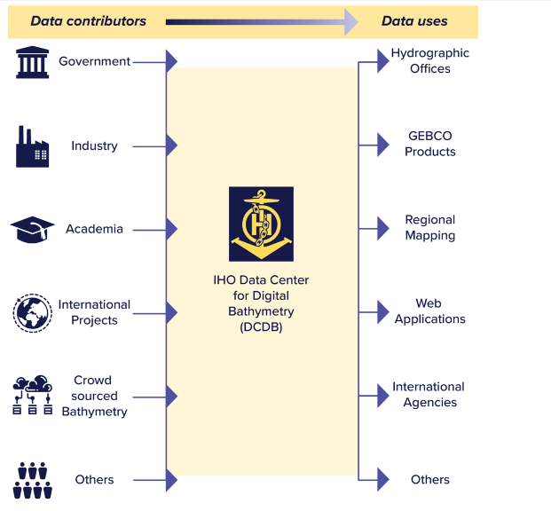
IHO Data Center for Digital Bathymetry (DCDB)

Slide 9
GEBCO 2019

Slide 10
New Data Sources

Slide 11
Working together to Map the Gaps

