Slide 1



The Caribbean Regional Track of the PPCR Programme
Brief Overview
Details on COMPONENT 1 – Improving Geospatial Data Management and Management for Adaptation Planning, Sea Level Rise and Storm Surge Impact Analysis
Ainsley A Henry
Program Manager
PMU – MORI – UWI
December 2019
Investment Plan for the Caribbean Regional Track of the Pilot Program for Climate Resilience

Slide 2


CRT-PPCTR OVERVIEW
The Pilot Program for Climate Resilience (PPCR) in the Caribbean consists of six participating countries each with individual National Projects (Dominica, Grenada, Haiti, Jamaica, Saint Lucia and Saint Vincent and the Grenadines) and a regional track of activities, co-implemented through regional organizations.
The regional track of activities are designed to have both direct benefits to PPCR countries and indirect benefits to non-PPCR countries in the Caribbean. The national and regional tracks are linked and the lessons learned under the PPCR will be shared with all countries across the region.
The Climate Investment Fund through the Inter-American Development Bank (IDB) has provided US$10.39 million in grant funding to implement over 5 years the Investment plan for the Caribbean Regional Track of the Pilot Program for Climate Resilience (PPCR). The University of the West Indies Mona signed a Technical Cooperation (TC) to implement the regional track through a Program Management Unit set up under the Mona Office for Research and Innovation.
Investment Plan for the Caribbean Regional Track of the Pilot Program for Climate Resilience

Slide 3
COMPONENT 1 – Improving Geospatial Data Management and Management for Adaptation Planning, Sea Level Rise and Storm Surge Impact Analysis
Activities:
Assessment of the presence of LIDAR data and use in pilot countries
National stakeholder consultations to determine sites
Data acquisition for selected highly vulnerable areas in the pilot countries
Production and transfer of geo-spatial outputs to key national and regional repositories
Capacity building of geospatial professionals in pilot countries to use LIDAR technology and products
Investment Plan for the Caribbean Regional Track of the Pilot Program for Climate Resilience

Slide 4
COMPONENT 1 – Improving Geospatial Data Management and Management for Adaptation Planning, Sea Level Rise and Storm Surge Impact Analysis
Activities
A1 – LIDAR (Bathymetry and Topography) Scoping and Monitoring - BSF Swissphoto
A2 – LIDAR Data Acquisition and Processing (HAI & JAM) – FUGRO Geoid SA
A3 – Training programme for all PPCR pilot countries in the use and value of LIDAR technology and products.
A1 – Completed (review of data acquisition and processing ongoing)
A2 – Data Acquisition: JAM 100%; HAI 98%
A2 – Processing On-going (completion December 2020)
A3 – Workshops scheduled for February 2020
Investment Plan for the Caribbean Regional Track of the Pilot Program for Climate Resilience

Slide 5

COMPONENT 1 – Improving Geospatial Data Management and Management for Adaptation Planning, Sea Level Rise and Storm Surge Impact Analysis
Assessment findings
The analysis of related projects revealed that all 6 PPCR countries except Jamaica had finished or ongoing Lidar projects.
The United Kingdom Hydrographic Office (UKHO) had contracted a Bathymetric Lidar survey in the summer of 2016 for the shallow-water zones of St. Vincent and the Grenadines and Grenada. The data collection took place between October 2016 and January 2017. The data was delivered to UKHO, who finished the validation process in August 2017. The data is ready to be released to the local states in the course of presentation workshops scheduled for the 4thquarter of 2017.
Furthermore Grenada has contracted the collection of topographic Lidar data for the whole country in August 2017. The data acquisition and data delivery were scheduled to be finished by the end of March 2018.
The Commonwealth of Dominica contracted the collection of topographic and bathymetric Lidar data for the whole country in May 2017.
St. Lucia hired a technical specialist to help develop the detailed specifications for, and supervise the Lidar Survey (bathymetric and topographic) for the entire country. The data acquisition was to be conducted during the dry season 2018 (i.e. March -April)1.

Slide 6
COMPONENT 1 – Improving Geospatial Data Management and Management for Adaptation Planning, Sea Level Rise and Storm Surge Impact Analysis
Assessment findings Cont’d
The Haitian Ministry of the Interior and Local Authorities through the World Bank financed Disaster Risk Management and Reconstruction Project launched the ‘High Resolution Risk Data Initiative’. For the entire national territory of Haiti, a topographic Lidar data collection was finished in 2017. The data was delivered and is available on the GFDRR financed open data platform Haitidata.org , managed by the Haitian National Center for GeoSpatial Information(CNIGS).

Slide 7
COMPONENT 1 – Improving Geospatial Data Management and Management for Adaptation Planning, Sea Level Rise and Storm Surge Impact Analysis
Jamaica
The area of interest for which Lidar and aerial imagery data has been collected includes 3 coastal areas
  • Area J1: Coastal zone Kingston-Morant Bay: ~60 km
  • Area J2: Coastal zone Port Antonio –Fairy Hill: ~25 km
  • Area J3: Coastal zone Ocho Rios –Annotto Bay: ~55 km
The total surface of the area for the topographic Lidar is 620 km².
The area of interest for which bathymetry LiDAR data is to be collected includes 3 coastal areas :
  • Area J1: Coastal zone Kingston-Morant Bay: ~207 km²
  • Area J2: Coastal zone Port Antonio –Fairy Hill: ~27 km²
  • Area J3: Coastal zone Ocho Rios –Annotto Bay: ~96 km²
The total surface of the area for the bathymetry Lidar is 331 km².
Investment Plan for the Caribbean Regional Track of the Pilot Program for Climate Resilience

Slide 8
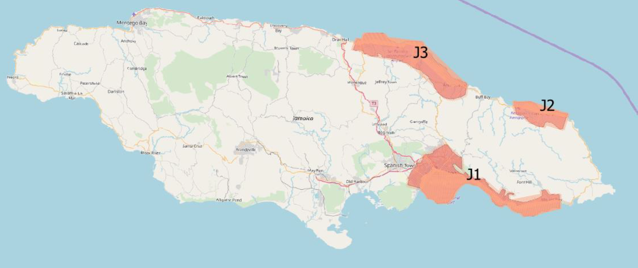
COMPONENT 1 – Improving Geospatial Data Management and Management for Adaptation Planning, Sea Level Rise and Storm Surge Impact Analysis
Data Acquisition Areas
Jamaica
Investment Plan for the Caribbean Regional Track of the Pilot Program for Climate Resilience

Slide 9
COMPONENT 1 – Improving Geospatial Data Management and Management for Adaptation Planning, Sea Level Rise and Storm Surge Impact Analysis
Haiti
The area of interest for which Lidar data has been collected under this project includes 3 coastal areas:
  • Area H1: Bay of Port-au-Prince: 154km (93%)
  • Area H2: La Gonave: 143km
  • Area H3: Jeremie-Cayemites: 205km
The total length of the areas of interest is 502km.
The area of interest for which bathymetry Lidar data is to be collected under this project includes 3 coastal areas:
  • Area H1: Bay of Port-au-Prince: ~507km²
  • Area H2: La Gonave: ~134 km²
  • Area H3: Jeremie-Cayemites: 303 km²
Investment Plan for the Caribbean Regional Track of the Pilot Program for Climate Resilience

Slide 10
COMPONENT 1 – Improving Geospatial Data Management and Management for Adaptation Planning, Sea Level Rise and Storm Surge Impact Analysis
Data Acquisition Areas
Haiti
Investment Plan for the Caribbean Regional Track of the Pilot Program for Climate Resilience

Slide 11
COMPONENT 1 – Improving Geospatial Data Management and Management for Adaptation Planning, Sea Level Rise and Storm Surge Impact Analysis
Outputs
Data acquisition for selected highly vulnerable areas in the pilot countries
Production and transfer of geo-spatial outputs to key national and regional repositories
  Bathymetry (Haiti and Jamaica)
  Topography (Jamaica only)
  Aerial Imagery and DEMs (Haiti and Jamaica)
Geospatial professionals in Pilot countries exposed to LIDAR technology and potential uses (workshop Feb 2020)
Investment Plan for the Caribbean Regional Track of the Pilot Program for Climate Resilience

Slide 12
COMPONENT 1 – Improving Geospatial Data Management and Management for Adaptation Planning, Sea Level Rise and Storm Surge Impact Analysis
Objective: To improve accessibility to high quality current Bathymetric and near shore topographic data;
  To support Climate Change analysis related to sea-level rise, storm surge and flooding
  To inform on-going and future coastal land-use and adaptation planning at the regional and national levels
  Data available for use by multiple stakeholder groups in each country
Investment Plan for the Caribbean Regional Track of the Pilot Program for Climate Resilience

Slide 13


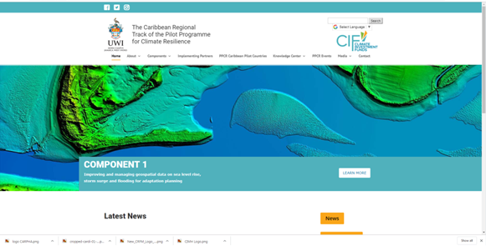
Connect with us: www.caribppcr.org.jm | Facebook| Instagram| Twitter: @caribclimateact
Investment Plan for the Caribbean Regional Track of the Pilot Program for Climate Resilience

