Slide 1
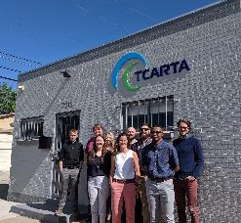
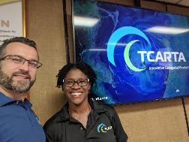
Survey Risk Reduction Using Satellite Derived Bathymetry for Remote Small Island and Developing States
MACHC XX
Santo Domingo, Dominican Republic
2-6 December, 2019
Denver, Colorado
Kingston, Jamaica

Slide 2
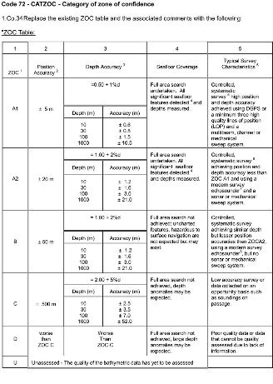
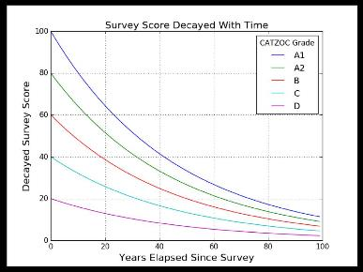
Role of Satellite Derived Bathymetry
SDB is like a cuisine. Numerous dishes, lots of styles and flavors, varying techniques and quality control “you get what you pay for” = free sushi from unknown fish off a street vendor?! No, Thank You!
One bad ceviche dish might spoil your appetite, but it would be short-sighted to toss our entire cuisine due to one bad taste in the mouth.
Satellite Derived Bathymetry is always fresh!
Image Credit: NOAA THOSA Presentation 2019

Slide 3
SDB Cookbook - Next Generation ESRI TOOLBOX & CARIS INTEGRATION
Variable | GEBCO Cookbook | Trident System
Scalability | Manual Approach, time consuming, repeatability is a challenge | Automated / Semi-Auto method, highly scalable
Method(s) | Empirical - Band ratio method | Integration of 4 physics based methods - Artificial Intelligence / Computer Vision techniques
Bottom Types | Treats all bottom types the same - issues with heterogeneous seafloor | AI based bottom segmentation, works with variable bottom types
Quality | Data produced is of unknown quality | Per pixel accuracy reporting and uncertainty metric
Calibration Source & Validation | Chart points or other historical data | Space based laser and photogrammetry for modern calibration points
National Science Foundation Small Business Innovation Research Grant - Phase II

Slide 4
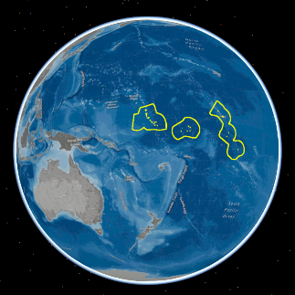
Kiribati - Satellite Derived Bathymetry Project Overview
In December 2018 TCarta was awarded a contract by the UKHO to Survey the waters of Kiribati, a remote island nation in the Pacific.
TCarta worked in close partnership with Maxar (DigitalGlobe) to successfully task imagery, overcome challenging environmental conditions, and implementation of remote data validation techniques, culminating in on-time delivery of the largest SDB contract ever awarded by an international Hydrographic Office.

Slide 5
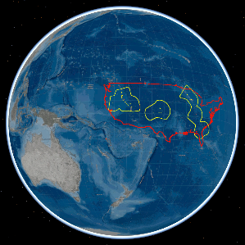
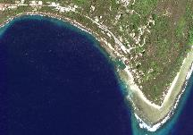
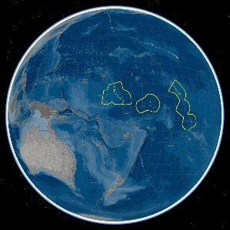
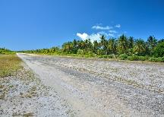
Airborne or Marine Survey in Kiribati KIRIBATI GEOGRAPHICAL AND MOBILIZATION CHALLENGES
Both LiDAR and MBES options would require mobilization of equipment and personnel to one of the most remote locations on the globe and incur very high cost and risk.
Banaba & Gilbert Islands
Banaba “Port”
Line Islands
Phoenix
Islands
Abemama Airstrip
3,000 NM
Notes:
Island hopping with airplane to get to Kiribati
Even mobilizing to Tarawa for base operations, a relatively developed and good facilities would require signiifcnat mobilization from Tarawa to other islands for surveying = equivalent of basing in St. Louis and deploying to survey Seattle or Key West Only a few islands have runways adequate for LiDAR aircraft - lots of transiting to the adjacent islands and back means loss of efficiency in survey vs transit time
Limited deep water ports for larger marine vessels; would require mothership and smaller craft deployment for shallow water surveying in coastal and lagoons areas where uncharted hazards exist

Slide 6
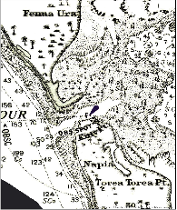
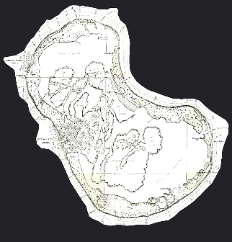
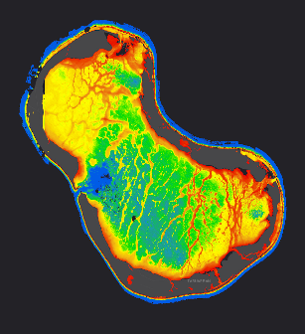
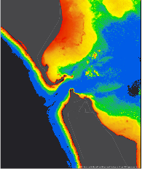
Kiribati | Satellite Derived Bathymetry UPDATED HYDROGRAPHY

Slide 7
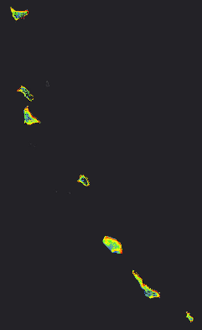
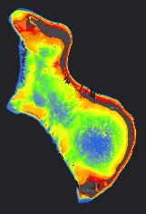
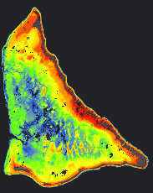
Kiribati Satellite Based Bathymetric Survey SUMMARY OF PROJECT
Butaritari
36 islands/atolls surveyed
3,143 km² coverage produced
~400 images assessed
87 images processed
3 month program
DigitalGlobe collected 300+ tasked images in less than 3 months
Delivered on time & to specifications
Onotoa
Abaiang
Tawara
Abemama
Nonouti
Tarawa
Tabiteuea
Onotoa

Slide 8
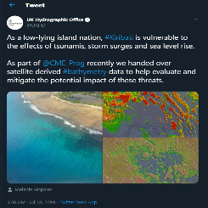
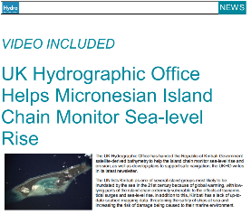
Project Impact Summary UKHO & KIRIBATI USES OF SDB DATA
In August 2019 data was handed over to Kiribati government as part of Commonwealth Marine Economy Programme to enable coastal monitoring and defense efforts as well as in development plans for safe navigation.
CME Programme Impact Summary:
Reduce risk of future marine surveys
Identification of hazards to mariners
Sea level rise impact modeling
Storm surge and severe weather impact modeling
Impact of erosion, wave action and flooding on coastline and marine habitats
Planning and design of natural and man-made defensive measures eg mangroves and seawalls
twitter.com/UKHO/status/1151810963496153088
https://www.hydro-international.com/content/news/uk-hydrographic-office-helps-micronesian-island-chain-monitor-sea-level-rise?output=pdf

Slide 9
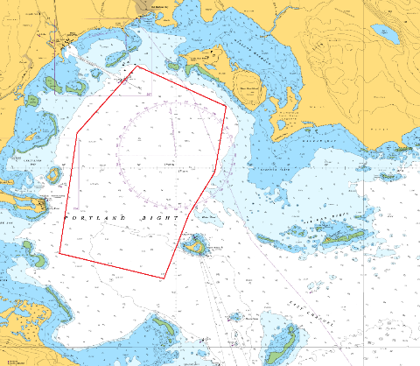
Planning of Hydrographic Survey using Charts
The Hydrographer will use available charts to guide him in planning a survey
If the chart is outdated this will limit the knowledge of the area and the most effective planning of the survey
This can increase the risk to survey crew
To mitigate against that risk there is usually a cut off depth contour
Source Data
1851-1975

Slide 10
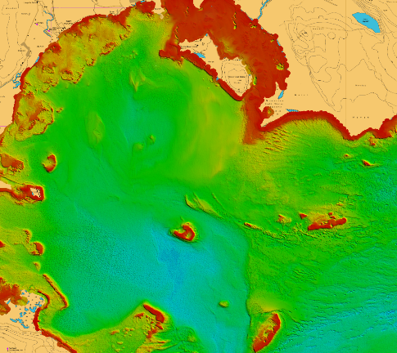
Planning of Hydrographic Survey using SDB
Increase or reduced coverage of the survey area
Facilitate better line planning and better coverage of the area to improve shipping lane width
SDB data will ensure accurate start and end point of line
Provide current data on reef extent and reduce occurrence of grounding and damage to equipment, vessel and marine life

Slide 11
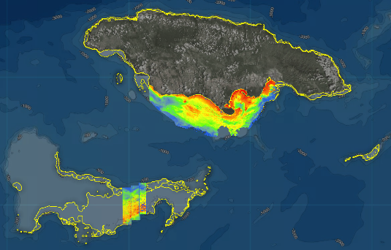
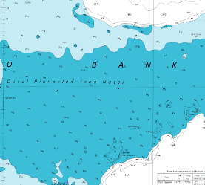
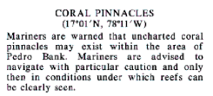
Reconnaissance and Risk Mitigation for Remote Survey Locations
Increased Risk for Remote Locations
High cost of mobilization
Risk of grounding in remote locations
Advanced reconnaissance using SDB
More Efficient Line Spacing and Planning
Lower cost / less time at sea
Avoidance of coral pinnacles in route planning
Improved Safety of Survey
Reduced Risk to Environment
Surveyed in 1970-1975

Slide 12
Cost Analysis of SDB & Traditional Hydrographic Survey at Pedro Bank
Traditional Hydro of Pedro Bank | SDB of Pedro Bank
Sailing time approx. eight hours to the location Transit time alone for one line at 5 knots of an area 25kn*21km would be nearly three hours At 30 meters line spacing with a total 710 lines total sounding time 2130 hrs approx. 266 days if 8hrs per day The cost alone for vessel of opportunity is 150 U.S per hour=U.S $319,500 With wages and other emoluments total cost will certainly exceed U.S $500,000 | Completely remote, satellite based method Remote data validation and accuracy reporting Images can be tasked daily to optimize results and mitigate environmental 2-3 months to do the entire island and Pedro Cays 3-4 week for 2m SDB of Pedro Cost of 2m resolution SDB for same area is ~$25,000 5% of the cost of boat survey

Slide 13
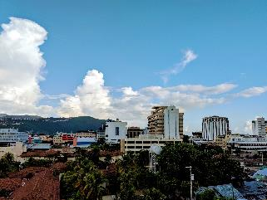
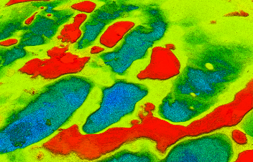
Carol Fisher | Program Manager
(office) +876-618-8870 (cell) +876-817-8567 (email) cf@tcarta.com
PanJam Building, 60 Knutsford Boulevard,
New Kingston, Jamaica
www.tcarta.com | info@tcarta.com

