Slide 1

Enhancing the accuracy of current profiles from
surface buoy - mounted systems
2019

Slide 2

Company Basics
2

Slide 3

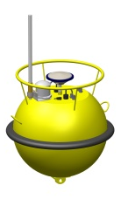
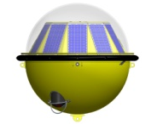
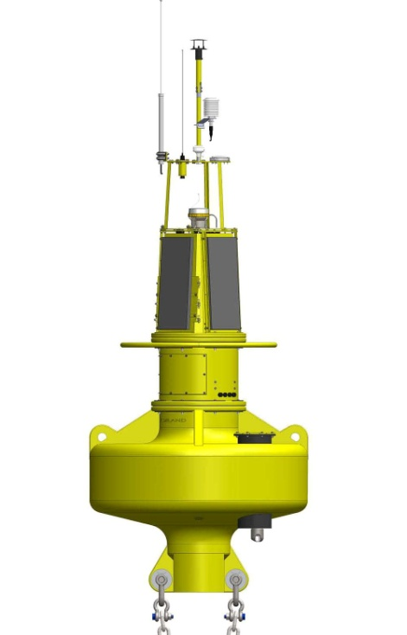
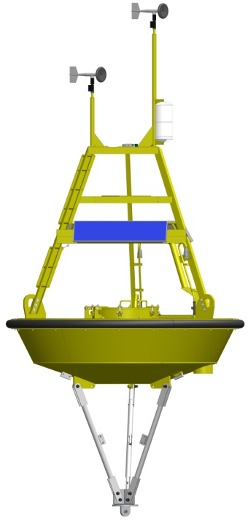
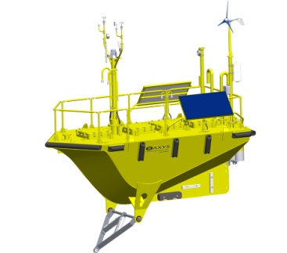
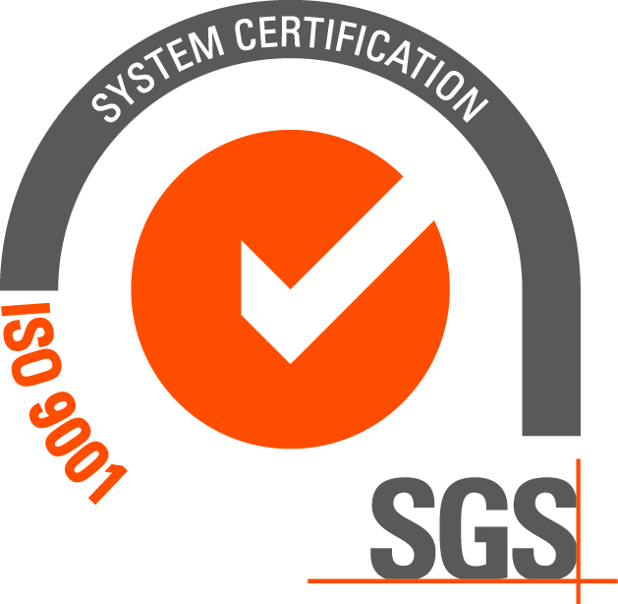


45 years in business (founded in 1974)
Focused on Buoy Ocean Data Acquisition Systems
Directional Wave Buoys
Custom Buoys & Systems
Over 800 Sensor/Acquisition systems in more than 50 countries
Renewable Energy
Oil & Gas
Science & Research
ISO 9001:2015 Certified
2 Offices
Canada & Belgium
Sustainability & Environmental Policy
Floating LiDAR Buoys
National Weather Service Networks
Ports & Harbours
Dredging/Construction
Metocean Buoys
3

Slide 4
Background
Waves and Currents are the Basic Oceanographic Parameters
Applications:
Safe and secure waterway navigation,
Weather forecasting
Offshore renewable energy
Scientific research
Engineering Design
4

Slide 5
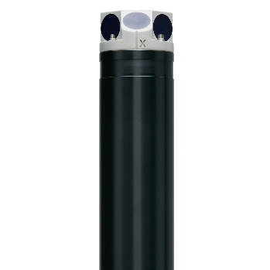
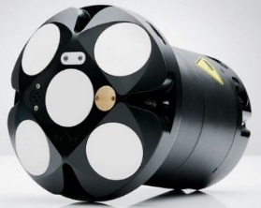
Background
Waves
TRIAXYS g3 Sensor
Directional Wave Sensor is a multipurpose sensor for monitoring complex dynamic motions. The compact unit measures 6 degrees of freedom: 3 accelerations and 3 rotational rates, along with magnetic orientation. All components used in the system are precision solid state sensors with no moving parts.
Resolution/Accuracy
Range Resolution Accuracy
Heave ±20m 0.01m Better than 1%
Period 1.5 to 33 sec 0.1 sec Better than 1%
Direction 0 to 360° 1° ±3°
Currents
Single Point Current Meter
Acoustic Doppler Current Profiler (ADCP)
5

Slide 6
Background
ADCPs have been placed on dynamically-moving surface platforms, such as surface buoys, for over two decades. AXYS has experience integrating ADCPs on its buoy fleet throughout this period of time.
Advantages of buoy mounted ADCPs include:
a) Real time data
  b) Ease of maintenance
  c) Colocation with other measurements
In 2014 a collaborative partnership was formed to explore the assessment conformed by:
    a)William Douglas Wilson Caribbean Wind
    b) Dan Shumuk AXYS Technologies
    c) David Velasco Nortek Group
    d)Laura Florentino NOAA NOS CO-OPS
    c)Robert Heitesenrether NOAA NOS CO-OPS
Four field experiments were conducted ( Winters of 2014-15, 2015-16, 2017-18, 2018-2019) in southeastern Chesapeake Bay.
6

Slide 7
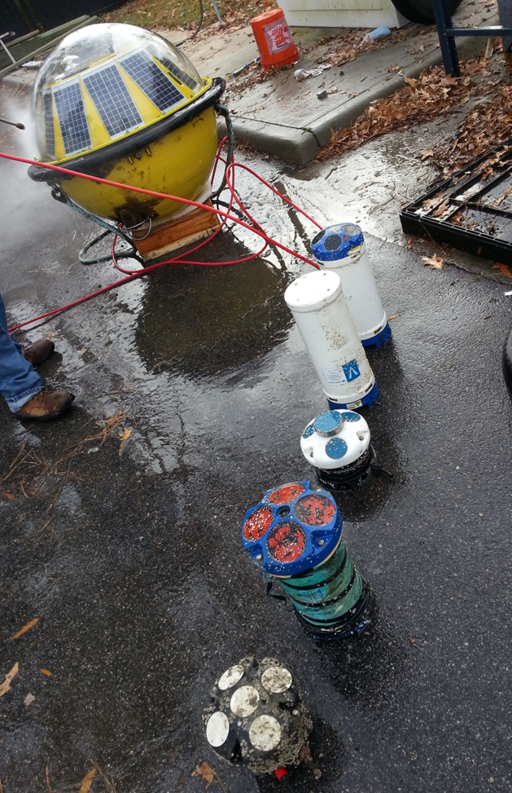
AXYS, Caribbean Wind, Nortek,
NOAA CO-OPS Studies 2014, 2016
First two studies identified two primary technological limitations:
Acceleration based tilt sensors used on previous generation ADCPs are subject to errors caused by platform motion
Platform tilts can result in bin mapping error that increases with the dynamic motion of the platform and vertical shear.

Slide 8
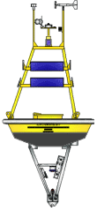
AXYS, Caribbean Wind, Nortek,
NOAA Studies 2014, 2016
15°
Velocity
1
2
“Biasing Effect”
3
4
5
15°
6
“Smearing Effect”
7
8
Beam 2’
9
Beam 2
Beam 1
Beam 1’

Slide 9
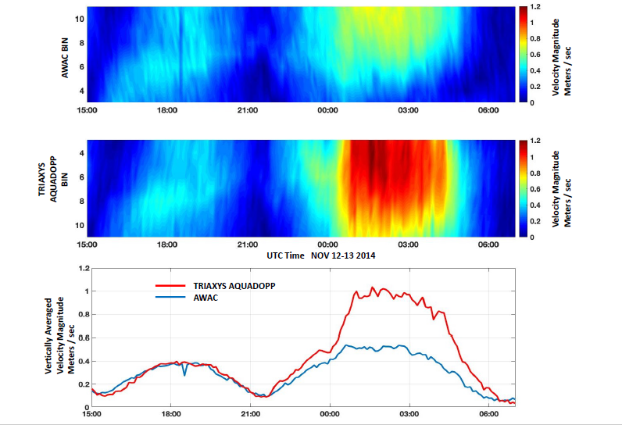
Williams et al Oceans Seatle USA 2019

Slide 10
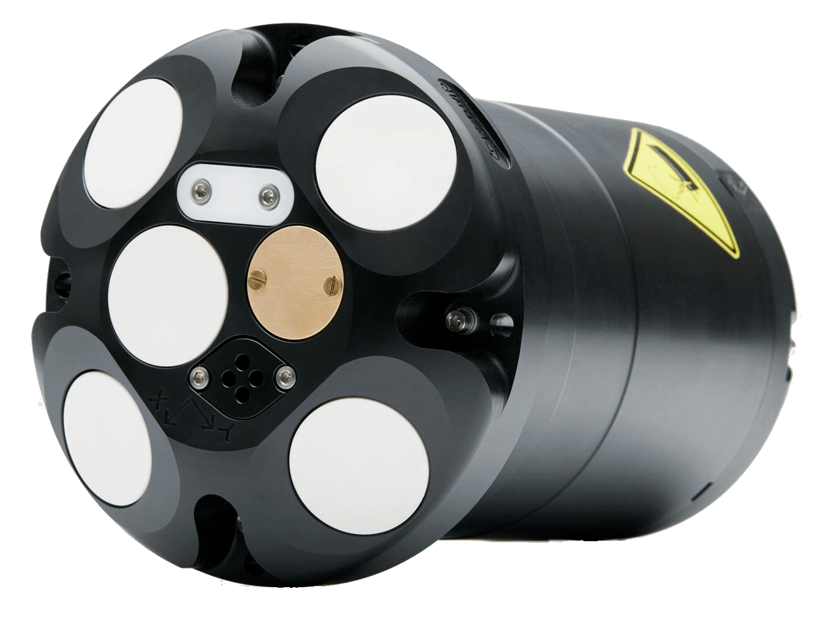
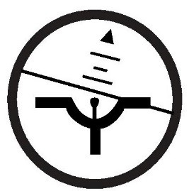
Improvement in Technology
Implements a gyro compensated Attitude and Heading Reference Sensor (AHRS)
Algorithm updates for real-time bin mapping on ping-by-ping basis
15°
1
2
3
4
5
+
6
7
8
Beam 2’
9
Beam 2
Beam 1
Nortek Signature Series ADCP
AHRS
Beam 1’

Slide 11
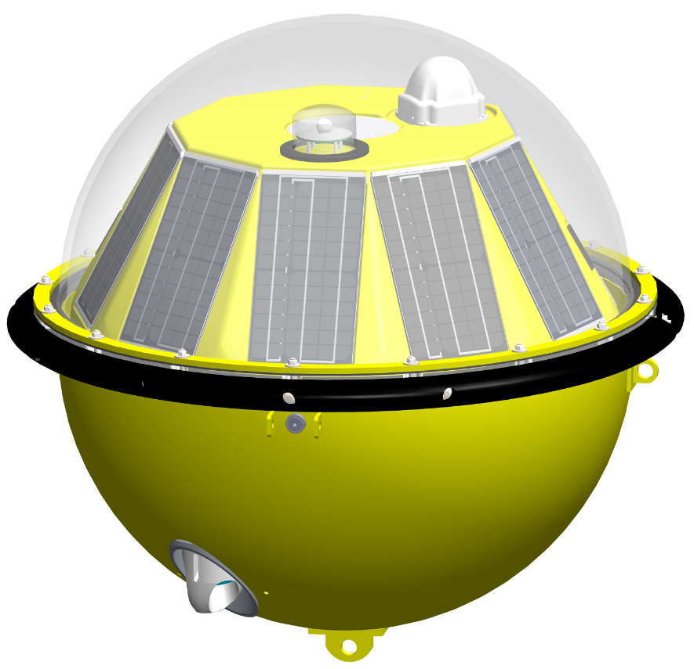
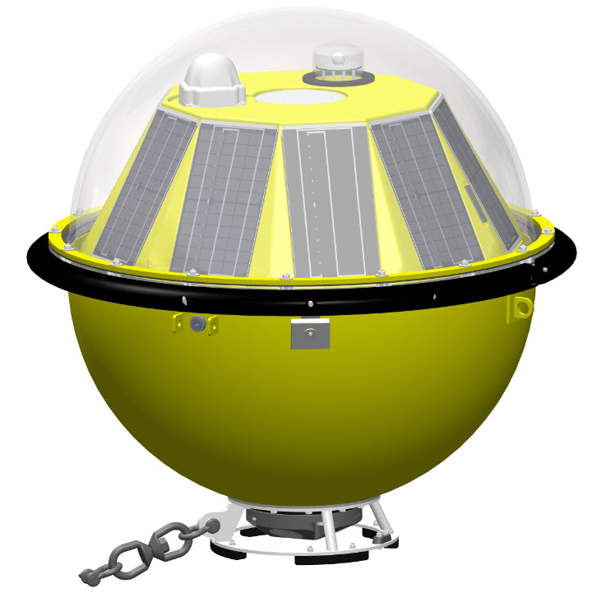
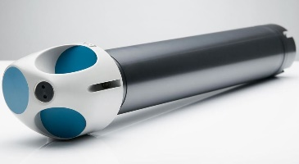
Mechanical Integration
Original TRIAXYS design
New TRIAXYS prototype

Slide 12
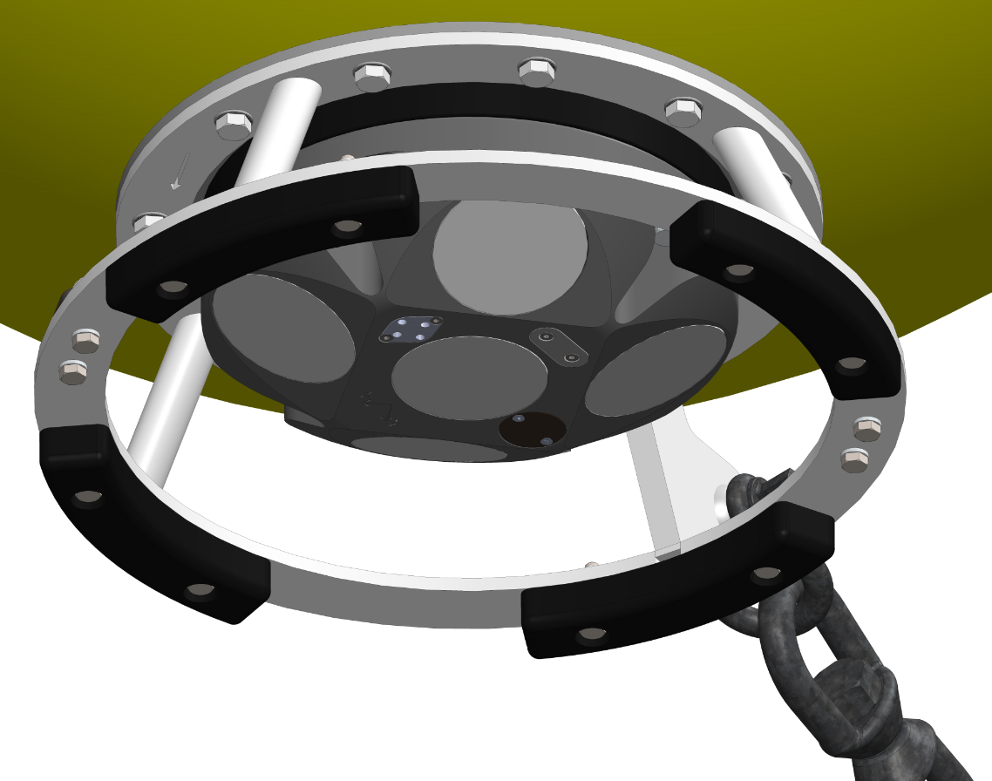
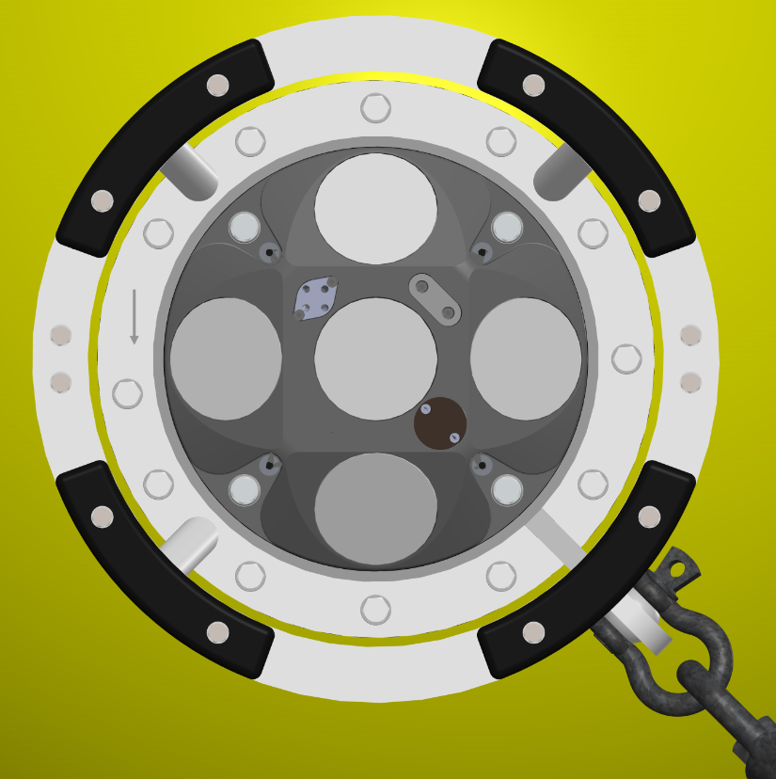
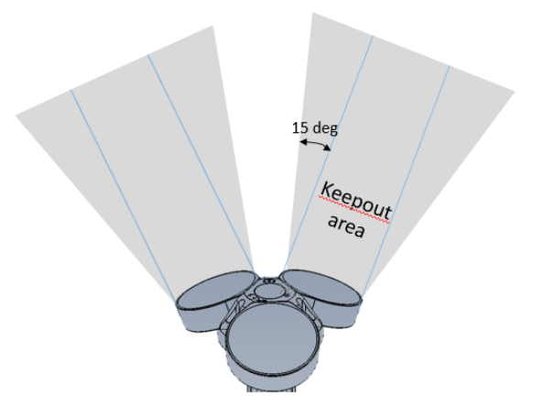
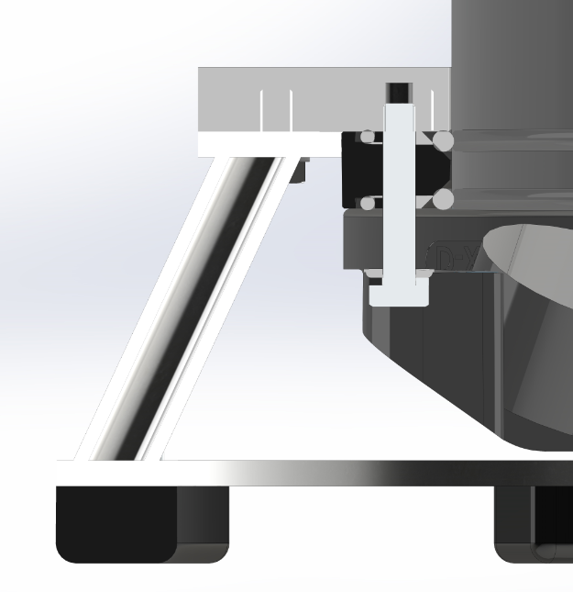
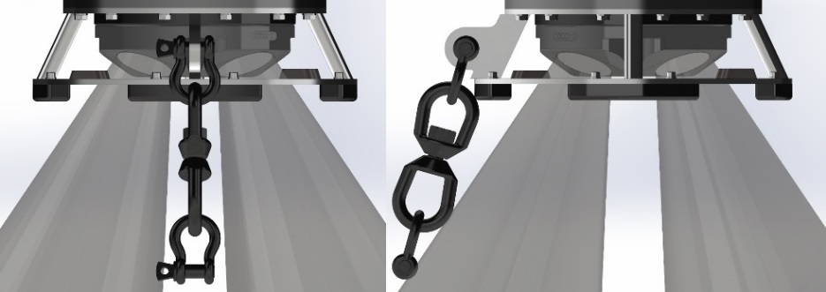
Mechanical Integration
Mechanical Design Considerations
Buoy Symmetry
  Maintains symmetry for buoy roll and pitch response.
Hydrostatic/Hydrodynamic Properties
  <10mm change in buoy draft
  70% ADCP volume within buoy
Beam Clearance & Unit Protection
  Satisfies 15° keep out zone requirement
  30mm floor head clearance
Offset Mooring Eye
  5th Beam clearance
  Possible improved response with currents
Notes:
Buoy Symmetry: In obtaining accurate wave measurements, a key hydrostatic consideration is maintaining buoy symmetry. This ensures consistency when processing wave data as the hull geometry has equal rolling/pitching frequencies, uninfluenced by the wave incident angle. For this reason, a bottom mounting was chosen to ensure that the TRIAXYS buoy maintained its symmetrical and low drag profile properties and the unit was protected and free from obstructions.
Hydrostatic Properties:
Low profile for reduced drag and better instrument protection. (70% ADCP Volume)
Placing the moonpool at the bottom of the buoy also makes use of void space located under the batteries. With this, the unit can be inserted after the buoy is setup with 70% of the ADCP’s volume being internal to the buoy, reducing the external exposed area and drag.
Low weight design = Minimal change (<10mm). 5kg in water weight added with SS frame and ADCP.
Beam Clearance: The Signature Series has a total of 5 transducers; 4 side beams offset at 25° angles and one vertical 5th beam. The expected acoustic zone consists of an additional 15° arc from the transducer face, labelled as the “keep out area” shown in Figure 4, below[DS1] [BM2] .
Offset Mooring Eye:
As a part of an in-house study on the effect of ocean currents on buoy tilt angles, the buoy was found to tilt 6° from horizontal in speeds of 1 m/s [7]. This [BM1] angle, although irrelevant to wave data, can add to the variation in wave currents in high shear environments. By offsetting the mooring eye, as shown in Figure 3, the ability for the buoy to pivot about the mooring attachment point is reduced resulting in the buoy maintaining its level in high currents. In changing this however, the mooring weight needs to be considered as it can cause unnecessary listing if too far from the buoy center. For this reason, the design required an iterative process of checking the mooring vs current loading to find the optimum position for the mooring attachment.
[BM1]Reference to Randys internal paper “

Slide 13
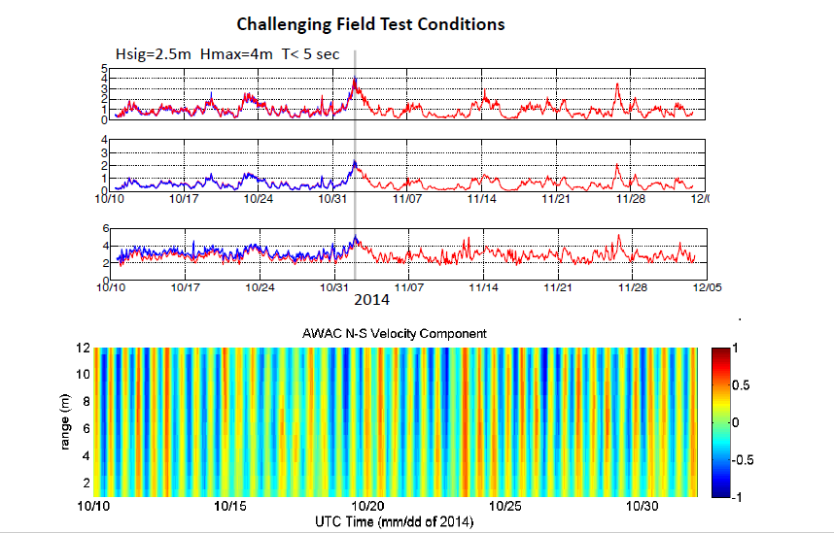
Test Área Selected

Slide 14
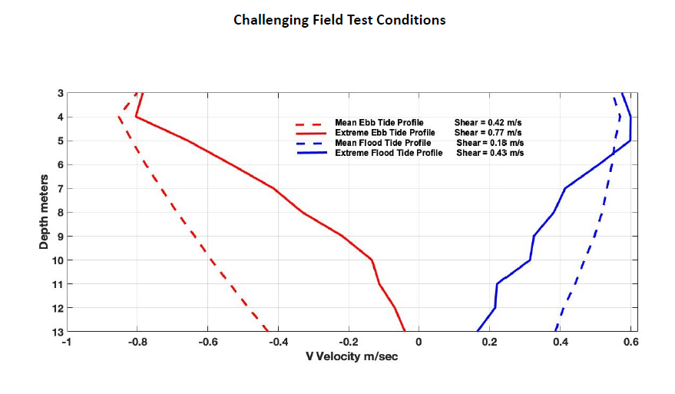
Williams et al Oceans 2019 Seatle USA

Slide 15
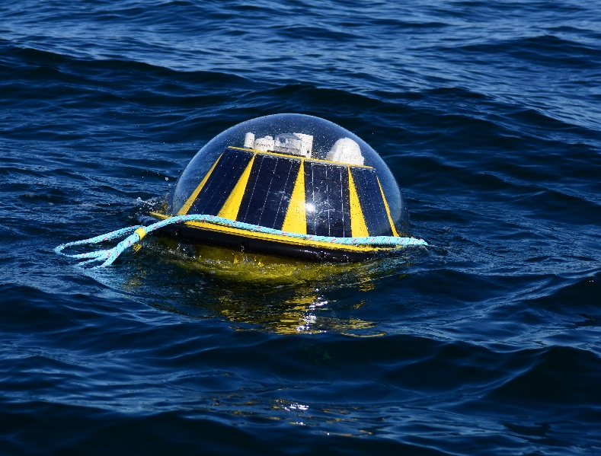
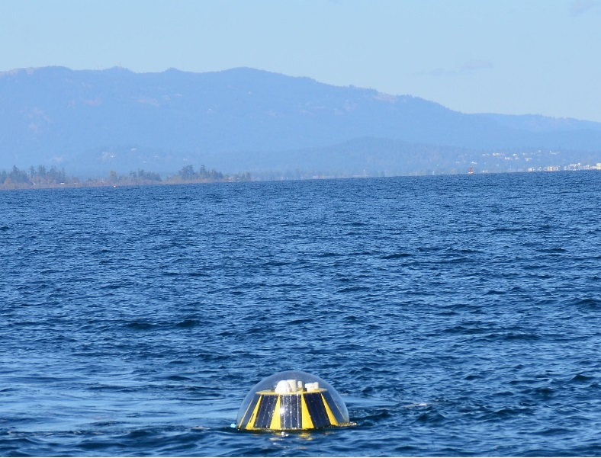
Field Validation
TRIAXYS buoy hull is selected as the first system to undergo field validation due to increased complexity of integration and dynamic response
The objective of field validations are:
To validate the performance of the ADCP when installed on these platforms to replicate the results of the previous buoy mounted studies.
To ensure there is no loss of performance to other aspects of the buoy.

Slide 16
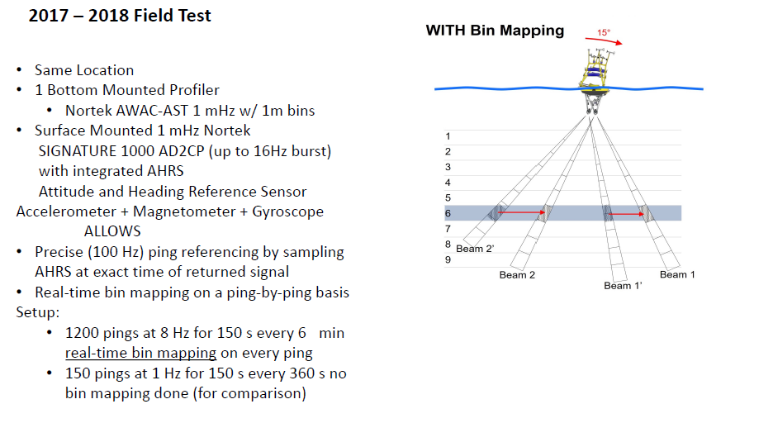

Slide 17
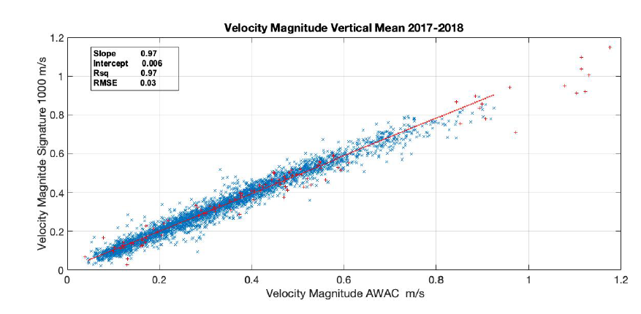
Williams et al Oceans 2019 Seatle USA

Slide 18
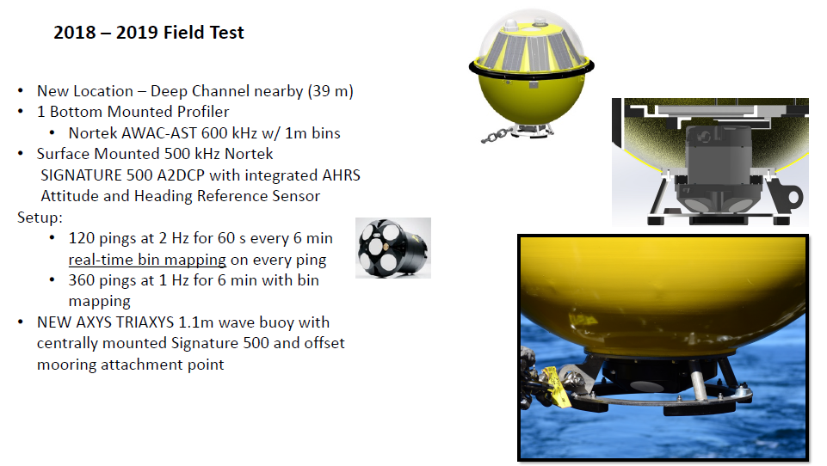

Slide 19
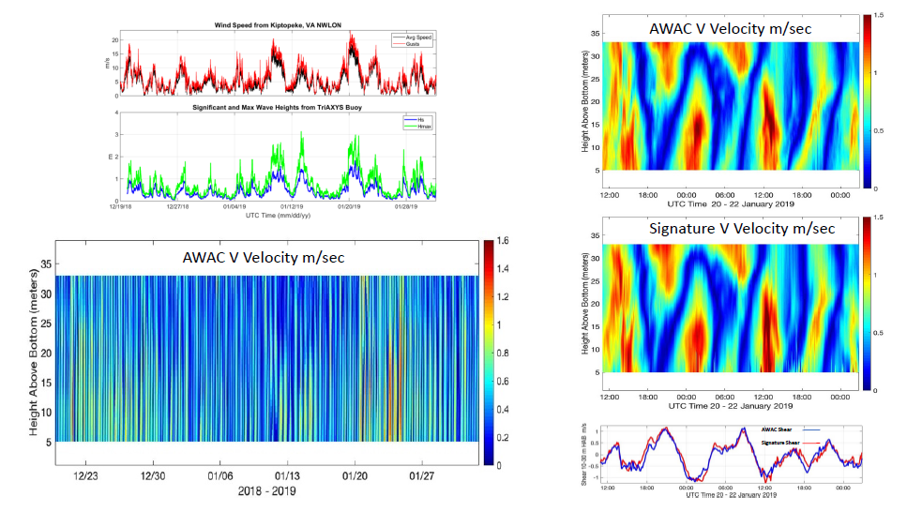
Williams et al Oceans 2019 Seatle USA

Slide 20
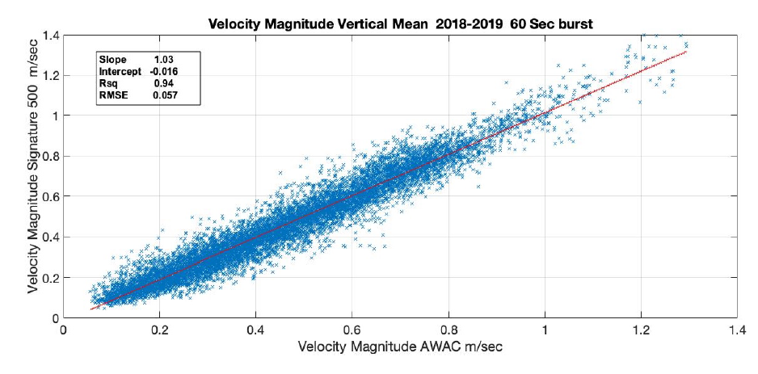
Williams et al Oceans 2019 Seatle USA

Slide 21
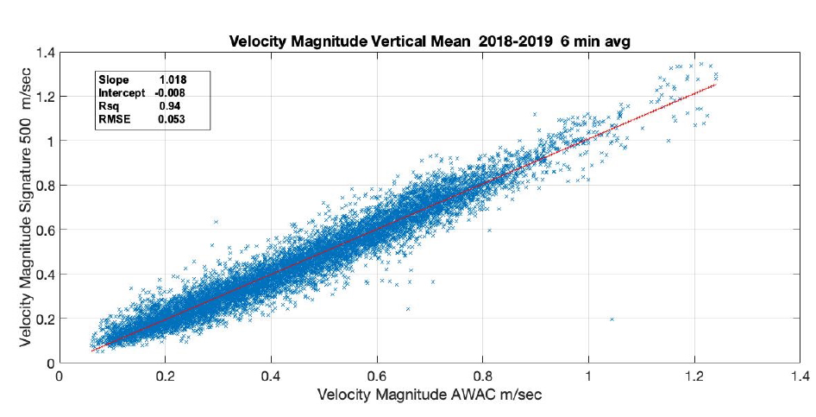
Williams et al Oceans 2019 Seatle USA

Slide 22
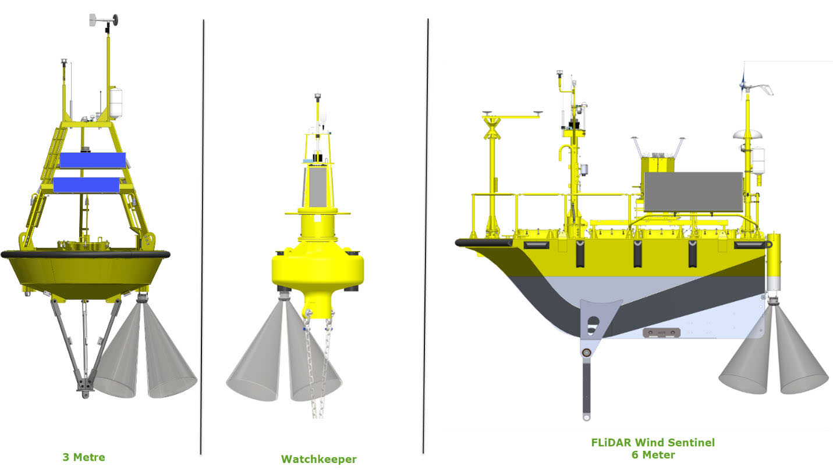
Integration design

Slide 23
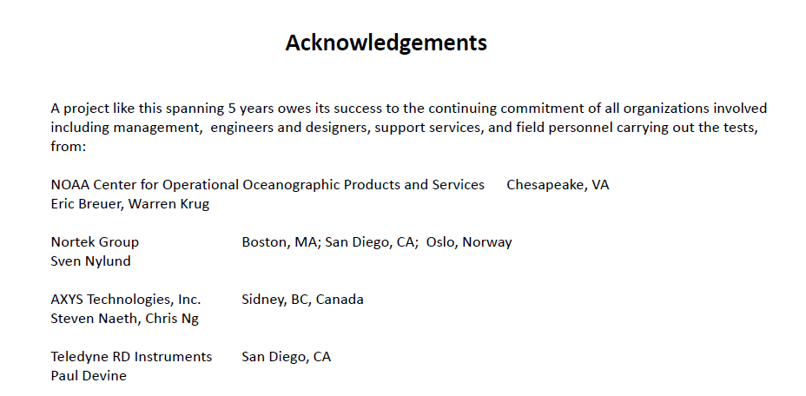

Slide 24
Visit www.axys.com or contact us at info@axys.com for more information
Julio Leal
Jleal@axys.com
+58 412 6504320

