Slide 1
UK Response to Hurricane Dorian impacts in The Bahamas

Slide 2
UK Government Response
RFA Mounts Bay first vessel to provide aid and assistance
This included 300 ration packs, 100 tonnes of water, 900 emergency shelters and 1000 hygiene kits
UK committed £1.5M to the immediate response
HMS Protector followed up with 23 tonnes of aid
3 Humanitarian experts from DfID onsite to assist in coordinating relief efforts

Slide 3
Support Provided
Provided imagery and mapping support to RFA Mounts Bay and HMS Protector following RFI.
Provided 3 digital charts to MapAction (See next slide)
Provided information on tide gauges to Turks and Caicos Islands in preparation (not needed in the event)
Provided PoC information to NOAA and the RHC coordinator.
Expecting Netherlands and NOAA data for chart updating in due course.

Slide 4
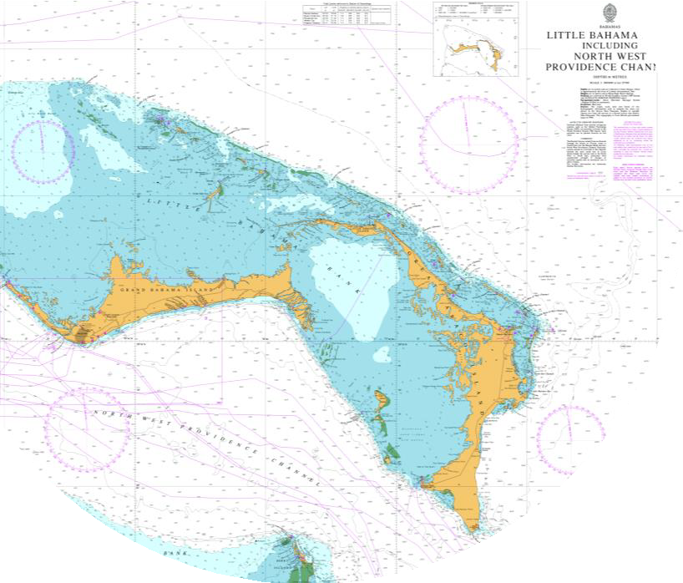
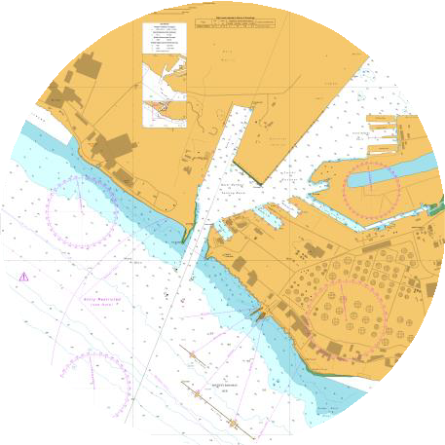
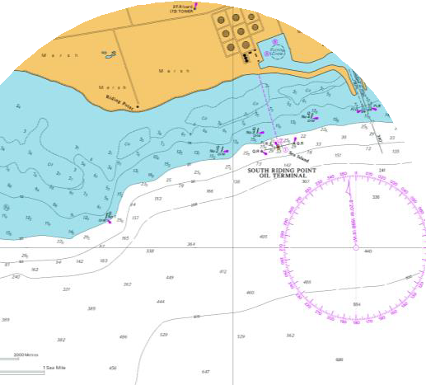
Charts provided to MapAction
BA0390
BA0398
BA3910

Slide 5
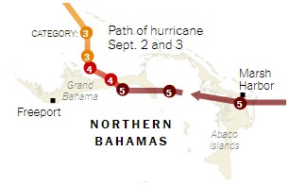
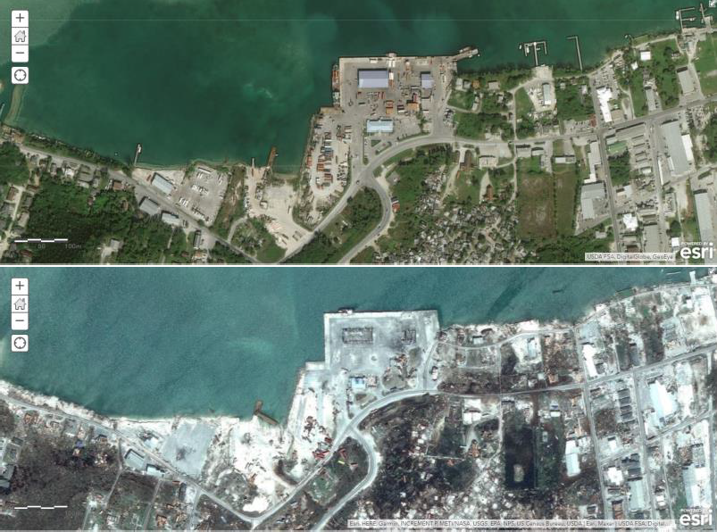
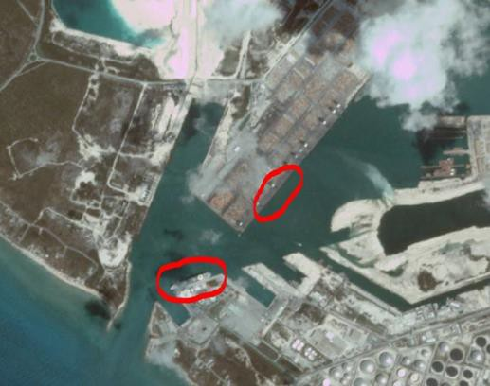
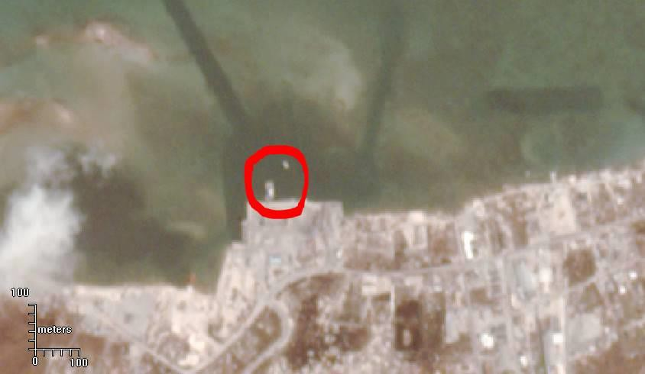
Natural Disasters - Emergency Response
BEFORE
AFTER
Map: New York Times
ESRI / Maxar
PlanetScope image courtesy Planet, CC-NC-BY license
PlanetScope image courtesy Planet, CC-NC-BY license

Slide 6
Summary
UKHO has a Humanitarian Aid and Disaster Relief (HADR)
team that is called together in the event of an emergency
like Dorian. In this particular instance, we were fortunate
that there were UK platforms in the region which enabled us
to provide a reasonable level of support, as this is not always the case.
We continue to review our internal procedures for dealing
with Requests for Information (RFI) to ensure a timely response.
We provided details to the MACHC Chair to enable greater awareness and coordination between member states.
It is worth noting that whilst we contacted our colleagues in
the Bahamas, we never received a direct request from them for support.

