Slide 1
ICG/CARIBE-EWS 2017-2019
Dr.rer.nat. Silvia Chacón-Barrantes
Chair ICG/CARIBE-EWS

Slide 2
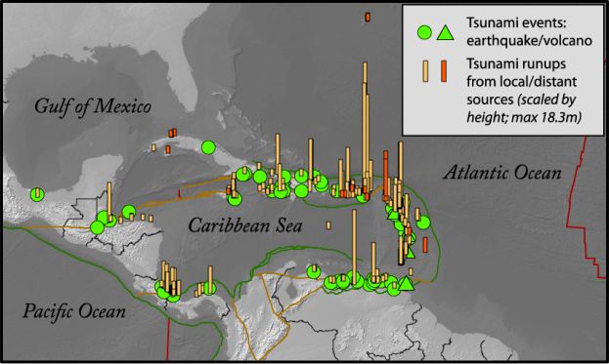
Tsunamis in the Caribbean and Adjacent Regions
Over the past 500 years more than 110 tsunamis have over 4,000 people

Slide 3
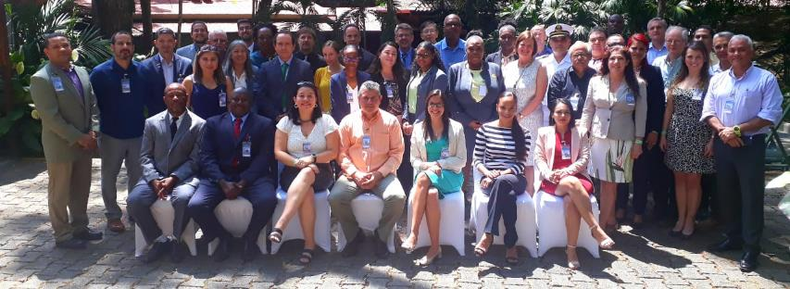
ICG/CARIBE-EWS-XIV
Costa Rica, 8-11 April, 2019
17/47 Member States and Territories
4 observers
Next Meetings
2020: TBD
2021: Cuba

Slide 4
ICG/Caribe-EWS WG and TT
WG 1- Tsunami Monitoring and Detection Systems – Dan McNamara (US)
WG2 - Tsunami Hazard Assessment – Nic Arcos (US)
WG 3 - Tsunami Related Services – Emilio Talavera (Nicaragua)
WG 4 - Preparedness, Readiness and Resilience – Christa von Hillebrandt-Andrade (CTWP, Puerto Rico - US)
TT CARIBE WAVE 20 – Elizabeth Vanacore (PRSN-US)
TT Volcanic Activity and potential Tsunamis – Valerie Clouard (France)
TT Tsunami Ready – Claricia Stevens (Saint Kitts and Nevis) and Jasen Penn (BVI-UK)
TT Evacuation Maps – Norwin Acosta (Nicaragua)
TT ImP – Mary Rengifo (Colombia)
Group of Experts for Other Coastal Hazards - TBD

Slide 5
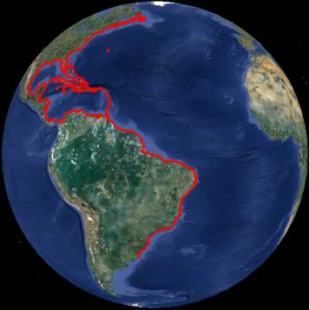
Current Participation in the CARIBE-EWS
1. Bahamas
2. Barbados
3. Belize
4. Brazil
5. Colombia
6. Costa Rica
7. Cuba
8. Dominica
9. Dominican Republic
10. France (Guadeloupe, Guyane, Martinique, Saint Martin, St. Barthelemy)
11. Grenada
12. Guatemala
13. Guyana
14. Haiti
15. Honduras
16. Jamaica
17. Mexico
18. Netherlands (Aruba***, Bonaire, Curacao***, Saba, Sint Maarten***, Sint Eustaius).
19. Nicaragua
20. Panama
21. Saint Kitts and Nevis
22. Saint Lucia
23. Saint Vincent and the Grenadines
24. Suriname
25. Trinidad and Tobago
26. United Kingdom of Great Britain & Northern Ireland (Anguilla***, Bermuda, British Virgin Islands***, Cayman Islands***, Montserrat***, Turks and Caicos)
27. United States (Puerto Rico and US Virgin Islands)
28. Venezuela (Bolivarian Republic of)
Observers
1. Antigua and Barbuda
2. Canada
3. Peru
Notes:
32 member states and 16 territories (6 associate member states of Unesco), including 16 Small Islands Developping States
All countries and territories but one have designated their TWFP and TNC
Half of the countries and territories have nominated a NTWC

Slide 6
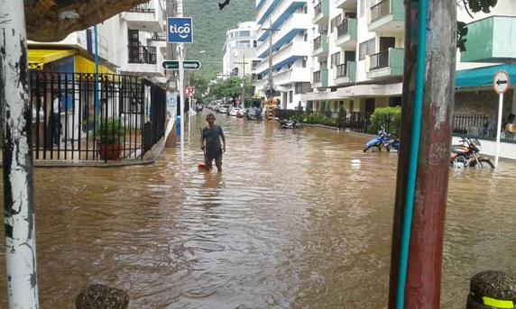
Colombia tsunami – 19 July 2017
Near Santa Marta
Landslide
No warning

Slide 7
Honduras EQ & Tsunami – 10 Jan. 2018 (UTC)
PTWC issued products in timely manner and according to users guide.
First tsunami measured in Belize and Cayman, thanks to new sea level stations, more are required for even quicker assessments.

Slide 8
Implementation plan
Adopted for 2018-2023
Will be used to track ICG goals
Will be reshaped in terms of Key Performance Indicators (KPI) and Sendai Framework
Dynamic document

Slide 9
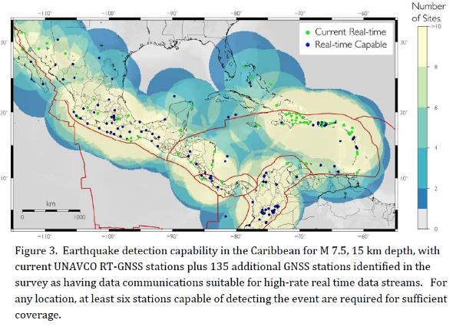
GNSS Data for Tsunami Warning

Slide 10
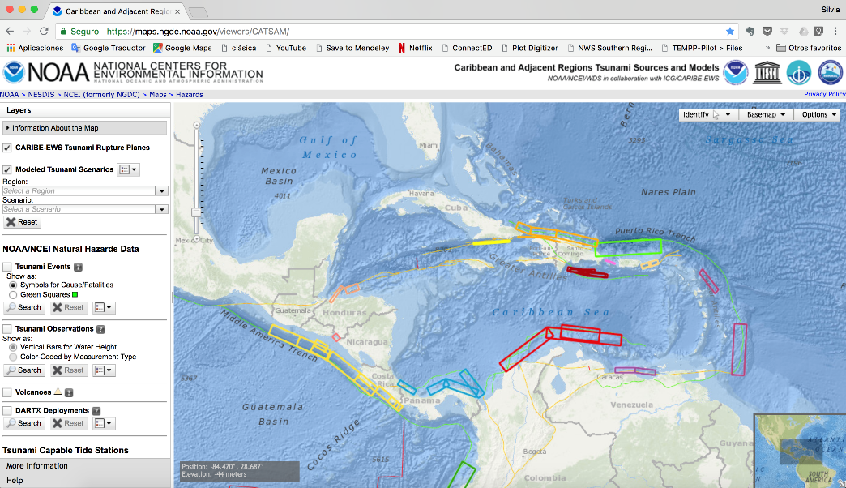
CATSAM: Caribbean and Adjacent regions Tsunami Sources And Models
https://maps.ngdc.noaa.gov/viewers/CATSAM/

Slide 11
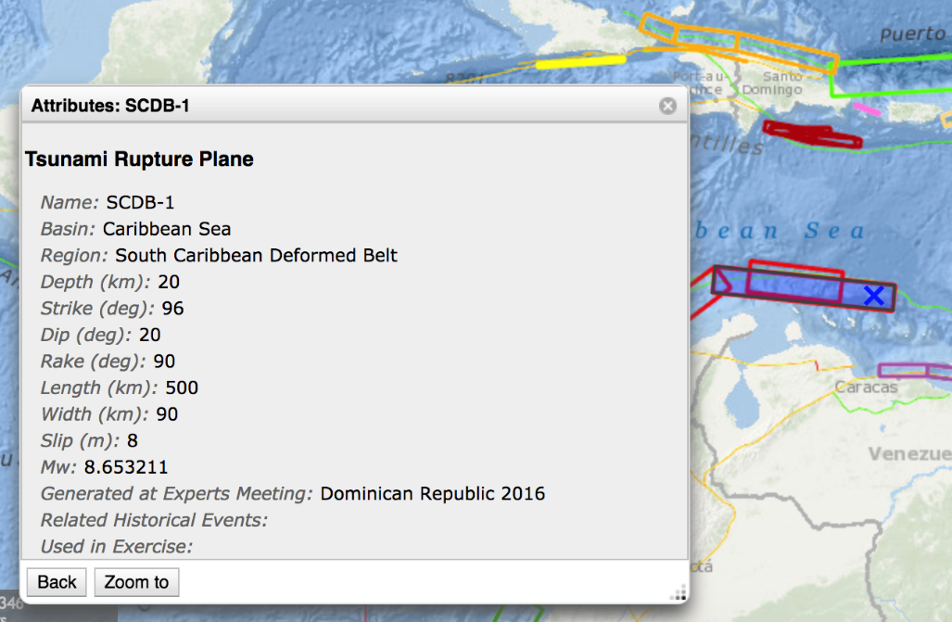
Name
Basin
Region
Depth
Strike
Dip
Rake
Length (km)
Width (km)
Slip (m)
Mw
Generated at Experts Meeting
Related Historical Events
Used in Exercise

Slide 12
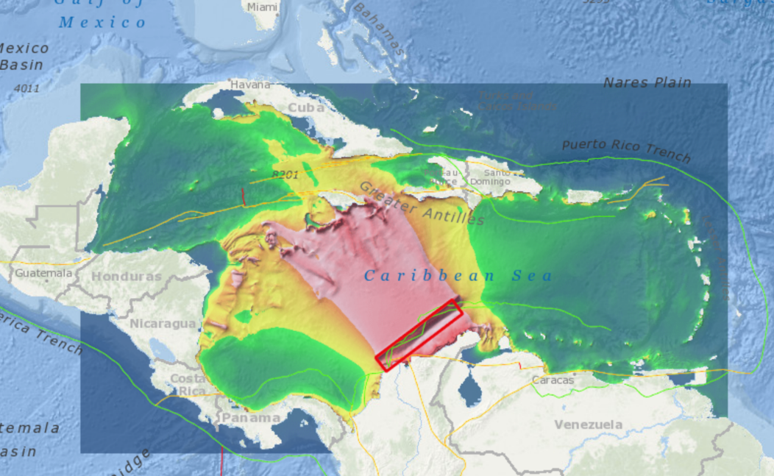
Energy plots

Slide 13
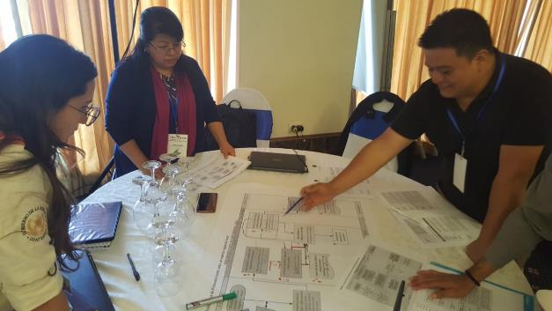
Tsunami Ready
+200 communities targeted by MS to be TR
TT working on pre- and post-evaluation instruments to measure the social impact of the pilot CARIBE EWS Tsunami Ready
PROPOSAL!!

Slide 14
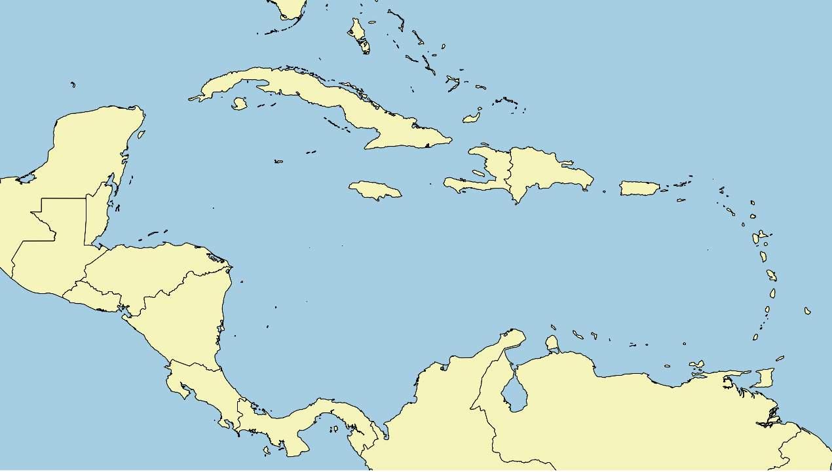
3 US or UNESCO/NOAA TsunamiReady
Haiti
Dominican Republic
PR
BVI
Anguilla
Antigua & Barbuda
Jamaica
USVI
Belize
St. Kitts & Newis
Guatemala
9 CARIBE-EWS Tsunami Ready
7 in progress (DIPECHO & USAID)
Honduras
St. Vincent
& the Grenadines
El Salvador
Nicaragua
Barbados
Grenada
Costa Rica
Trinidad & Tobago
5 PTWS Tsunami Ready
9 in progress
Panamá

Slide 15
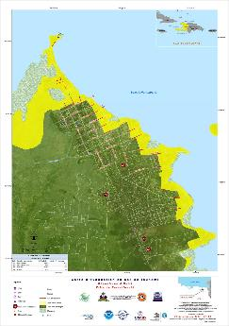
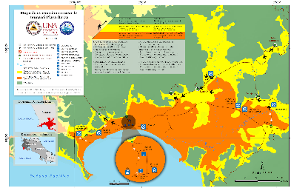
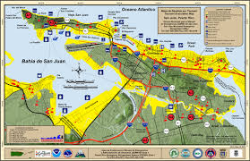
Tsunami evacuation maps
Declared a priority for the region in 2017
TT identifying funding for a training workshop for Tsunami Inundation Maps and Tsunami Evacuation Maps and/or TEMPP for the Caribbean Region
Strong need for coastal HR bathymetry

Slide 16
Non-tectonic Tsunami Sources
TT on Volcanic Sources for Tsunamis since 2016
Scenarios to be included in CATSAM
For the first time CaribeWave19 included a volcanic scenario

Slide 17
Tsunami related services
Integration of social media experts as part of the national alerting systems
Diversification of communication systems to guarantee the redundancy of communications methods available between the TSP, the TWFP and the NTWC, and for national and local dissemination
Comms were completely down during and after Maria and Irma

Slide 18
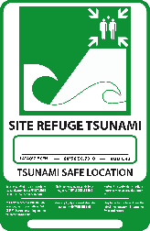
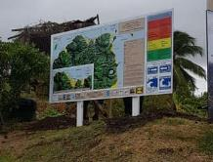
Public awareness, education & resilience
Technical guidelines on “How to prepare, conduct, and evaluate a community-based tsunami response exercise” now finished and available
WG4 developing an inventory of tsunami evacuations signs and symbols used in the region as well as internationally (including the ISO 20712) with to make a recommendation to the ICG on tsunami signage within the Caribbean

Slide 19
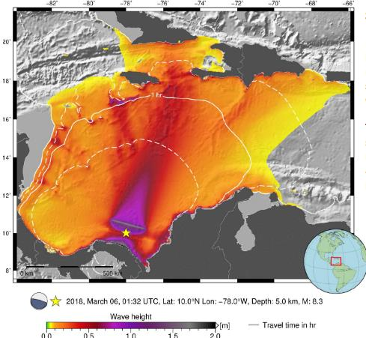
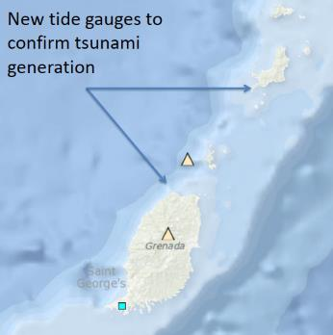
CARIBE WAVE 19
14 March 2019 14 UTC
2 scenarios
North Panamá Deformed Belt
Kick’em Jenny eruption
500,869 people participated
Kick’em Jenny
NPDB

Slide 20
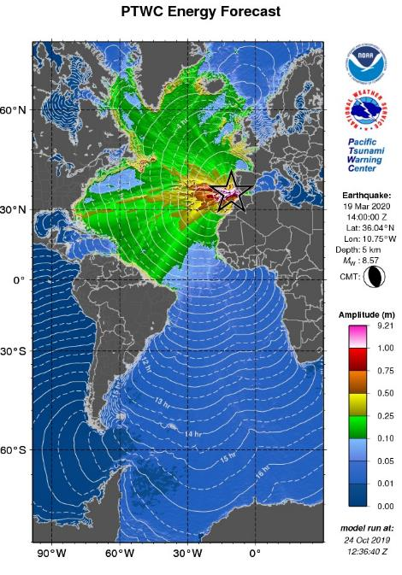
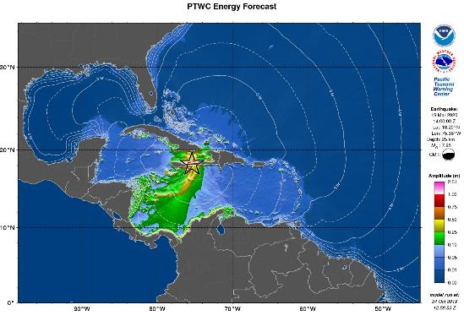
CARIBE WAVE 20
19 March 2020 14 UTC
2 scenarios: Jamaica & Portugal

Slide 21
Thank you!
Silvia Chacón-Barrantes
silviach@una.ac.cr
+506-8309-6690

