Slide 1
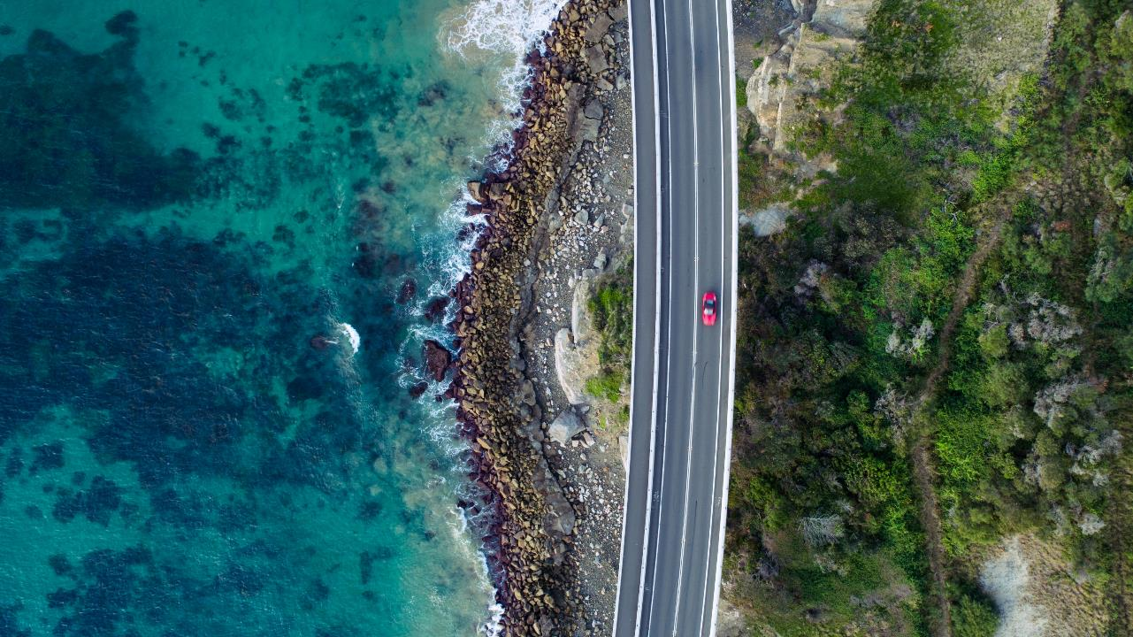
MACHC 20
4-6 Dec 2019 Santo Domingo, Dominican Republic
Doc: MACHC20-07.5
Modern Hydrographic Surveys as a Disaster Mitigation Tool

Slide 2
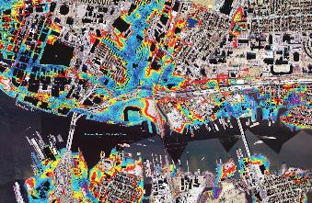
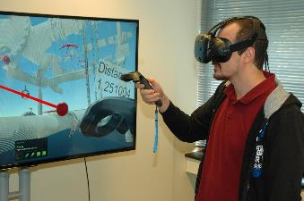
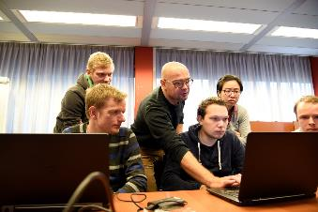
Discussion
What’s different about modern hydrographic surveys?
What can we do with the data to mitigate natural disasters affecting coastal regions?
Who needs the data?
How might we plan surveys to help in the mitigation process?

Slide 3
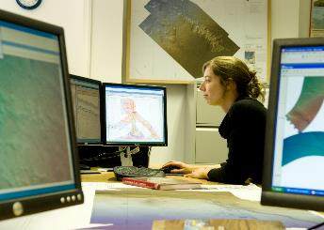
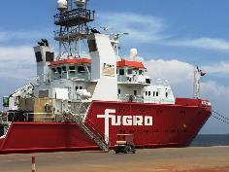
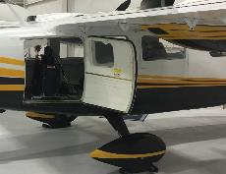
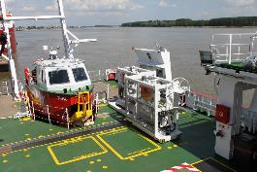
What’s different about modern hydrographic surveys?
Hydrographic data is a form of geodata
We can now acquire our geodata with a combination of complementary technologies
We can now acquire our geodata from a combination of different platforms
We can create seamless data across the land-water boundary
We can generate products and information in a variety of formats and on datums to suit the customer
Stakeholders (customers) can access the data held and maintained by the hydrographic agency

Slide 4
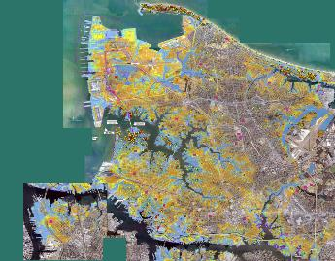
What can we do with the data to mitigate natural disasters affecting coastal regions?
We can establish a more consistently-acquired and accurate geo-dataset….the baseline
We can map the geophysical and geological constituents of the coast
We can map the biological constituents of the coast such as aquaflora and fauna, coastal vegetation and native animal species requiring protection
We can merge these data to create different products for different stakeholders
We can fuel modern, digital coastal process models such as flood inundation
Using and comparing to the baseline, we can detect, quantify and monitor CHANGE
Using the CHANGE data, we can provide robust arguments for remedial work, support and funding

Slide 5
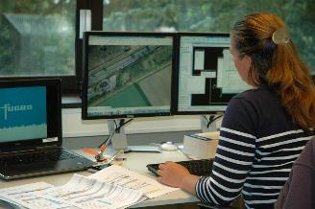
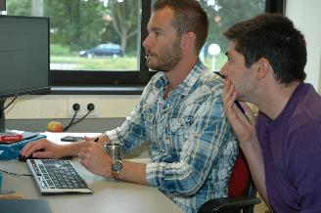
Who needs the data?
Only those who can maintain and manage it, but…
Who needs the information??
Lots of stakeholders here:
  Hydrographic offices
  Emergency preparedness agencies
  Environmental agencies
  Strategic planning teams
  Coastal engineering agencies and companies
  Aid agencies
  International financial institutions
  Etc……..

Slide 6

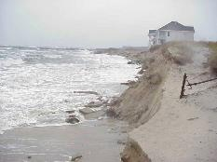
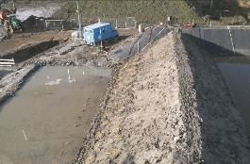
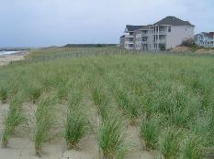
How might we plan surveys to help in the mitigation process?
If we baseline an area or region, we can immediately monitor CHANGE
CHANGE drives future survey prioritization and inclusion of projects in the national survey program
The ability to capture the entire CHANGE picture along an affected area of coast, both above and below the water, generates the survey planning necessary
Smart planning leads to smart decision making based on modern, dependable data
Remedial work is better directed and quicker to approve

Slide 7
We work to improve lives in Latin America and the Caribbean. Through financial and technical support for countries working to reduce poverty and inequality, we help improve health and education, and advance infrastructure. (IDB Website)
(Client quote)

Slide 8
Together we create a safe and liveable world. (Fugro Mission Statement 2019)
(Client quote)

Slide 9
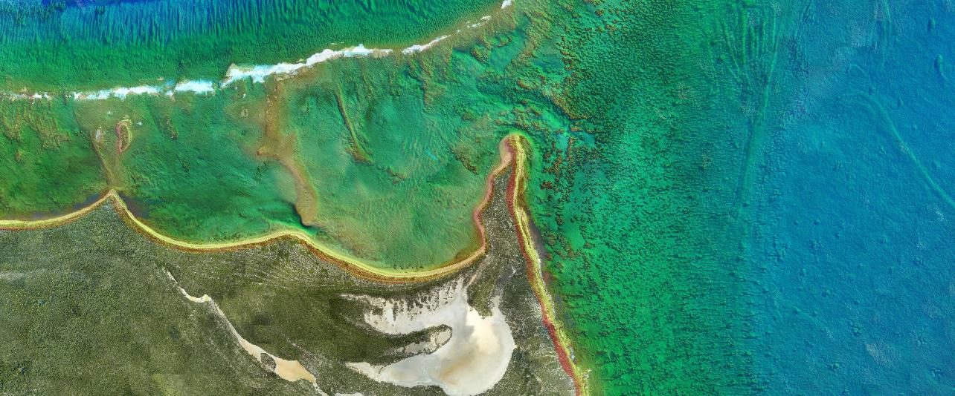
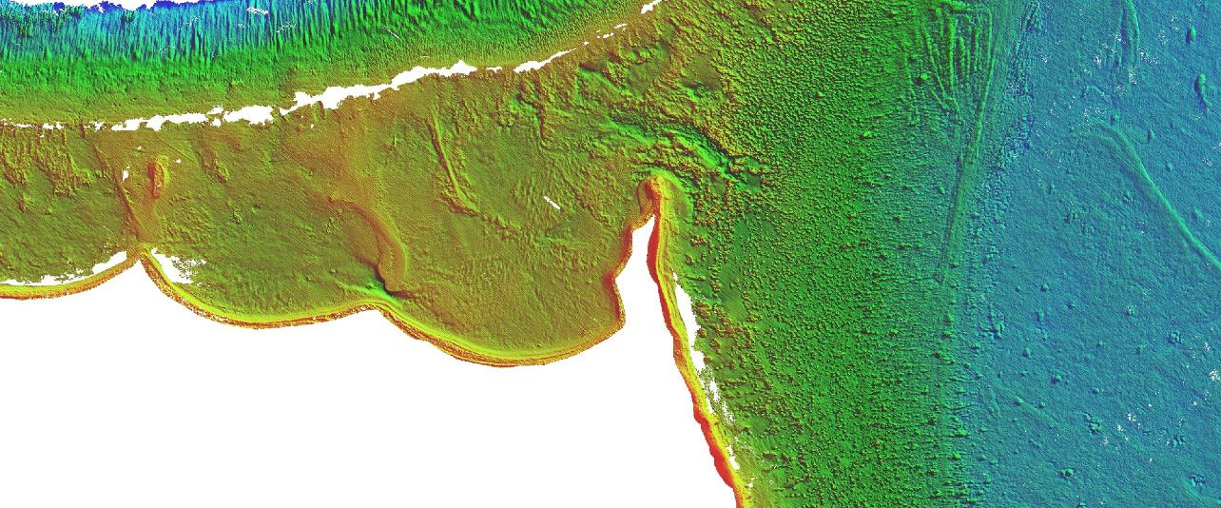
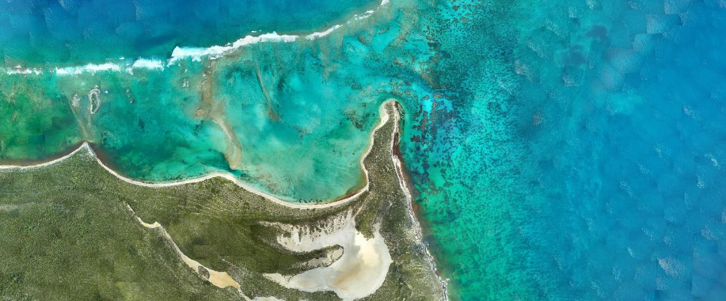

Summary
Investment in hydrographic surveys can fuel better disaster mitigation strategies
Seamless geodata provides a much clearer picture on wholesale impact and negative CHANGE
Resulting information provides evidence for international aid agencies to help release timely funding and support

Slide 10
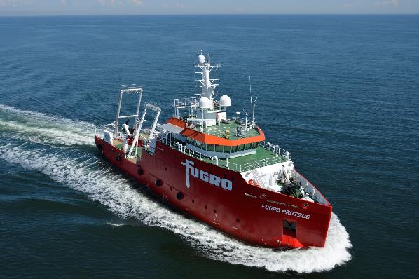
Don Ventura
+1 228 365 0906 (M)
dventura@fugro.com
https://www.fugro.com

