Slide 1
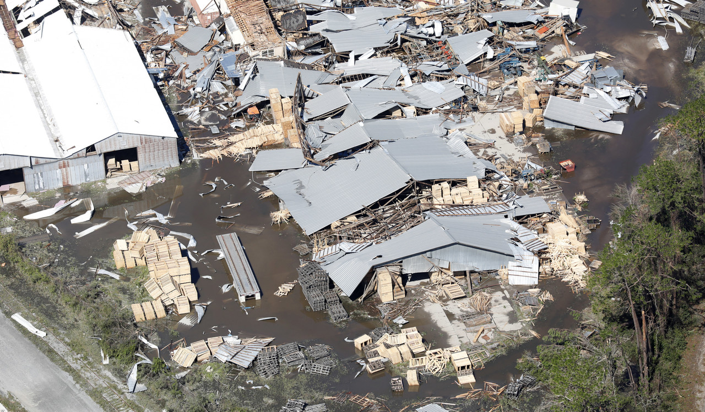
AI for Disaster Response
Detect Damaged Buildings, Detect Damaged Roads, & Allocate Resources

Slide 2
The Unique Challenges of Coordinating Response
Limited time and resources
Need human analysis of large areas of imagery
Multiple elements involved (detection, routing, monitoring)
We propose an A.I augmented pipeline that provides an end-to-end solution

Slide 3
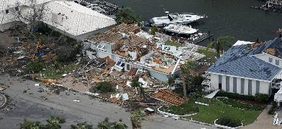
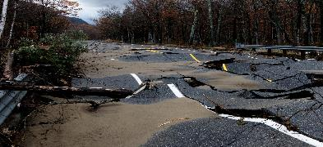
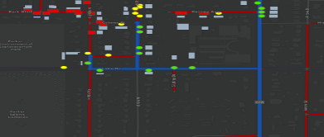
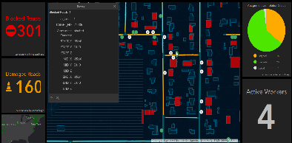
Detect damaged structures
An A.I model runs on aerial imagery and outputs a feature class of damaged and undamaged structures
Detect damaged roads
I am not a criminologist! We are working with a police department to help solve their resource allocation challenges.
This will never supersede human expertise, but rather inform decision makers.
This is not Skynet; but we think it is pretty cool
I am not a criminologist! We are working with a police department to help solve their resource allocation challenges.
This will never supersede human expertise, but rather inform decision makers.
I am not a criminologist! We are working with a police department to help solve their resource allocation challenges.
An A.I model runs on aerial imagery + road layer and outputs a feature class of damaged and undamaged roads
Optimal routing
ArcGIS Network Analyst consumes the damaged structures and blocked roads feature classes, and creates an optimal route from a base (fire station, shelter etc.) to all the damaged structures, accounting for blocked roadways
Operational dashboard
Utilizing the Esri Workforce mobile app, we can assign each responder a set of structures to inspect and use Operations Dashboard to monitor their progress and other key metrics

Slide 4
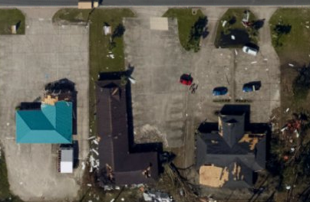
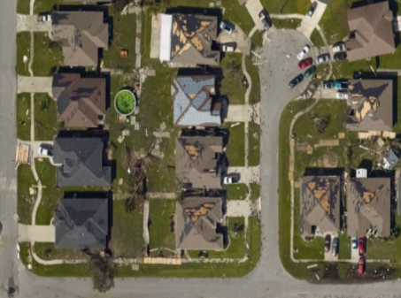
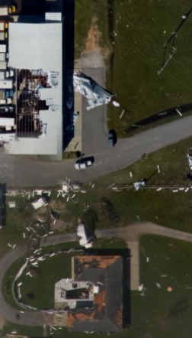
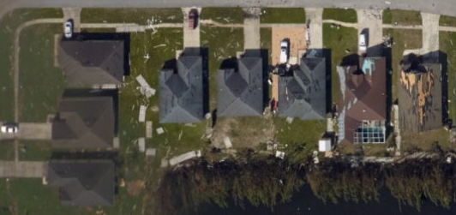

Slide 5
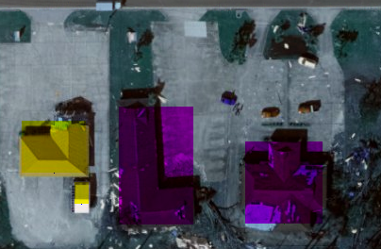
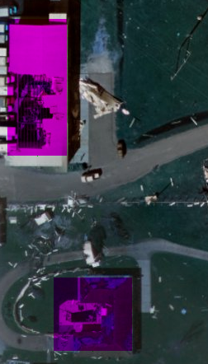
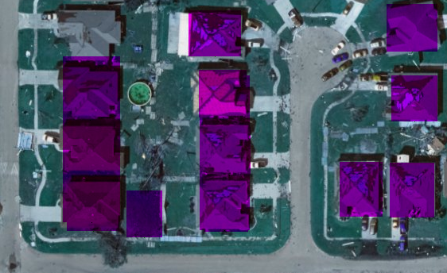
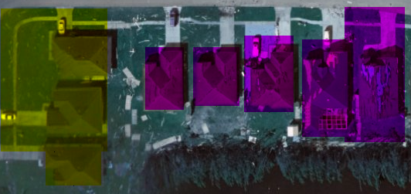

Slide 6
Damaged Structure Detection
We train two A.I models, one to identify building footprints and another to classify them as damaged/undamaged
Optionally, an existing building footprints layer can be passed in, and only the second model will run on the areas specified by the footprint
We also provide a training interface, so the model can be retrained against new data and also trained to classify other building features by pointing it to a folder of relevant positive/negative example images

Slide 7
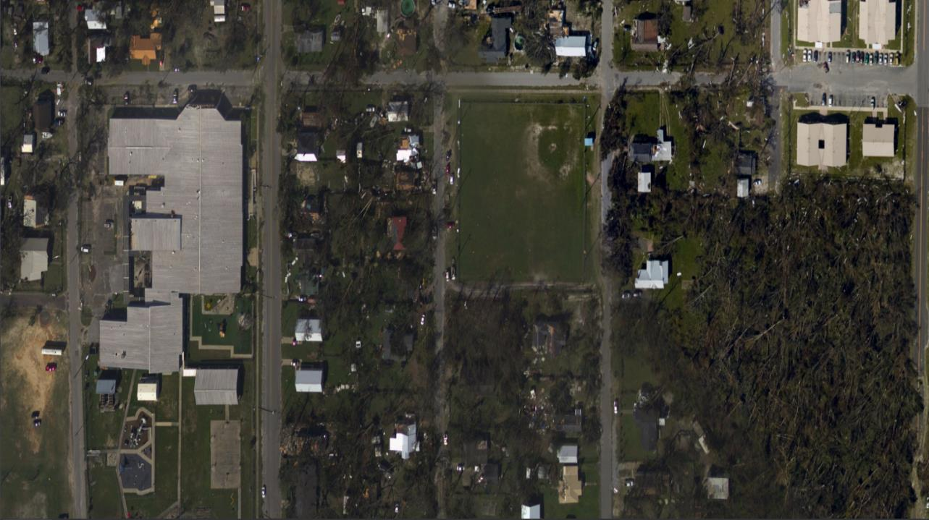

Slide 8
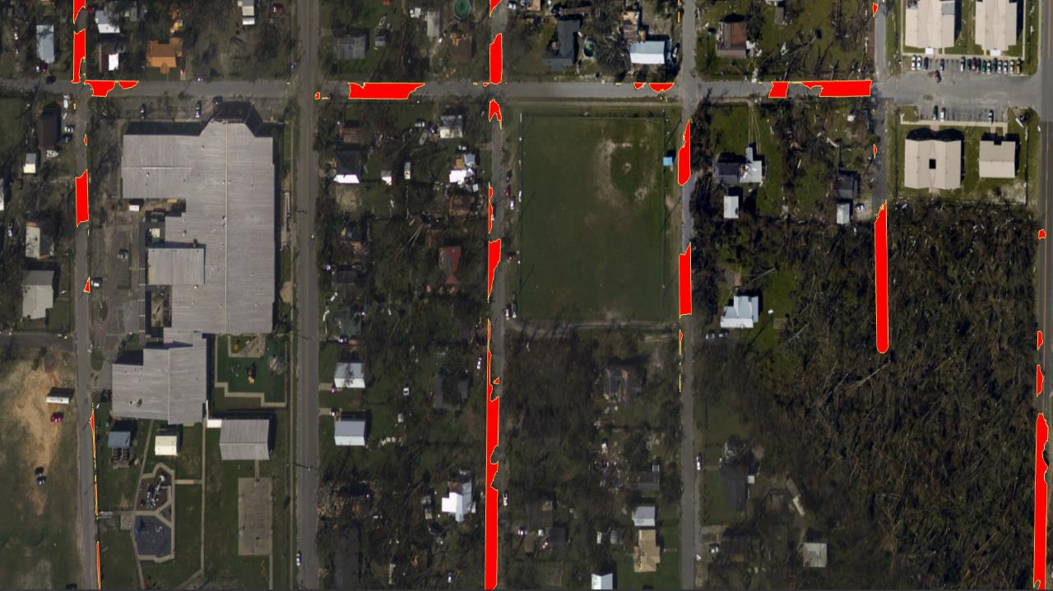

Slide 9
Blocked Roads Detection
We train an A.I model to detect road debris and run it against an imagery layer consisting of roads (this requires having the underlying road network)
The model will output a feature class highlighting road debris – we can utilize this directly with ArcGIS Network Analyst to place barriers and route optimally around the blocked roads

Slide 10
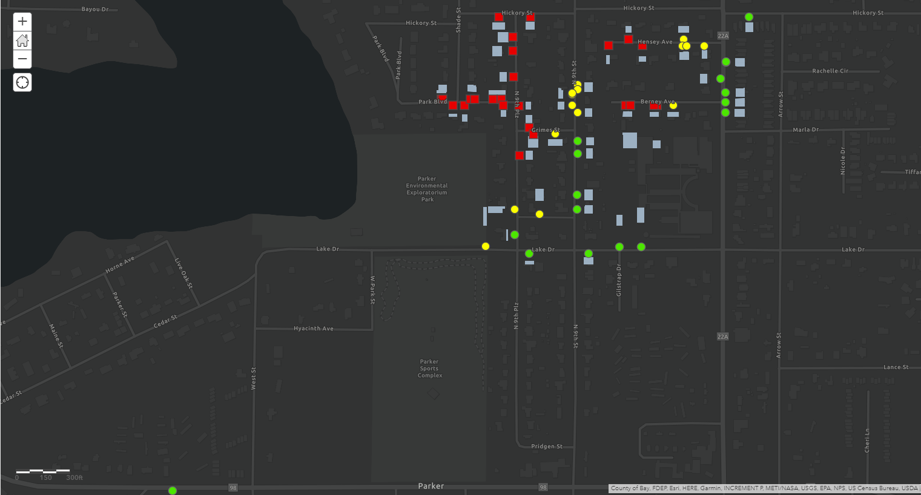

Slide 11
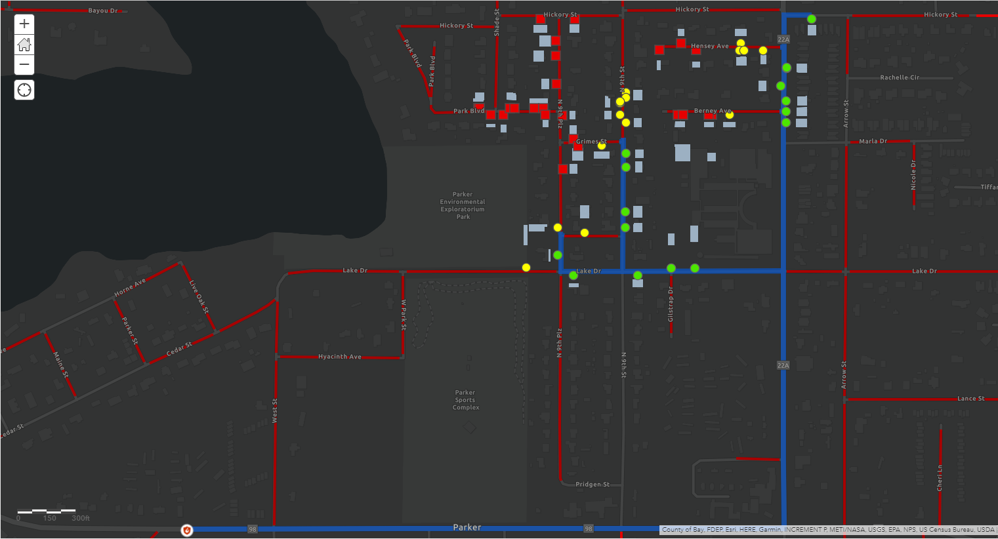

Slide 12
Optimal Routing
Once we have layers for the damaged structures and blocked roads, we can designate a base of operations and create an optimal route for first responders
Utilizing Network Analyst, we can designate the blocked roads as barriers and build an optimal route to all the accessible damaged structures accounting for these. We can also build separate routes to the blocked roads themselves to allow for clearing operations

Slide 13
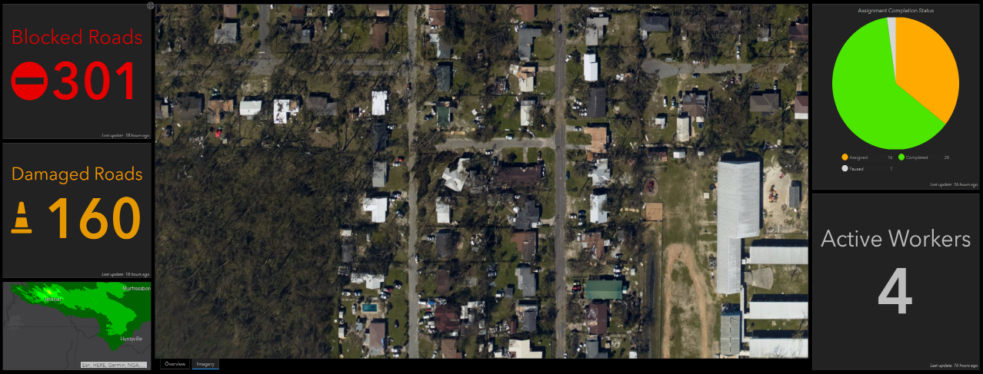

Slide 14
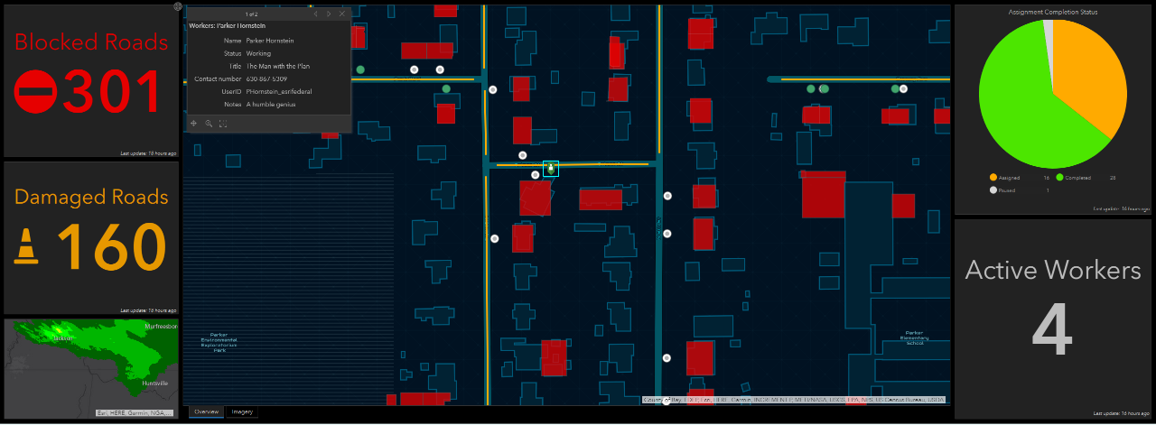

Slide 15
Operations Dashboard
We can push the routes discovered by Network Analyst to multiple first responder teams using Esri’s Workforce mobile app
The Workforce app can monitor real time location of responders as well as allow them to view their routes and make updates to structures after they’ve been inspected
These updates are pushed back to a central operations dashboard (and eventually to the underlying model to retrain), where a command center can monitor the current response and push new directions as needed

