Slide 1
Meso American – Caribbean Sea Hydrographic Commission (MACHC) Marine Spatial Data Infrastructure (MSDI) Working Group (MMSDIWG) Plenary Report
Presented by: Jim Rogers (Chair)
Vice Chair: Tom Scott-Clarke
06 December 2019

Slide 2
Key accomplishments
Finalized MMSDIWG TOR (MACHC Action 19.8.7)
Finalized MMSDIWG Governance Framework
Developed a MMSDIWG Workplan (MACHC Action 19.8.7a)
Established MMSDIWG Website…
https://ocsihomachcaseus2-dev.azurewebsites.net/bootstrap/mmsdiwg.html

Slide 3
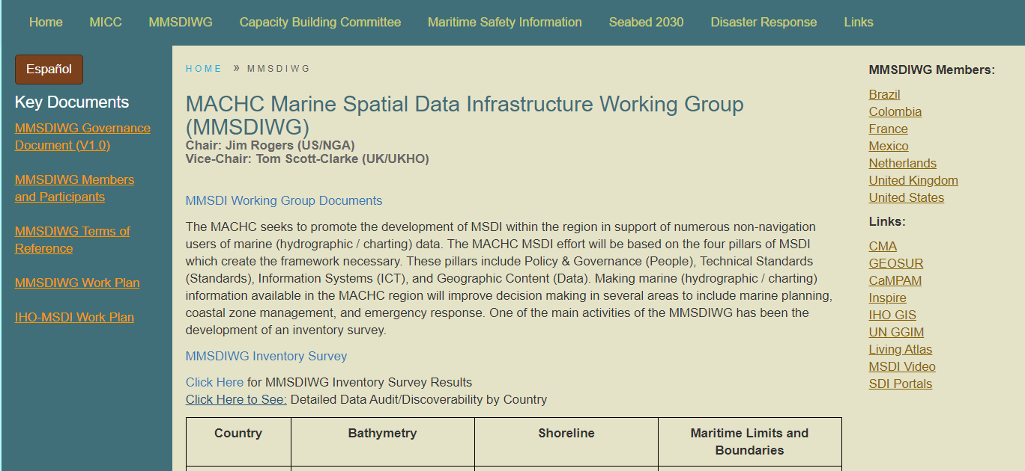

Slide 4
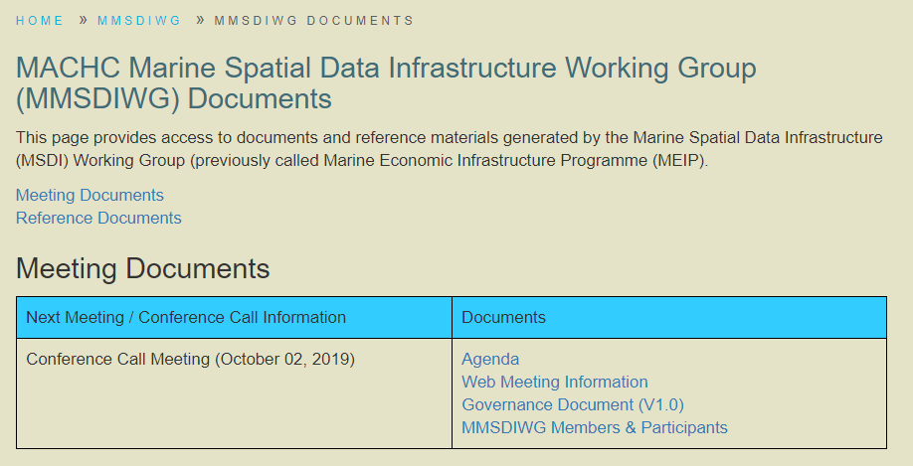
Documents uploaded back to 2012

Slide 5
Key accomplishments continued…
Engaged with stakeholders on MSDI use cases:
Need for an MSDI in the MACHC – Dawn Seepersad
Hurricane Dorian Event and how MSDI can support Disaster Response – Sudesh Botha, Map Action
CMA – Carolina Garcia

Slide 6
Key accomplishments continued…
Undertook an Inventory of MSDI resources with Member States of the MMSDWG. Discoverability is key to a good MSDI effort!

Slide 8
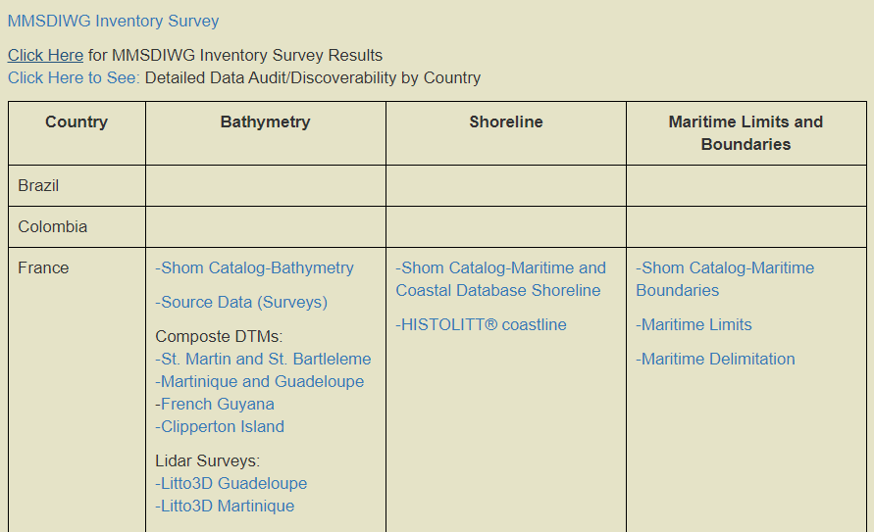
MSDI Inventory
Summary by member
Link to breakdown by coastal state.

Slide 9
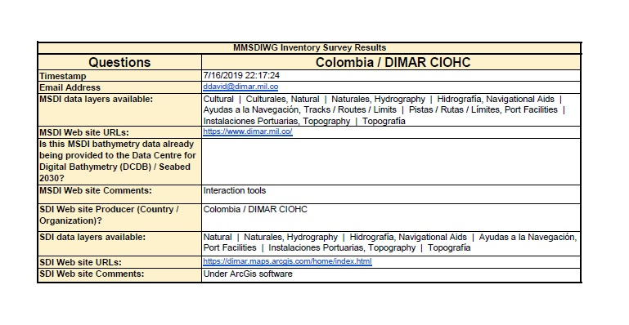
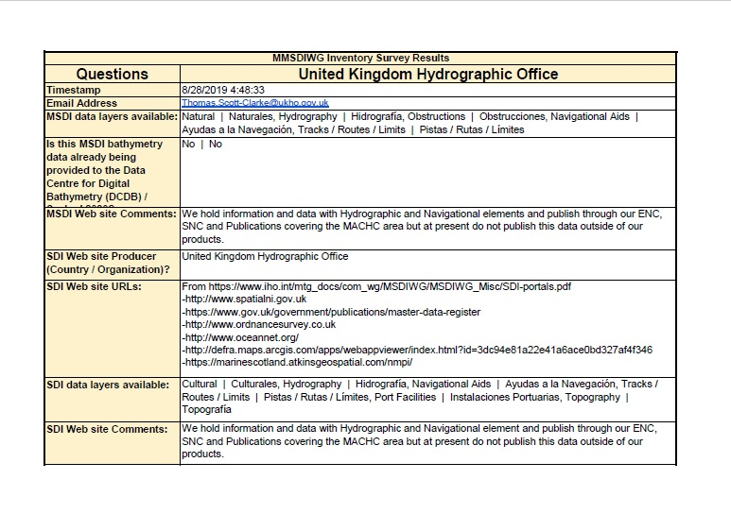
Country Submissions

Slide 10
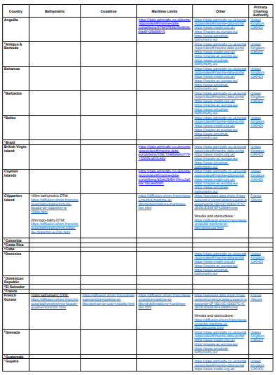
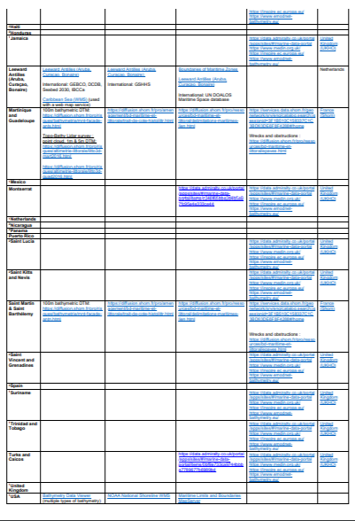
MSDI Inventory – coastal state summary

Slide 11
Future MMSDIWG Direction and Workplan
a) Propose an action that all MACHC Coastal States complete the Inventory Survey.
Direct Link: https://docs.google.com/forms/d/e/1FAIpQLSeLy3QTXAykjUSPAYBYRho3eDPSqslKSEgKkbrWib9OXddISg/viewform?vc=0&c=0&w=1

Slide 13
Future MMSDIWG Direction and Workplan continued…
b) Continue to review use cases and to coordinate identification of foundation data layers necessary to support their work. Some additional layers identified during the MMSDIWG Pre-Meeting:
Sensitive Sea / Environmental Areas
Hazards
Geographic Names
Ship Traffic
Notes:
Examples include Geo graphic names; sensitive sea areas – protection areas; Sediment Data; Vessel traffic; Navigational hazards; Routes database; List of layers; Seabed mining

Slide 14
Future MMSDIWG Direction and Workplan continued…
c) Conduct a follow on Inventory of MSDI Resources to account for some subset of the additional layers identified during the MMSDIWG Meeting.
d) Consider data principles and standards for the MACHC MSDI efforts. Review the UN GGIM data principles as a starting point for the MMSDIWG .
Notes:
Examples include Geo graphic names; sensitive sea areas – protection areas; Sediment Data; Vessel traffic; Navigational hazards; Routes database; List of layers; Seabed mining

Slide 15
Future MMSDIWG Direction and Workplan continued…
e) Encourage Member States to make their MSDI data available in GIS formats that can be used to support the analysis necessary in the various MSDI use cases.
f) Encourage Member States to consider some minimal regular update cycle to their MSDI data to ensure the data does not become outdated.
Notes:
Examples include Geo graphic names; sensitive sea areas – protection areas; Sediment Data; Vessel traffic; Navigational hazards; Routes database; List of layers; Seabed mining

Slide 16
Future MMSDIWG Direction and Workplan continued…
g) Work with Member States to coordinate receipt of data and to integrate web mapping and web cataloguing services per each states approach to MSDI.
h) Continue to Support Disaster Response and coordination as well as other use cases within the region by making MSDI Information discoverable and accessible to non-navigation users.

Slide 17
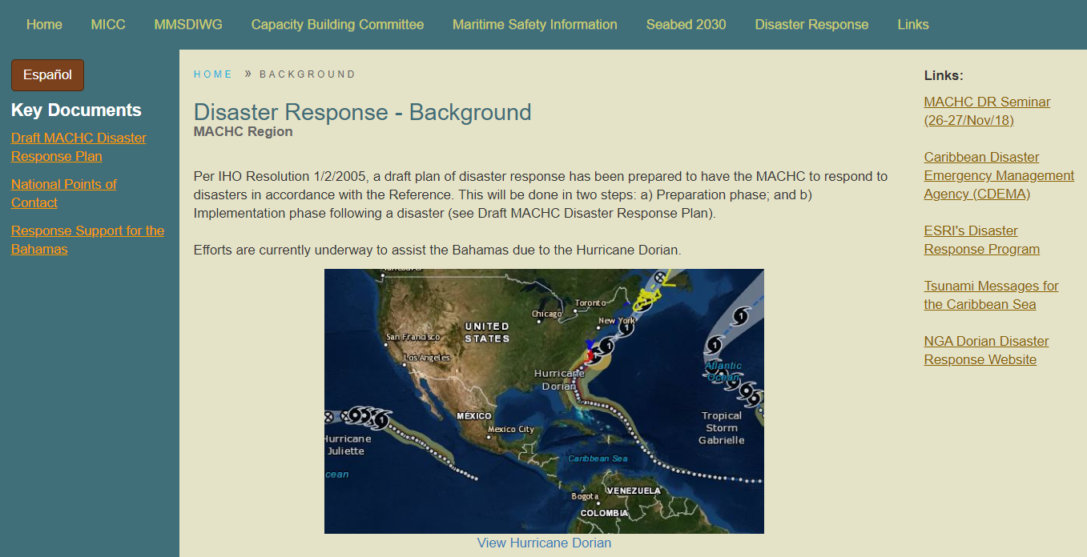

Slide 18
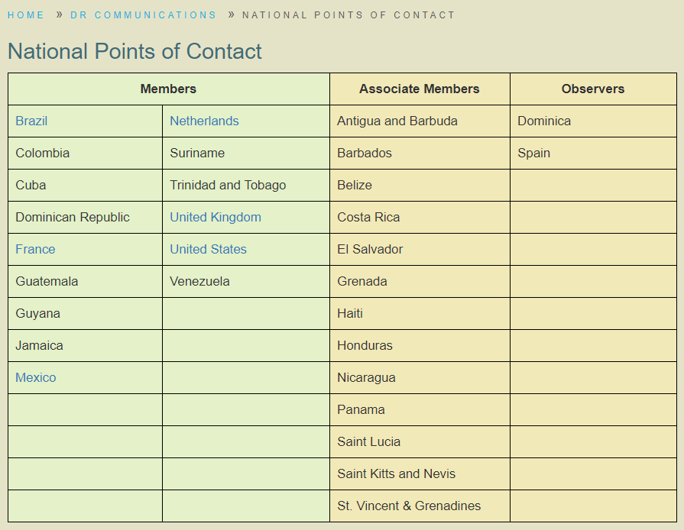
Propose an action point for all states to provide updated key contact information.
Please send to Chair, Copied to Vice Chair.

Slide 19
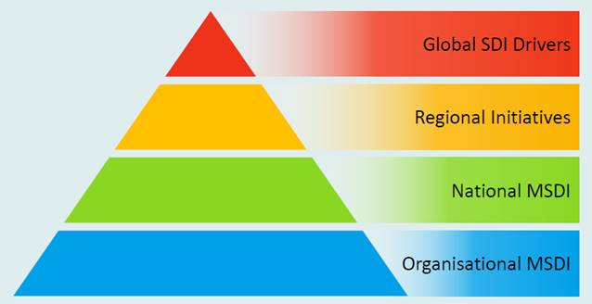
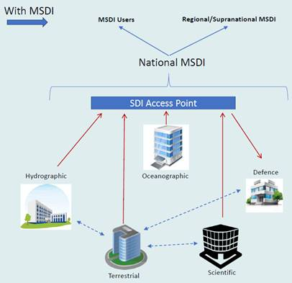
Better define MACHC position as a supranational MSDI and continue to engage with wider regional initiatives

Slide 20
MMSDIWG Recommendations
a) The MMSDIWG group asks that the MACHC Approve the MMSDIWG Workplan.
b) The MMSDIWG asks that Member States consider making their bathymetric data available via the Seabed 2030 and DCDB initiatives.
c) The MMSDIWG asks that Member States consider making their MSDI data available via the CMA as the Netherlands is now doing.

Slide 21
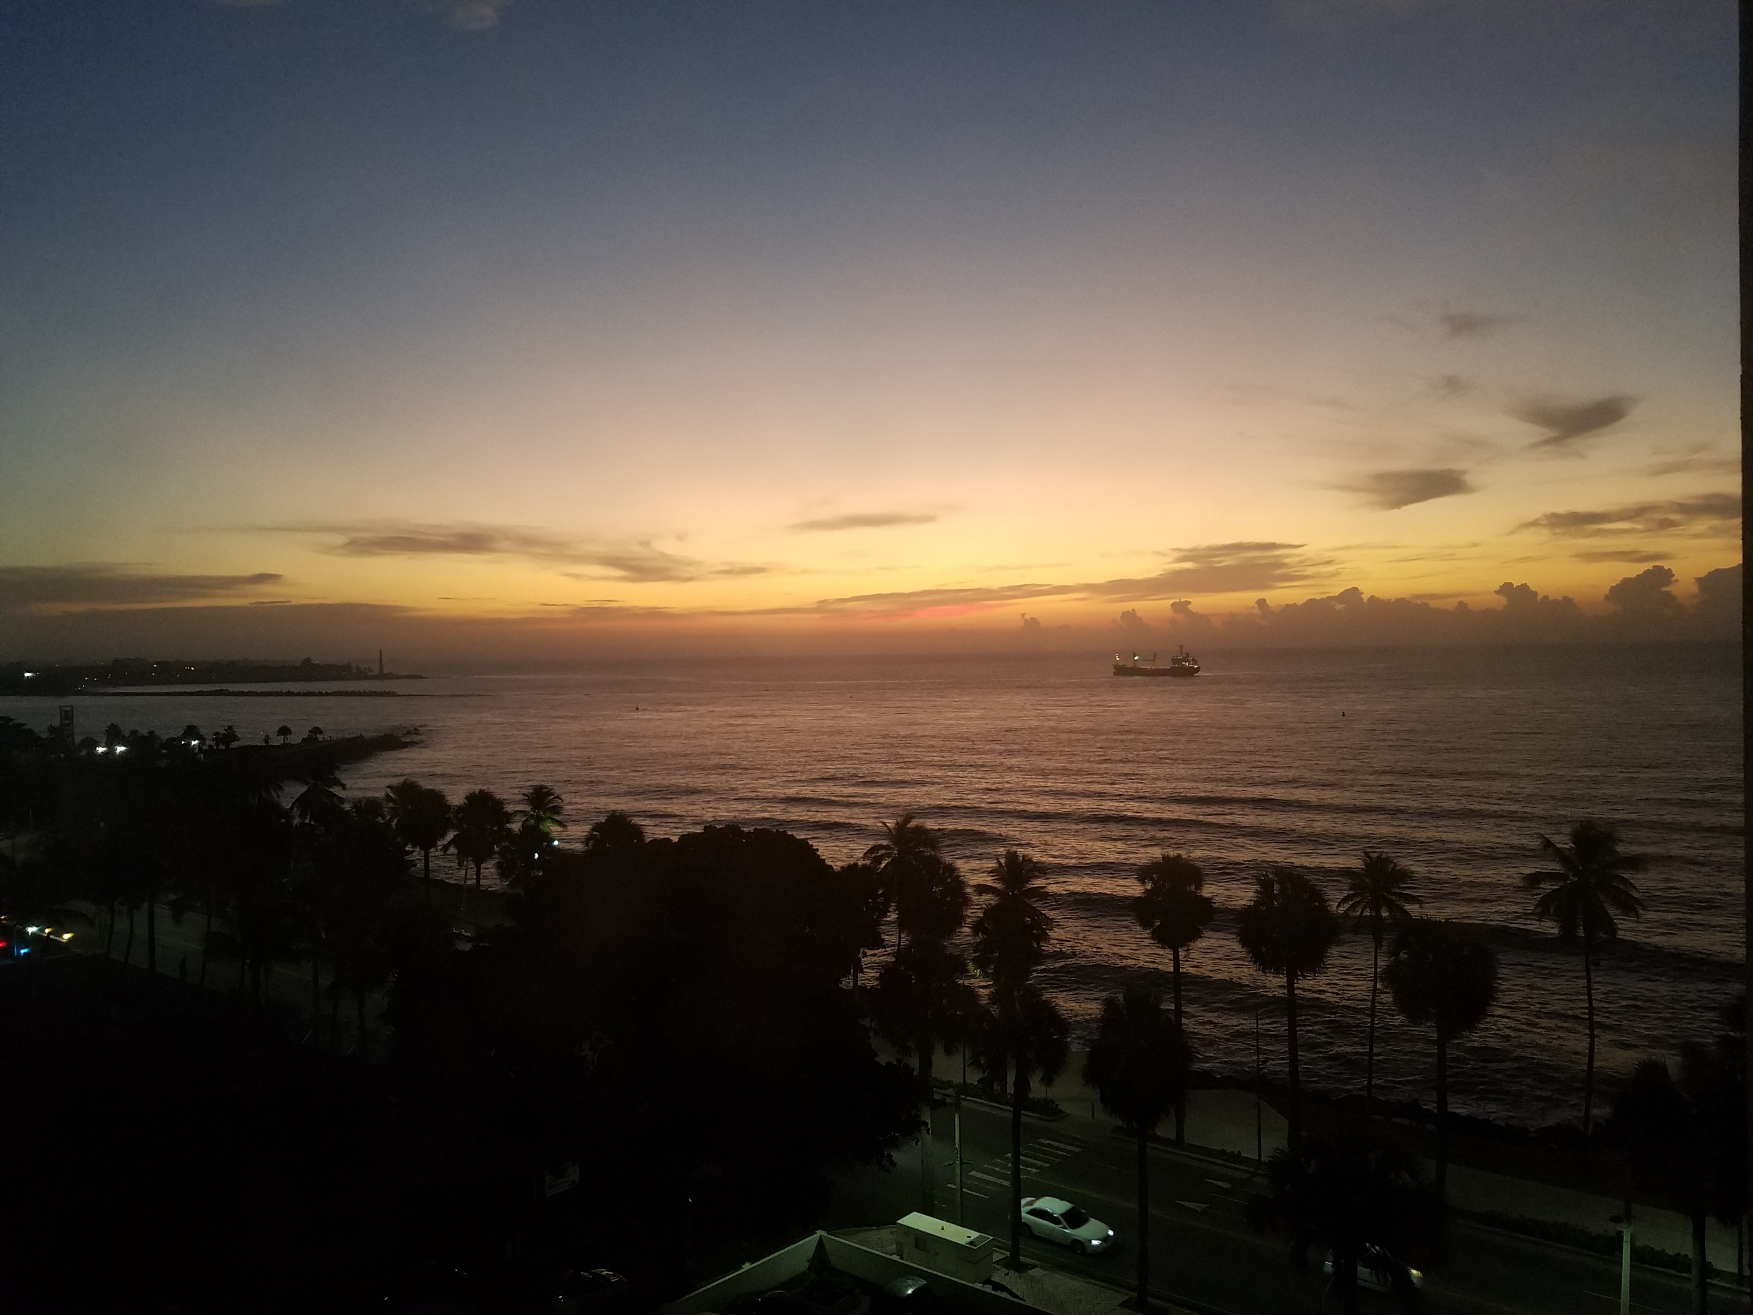
Please Note this Report

