Slide 1
20th Meeting of the Meso American - Caribbean Sea Hydrographic Commission (MACHC)
2-6 December 2019
Santo Domingo, Dominican Republic
CARIBBEAN MARINE ATLAS - CMA ATLAS MARINO DEL CARIBE - CMA

Slide 2
COORDINATION STRUCTURE
Execution and financial support
IOC / International Oceanographic Data and Information Exchange IODE-
Flanders Government
Regional coordination
Marine and Coastal Research Institute –INVEMAR- (Colombia)
Partners
National Focal Point (NFP) / Country
Projects
Agencies

Slide 3
CARIBBEAN MARINE ATLAS
Digital technological platform on line which function as repository of geospatial and documental information to support decision making in Integrated Coastal Zone Management ICZM as well as monitoring and evaluation of Caribbean Large Marine Ecosystem CLME
Special attention to: coastal hazards, climate change, biodiversity and habitats, fisheries, land based sources of pollution

Slide 4
TOOLS
Cartographic layers
Maps
Catalogue
External sources
Documents
Indicators
+
Metadata
Digital repository
Digital Repository
Web Services
Repository for geospatial information (layers, maps, documents)
Geospatial viewer: free consultation / creation / download of maps and layers (shapefile, raster, WMS)
Display of indicators (graphs)
Link to other online data sources
News
http://www.caribbeanmarineatlas.net

Slide 5
INFORMATION TECHNOLOGY
GeoNode
Geoserver
PyCSW
and others…
Simile ExHibit
JSON database & Facets text search
Power BI
Extract data & publish on cloud
WordPress
Publish news & calendar
Interoperability
Use open standards approved by the OGC (Open Geospatial Consortium)
WMS and WFS to access maps and vectors
WCS to access raster or raster data.
CSW (Catalog Service for the Web) for metadata exchange
Software

Slide 6
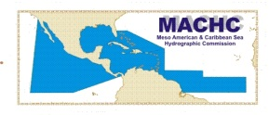
DATA PROVIDERS
8 countries of the 13 CMA partners share information to support Integrated Coastal Zone Management and Ecosystem Based Management
Trinidad & Tobago (Institute of Marine Affairs - IMA) as responsible for carrying out activities aimed at implementing the Land-based Sources protocol - LBS for pollution at the Regional level for the English speaking islands of the Caribbean, hopes to use the atlas as a platform for their products.
Member countries of the Meso American and Caribbean Sea Hydrographic Commission

Slide 7
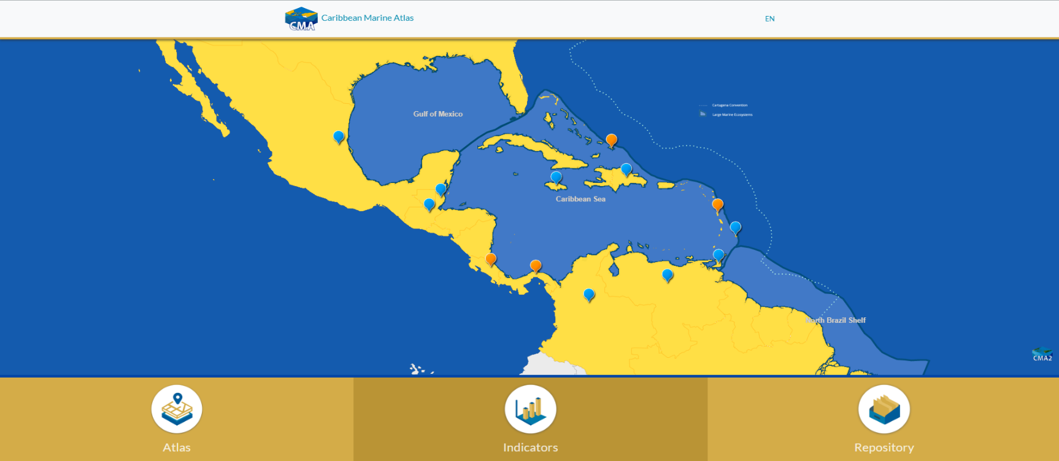
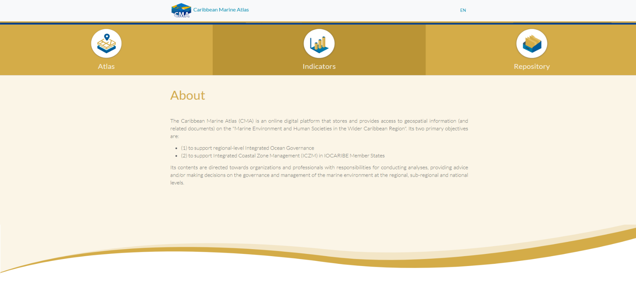
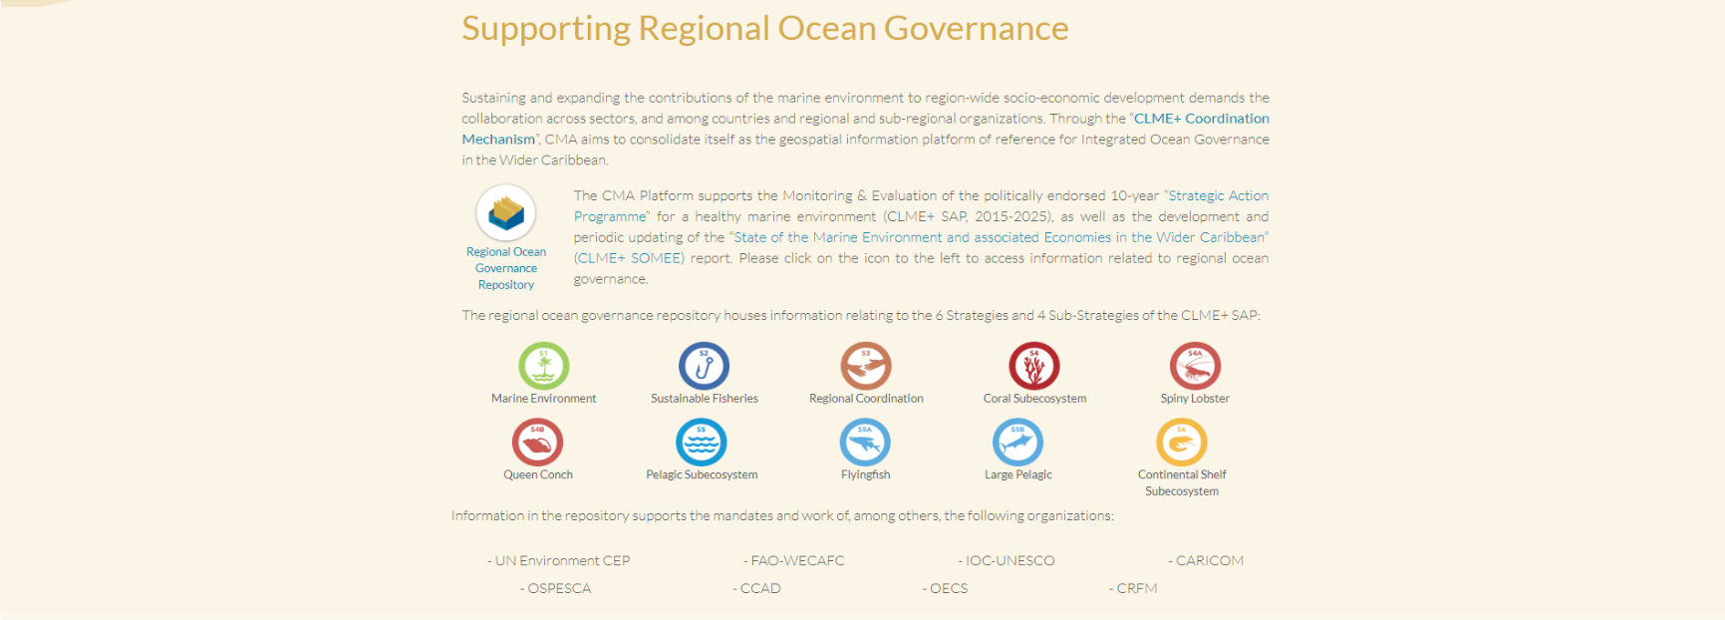
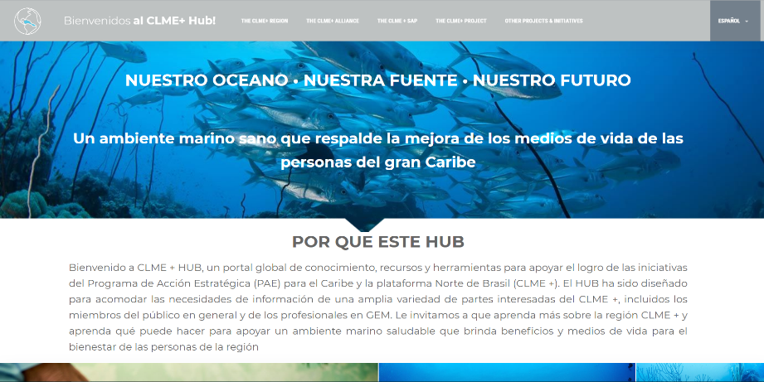
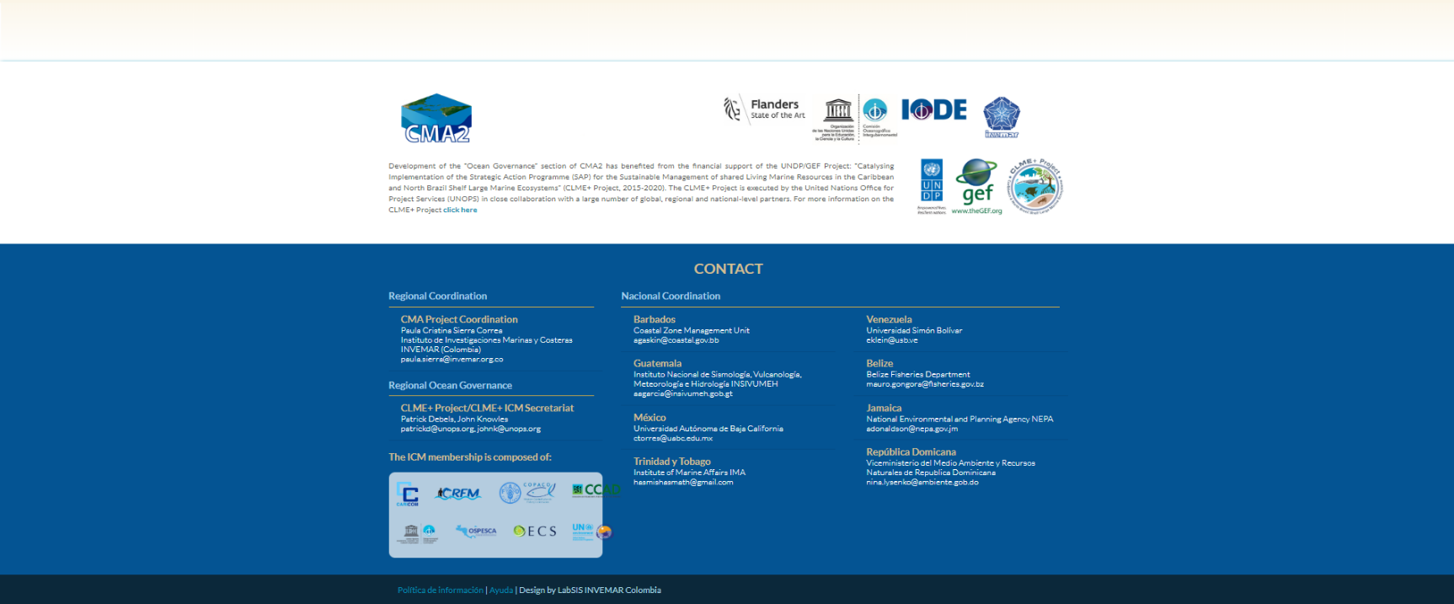
In the last year the Atlas management has been directed to intensify the interaction with other regional projects / initiatives in order to increase the supply of information and the spectrum of topics for the Caribbean region.
Landing page

Slide 8
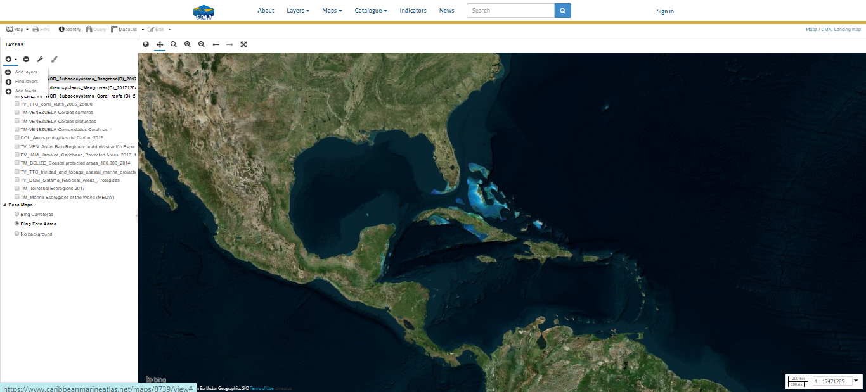
LANDING PAGE: ATLAS
https://www.caribbeanmarineatlas.net/
Notes:
The CMA2 landing page was updated to make visible supporting role in the regional SAP Strategic Action Programme M&E and SOMEE State of the Marine Environment and associated Economies reporting efforts. Currently, it provides relevant background upfront, as well as a shortcut to access information that specifically relates to certain aspects of the CLME+ SAP (and thus the SOMEE report, whose structure is based on the SAP), hyperlinks to various pages on the CLME+ HUB, acknowledgements and regional ocean governance contacts. At the same time, the CLME+ HUB also links back to the CMA2 GeoNode (https://clmeplus.org/ ).

Slide 9
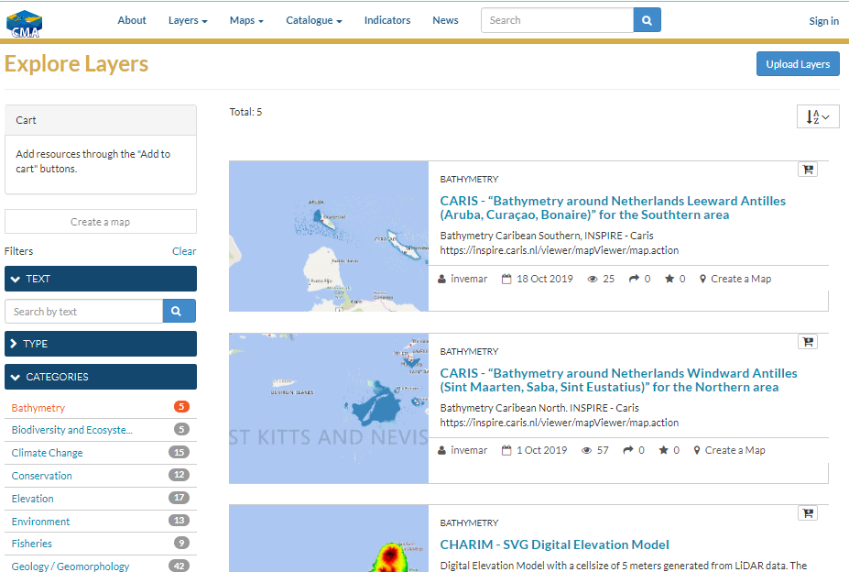
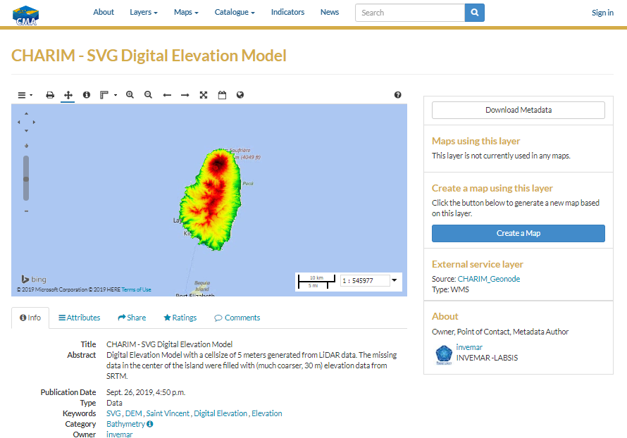
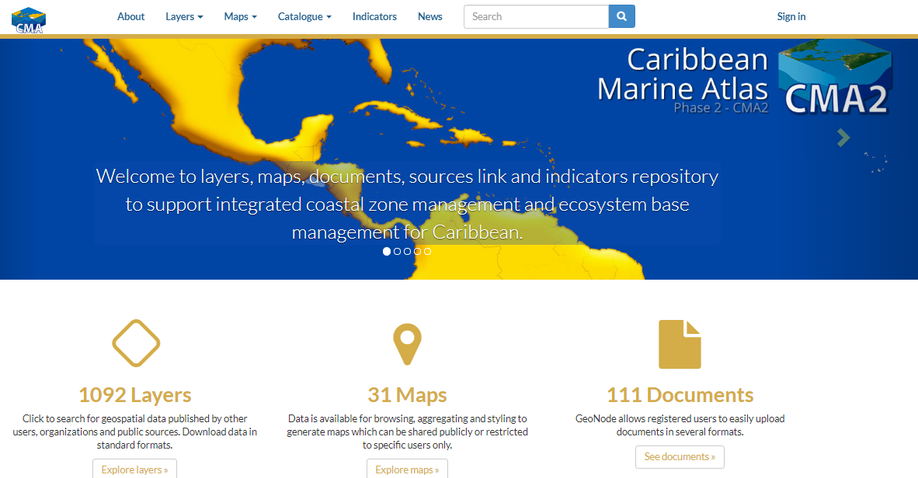
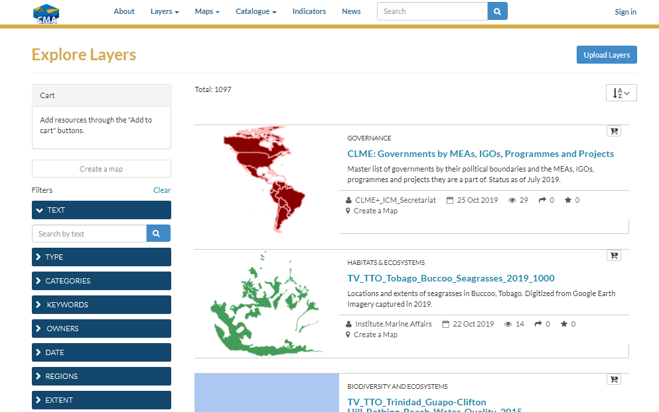
REPOSITORY DISPLAY: LAYERS
Notes:
The CMA2 landing page was updated to make visible supporting role in the regional SAP Strategic Action Programme M&E and SOMEE State of the Marine Environment and associated Economies reporting efforts. Currently, it provides relevant background upfront, as well as a shortcut to access information that specifically relates to certain aspects of the CLME+ SAP (and thus the SOMEE report, whose structure is based on the SAP), hyperlinks to various pages on the CLME+ HUB, acknowledgements and regional ocean governance contacts. At the same time, the CLME+ HUB also links back to the CMA2 GeoNode (https://clmeplus.org/ ).

Slide 10
REPOSITORY DISPLAY: MAPS

Slide 11
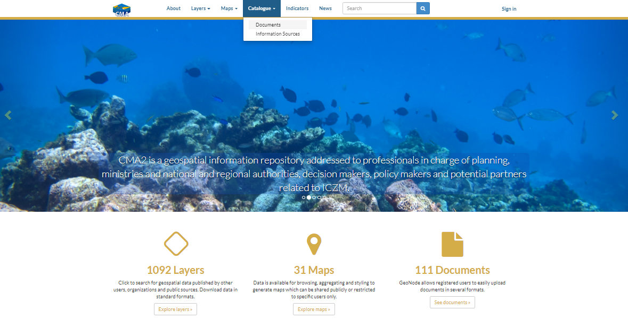
CATALOGUE DISPLAY: DOCS & EXTERNAL SOURCES
Notes:
The CMA2 landing page was updated to make visible supporting role in the regional SAP Strategic Action Programme M&E and SOMEE State of the Marine Environment and associated Economies reporting efforts. Currently, it provides relevant background upfront, as well as a shortcut to access information that specifically relates to certain aspects of the CLME+ SAP (and thus the SOMEE report, whose structure is based on the SAP), hyperlinks to various pages on the CLME+ HUB, acknowledgements and regional ocean governance contacts. At the same time, the CLME+ HUB also links back to the CMA2 GeoNode (https://clmeplus.org/ ).

Slide 12
CONTENT
1092 Layers
Geoviewer for consult layers (vector/raster/remote) and building/downloading maps
25 Remote services(WMS/WFS)
142 Maps
Maps (spatial viewer for consult /creation /downloading maps and layer / Layers (shapefile, raster, WMS) / free access to data and information
Catalogue:
111 Documents
93 Information sources
Documentation related to spatial information and links with external information sources (projects, countries, institutions)
Summary of the trend in content time in the Atlas:

Slide 13
categories
Thematic areas to support ICZM, EbM and governance
Permanent and detailed reviewing allow a significate collection of maps, layers or documents. Each one include a metadata minimum based on ISO 19115 standard.

Slide 14
INDICATORS
Special interest from partner countries on indicators report, has converted this module in a great opportunity to design a report of indicators that look for responding to gap information for the region, using mainly environmental/economic national information. In addition, the indicators defined contribute as a voluntary report for some SDG, especially SDG 14.
CMA2 objectives
SDG
Aichi Targets
Implementation process for publishing 10 indicators derived from national data
Contribution to show country advances in global strategies as SDG
http://www.caribbeanmarineatlas.net/indicatorscma2
Notes:
One the most relevant product that CMA2 offers are the set of indicator, published most of them using national data. From 10 indicators selected in the project frame, five are already published (see green boxes) . The rest are in process of design of Methodological sheets or collecting data.
CMA2 works on a voluntary contribution to Sustainable Development Strategy, more specifically to SDG 13 and 14
As part of the rules of game, a set of commitments were agreed among al the country pilots of the project, some of them are…

Slide 15
INDICATORS
Coastal Population density Change (municipalities)
Coral Health. Assessment of reef biota (% cover) (Healthy Reefs Initiative)
Marine Protected Areas
Ecosystems Representativeness (The spatial extent ecosystems in marine and coastal protected areas as a proportion of the total ecosystem extent in the country - mangroves, seagrasses, coral reef, and beaches )
Coastal economic activities (% GDP by economic activity by political-admin. division of the 1st level)
Threatened Species (National data / OBIS)
Invasive Species (National data / OBIS)
Extreme events (Effects for nine natural hazards -losses of human lives, and frequency of events- tsunamis, storm surges, wind, earthquakes, volcanic eruption, landslides, floods, drought and, hurricanes)
Sea Level trend (NOAA data and sea level national stations)
Global Capture Production (marine capture production by country - FAO data)

Slide 16
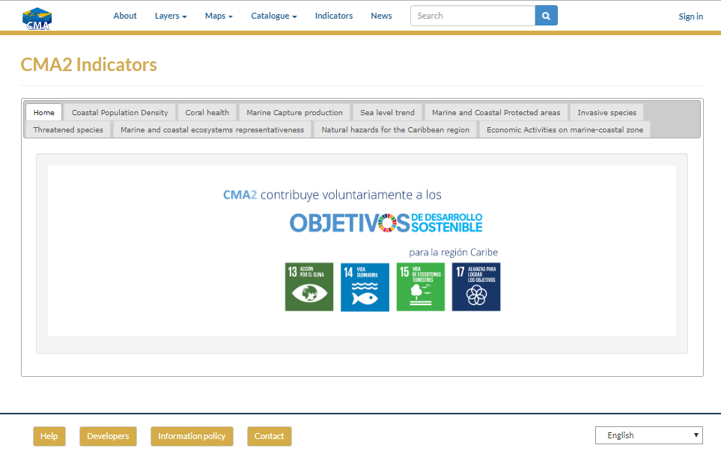
INDICATORS
http://www.caribbeanmarineatlas.net/indicatorscma2
Notes:
Deployment of indicators using charts, tables and spatial reference maps
Each card include title, definition, period of data, data source and link to Methodological sheet.

Slide 17
CMA IS BASED ON…
A collaborative approach to strengthening national capabilities from existing national, regional and international marine data and information management programs, projects or strategies of IODE (cooperation exchange and expertise, Strategic synergies, opportunists and tools)
Increasing of the number/type of data providers: countries, projects, agencies
A coordination structure with a regional coordination and national coordination from institutions which works like National Focal Point with a delegate (countries)
Partners using GeoNode platform (technology) for self-manage information. Content include thematic information for ICZM, Regional governance (CMLE+project)
Activities centered on the dissemination of the platform in several scientific and technical events of the Caribbean region, to increase the use of the platform by other projects/partners.

Slide 18
CMA IS BASED ON…
Information management: metadata and standards use, Information policy (IODE information Policy www.iode.org/policy), Protocol to upload products on CMA2 platform and Quality control periodically
Quality control supported by INVEMAR
Free access to data and information available 24/7 (supported by INVEMAR)
Training courses in GeoNode technology use to GIS expert from data providers
Work in two languages

Slide 19
SESSIONS AND VISITS
WEB STATISTICS
Expert Users: 60
Institutions: 11
Countries: 13
Projects: 1
329
1340
Trend
https://www.caribbeanmarineatlas.net/social/recent-activity
Notes:
Session: A session is the period during which a user interacts with your website, application, etc. All usage data (visits to a screen, events, electronic commerce, etc.) are associated with a session
Number of page visits: corresponds to the total number of page views during a session; repeated visits to the same page are also counted.

Slide 20
THANK YOU
GRACIAS
MERCI BEAUCOUP
Contact:
CAROLINA GARCIA
carolina.garcia@invemar.org.co

