Slide 1
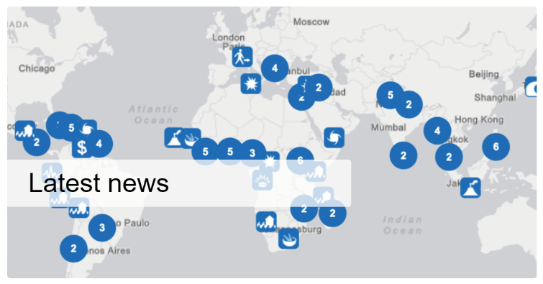
MapAction: Humanitarian Aid in the Right Place Dorian Response and working with the IHO in The Bahamas
Presenter:
Sudesh Botha BSc. Eng. MBA MISTT
Director – GISCAD Limited
Mapaction Volunteer
Notes:
Good day All,
Today I'm going to share a little bit about MapAction and the humanitarian work that they do in the region and by extension Internationally.
My name is Sudesh Botha, and I have been a volunteer with MapAction for the last 12 years.
I'm also going to talk a little bit about an actual deployment, and how working with other agencies assisted in providing much needed data in creating Maps used in the delivery of Aid where required.

Slide 2
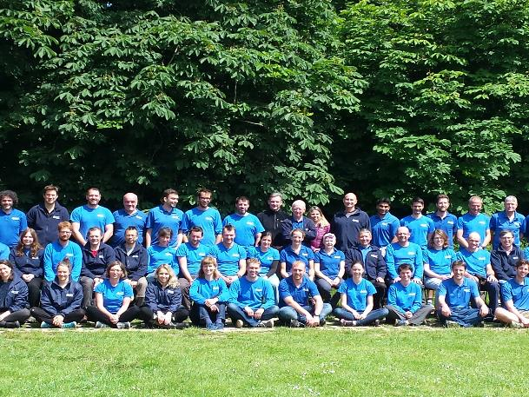
Our Team…
MapAction’s work depends on a group made up of over 80 skilled and dedicated volunteers, Who are supported by our staff and trustees. In their day jobs, these volunteers work in a range of Fields and Focus from Antarctic surveying to zoological research.
Notes:
A little bit about us…MapAction is made up of volunteers from all around the Globe…
The Majority of MapAction Personnel have a strong background in GIS or GIS related professions but there are many others that round out MapAction…From Astrophysicists to Accountants to ex Military personnel, they all bring valuable skill sets to MapAction.
We have over 80 volunteers
With a Small, staff team, most of whom are part time, based in Oxfordshire, UK
Im fact, Volunteers are predominantly UK based, in order to attend regular training weekends and regular monthly training.
This ensures they are ready to deploy to the scene of an emergency within hours of an alert.

Slide 3
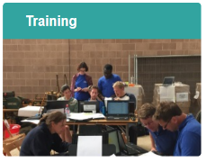
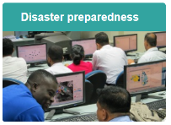
Our Focus…
Our training programme is focused on two distinct areas: increasing the knowledge and capacity of our own volunteers, and increasing the knowledge and capacity of our humanitarian partners.
Our well-rehearsed deployment model means our volunteer mapping professionals are often at the scene within 24-48 hours of a disaster striking.
MapAction runs a range of preparedness projects that complement our rapid deployment capability
Notes:
What do we do…Mapaction Focuses on 3 main areas…
Emergency response
24 hours a day, 7 days a week, 365 days a year, anywhere in the world – MapAction is ready to respond as soon as disaster strikes.
Our well-rehearsed deployment model means our volunteer mapping professionals are often at the scene within 24-48 hours of a disaster striking.
Even before they arrive in-country, they’ve started collecting data and information that will be crucial in helping coordinate the world’s response, and getting aid to where it is needed most.
Our field team is assisted by fellow volunteers, who provide remote support throughout the mission. This means we gain the benefit of many more pairs of hands but without the cost of deploying large teams to the field.
Preparedness
While emergencies cannot be accurately predicted, steps can be taken to mitigate the impact and make communities more resilient.
MapAction runs a range of preparedness projects that complement our rapid deployment capability. Specific projects seek to ensure that both MapAction and our partners can respond more quickly and improve information sharing in difficult operational contexts.
MapAction’s disaster preparedness activity is cost effective, trains others in mapping and data management methodologies, saves time and enables a wider base of people to provide maps in an emergency.
Training
Our training programme is focused on two distinct areas:
increasing the knowledge and capacity of our own volunteers,
and increasing the knowledge and capacity of our humanitarian partners.
Training our volunteers
Every year our volunteers take part in an intensive simulation exercise, focusing on developing the skills they need to deliver our mapping service in the potentially challenging context of an emergency response.
Our training helps team members make judgement calls about what sort of products they should create given the time available and the volume of rapid requests coming in.

Slide 4
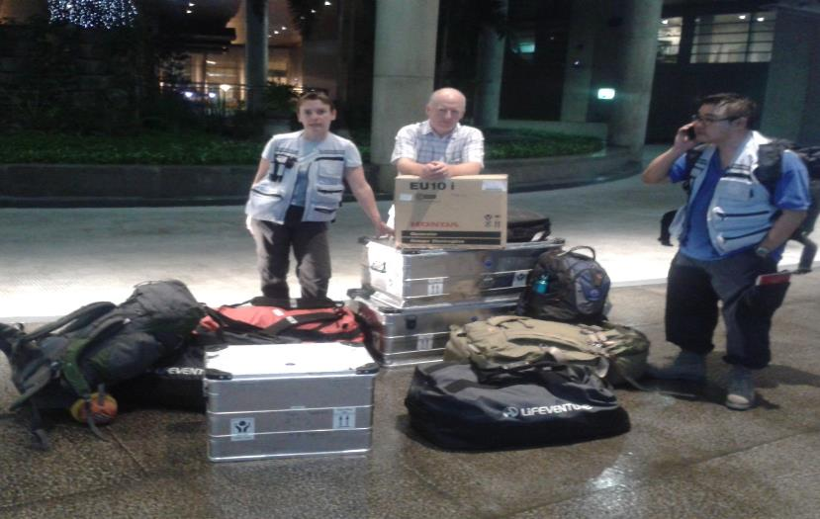
Emergency Response or Deployments
Our intensive training programme means all teams are always up-to-date and prepared.
Since 2003, MapAction has responded to more than 80 humanitarian emergencies, ranging from earthquakes to conflict-related crises.
Notes:
Typical deployments would require substantial gear and equipment to be taken into a disaster response situation. This is in order to support the other disaster response agencies with their mapping requirements

Slide 5
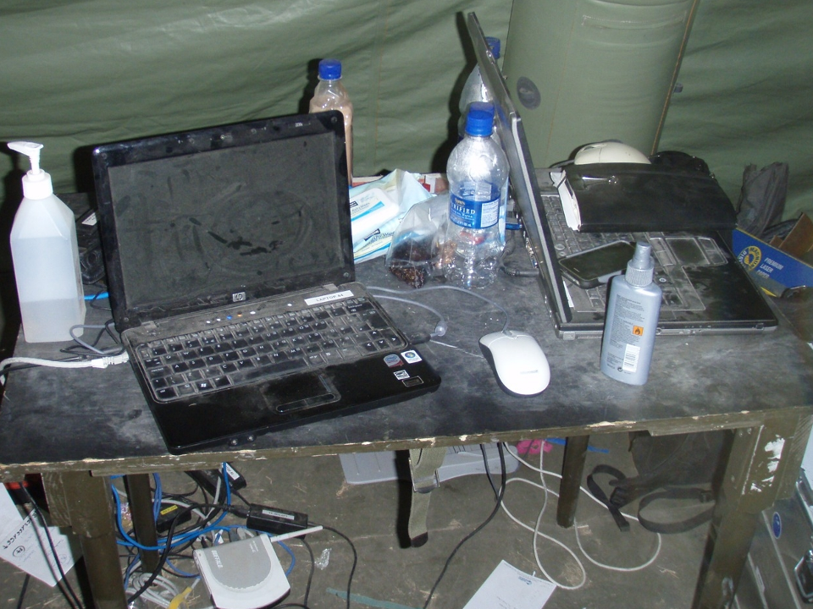
Notes:
Needless to say a lot of the equipment once it's used within those disaster response environments will not be used under the best of conditions…. they won't be used in nicely air-conditioned rooms… with regulated power supplies… it usually involves working out of a tent with very little airflow, under very harsh, dusty and hot conditions.
As you can imagine, this results in alot of equipment failures and equipment that completely cannot be used after a deployment is completed

Slide 6
MapAction Emergency Deployments
2003 Lesotho food crisis
2004 Asian tsunami
2005 Niger famine
Pakistan earthquake
2006 Suriname floods
Java earthquake
Dominica hurricane
Kenya floods
2007 Ghana floods
Jamaica hurricane
2008 Bolivia floods
Myanmar cyclone
Haiti hurricanes
2009 Namibia floods
Pakistan IDP
Sri Lanka post conflict
Benin floods
Burkina Faso floods
Sumatra earthquake
El Salvador floods
Philippines cyclones
2010 Albania floods
Haiti earthquake
Pakistan floods
Saint Lucia hurricane
2011 Libya refugees
Japan earthquake
Cote d’Ivoire refugees
Nicaragua floods
2012 Philippines floods
Sahel food crisis
Congo ammo dump
Madagascar floods
Comoros floods
Paraguay floods
2014 - Iraq ISIS refugees
Liberia Ebola
Sierra Leone Ebola
Ghana Ebola
Mali Ebola
2015 Malawi floods
Vanuatu cyclone
Chile floods
South Sudan
Nepal earthquake
Yemen cyclone
Mediterranean refugees
Dominica cyclone
2016 Fiji Cyclone
Paraguay floods
Ecuador earthquake
Cape Verde seismic
Tanzania
Jamaica/Haiti hurricane
N Nigeria refugees
2017 Chile forest fires
Madagascar cyclone
Peru floods
Sierra Leone floods
Caribbean hurricanes
2018 Philippines Typhoon
Indonesia Earthquake
Nigeria floods
Venezuela Refugees
2019 Mozambique Cyclone
Bahamas Hurricane
Laos Floods
2013 CAR refugees
Lebanon/Turkey
India flooding
Myanmar cyclone
India cyclone
Philippines cyclone
2014 Lebanon
South Sudan
Serbia floods
Paraguay floods
Notes:
The emergency deployments to 2017…
Colour code
Green - Food/Medical,
Red - Earthquakes,
Blue - Floods,
Yellow - Winds and Hurricanes,
Black - “Complex”

Slide 7
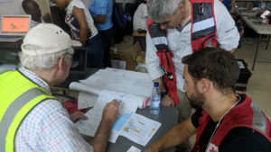
What do we do?
Notes:
What do we do? ….
Or what do we produce during a Disaster Response?

Slide 8
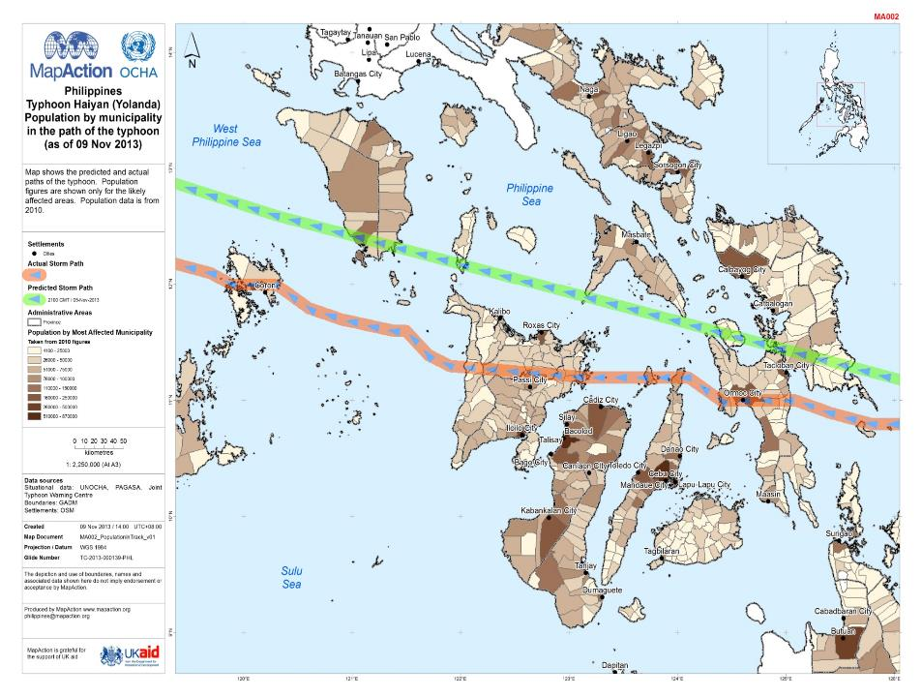
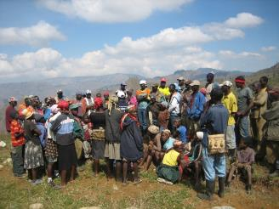
“Where are the affected areas and where are the affected people?”
Notes:
we determine where the affected areas are and then determine where the affected people are located or have relocated to…

Slide 9
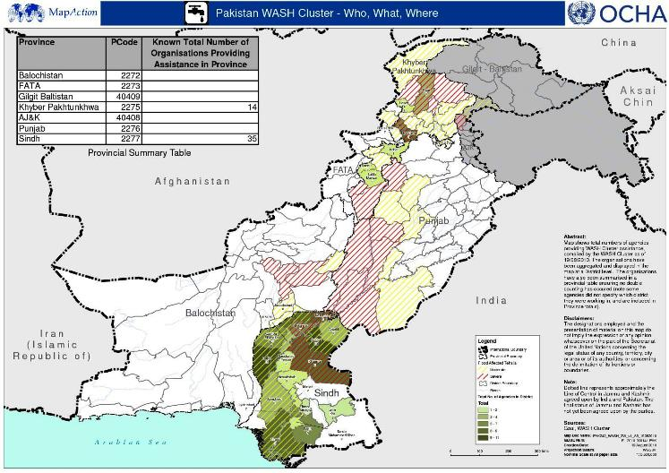
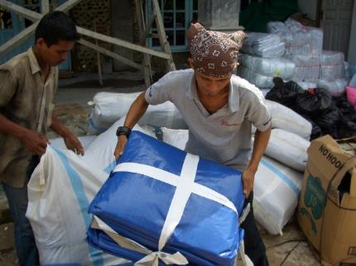
“Where are other relief agencies/teams working?”
3W – Who, What, Where…
Notes:
As the disaster response activity progress is it becomes critical to determine where the other relief agencies and teams are working…. this is incredibly important to ensure that not all the AID is being directed to one area where other areas which may also require it may not be focused on.
It helps the coordinating agencies to equitably distribute AID to all affected regions, and prevents situations where multiple response agencies rush to an area where they know AID is requires in less than a coordinated effort…. resulting in multiple agencies arriving at the same location….. delivering the same aid…. at the same time…. where other areas are completely ignored.
Knowing where the relief agencies or teams are centered, is also extremely useful from a security perspective. In disaster situations, because of the volatility and uncertainty of the environment there is often the need to extract teams from areas at very short notice.

Slide 10
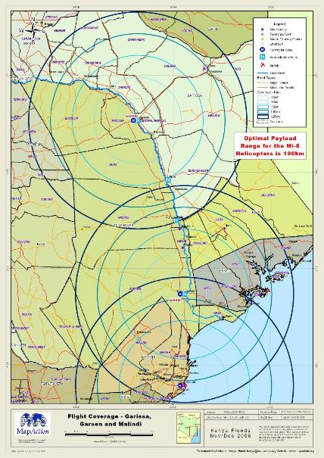
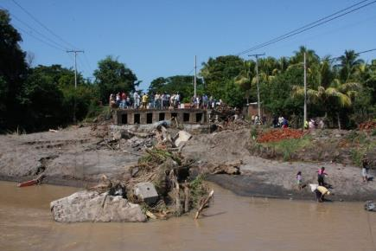
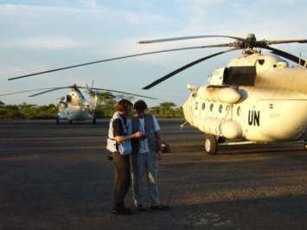
“Where are the access routes?”
Notes:
Another critical component of the Maps that are created by Mapaction on a given disaster response deployment would be Maps associated to the access routes…
This is quite obvious as this would determine the best way for aid and other supplies that are required to get to the areas in need.
There are many factors that one has to take into consideration in determining the best access routes some of those traditional routes that would have been used, may no longer exist…
bridges may be wiped out… roads may be destroyed or sections may be underwater…. helipads and airports may be destroyed or underwater… ports may be destroyed or the channels may now be unusable due to debris or other navigational hazards. Not to mention the security concerns at these ports where Aid is being brought in…

Slide 11
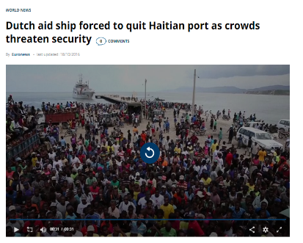
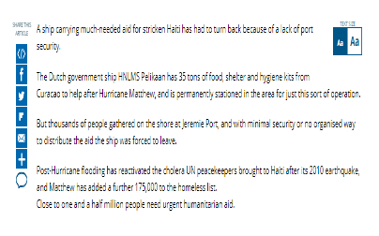
Video removed by the IHO due to space
Notes:
I was actually part of the Mapaction team deployed to hurricane Matthew in Haiti. We worked with the captain and other officials from the Dutch ship Pelicaan. They used navigational Maps, some of which we got through the hydrographic organization, to determine alternate routes where smaller vessels could have been used to ferry small amounts of supplies across… they also use some of that mapping to determine alternate areas where they could have created temporary port facilities for landing slightly larger vessels and eventually use some of those locations to actually drive trucks of aid onto onshore from the ship.
All of this mapping was used in conjunction with other situational data example where the people in need started to cluster, in order to get the closest location to them that was possible and feasible.

Slide 12
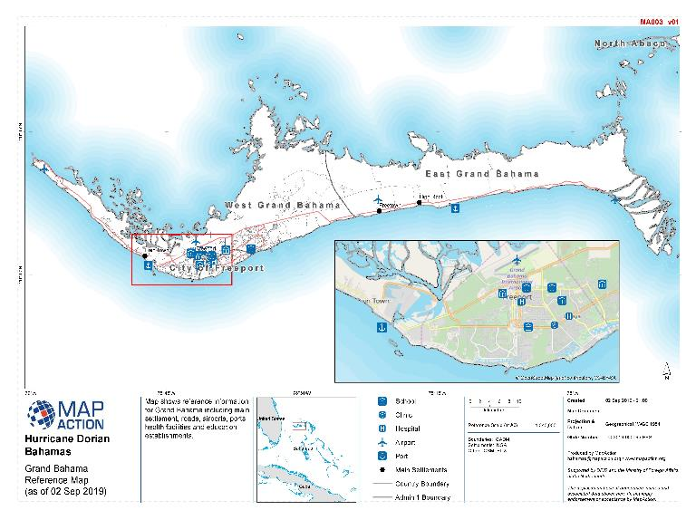
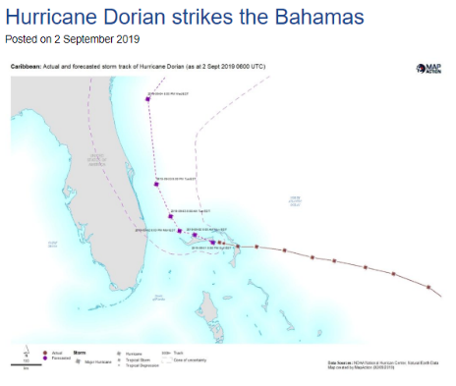
A MapAction team is en route to the Bahamas to support the Caribbean Disaster Emergency Management Agency (CDEMA) and the UN Office for the Coordination of Humanitarian Affairs (UNOCHA) as they coordinate the response to Hurricane Dorian.
With windspeeds over 160mph, the category 5 Hurricane was the strongest to hit the Bahamas
since records began. It moved slowly westwards across the Abaco Islands and Grand Bahama.
Posted in News
Tagged Caribbean, CDEMA, deployment, Dorian, Hurricane, Hurricane Dorian, UNOCHA, DFID, NMFA
Notes:
And then there was Dorian striking the Bahamas in 2019…
with wind speeds over 160 mph …Dorian at a category 5 hurricane, was the strongest to hit Bahamas in its history.
Hurricane Dorian caused $3.4 billion in losses in the Bahamas
Left 10’s of Thousands Displaced and Homeless
And resulted in the Deaths of at least 60 persons and counting with many persons still missing.

Slide 13
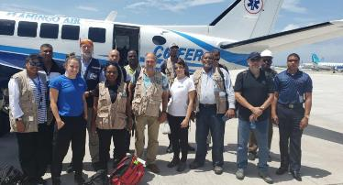
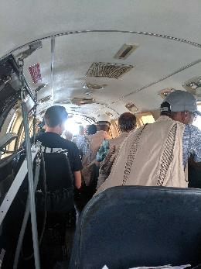
Mapping the affected Areas…Post Dorian Using situational data from various sources including Rapid Needs Assessment Teams (RNAT) from CDEMA, CDRU and other agencies…A picture of the devastation within the Bahamas begins to emerge…
Map Showing % of Evaluated Buildings that were destroyed by 10km² Hexagonal Rapid Needs Assessment Grid
Notes:
Once field teams (RNAT) started to go out, a lot more situational data could be gathered.
Actual areas visited, resulted in better and more detailed information with respect to actual counts of houses destroyed, numbers of persons needing assistance and the type of assistance required.
It also resulted in information coming back on road conditions and accessibility, and landing sites such as airports, ports etc. and the ability of these sites to accommodate landings of vessels carrying Aid and Aid Workers and Responders

Slide 14
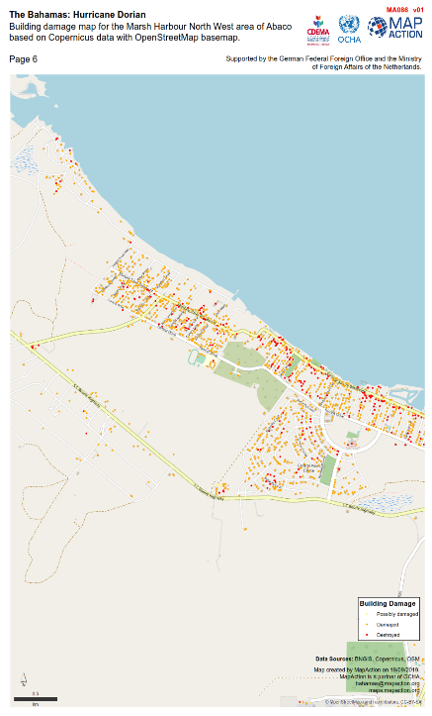
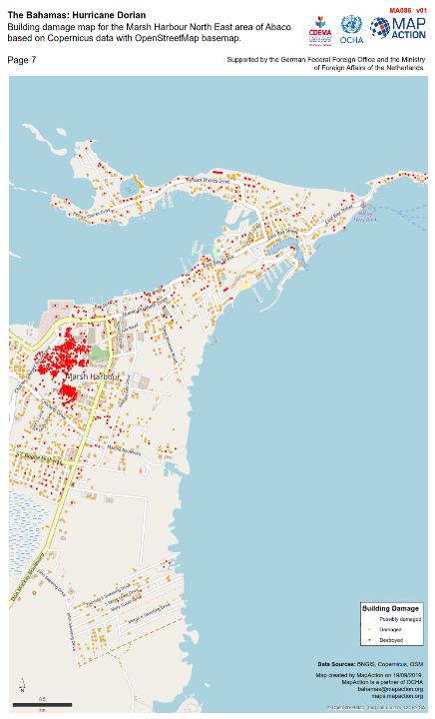
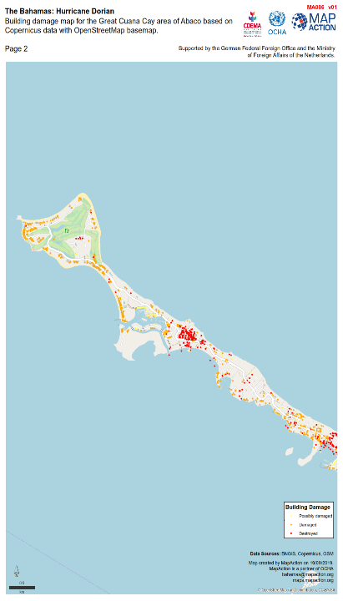
Notes:
Map showing the buildings that were destroyed or damaged based on information received by Field Assessment Teams and Rapid Needs Assessment Teams …
As you can see, the devastation was overwhelming with most of Bahamas and specifically The Abaco Islands and Grand Bahama Island experiencing devastating storm-surge flooding and catastrophic wind damage.

Slide 15
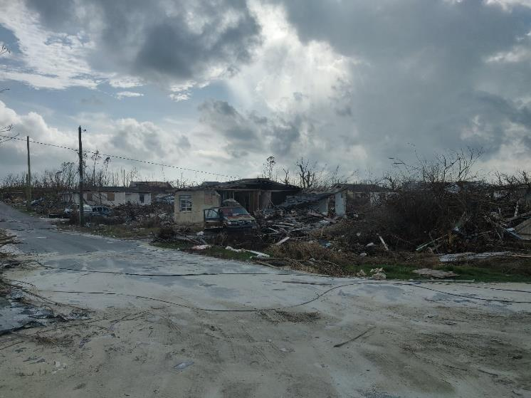
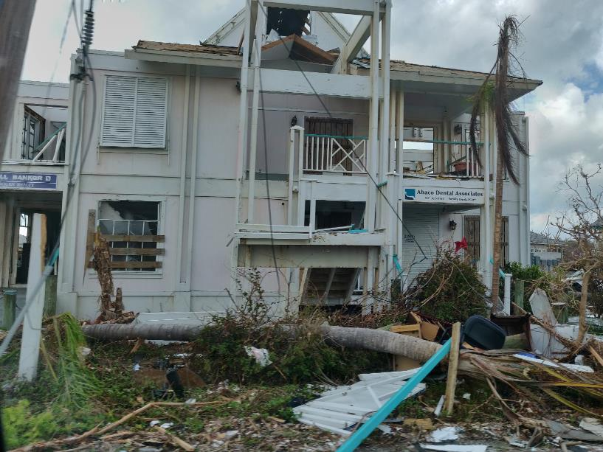
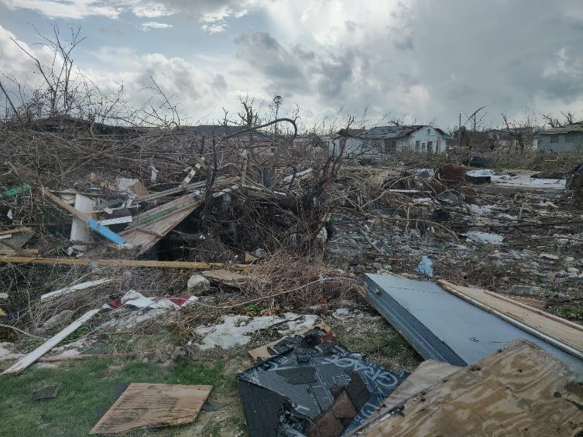
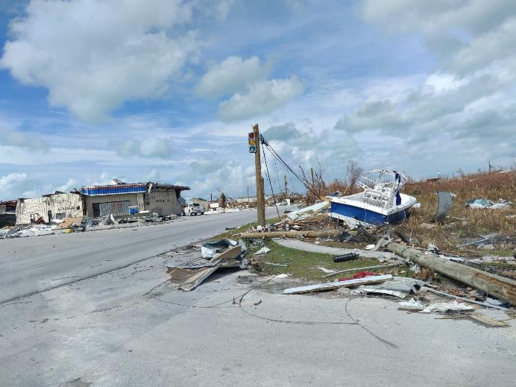
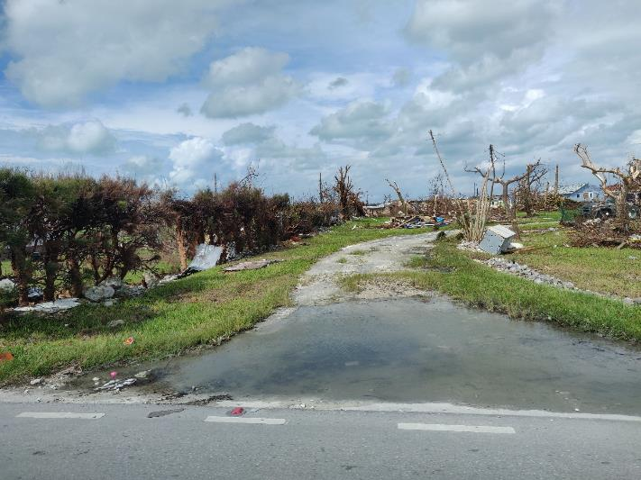
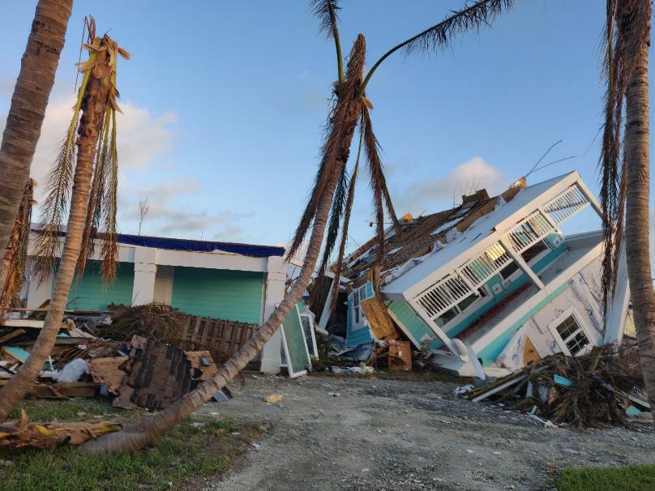
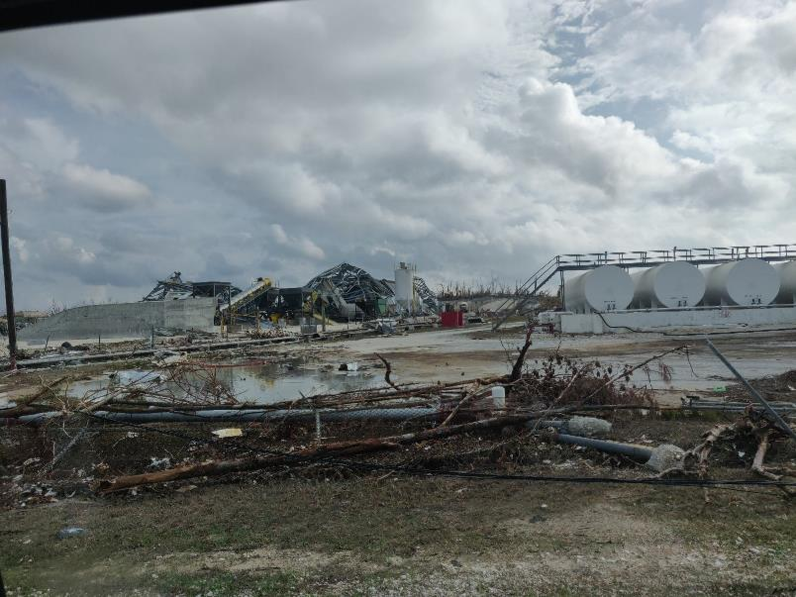
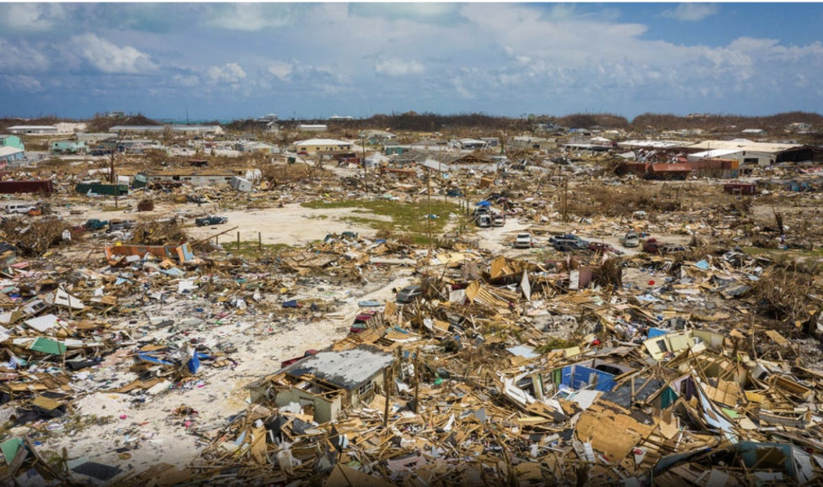
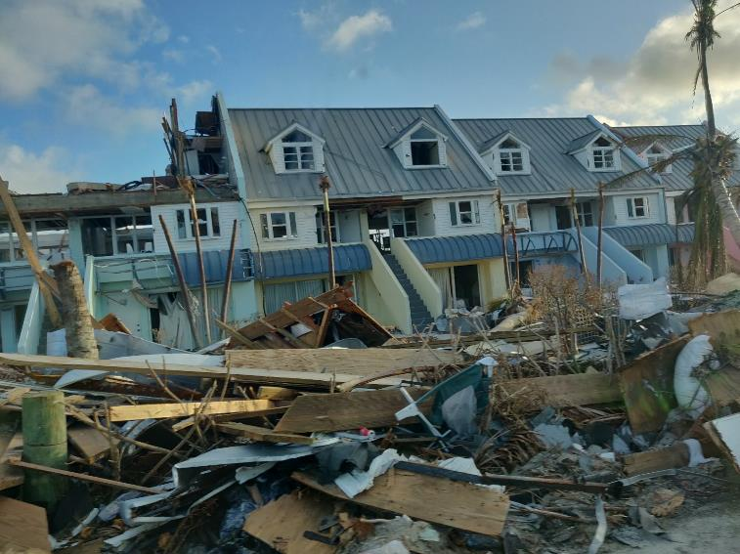
Notes:
Some photos of the devastation that was seen in Grand Bahama and the Abaco islands.
These pictures were taken by some of the field assessment teams as well as photos taken from media briefings and media reports

Slide 16
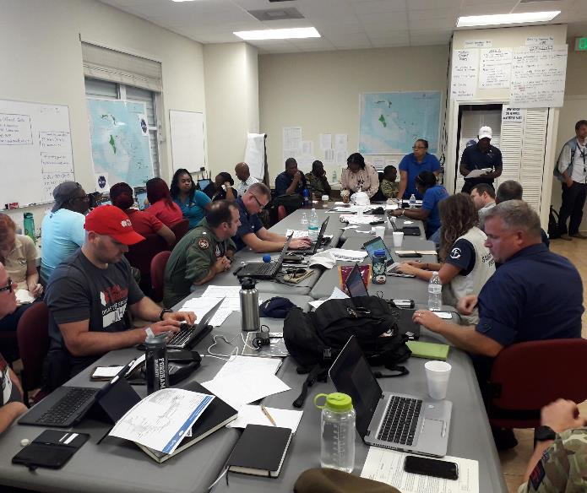
Where are Relief Agencies?
They were everywhere…but needed to be constantly located and mapped for changes in location, and overall coordination by a central command
Notes:
As stated earlier… it was really important to map where the relief agencies were for a number of reasons …
The first, and obvious reason - you would want to coordinate where aid and responders were, so it got equally distributed based on where the need was and not have all aid agencies targeting one location and in other areas not receiving as much AID but having just as much of a need…
the second reason would of course be from a security perspective, the coordinating agency… really needed to know where all the aid agencies were and by extension where the aid workers and responders were, so that in the event that there was some kind of security threat that information could be gotten into the hands of the right people. The necessary actions could then be taken and relevant arrangements made, to ensure that that security threat was mitigated and/or dealt with.
Even if that meant pulling the AID workers and the responders out of that area until the security threat dissipated

Slide 17
3W’s Maps Who is doing What, and Where are those Activities are located…

Slide 18
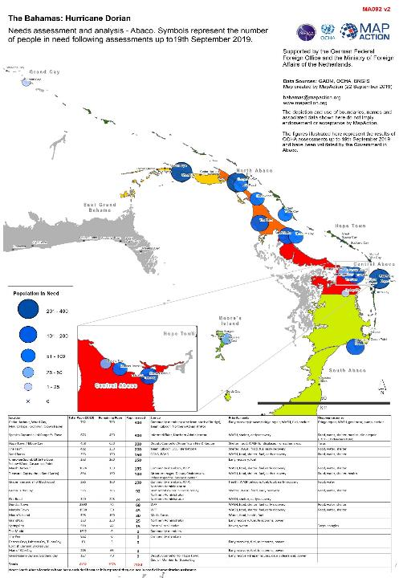
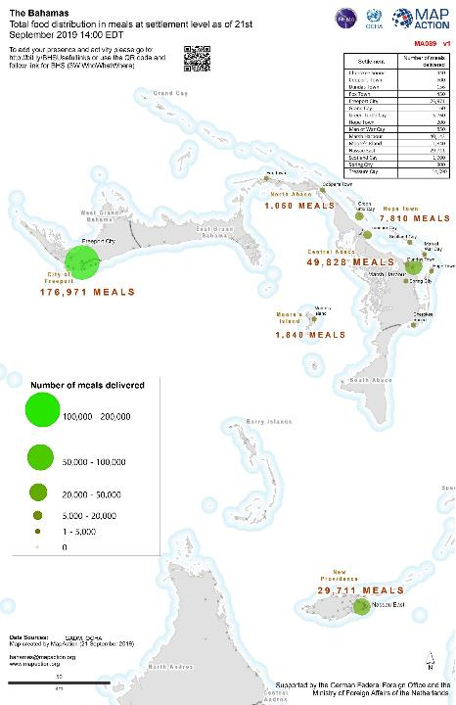
Who needs What?
Where Medical Supplies, Food, Shelter and Water is High Priorities
This Photo by Unknown Author is licensed under CC BY
Demand for Meals/Food currently being supplied
This Photo by Unknown Author is licensed under CC BY

Slide 19
Where are the access routes? How did UKHO/IHO data help…
The Map to the Left shows the Distribution Points for Food Supplies in Abaco in relation to Ports, Airports and Primary Road Infrastructure
Notes:
So let's talk about the importance of understanding how AID gets from where it is landed to where the affected areas and population are…
Will also talk a little bit about the role that the UKHO played in providing data to MapAction, which was then used to assist responders an aid agencies in determining the best and most efficient routes to deliver aid to areas that needed it most.

Slide 20
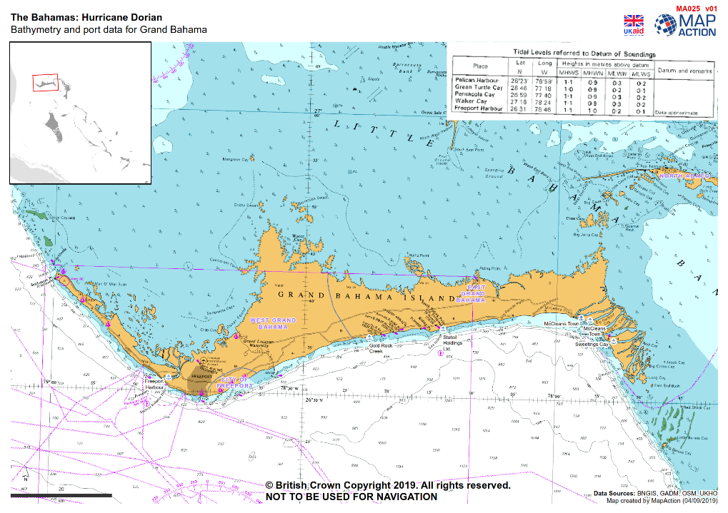
Route Access Mapping How do we get the supplies to the locations where it is needed most…
Notes:
Request came from the Dutch Navy and later the UK Navy Responders for mapping support, which would assist them in determining not just alternate landing site, but also different options with respect to the type of vessel that can be used to gain access to areas that needed AID.
These areas will primarily those where people in need, homeless and displaced… clustered in certain areas that provide natural shelter and protection, This clustering happened as a result of most of the predetermined shelter locations being damaged, destroyed or inaccessible.

Slide 21
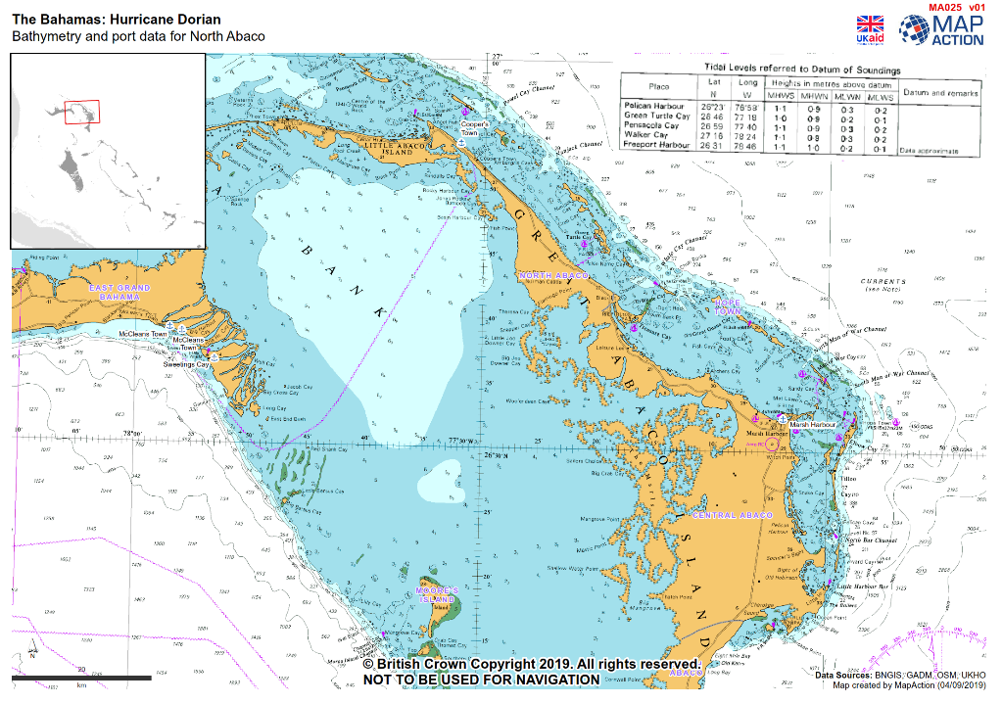
Route Access Mapping How do we get the supplies to the locations where it is needed most…

Slide 22
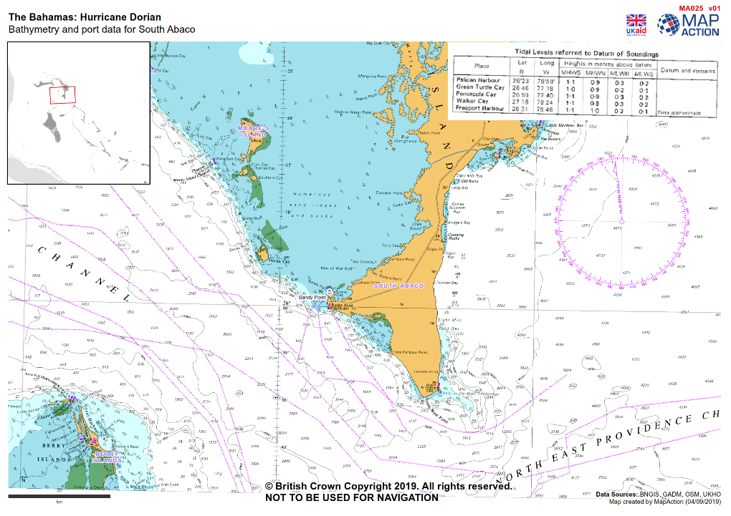
Route Access Mapping How do we get the supplies to the locations where it is needed most…

Slide 23
Feedback from the Deployment Team…
Maps were used to as a critical tool to determine alternate landing options and where smaller boats could be used safely to deliver Aid to Distribution Centres, especially where meals were supplied.
Data Requests and Protocols for Access…Need to be Formalized.
“Hi Sudesh, we made a few products using the large scale UKHO bathymetry that was used for aid delivery by the Dutch navy (to gain an understanding of what boats could be used depending on the draft).”
DC - Team Lead MapAction Deployment Bahamas 2019

Slide 24
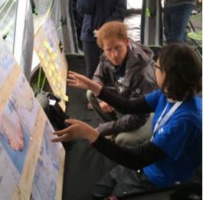
From Prince Harry…
“To see highly-skilled individuals give up their time like this is remarkable. Considering how few people there are, it is unbelievable how much they achieve. It’s the glue that binds everyone together.”
Prince Harry on visiting MapAction’s work at an international simulation exercise, September 2016

Slide 25
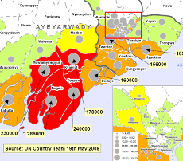
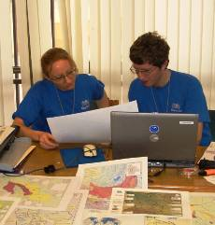
What the United Nations says:
“MapAction’s maps are in every UN, NGO and donor office. They have informed our decision making and proved essential to the planning of the humanitarian response.”
Daniel Baker, UN Humanitarian Coordinator
“I witnessed outstanding teamwork, cooperation, and willingness to go the extra mile. The performance displayed by your team speaks volumes of your organization’s commitment and dedication.”
UNDAC Team Leader

Slide 26
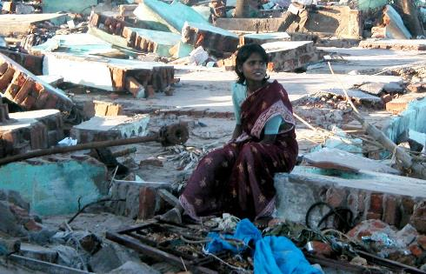
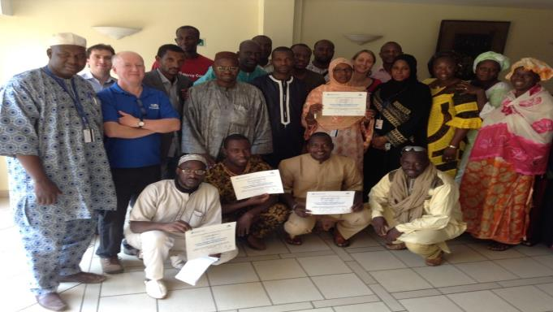
MapAction’s work helps to get aid to the right place and help people in the greatest need…
www.mapaction.org
Notes:
In conclusion, MapAction continues to be dedicated to providing disaster mapping response services wherever and whenever it is required to do so…
By assisting to :
Build response and data capacity within countries,
By Maintaining our level of
Inhouse Response Capability Training
Research and Development into Improved Software Tools
and finally but equally as important…
Building Relationships with other Critical Partner Agencies like the IHO. Partners with the ability to provide massive contributions with respect to knowledge, expertise and data.
Together, we can continue to make a valuable contribute, helping our fellow man in times of need. Thank You for you Time.

