Slide 1
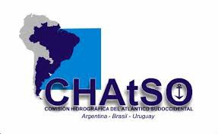
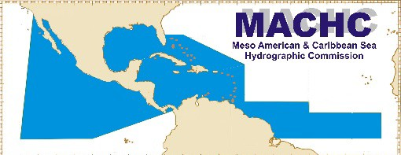
20th Meeting of the
Meso American – Caribbean Sea Hydrographic Commission
SWAtHC ENC Scheme
Directorate of Hydrography and Navigation Brazilian Navy

Slide 2
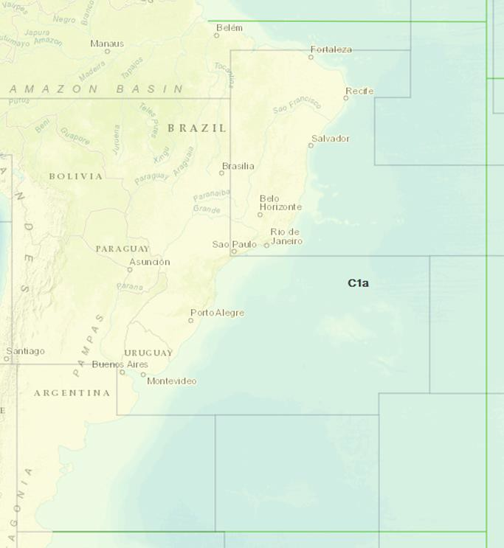
SWAtHC ENC Scheme
Usage Band 1 (all GB cells)

Slide 3
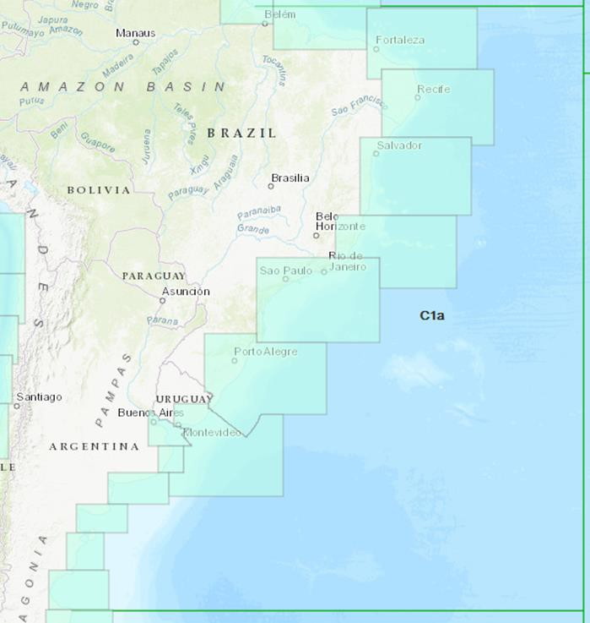
SWAtHC ENC Scheme
Usage Band 2 (all national cells)

Slide 4
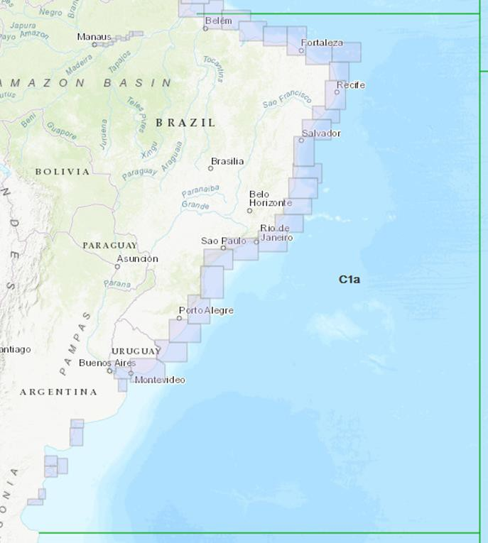
SWAtHC ENC Scheme
Usage Band 3 (all national cells)

Slide 5
SWAtHC ENC Scheme
Number of cells:
Argentina: 17
Brazil: 28
Uruguay: 4
Usage Band 1 national cells are being schemed in order to replace GB ones.

Slide 6
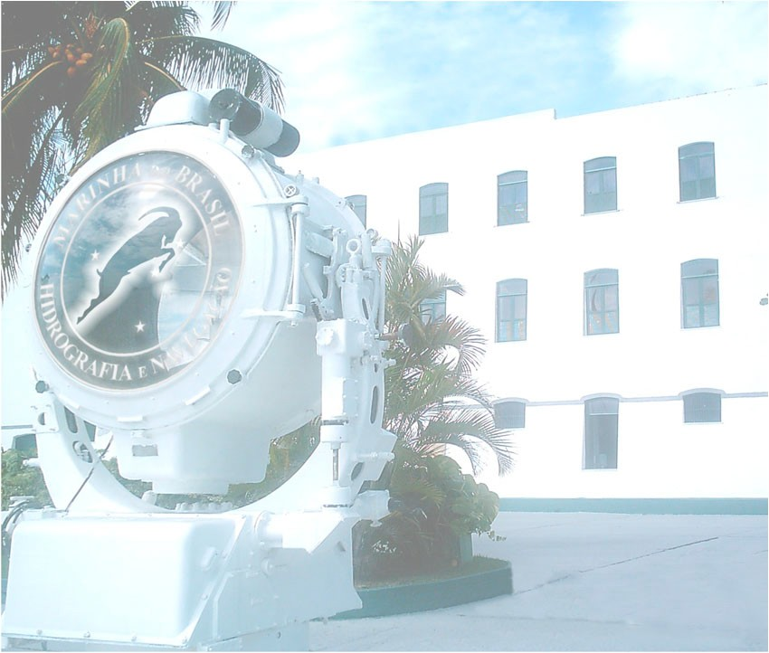
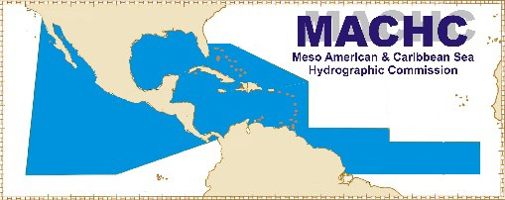
THANK YOU
Any further questions:
Lt Cdr (Engineer) Rafael Vieira rafael.vieira@marinha.mil.br
SWAtHC ENC Coordinator

