Slide 1
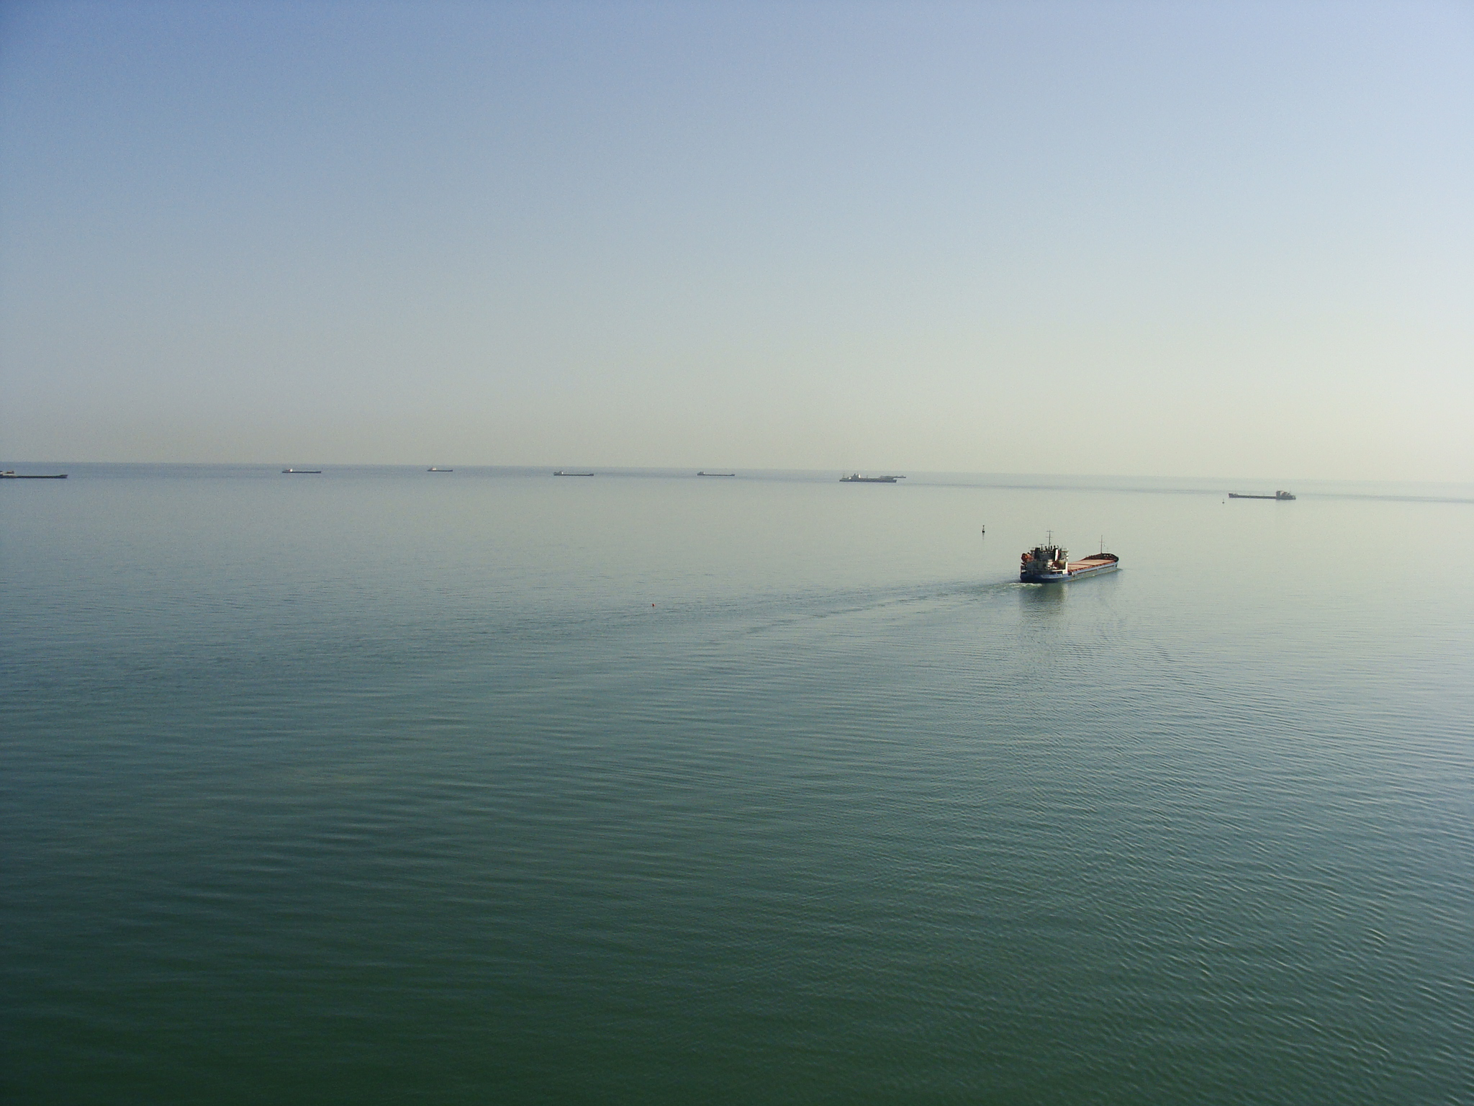
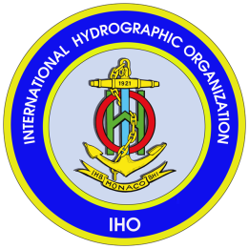
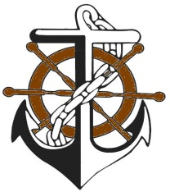
PMO
19th Meeting of Mediterranean and Black Seas Hydrographic Commission (MBSHC)
Batumi / Georgia 30 June-02 July 2015
Iran MSI Activities at the Caspian Sea
N.Baha, Head of Maritime Safety Dept. of Noshahr port.
Ports& Maritime Organization of Iran

Slide 2
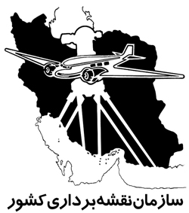
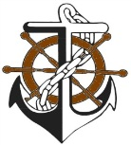
Iranian National Hydrography Committee
Iranian National Hydrography Organization ( NHO)
Iranian National Cartographic Center( NCC)
Iranian Ports & Maritime Organization( PMO)
Caspian sea National Research Center ( CSNRC)

Slide 3
Iranian National Cartographic Center( NCC)
Hydrographic operations including production of base charts and on request charting, acquisition and processing of tidal information, prediction and producing tide tables.
Production of Iran’s territorial waters hydrogarphic charts

Slide 4
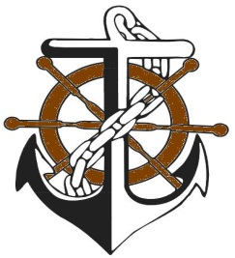
Ports & Maritime Organization( PMO)
PMO run Iranian three major ports at the Caspian Sea .
PMO is Iranian ports and maritime authority .
PMO is responsible for providing safety of navigation in whole Iran’s territorial water including within the Caspian Sea.
PMO has established three hydrography stations at the Caspian sea.
PMO produce nautical chart of port and its vicinity waters
PMO monitor the water level fluctuation of the Caspian Sea daily.

Slide 5
There is bilateral agreement between PMO and PRIMAR.
To produce ENC for the Caspian Sea 2015-2016

Slide 6
‍Caspian Sea fluctuation
1945-2015

Slide 7
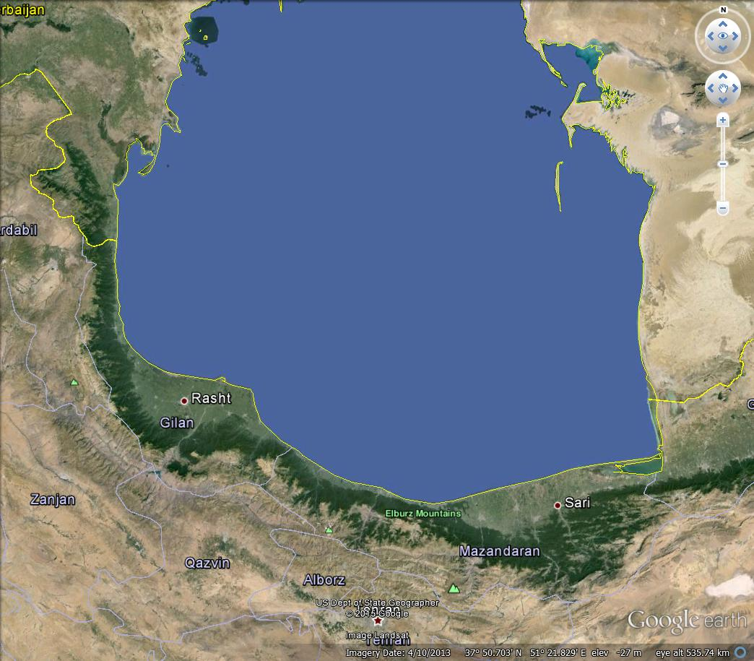
Iranian major ports and hydrography stations at
the Caspian Sea
Port of Anzali
Port of Fereydonkenar
Port of Amirabad
Port of Noshahr

Slide 8
Ministry of Energy
Water Research Institute (WRI)
Caspian Sea National Research Center (CSNRC)
Since : 1992

Slide 9
Major Functions
Environmental Monitoring
Caspian Sea Water level fluctuations
Hydrodynamic factors
Coastal processes and shoreline changes
Oceanography parameters
Rivers Hydrology which pour into the Sea
Marine Meteorology characteristics
Coastal Zone Management
Sea setback and controlling it
Controlling the shorelines and coastal profiles
Shore protection and beach management

Slide 10
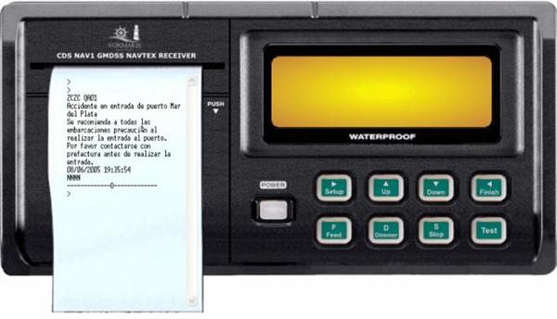
NAVTEX of the Caspian Sea

Slide 11
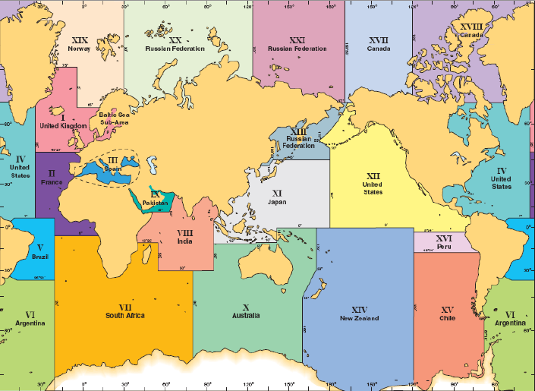
Here, we are

Slide 12
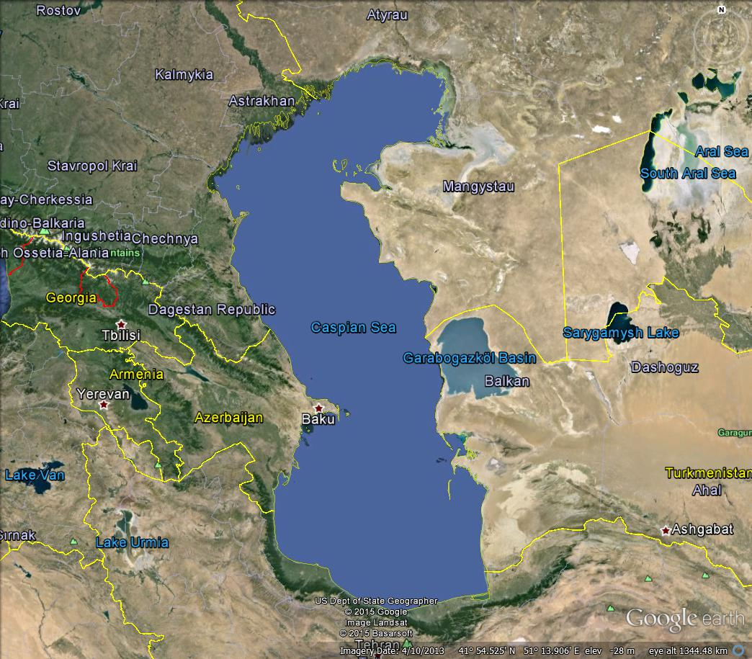
There are three NAVTEX stations at the Caspian sea:
1- Russia ( Astrakhan) NAVTEX covers North area of it.( 250 NMs)
2- Azerbaijan ( Chilov) NAVTEX covers middle of it. ( 200NMs)
3- Iran ( Fereydon Kenar) AVTEX covers South of it. ( 250NMs)

Slide 13
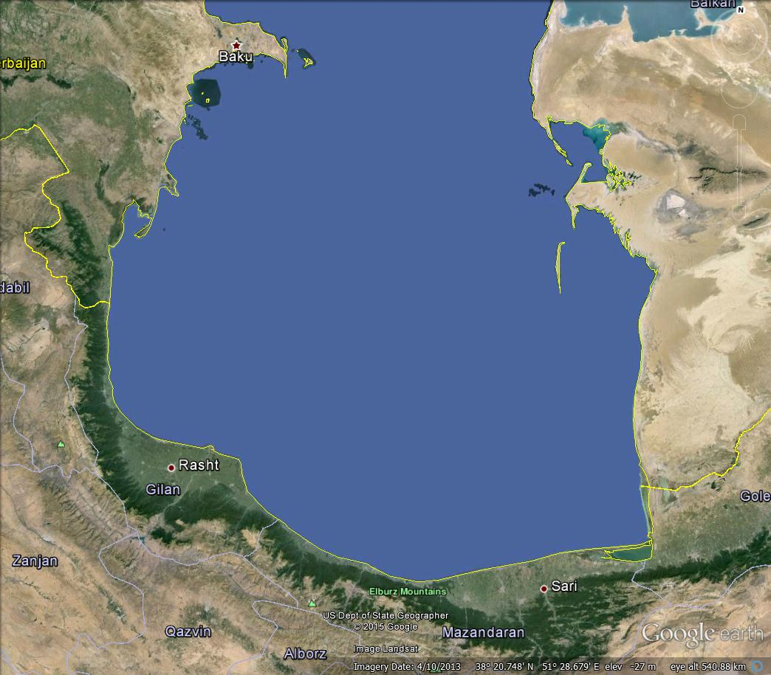
Iran’s NAVTEX station at the Caspian Sea Fereydon kenar port
Specification:
Area: III
ID: J -490 KHZ local language
ID: G- 518 KHZ English language.
Latitude: 36 42 00N
Longitude: 45 33 00 E
Rang: 250 NM
Status: Operational
Fereydon Kenar

Slide 14
Timetable of Message
 | 2100 | 1700 | 1300 | 0900 | 0500 | 0100 | U.T.C
 | 0030 | 2030 | 1630 | 1230 | 0830 | 0430 | L.T

Slide 15
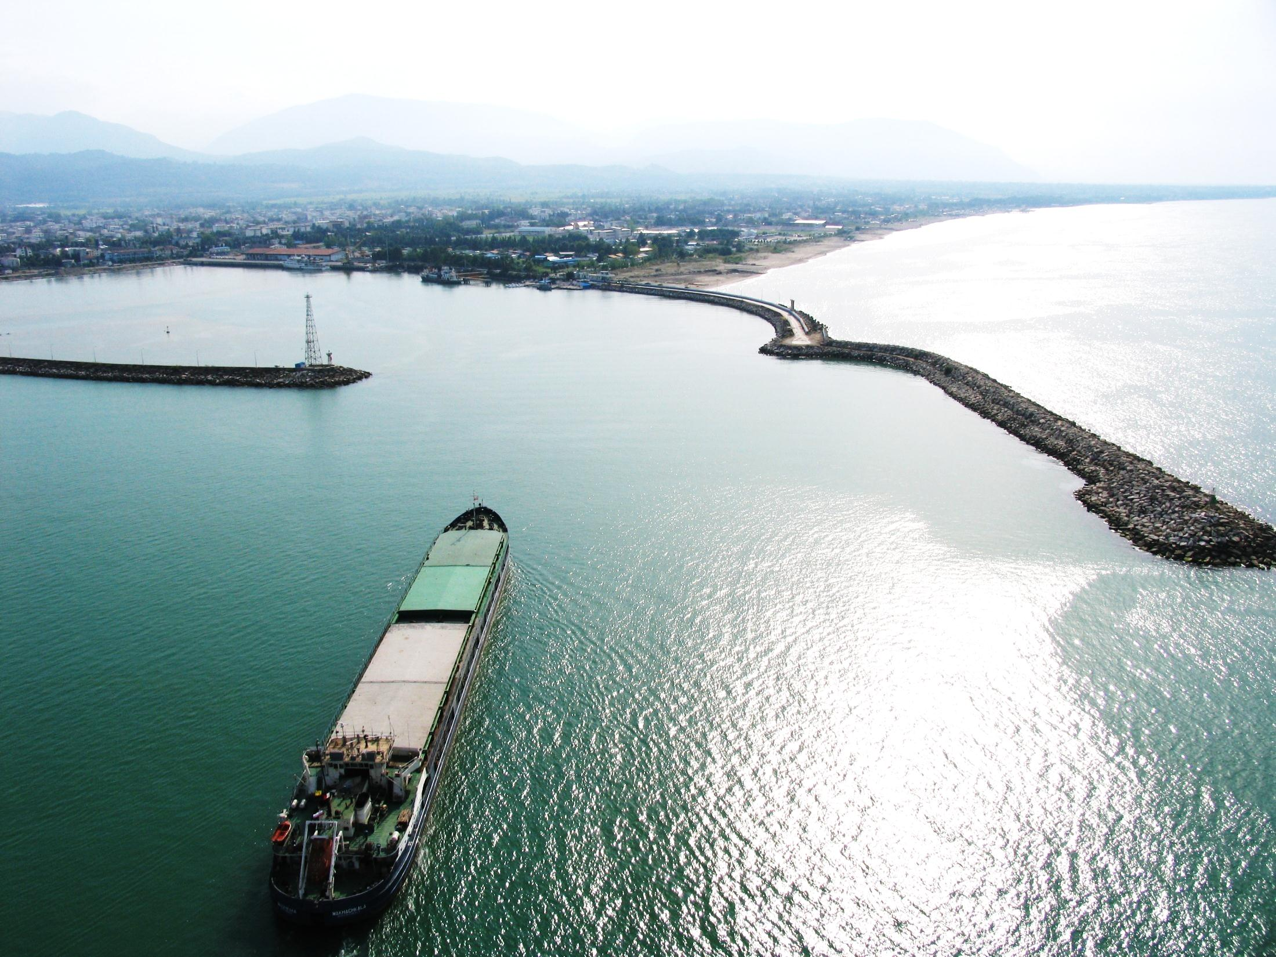
Thanks for your Attention

