Slide 1
PRIMAR 2016 – NHC61
Norwegian Hydrographic Service

Slide 2
PRIMAR’s Vision
In order to enhance safety at sea and protect the maritime environment, PRIMAR’s vision is to be the most efficient model for the provision of ENC services and maritime geospatial data worldwide.

Slide 3
Targets for 2016
Continuously provide the world’s most efficient ENC quality control and validation services.
Increased ENC coverage
Capacity Building
Increase sales – financial sustainability
Technology development
Visibility

Slide 4
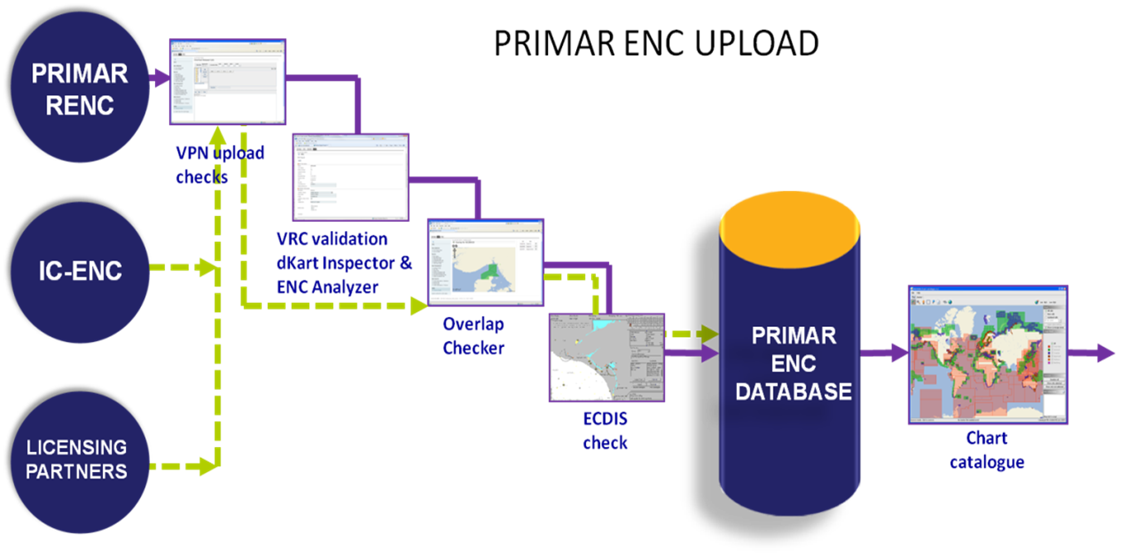
ENC qC and validation services

Slide 5
ENC qC and validation services

Slide 6


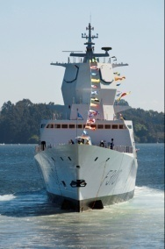
PRIMAR RENC value chain
Croatia
Estonia
Finland
France
Georgia
Iran
Latvia
Lithuania
Montenegro
Mozambique
Norway
Poland
Sweden
Russia
Ukraine
PRIMAR
RENC
MEMBERS
60 different official ENC providers
Commercial
users
PRIMAR
ENC
Database
15 200
ENCs
54 Commercial Distributors
Governmental users
8 Governmental Distributors
Canada
China
India
Indonesia
EAHC
MSS
Japan
Korea
PRD ENC
Singapore
PRIMAR
LICENSING PARTNERS
7 Navy Suppliers
Navy
users
19 500 registered end-users
ALL
IC-ENC
RENC
DATA

Slide 7
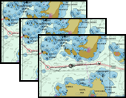
PRIMAR ENC Distribution
Commercial
users
54 Commercial Distributors
PRIMAR ENC
DATABASE
Governmental users
8 Governmental Distributors
7 Navy Suppliers
Navy
users
PRIMAR supports a wide range of services to assist hydrographic offices in meeting their national requirements.

Slide 8
PRIMAR Navy / Governmental Supplier Services
Delivery of both encrypted and unencrypted ENC service to Navy users – depending on national restrictions.
Access to all ENCs distributed by PRIMAR.
ENCs at wholesale prices. HOs may issue a discount for their own national ENCs.
Distribution from the Navy / Governmental Supplier is strictly limited to own national users.

Slide 9
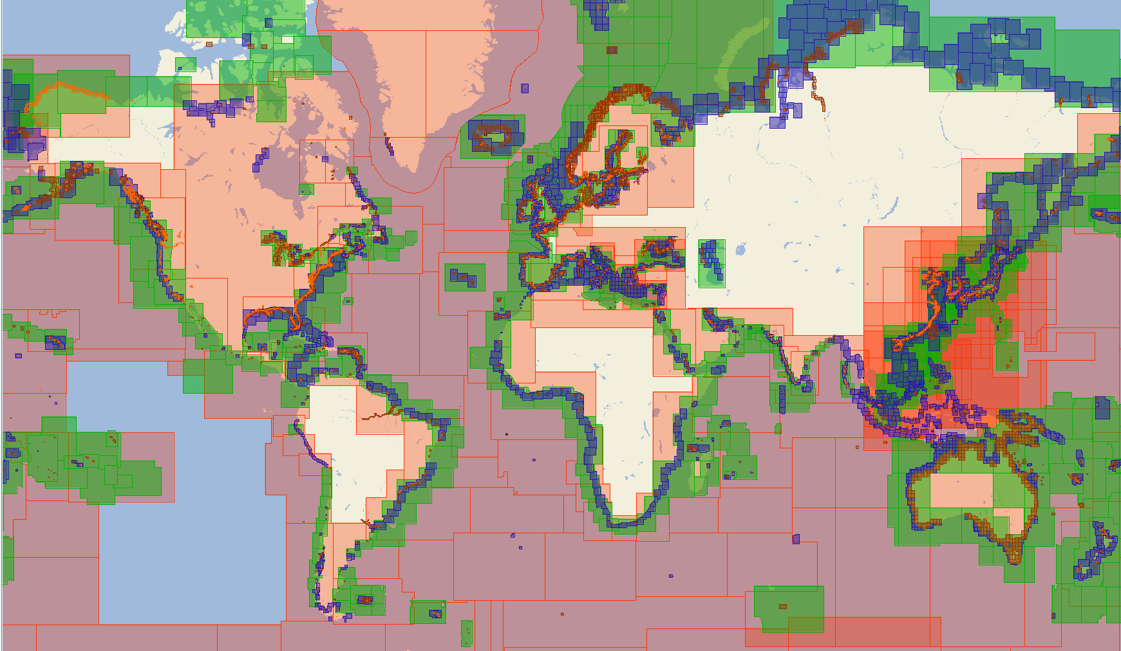
PRIMAR Chart Catalogue

Slide 10
2016 Capacity Building
Three ENC validation workshops for four different nations. Nine ENC validators were trained.
The 14th PRIMAR TEWG meeting. Thirty participants. Focus on new WEB Data Management tools in PRIMAR, ENC overlap. S-58, S-101 and S-102.
One course in ENC distribution and services arranged for a Navy after signing the PRIMAR Navy Supplier Service.

Slide 11
2016 Financial Issues
Total revenue of ENC sales 21 % increase compared with 2015.
Total cost of PRIMAR operation $2,07m.
Financial surplus (excess of cost coverage) of approximately $460k to be paid back to member nations.

Slide 12
2016 Financial Issues
New financial model approved by PAC 23. Effective from 2017.
Fixed fee pr. ENC transaction
Transaction fee commercial transactions: $1,0
Transaction fee national transactions: $1,4
Transaction fee national services to non-PRIMAR members: $2,3

Slide 13
2016 Technology Development
VPN Java applets to WEB project. Completed.
Official ENC data report. Completed.
Development of next generation of the PRIMAR Chart Catalogue has started. From Java to Web with improved functionality.

Slide 14
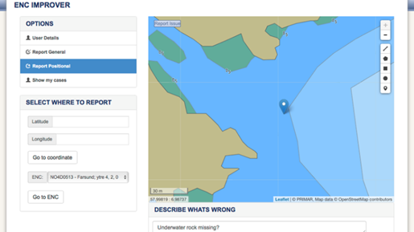
2016 Technology Development
Web-based PRIMAR ENC Improver. Completed.
Allows an end-user to provide feedback to the Hydrographic Office on observed errors in an ENC.

Slide 15
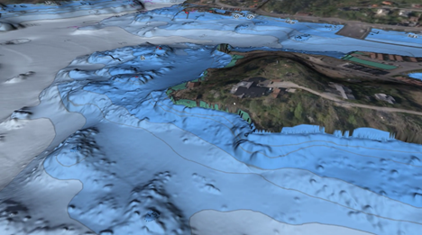
2016 Technology Development
S-102 data distribution. Ongoing.
S-102 upload, validation, viewing, encryption and distribution.

Slide 16
Targets for 2017
Provide the world’s most efficient ENC quality control and validation services.
Increased ENC coverage – new members.
Capacity Building
Evaluation of new financial model
Updated strategic plan
Continue technology development – S-101 project start.
Visibility

Slide 17

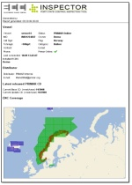
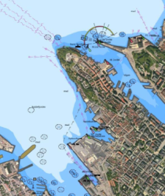
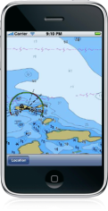

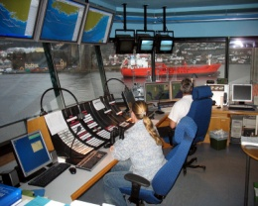
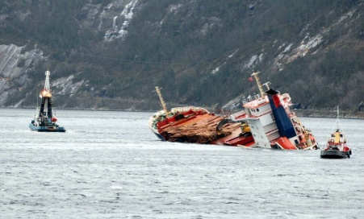

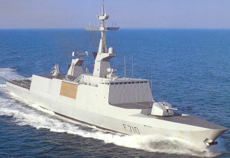
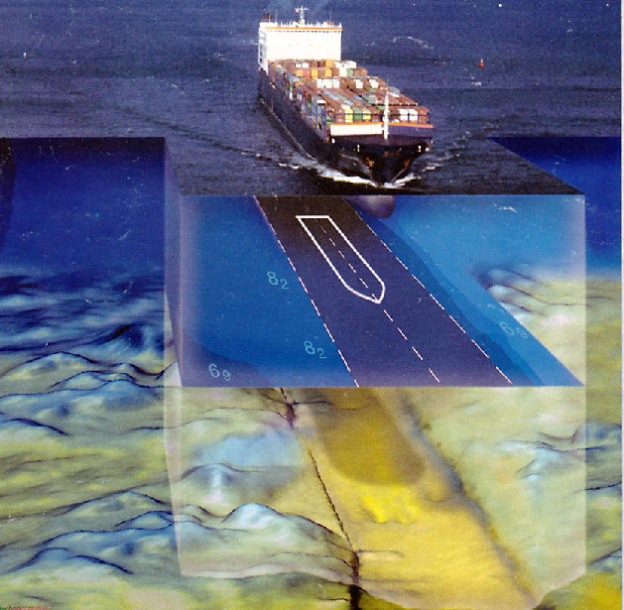
Maritime Safety Circle
Through PRIMAR, all actors have access to the
SAME CHARTING INFORMATION
Port State
Control
Government and
maritime authorities
Navigation on
official ENCs
ENC
on WMS
Vessel Traffic
Management
Pilots
Search and
Rescue
Navy and
coast guard
Navigation on
official ENCs
Notes:
By utilizing the PRIMAR infrastructure, a PRIMAR member nation can contribute to increased maritime safety and protect the maritime environment.
All actors in the maritime safety circle can have access to the same charting information.

Slide 18
Thank you for your attention
Questions?
www.primar.org

