Slide 1
MERTA MIGRATION
- Our experiences so far
NHC63 / Juho Salmia
10.4.2019
1

Slide 2
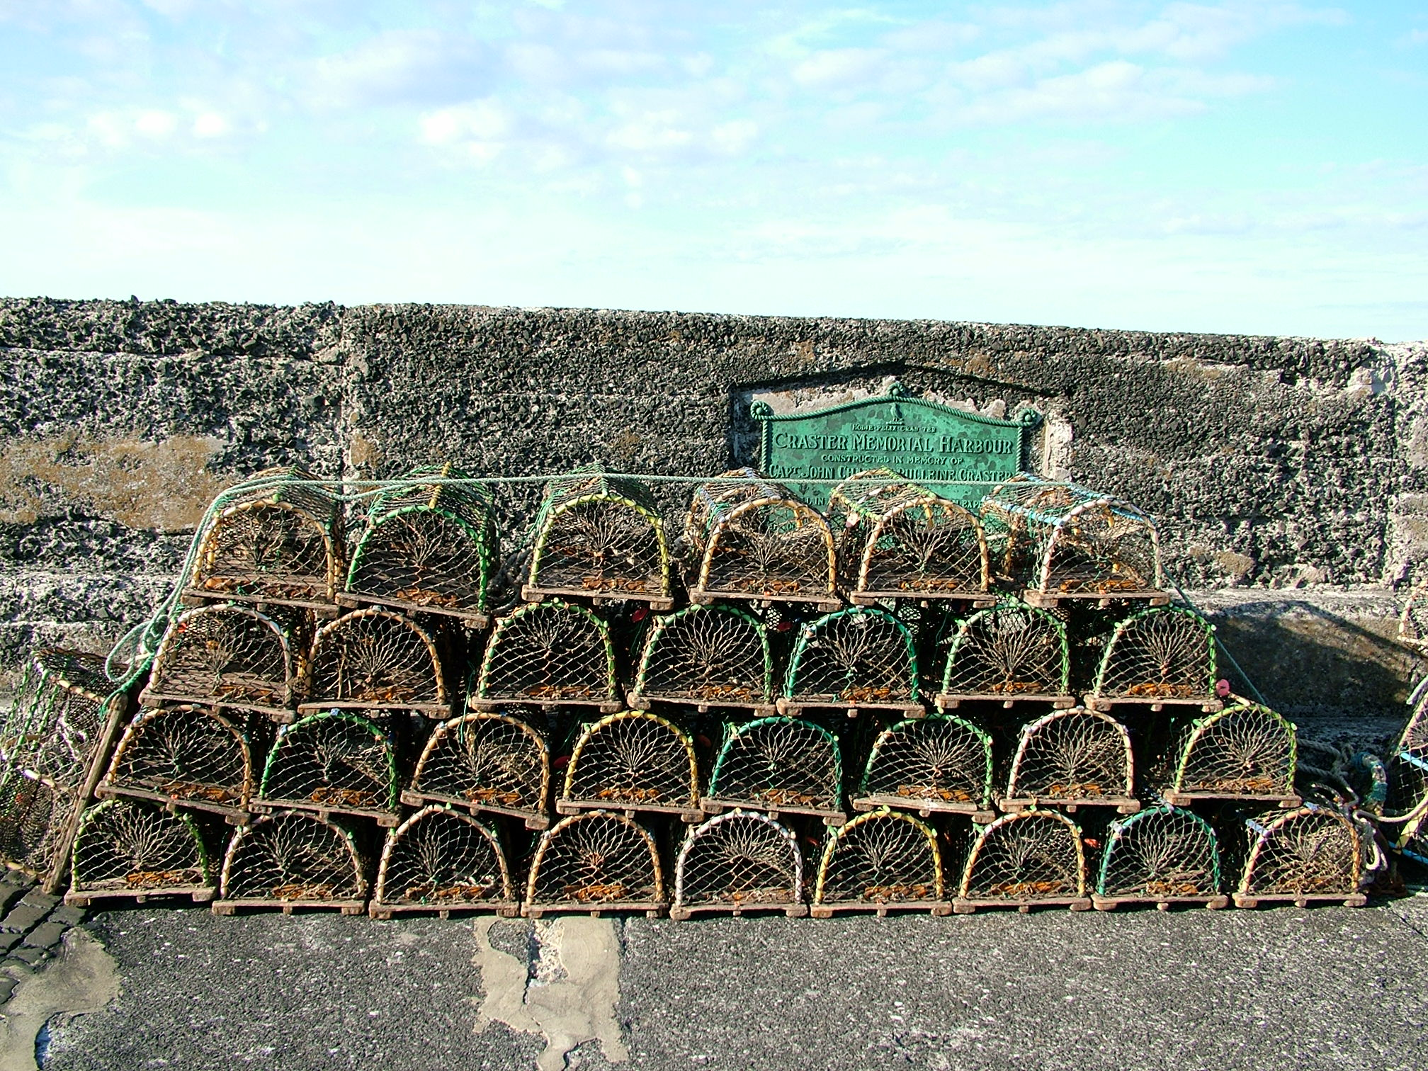
MERTA
“MERTA is a system for validating, maintaining and storing hydrographic survey data. It is also used for creating surface models and other deliverable data products from hydrographic survey data”
MERTA is also a finnish word for crab trap →
Image source:
Tagishsimon
CC BY-SA 3.0
https://commons.wikimedia.org/wiki/File:Lobster_pots_at_Craster_harbour_-_2005-06-25.jpg
Retrieved 11.3.2019
Notes:
My collague described Merta
MERTA is actually a finnish word that means crab trap

Slide 3
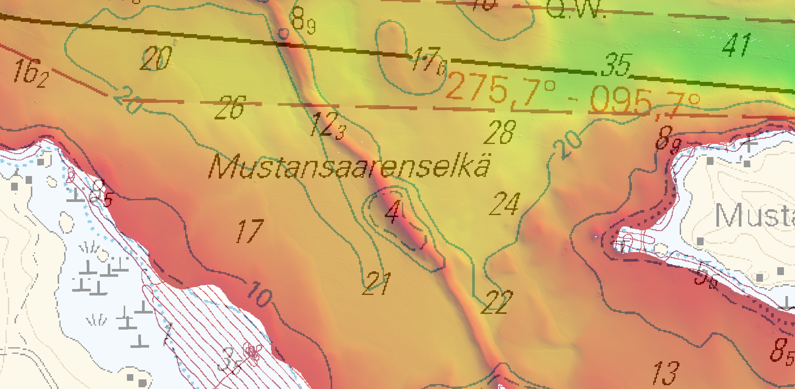
OBJECTIVE OF DATA MIGRATION TO MERTA
All data is uniform and accessible with CARIS software
CRS: ETRS-TM35FIN
Vertical Datum: N2000 / N2000+xx.xx
Format: CSAR
Image: Beautiful ridge at the bottom of lake Saimaa. Chart L208 overlaid on SDTP-combine surface made of MBES and SBES-surveys. Grid size is 2m.
Notes:
Compliant to finnish standards

Slide 4
SOURCE DATA
}
Bathymetric point clouds
Formats: FAU, LAS, S2 (legacy)
FAU
Differences in angle formats
LAS
S2 (legacy)
Differences in the level of maintanence
and point cloud density
Differences in x,y,z origo
Vertical datums
Mean Water (MWyyyy)
N2000
N2000+xx.xx
Normal Null (NN+xx.xx)
CRS
KKJ
KKJ (MKL7-transformation)
WGS84
ETRS89/UTM34N
ETRS89/UTM35N
CSAR
N2000 / N2000+xx.xx
ETRS-TM35FIN
Notes:
Tenths and hundreths

Slide 5
SOURCE DATA
FORMAT | SIZE
FAU | 17.9 TB
S2 | 1.5 TB
LAS | 1.5 TB
TOTAL: | 20.9 TB
Numbers presented in this table are rough estimates
Massive task to go through and transform all data, even for high end computers!
… and we did not want to make it too easy for ourselves, either!
Size increases when transformed to CSAR –format!
Icon source:
The Oxygen Team, KDE
GNU Lesser General Public License
https://commons.wikimedia.org/wiki/File:Oxygen480-devices-drive-harddisk.svg
Retrieved 11.3.2019

Slide 6
ORIGINAL MIGRATION WORKFLOW
VECTOR MIGRATION
BATHYMETRY MIGRATION
POINT CLOUD IN DB
Vectors are migrated first
Information is checked
Metadata for vertical shift
Necessary transformations are performed for each dataset
Dataset is gridded to 25cm shoalest depth true position
Dataset is uploaded to DB
Point cloud is stored in the database
Combine surface is created from the point clouds in the DB
Combine surface is compared to mechanical sweepings, dredging areas etc. → 25cm point cloud is updated accordingly

Slide 7
CURRENT MIGRATION WORKFLOW
VECTOR MIGRATION
BATHYMETRY MIGRATION
POINT CLOUD PROCESSING
POINT CLOUD IN DB
Vectors are migrated first
Information is checked
Metadata for vertical shift
Necessary transformations are performed for each dataset
Each full density point cloud is compared to Safe Clearence Areas and conflicting soundings are outputted into CSAR
Full Density point cloud is compared to other data sources
Conflicts are resolved or onflicting soundings that fall within error budget are flagged as Examined
Full Density point cloud is transferred to file server
Full Density CSAR is first gridded/thinned to 25cm SDTP
25cm SDTP is uploaded to DB
Combine –surfaces are created from the point cloud in DB.

Slide 8
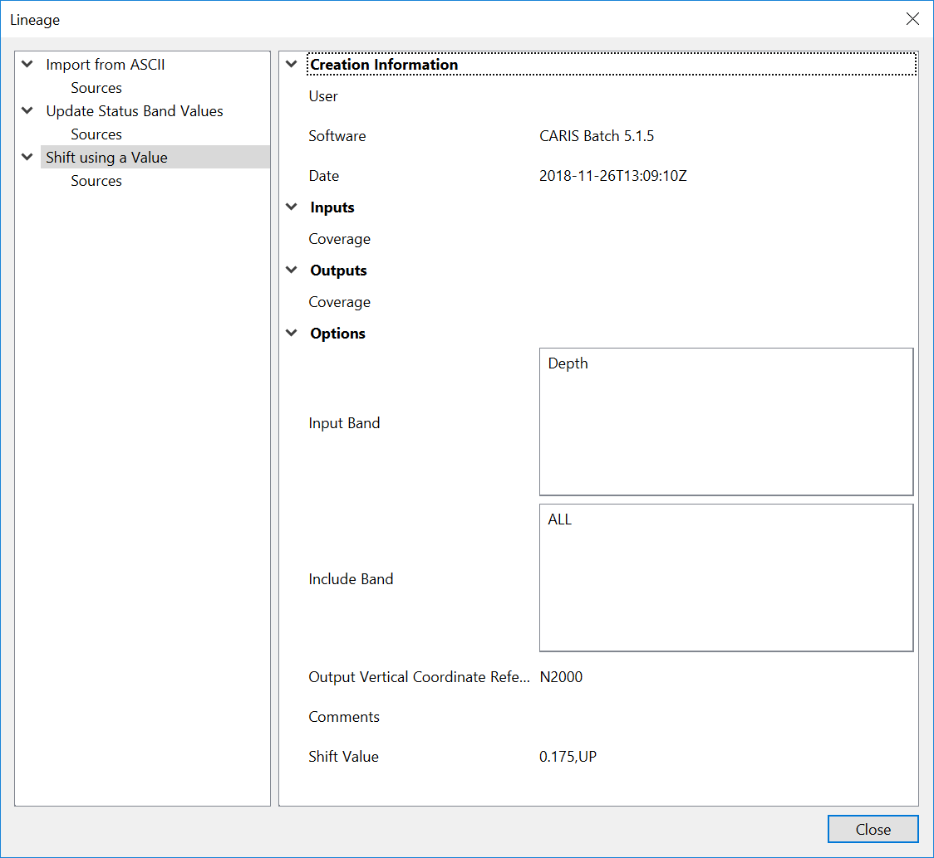
TOOLS
CARIS PYTHON API
CARIS provided scripts for basic functionalities
Tools were suitable for the initial plan
We had to modify the tools
Batch –runs
FME (comparison against SCA’s, Affine transformation for KKJ→ETRS-TM35FIN
Automate everything that we can (file transfer, naming, gridding etc.)
User has to know the data and select correct migration path
Tool transforms the data into CSAR, performs necessary shifts, renames files, modifies attributes and performs comparison against safe clearance areas
User has to know the data and select correct migration path

Slide 9
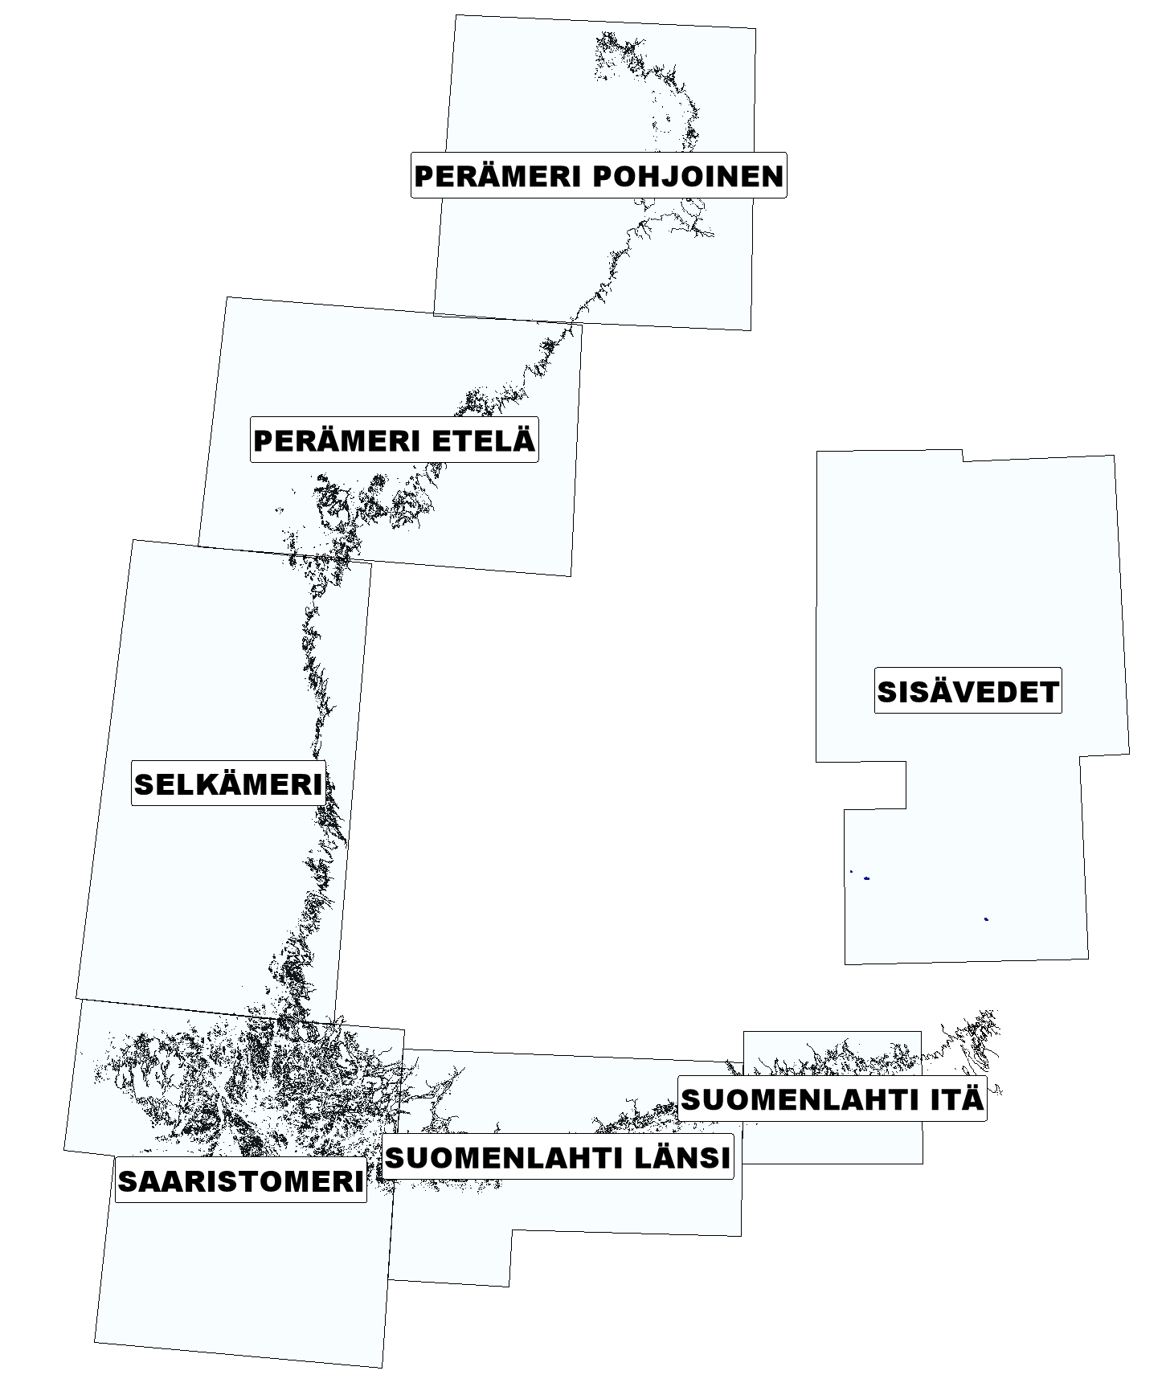
SCHEDULE
Eat the elephant one bite at a time…
Follows the schedule for publishing charts
Starts from Bay of Bothnia
Currently we are working on area 1 (Bay of Bothia north), lot has been done, but still work to do ☺
Notes:
If I had any humor left, I’d ask which schedule are we behind this time.

Slide 10
CHALLENGES
Effective use of computers
Software issues (or features?)
Licensing, vector rendering from DB, quick update cycle of BASE Editor
Amount of variations in the data, especially legacy data
Amount of data in source data AND in Full Density CSAR’s
Processing the full density data takes A LOT of time
Searching for conflicts in the FD data takes time
Update cycle of the full density CSAR’s takes a lot of time
Handling several over 200GB CSAR’s at one workspace
Limited time
Creation of the end product (Combine-model) takes too much time with the current specifications

Slide 11
Thank you for listening!
juho.salmia@traficom.fi
www.traficom.fi
@TraficomFinland

