Slide 1
The IALA World-Wide Academy
Presentation to RSAHC
Stephen Bennett; Programme Manager
March 2013

Slide 2
IALA – The Aim
To harmonise Aids to Navigation worldwide and to ensure that the movement of vessels are safe, expeditious, cost effective and harmless to the environment

Slide 3
IALA
International Association based in Paris
Not-for-profit
Non political
Created in 1957 (but with origins from the 1800’s)
One of the first International Organisations to be granted special Observer Status with the International Maritime Organization 1961
A number of Memoranda of Understanding with other international organisations

Slide 4
Governing Bodies and Membership
General Assembly
National Members voting
All members participate
24 Member Council
Council Working Groups
Strategy Group
Legal Advisory Panel (LAP)
Over 80 National Members (Coastal States)
Associated Members (Organisations with related maritime activities such as Port Authorities)
Over 100 Industrial Members

Slide 5
The IALA Toolbox
Council
Bulletin
Seminars
Workshops
Symposia
Academy
Website
Conference
Committees

Slide 6
The IALA Committees
Aids to Navigation Management
e-Navigation – over 100 delegates
Engineering, Environment and Preservation
Vessel Traffic Services
Draft IALA Recommendations and Guidelines available free on the IALA website

Slide 7
The Academy
“The IALA World-Wide Academy (WWA) is the vehicle by which IALA delivers training and capacity building”
The Academy works closely with the IMO, IHO, WMO, IOC and FIG as part of the UN capacity-building “Delivering as One” initiative
Effective AtoN cannot be delivered without hydrographic surveys conducted to IHO standards

Slide 8
Governance
Academy Board
Activity listed in Master Plan - approved by Council
Independently funded but totally integrated
Increasing significance within IMO

Slide 9
Academy Deliverables - Training
Training and Model Courses
VTS courses – V-103 series
Risk Management Workshops
AtoN courses – E-141 Ed 2
AtoN Manager – E-141/1
One month AtoN Level 1 Manager course at IALA in March 2014
AtoN Technician – IALA WWA L2.0
30 specialised model courses – L2.1.1 to L2.11.5
Awareness seminars for Senior Managers – E-141/2

Slide 10
Capacity Building - The “4As”
Joint IHO/IALA WWA strategy
Stage 1: Raising AWARENESS through targeted “Level 1+” seminars using a pre-seminar questionnaire
Stage 2: Request by newly aware States for ASSESSMENT of needs leading to…..
Stage 3: ANALYSIS of requirements including the use of available AIS data from all sources to give……..
Stage 4: Recommended ACTIONS to achieve full compliance

Slide 11
Capacity Building Regions
Region | Target States
East Asia | 4
Eastern Atlantic | 19
Meso-America and Caribbean | 19
North Indian Ocean | 10
ROPME Sea Area Region | 4
Southern Africa and Islands | 8
South-west Pacific | 11

Slide 12
Academy Capacity Building Events
 | Category | 2012 | 2013 | 2014
Stage 1 | Awareness | Bahrain Cape Town Mauritius Thailand Sydney E Atlantic (Portugal) Guatemala | Mauritania Myanmar Riyadh Mombasa Indonesia Thailand Singapore Vanuatu | SW Pacific East Asia S. Africa Gulf
Stage 2 | Assessment |  | Mauritius Cameroon Madagascar | East Asia SW Pacific N. India
Level 1 | AtoN manager |  | Papua New Guinea France | IALA HQ France
Risk | Workshops | Sydney | Madrid | East Asia?

Slide 13
Responsibility of the Competent Authority
Responsibility for the provision of AtoN services remains with the Government or its delegated Competent Authority (CA) not with the service provider
In many cases, the CA is also the AtoN service provider

Slide 14
Training and Accreditation
IALA does not accredit training organisations or courses conducted by other authorities or academies
Only Competent Authorities of IALA Member States can accredit Training Organisations to deliver approved IALA Model Courses

Slide 15
Accreditation Process
IALA WWA
CA
LIST of fully compliant States; training institutes and Industrial Members delivering V-103 and E-141 training
IALA-endorsed experts
Training Institute

Slide 16
Register of IALA Experts
Potential experts to be nominated by National Members or by individual application
Forms available soon on the Academy website
Applications to be vetted by panel from appropriate committee
IALA Council to endorse experts
Endorsement to be reviewed after specified time
Remuneration at UN day rates

Slide 17
Use of IALA Logo
Certificates of attendance or competency to participants on Model Courses or workshops delivered by IALA will carry the logo
Not on the list of ATOs –IALA logo cannot be used!

Slide 18
Summary
IALA aims to improve safe navigation
IALA Committees generate Recommendations and Guidelines
The World-Wide Academy delivers training through model courses and seminars
Competent Authorities requested to accredit Training Courses
Joint Capacity Building Strategy with the IHO

Slide 19
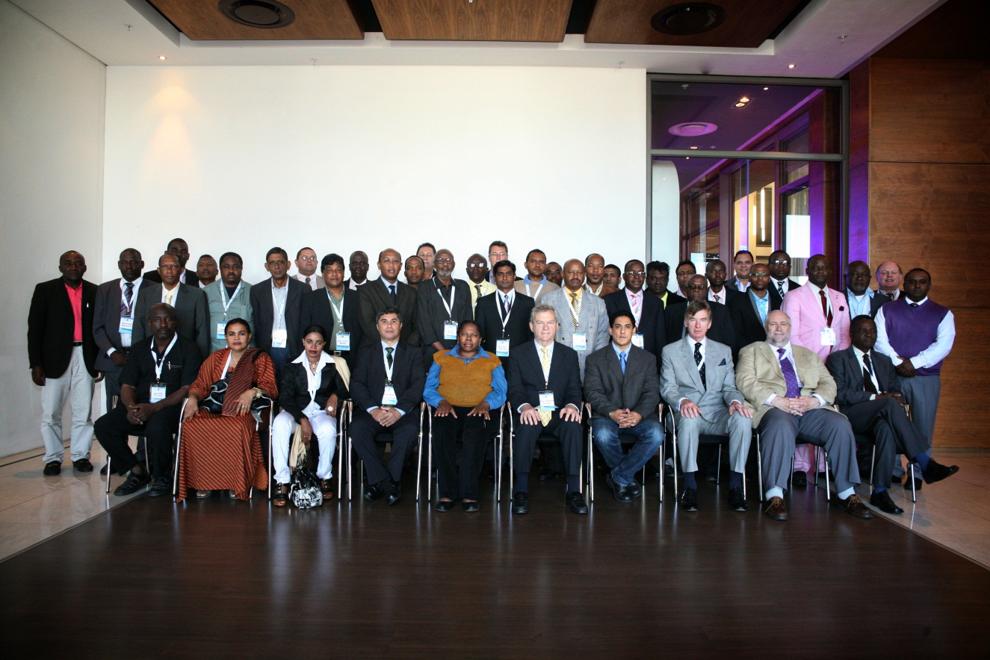
Questions?

