Slide 1


14th South West Pacific
Hydrographic Commission Conference
30 November – 02 December
Noumea, New Caledonia
COOK ISLANDS
Vaipo MATAORA
Director Civil Work & Hydrography

Slide 2

14th South West Pacific Hydrographic Commission Conference
Outline
CINHCC Update
IALA Technical Needs Assessment Findings
PRNI
    Bilateral Arrangement
    AtoN Registered
    Survey Charting
    Capacity Building
SWPHC Meeting
IHO C-55 Status of Hydrography Surveying and Charting
Worldwide – review & update
IHO Yearbook
MSI
Capacity Building
Conclusions

Slide 3
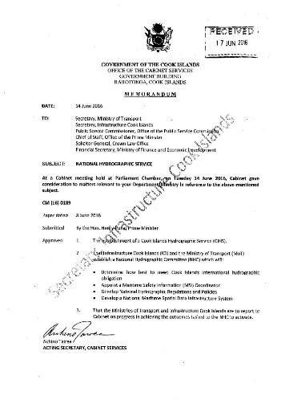
14th South West Pacific Hydrographic Commission Conference
CINHCC Update

Slide 4
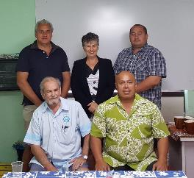
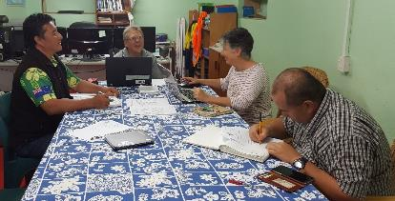
14th South West Pacific Hydrographic Commission Conference
CINHCC Update
Cook Islands Government approved 14th June 2016
CINHCC Established 6th September 2016
CINHCC Core Members
    Infrastructure Cook Islands
    Ministry of Transport
    Cook Islands Port Authority

Slide 5
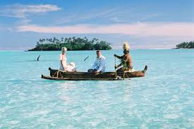
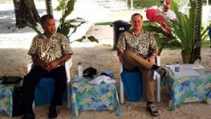

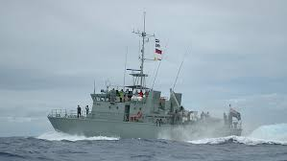
14th South West Pacific Hydrographic Commission Conference
CINHCC Update
CINHCC Members
Tourism Cook Islands
Ministry of Foreign Affairs & Immigration
Ministry of Marine Resources
Ministry of Police (Surveillance)

Slide 6
14th South West Pacific Hydrographic Commission Conference
CINHCC Update
Reviewing and managing the Memorandum of Understanding (MoU) with Land Information New Zealand (LINZ) with regards to surveys, nautical charts and promulgation of MSI.
Reviewing and verifying information in notices to mariners, sailing directions, lists or lights, etc. related to the Cook Islands is correct and up to date;
Verifying processes and procedures for MSI are implemented effectively;
Reviewing reports and audits of hydrographic, aids to navigation, MSI or related matters and ensuring action plans are implemented to address findings;
Clarifying procedures and processes for implementation of aids to navigation (AtoN) to ensure information is included as MSI / on charts.
Reviewing and verifying charted information is correct and up to date;
CINHCC will coordinate national hydrographic requirements through;

Slide 7
14th South West Pacific Hydrographic Commission Conference
IALA Technical Needs Assessment
High Priority (immediate)
Recommendation 3: compile list of AtoN -related charted differences
Medium Priority (by October 2016)
Recommendation 2: nautical publications and charts held and maintained
Recommendation 15: numerical analysis of maritime traffic
Recommendation 17: develop and maintain national AtoN register
Medium Priority (by June 2017)
Recommendation 18: physical audit of all AtoN listed in register
Lower Priority (by end 2018)
Recommendation 35: install lights on FADs

Slide 8
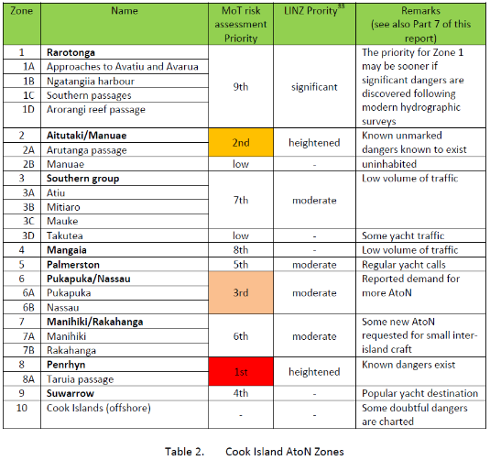
14th South West Pacific Hydrographic Commission Conference
IALA Technical Needs Assessment

Slide 9
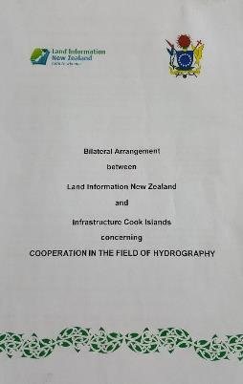
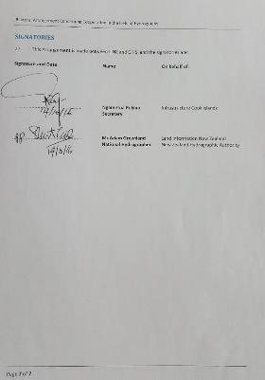
14th South West Pacific Hydrographic Commission Conference
BILATERAL ARRANGEMENT – COOK/LINZ
Bilateral Arrangement – Agree and Signed

Slide 10
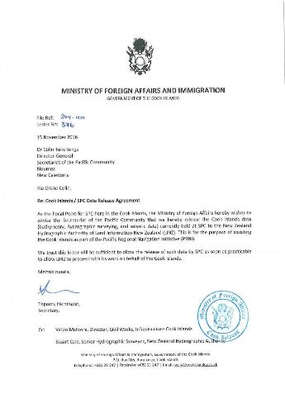
14th South West Pacific Hydrographic Commission Conference
PRNI – SPC/Cook Islands
Bathymetric
Seismic
Hydrographic
Multi beam
Single Beam

Slide 11
14th South West Pacific Hydrographic Commission Conference
Cook Islands Charts
Chart Number | Title | Date | Plans | Scale | ENC
NZ 93 | Cook Islands | Apr-95 | N/A | 1 500 000 | NZ200093
NZ 945 | Plans of the Cook Islands (Northern Sheet) | Oct-95 | Pukapuka | 100 000 | NZ309451
 |  |  | Nassau | 75 000 | NZ409451
 |  |  | Suwarrow | 100 000 | NZ309452
 |  |  | Suwarrow Lagoon Entrance | 25 000 | NZ509451
 |  |  | Manihiki | 75 000 | NZ409452
 |  |  | Manihiki Anchorage | 15 000 | NZ509452
 |  |  | Rakahanga | 50 000 | NZ409453
 |  |  | Penrhyn | 75 000 | NZ409454
 |  |  | Penrhyn: Taruia Passage to Gudgeon Bay | 12 500 | NZ509453
 |  |  | Penrhyn: Taruia Passage | 6 000 | NZ600945
NZ 955 | Plans of the Cook Islands (Southern Sheet) | Oct-93 | Aitutaki | 60 000 | NZ400955
 |  |  | Arutanga Anchorage | 15 000 | NZ500955
 |  |  | Palmerston | 75 000 | NZ409556
 |  |  | Mitiaro | 75 000 | NZ409557
 |  |  | Mauke | 75 000 | NZ409551
 |  |  | Manuae | 75 000 | NZ409555
 |  |  | Takutea | 75 000 | NZ409554
 |  |  | Atiu | 75 000 | NZ409553
 |  |  | Mangaia | 75 000 | NZ409552
NZ 9558 | Rarotonga | Oct-92 | Rarotonga | 40 000 | NZ409558
 |  |  | Approaches to Avatiu & Avarua Harbours | 9 000 | NZ509558
 |  |  | Avatiu Harbour | 3 000 | NZ609558
 |  |  | Arorangi Reef Passage | 2 000 | NZ695581

Slide 12
14th South West Pacific Hydrographic Commission Conference
Cook Islands Priority Areas for Safety Improvements (Based on Comparative Risk Level

Slide 13
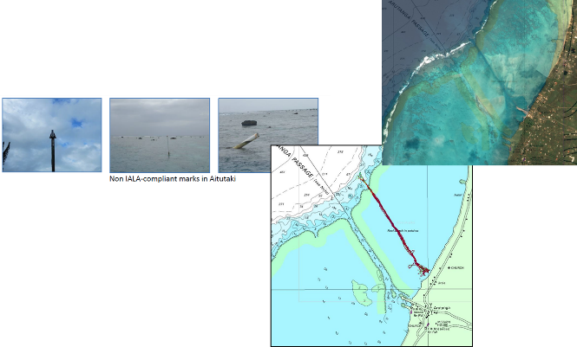
14th South West Pacific Hydrographic Commission Conference
Charts Improvements
Priority 1: Aitukaki
Geodetic control for satellite imagery
RNZN 2014 survey of channel & anchorage
Chart existing AtoN

Slide 14
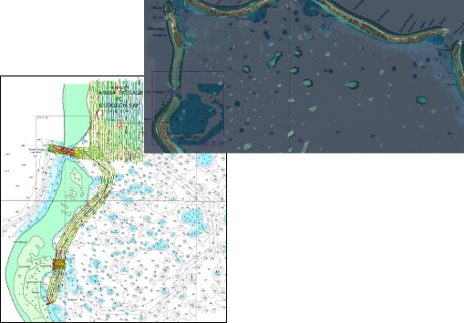
14th South West Pacific Hydrographic Commission Conference
Charts Improvements
Priority 2: Penrhyn
Update coastline from latest satellite imagery
RNZN 2014 survey of Taruia Passage & Gudgeon Bay
Update AtoN

Slide 15
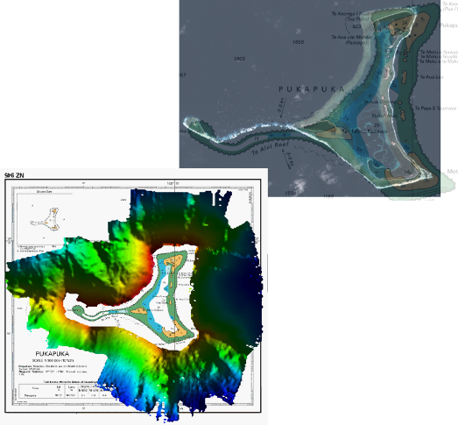
14th South West Pacific Hydrographic Commission Conference
Charts Improvements
Priority 3: Pukapuka
Geodetic control for satellite imagery
RNZN 2005 survey offshore (deep water)
Uncharted AtoN?

Slide 16
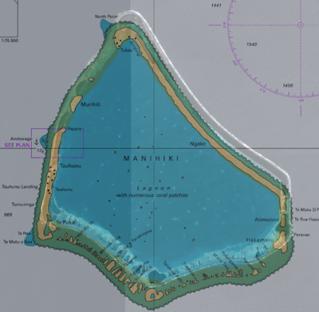
14th South West Pacific Hydrographic Commission Conference
Charts Improvements
Priority 4: Manihiki
Geodetic control for satellite imagery

Slide 17
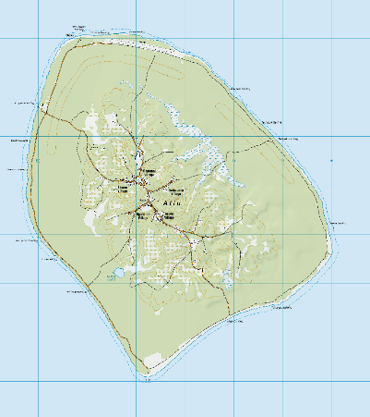
14th South West Pacific Hydrographic Commission Conference
Charts Improvements
Priority 5: Atiu
Geodetic

Slide 18
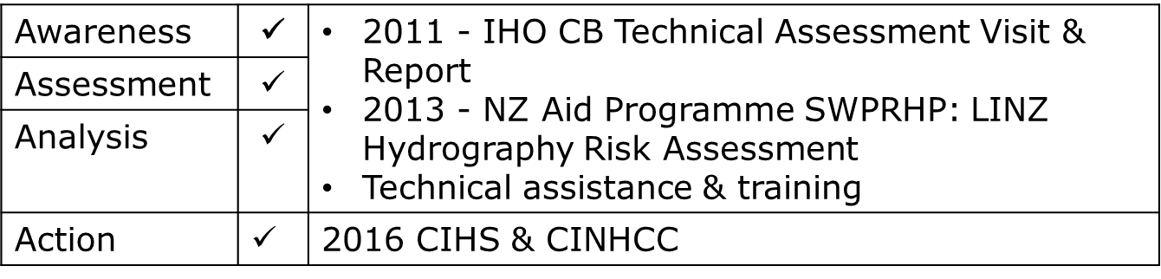
14th South West Pacific Hydrographic Commission Conference
IHO CB Strategy
The capacity building process is built around 4 steps: awareness, assessment, analysis and action

Slide 19
14th South West Pacific Hydrographic Commission Conference
Cook Islands Status – Feb 2015
Country | SWPHC Status | IHO Member | Bilateral (Y/N) | Phase 1 |  |  | Phase 2 |  | Phase 3 |  | PCA
 |  |  |  |  |  |  | Hydro Survey |  | Charting
 | FM/AM/O |  |  | Hydro Governance | National MSI Coordinator | NHCC (who & how often do you meet?) | In-house | Bilateral | In-house | Bilateral
Cook Islands | AM | X | X | None | No | No | X | X | X | X | NZ
Cook Islands |  | To be proposed following IMO course | with NZ? | National legislation in place by 30 June 2015, ideally. 2012, Cabinet Directive approved to establish Governance. Still to be implemented. National MSI Coordinator to be established once Directive implemented. 2015/16 to be appointed |  |  |  | with NZ? |  | with NZ?

Slide 20
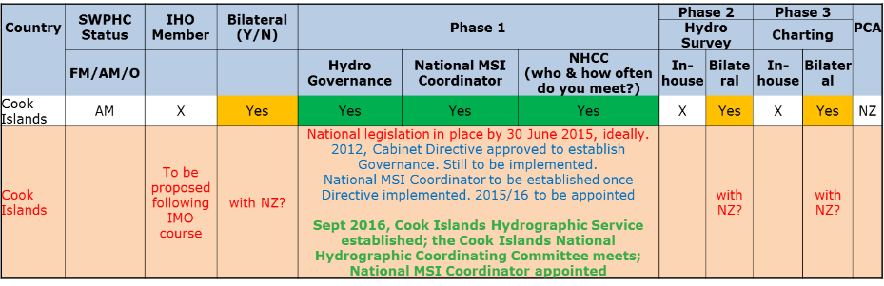
14th South West Pacific Hydrographic Commission Conference
Cook Islands Status – Dec 2016

Slide 21
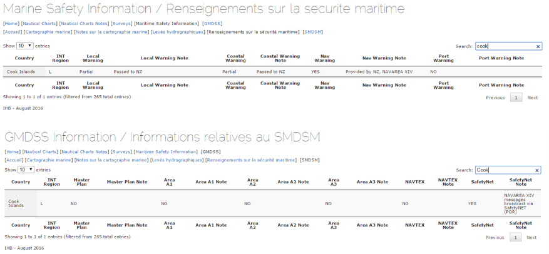
14th South West Pacific Hydrographic Commission Conference
IHO C-55

Slide 22
14th South West Pacific Hydrographic Commission Conference
IHO Yearbook
Contact information/ Informations de contact / Información de contacto
-National Hydrographer or equivalent -Directeur du service hydrographique ou équivalent -Director del Servicio Hidrográfico o equivalente | Post: Director of Civil Work & Hydrography Name: Vaipo Mataora Postal address: Infrastructure Cook Islands Tel: (682) 20321 Fax: (682) 24321 Email: vaipo.mataora@cookislands.gov.ck
-Head of the Hydrographic Office (if different from the person indicated above) -Directeur du Service Hydrographique (si différent de la personne indiquée ci-dessus) -Director del Servicio Hidrográfico (si diferente de la persona indicada anteriormente) | Post: Name: Postal address: Tel: Fax: Email:

Slide 23

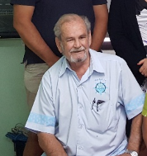
14th South West Pacific Hydrographic Commission Conference
MSI
Maritime Safety Information National Coordinator - Appointed

Slide 24
14th South West Pacific Hydrographic Commission Conference
Conclusions
√
The Cook Islands finally established the Cook Islands National Hydrographic Service 6th September 2016
The Cook Islands have established the Cook Islands National Hydrographic Coordinated Committee-6th September 2016
MSI appointed Stephen Simpson
Bilateral Arrangement (LINZ – Cook Islands) signed- 14th October 2016
MFAI approved Data Release Agreements – SPC to support PRNI- 15th November 2016

Slide 25
14th South West Pacific Hydrographic Commission Conference
Thank You
&
Meitaki Ma’ata

