Slide 1

14th South West Pacific Hydrographic Commission
30 November – 02 December 2016, Noumea
Geoscience Division
Hydrographic related activities in 2016
Presented by: David Mundy, Senior Hydrographic Surveyor, SPC
Notes:
Bit about Geoscience and some examples what we’ve been up to relating to H

Slide 2
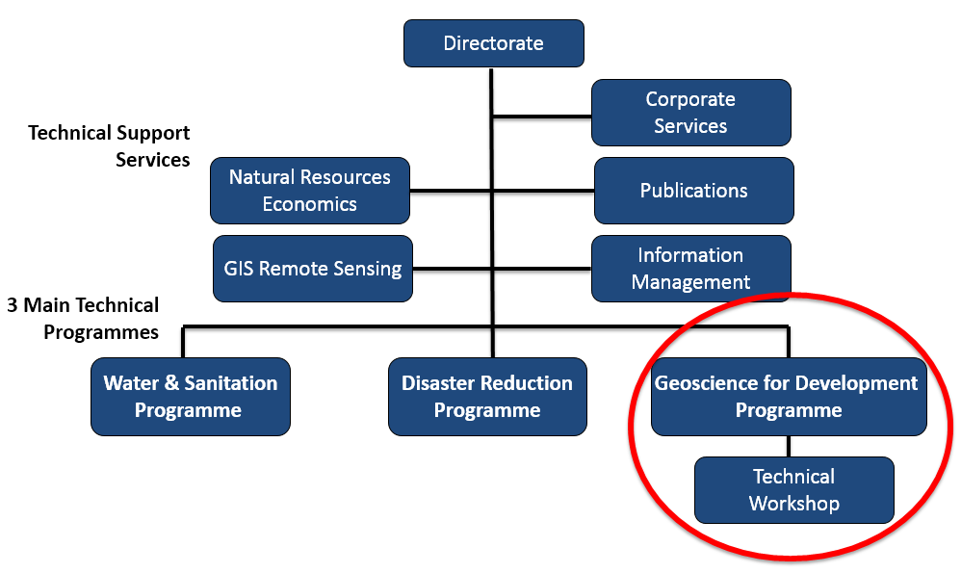
14th South West Pacific Hydrographic Commission Conference vv
30 November – 02 December 2016, Noumea
Geoscience Division
Notes:
Obligatory organizational diagram
Interest to those not familiar that Geoscience covers three programmes
Covering multiple sectors and activities – some specific to Geoscience:

Slide 3
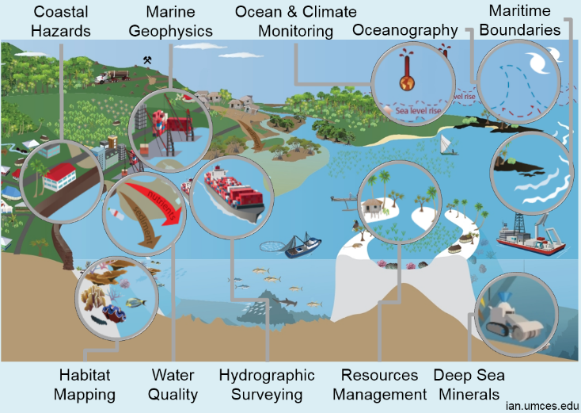
14th South West Pacific Hydrographic Commission Conference vv
30 November – 02 December 2016, Noumea
Notes:
Lots of sectors and activities
Selected a few examples, starting with some work by Hydro section

Slide 4
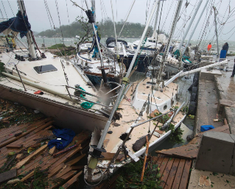
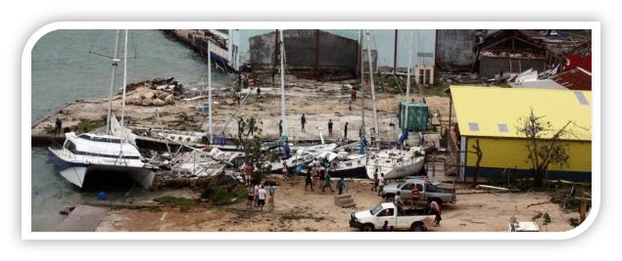
14th South West Pacific Hydrographic Commission Conference vv
30 November – 02 December 2016, Noumea
Geoscience Division
  TC PAM – Navigation Hazard Identification Survey
    22 yachts submerged
    6 charter boats unaccounted
    Numerous moorings lost
Notes:
All aware of the devastating TC PAM ravaged Vanuatu and other countries in March last year

Slide 5
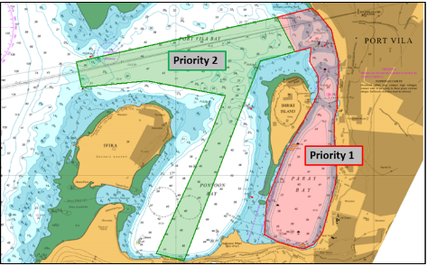
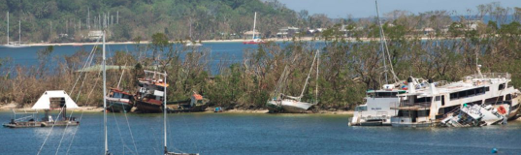
14th South West Pacific Hydrographic Commission Conference vv
30 November – 02 December 2016, Noumea
Geoscience Division
  TC PAM – Navigation Hazard Identification Survey
    Port Vila, Vanuatu
    Funded by KFW
    Conducted July-August 2016
Notes:
A post disaster needs Assessment completed less than a month after the TC set the way forward for response and recovery programme.
This comprised 42 support packages in four countries and included a Navigation Hazard Identification survey of the main port and approaches in Port Vila

Slide 6
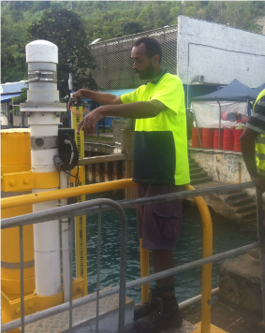
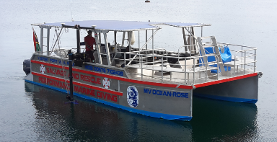
14th South West Pacific Hydrographic Commission Conference vv
30 November – 02 December 2016, Noumea
Geoscience Division
  TC Pam – Navigation Hazard Identification Survey
    Comparative MBES survey
    Vessel of Opportunity
    Capacity Building opportunity

Slide 7
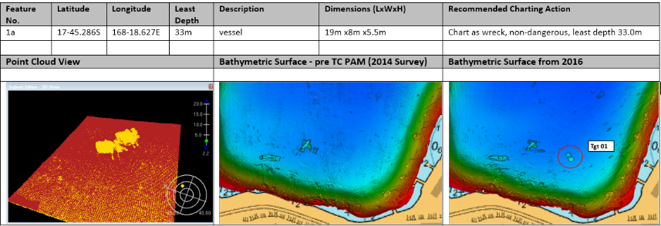
14th South West Pacific Hydrographic Commission Conference vv
30 November – 02 December 2016, Noumea
Geoscience Division
  TC Pam – Hazard ID Survey
    3 Significant Objects
    None dangerous to Nav
    Results communicated

Slide 8
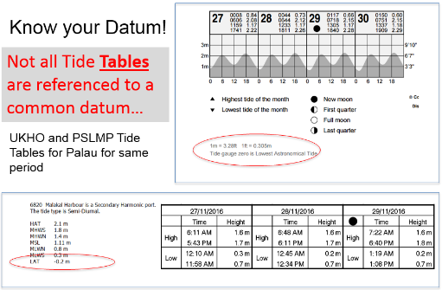
14th South West Pacific Hydrographic Commission Conference vv
30 November – 02 December 2016, Noumea
Geoscience Division
  Ocean and Tides Knowledge Unit
    Options for wider use of tide calendars
    Based on quality data but datum differences
    Source of data to update official tide tables
Notes:
Oceans and Tides Knowledge Unit
Funded by Australian DFAT through the COSPPac
Involved in:
The maintenance of TG’s Pacific Sea Level Monitoring Project
Making it more available to countries
Implementing applications to make more useful to different sectors (Shipping, swell predictions)
Provision of accurate, freely available tide calendars based on PSLMP data
Under COSPPac, we’re growing and doing more than ever before with some of this data- making it more accessible to countries, creating applications that make it more useful for different sectors, and updating the equipment and even expanding the network of tide gauges to include Niue and Suva.

Slide 9
14th South West Pacific Hydrographic Commission Conference vv
30 November – 02 December 2016, Noumea
Geoscience Division
  Maritime Boundaries
  Provide maritime boundaries delimitation data and information
  Develop comprehensive data-sets
  Build national capacity within member countries to undertake assessments;
  Provide advice and assistance to member countries on relevant provisions of UNCLOS;
  Act as an information and data repository.
Notes:
SPC involvement in assisting PICT’s MB Boundary aspirations in partnership with Geoscience Australia

Slide 10

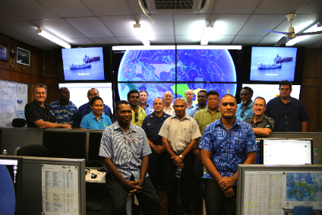
14th South West Pacific Hydrographic Commission Conference vv
30 November – 02 December 2016, Noumea
Geoscience Division
  Maritime Boundaries
    FFA requirement for MB information for VMS
    SLA in 2016 with SPC
    Adoption of S-121
Notes:
The 2016 SLA underlined the need for the maritime zones lines in the Pacific Islands Forum Fisheries Agency (FFA) Vessel Monitoring System (VMS) to be updated with publicly available and legislated boundaries for the purpose of fisheries monitoring, control, surveillance and enforcement and management.

Slide 11
14th South West Pacific Hydrographic Commission Conference vv
30 November – 02 December 2016, Noumea
  Maritime Boundaries – S121
Concurrent with the advent of electronic navigation, Geographical Information Systems (GIS) and the online delivery and exchange of information; the need arose for a high precision data format for the exchange of officially recognised maritime limits and boundaries.
Such a digital format would enable States to exchange, lodge and distribute their maritime boundaries in a form that would be portable across a number of applications and platforms. The specification’s primary function is for States to exchange maritime boundary information in a recognised format, both between States and as the preferred format for lodgement to the United Nations.
Furthermore, the format would encourage the development of digital marine spatial data infrastructures to improve all aspects of ocean management. The format will be appropriate for MSDI, GIS and online utilisation.
Notes:
SPC involvement in assisting PICT’s MB Boundary aspirations in partnership with Geoscience Australia

Slide 12
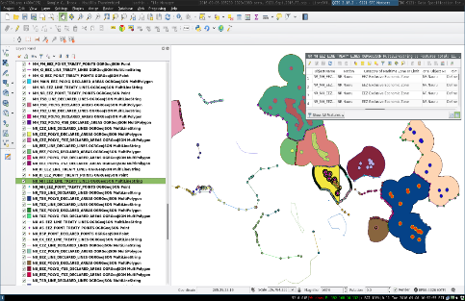
14th South West Pacific Hydrographic Commission Conference vv
30 November – 02 December 2016, Noumea
Geoscience Division
  Maritime Boundaries – S121
    Limitations of current MB data
      ESRI Shape Files
      100’s of files
      Non-authoritative
Notes:
SPC involvement in assisting PICT’s MB Boundary aspirations in partnership with Geoscience Australia

Slide 13

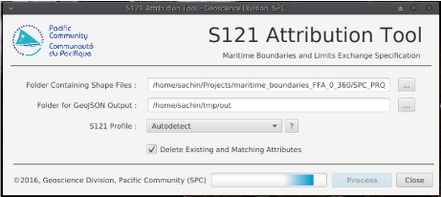
14th South West Pacific Hydrographic Commission Conference vv
30 November – 02 December 2016, Noumea
Geoscience Division
  Maritime Boundaries – S121
    Develop tool to attribute existing files into format that emulates S121
    GeoJSON adopted
      Single file supports multi-feature type
      Huge reduction in data file size and number
Notes:
SPC involvement in assisting PICT’s MB Boundary aspirations in partnership with Geoscience Australia

Slide 14
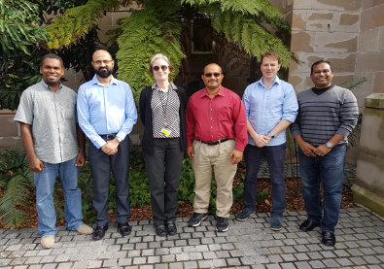
14th South West Pacific Hydrographic Commission Conference vv
30 November – 02 December 2016, Noumea
  Pacific Fisheries Data Exchange Standard Committee
    Formed July 2016
    Members from GA, SPC, FFA, UNEP
    Contribute towards development of S121
Notes:
SPC involvement in assisting PICT’s MB Boundary aspirations in partnership with Geoscience Australia

Slide 15
14th South West Pacific Hydrographic Commission Conference vv
30 November – 02 December 2016, Noumea
Questions
Notes:
SPC involvement in assisting PICT’s MB Boundary aspirations in partnership with Geoscience Australia

