Slide 1
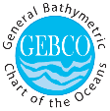
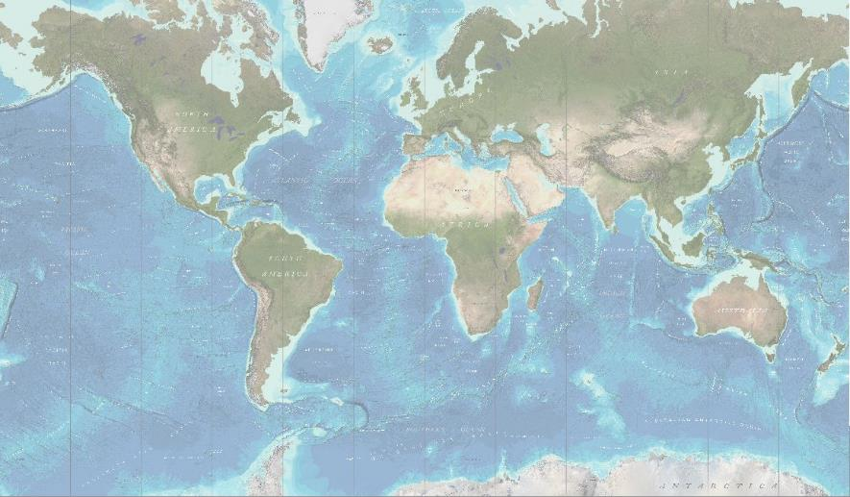
GEBCO (GENERAL BATHYMETRIC CHART
OF THE OCEANS)
On behalf of GEBCO: Shereen Sharma
Notes:
Font: RGB 213; 250; 246
Highlight green: 110; 225; 200
GEBCO darker banner green RGB
161; 217; 214
Background: RGB 30; 70; 120

Slide 2
What is GEBCO?
The General Bathymetric Chart of the Oceans (GEBCO),
Operates under the joint auspices of the International Hydrographic Organization (IHO) and Intergovernmental Oceanographic Commission (IOC)
Aims to provide the most authoritative, publicly-available bathymetric data sets for the world’s oceans
We are a non-profit making organisation which relies largely on the voluntary contributions of an enthusiastic international team of geoscientists and hydrographers

Slide 3
GEBCO’s organisational structure
GEBCO is led by a Guiding Committee consisting of five IHO-appointed members; five IOC-appointed members; Sub-committee Chairs and the Director of the IHO-DCDB
It has sub-committees and a number of working groups:
Sub-Committee on Undersea Feature Names (SCUFN)
SCUFN maintains and makes available a digital gazetteer of the names, generic feature type and geographic position of features on the seafloor. The gazetteer is available to view and download via a web map application

Slide 4
Sub-Committee on Regional Undersea Mapping (SCRUM)​
SCRUM's aims are to facilitate a closer collaboration with regional mapping efforts and coordinate, as well as encourage, the incorporation of their compilations into GEBCO.
GEBCO Cook Book​
In order to assist and encourage further participation in bathymetric grid development work, GEBCO has created a technical reference manual, on how to build bathymetric grids.​
A wide range of topics are included, for example
gathering data
data cleaning
gridding examples
software overviews

Slide 5
GEBCO’s products
Our bathymetric data sets and products:
Global gridded bathymetric data set (30 arc-second interval)
GEBCO Gazetteer of Undersea Feature Names
GEBCO Digital Atlas
Grid viewing software
Printable maps
Web Map Service (WMS)
IHO-IOC GEBCO Cook Book

Slide 6
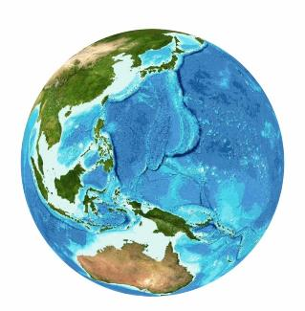
GEBCO’s products: global bathymetric grid
The GEBCO Grid is a global terrain model at 30 arc-second intervals:
Largely based on a database of ship-track soundings with interpolation between soundings guided by satellite-derived gravity data
Includes regional grids which may be based
on different interpolation models
Accompanied by a Source Identifier Grid showing which cells are based on soundings or existing grids and which are interpolated
GEBCO’s grids are made available for non-navigational purposes!

Slide 7
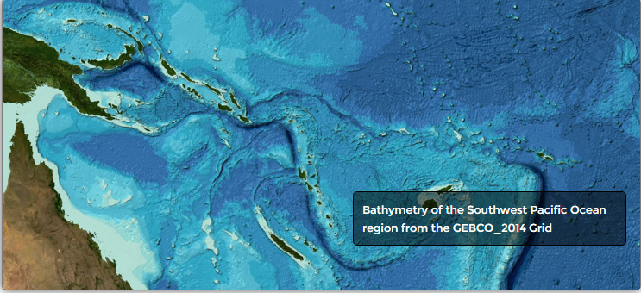

Slide 8
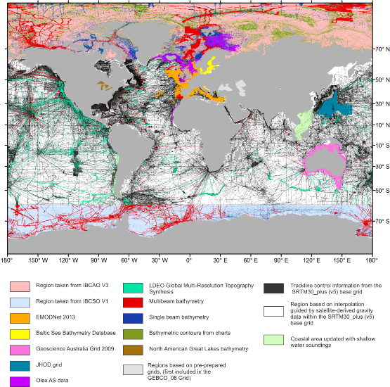
GEBCO’s products: Source Identifier Grid
Example of the GEBCO Source Identifier (SID) Grid showing the source of depth value in each grid cell, i.e. if it is based on trackline data; pre-existing grids or if it is based on interpolation
GEBCO Grid

Slide 9
Filling the data gaps
Raising awareness of the ‘data gaps’ to encourage data collection in these regions
Encouraging organizations to make their bathymetric data sets easily discoverable and accessible, either directly or by contributing data to international publically-available databases such as the IHO Data Center for Digital Bathymetry (IHO-DCDB)
Crowd-sourced bathymetry (CSB) initiatives – such as the IHO CSB Working Group
GEBCO initiative to request shallow water bathymetry data extracted from Electronic Navigation Charts from the Hydrographic community

Slide 10
Shallow water bathymetry data
To more accurately model the shape of the ocean floor in all areas and serve a wider user community, GEBCO is striving to improve its gridded bathymetric datasets in shallower waters
In 2006 a request was made to IHO Member States to provide ENC data (usage bands 2 and 3) to GEBCO to help update its global model
New request to IHO MS for ENC data sent out in March 2016 (circular letter 11/2016)

Slide 11
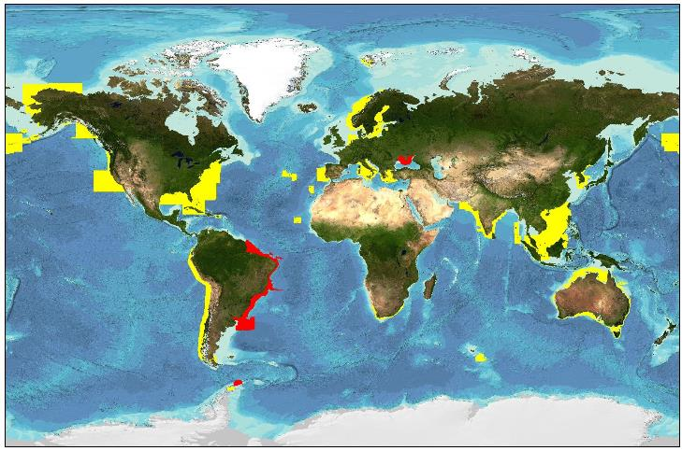
Shallow water bathymetry – ENC data
ENC data coverage (usage bands 2 & 3) provided by IHO MS and organizations, to date, to GEBCO for grid updating work after calls in 2006 (yellow) and 2016 (red),

Slide 12
Future of Ocean Floor Mapping
The was held in June 2016 and was attended by over 150 senior representatives, scientists, scholars and business associates from major ocean related organisations from around the world.
Seabed 2030
Mr Sasakawa, Chairman of The Nippon Foundation, set forth an initiative to partner with GEBCO to cooperatively work towards mapping 100% of the World Ocean bathymetry by 2030!
More than 85 per cent of the world ocean floor remains unmapped with modern mapping methods.

Slide 13
This project will seek to encourage the data collectors and data managers of governmental, academic and private interests to work together to improve the quality of publicly-available grids of the ocean floor.

Slide 14
The Postgraduate in Ocean Bathymetry
Designed to train a new generation of scientists and hydrographers in ocean bathymetry
is funded by: The Nippon Foundation of Japan
and taught at: The Center for Coastal and Ocean Mapping / Joint Hydrographic Center; University of New Hampshire, USA

Slide 15
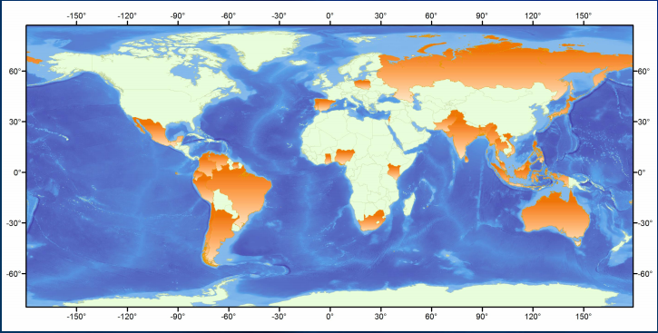
76 Scholars so far....

Slide 16
Summary
GEBCO aims to:
Continually update and improve its global bathymetric model and collaborate with regional mapping groups to help achieve this
Encourage (where possible) the contribution of bathymetry data to publicly-available national or international databases
GEBCO project and community
How to contribute data to help update GEBCO’s global grid: www.gebco.net/about_us/contributing_data/

Slide 17
Thank you

