Slide 1
Hydrography and the INFLUENCE on SW Pacific national economies

Slide 2
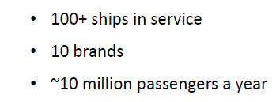
Carnival corporation plc.

Slide 3
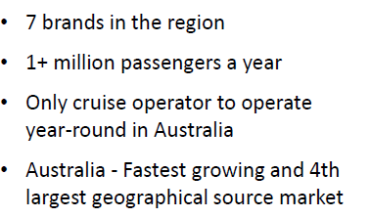
CARNIVAL AUSTRALIA

Slide 4
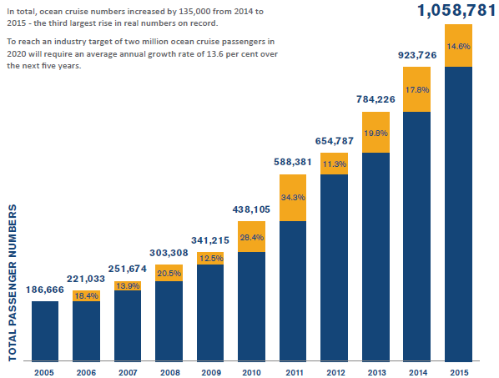
YEAR ON YEAR INDUSTRY GROWTH in Australia

Slide 5
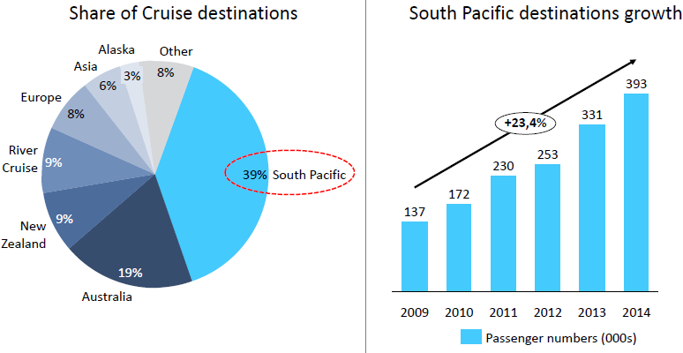
CARNIVAL AUSTRALIA - pacific market share

Slide 6
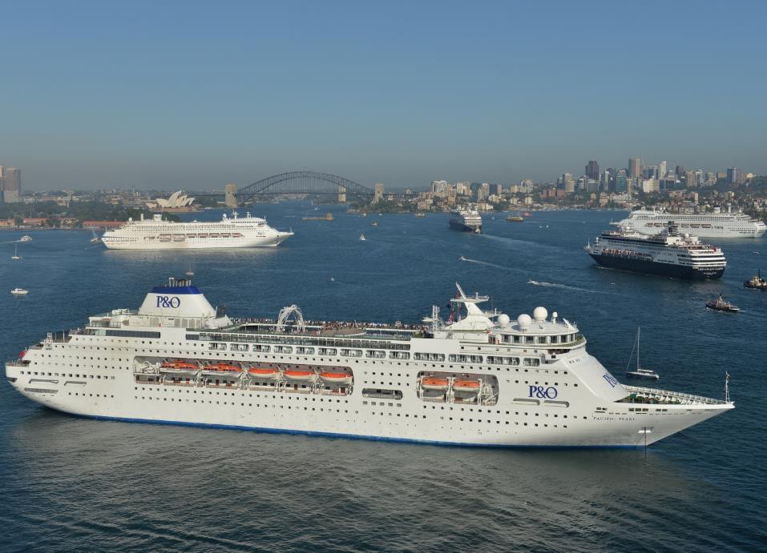
INDUSTRY GROWTH
12 years of average 20% consecutive Year on Year industry growth.
Australia is world’s fastest growing market with penetration at 4.2%, highest in the world and now ahead of the US (3.4%)
Industry achieved 1million annual guests in 2015 – 5 years ahead of forecast.
A CLIA independent study showed that cruising contributes $3.2 billion annually in economic benefit to Australia and accounts for 14,000 jobs nationally.

Slide 7
Regional SUCCESS STORIES
Papua New Guinea
First call November 2013 to Alotau: Now 30 ships per year.
Trobriand Islands, Kiriwina & Kitava: Now 33 ship calls per year.
First of 11 calls in 2016 to Conflict Group: Set to increase.
Solomon Islands
Gizo- inaugural call September 2016
New wharf at Honiara- September 2016
Vanuatu
ENC coverage of Wala, Champagne Bay and Luganville
New wharf development in Luganville and Port Vila

Slide 8
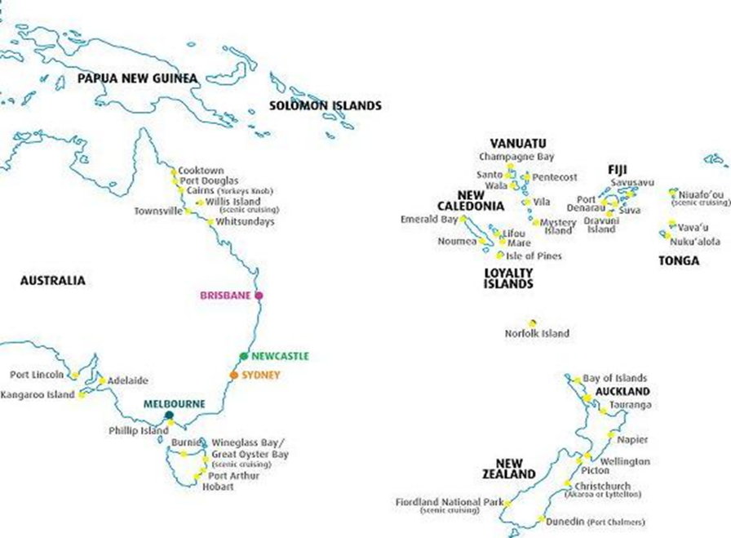
NEW PACIFIC CRUISE DESTINATIONS established IN 2016
WEWAK
VITU ISLANDS
GIZO
CONFLICT ISLANDS
HONIARA
PACIFIC EDEN INAUGURAL HOME PORT FROM CAIRNS
GLADSTONE
FRASER ISLAND
STEWART ISLAND

Slide 9
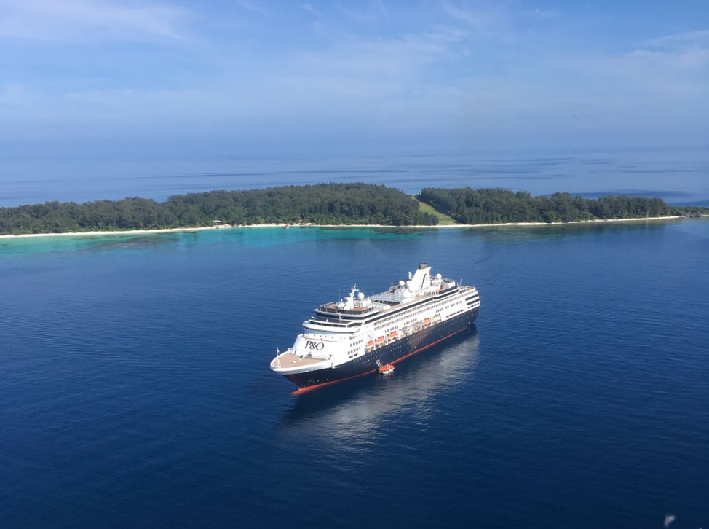
CONFLICT ISLANDS
PREVIOUSLY INSUFFICIENTLY SURVEYED, ACCESS WOULD NOT HAVE BEEN POSSIBLE WITHOUT SURVEY AND CHART PRODUCTION BY AHS

Slide 10
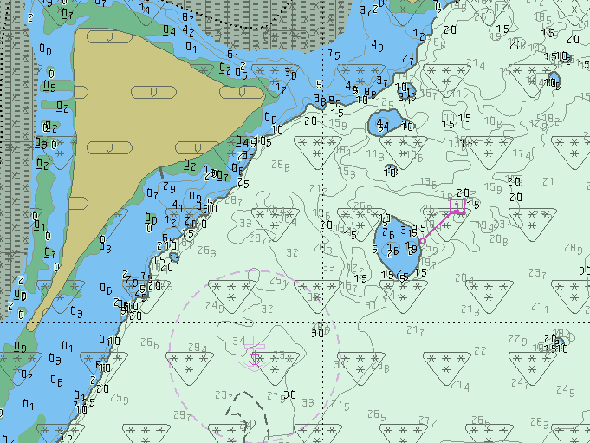
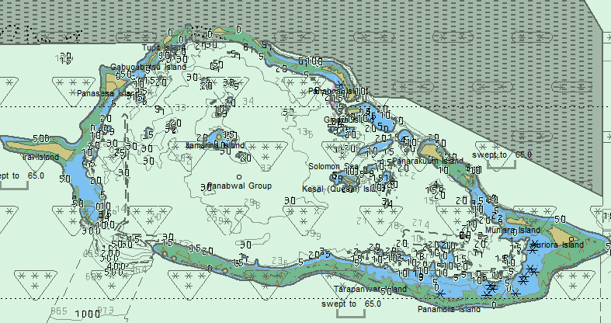
CONFLICT ISLANDS

Slide 11
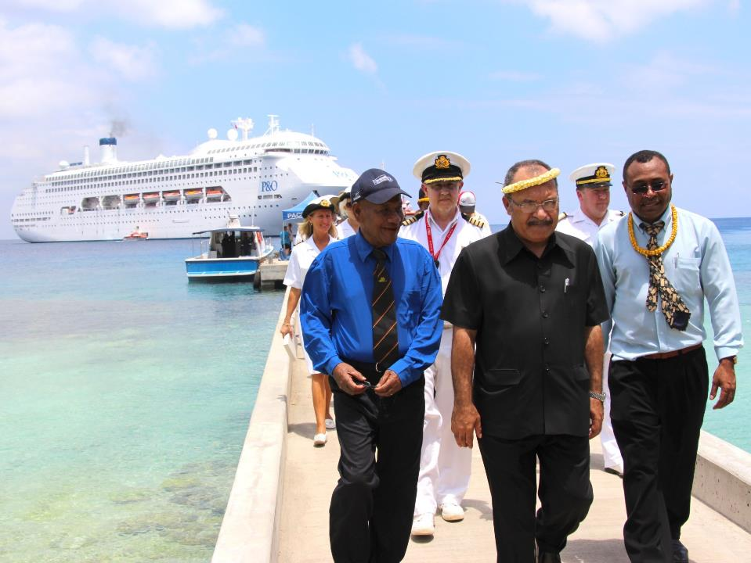
Government awareness of Hydrography as catalyst for Economic benefit (Prime minister o’neill – png)

Slide 12
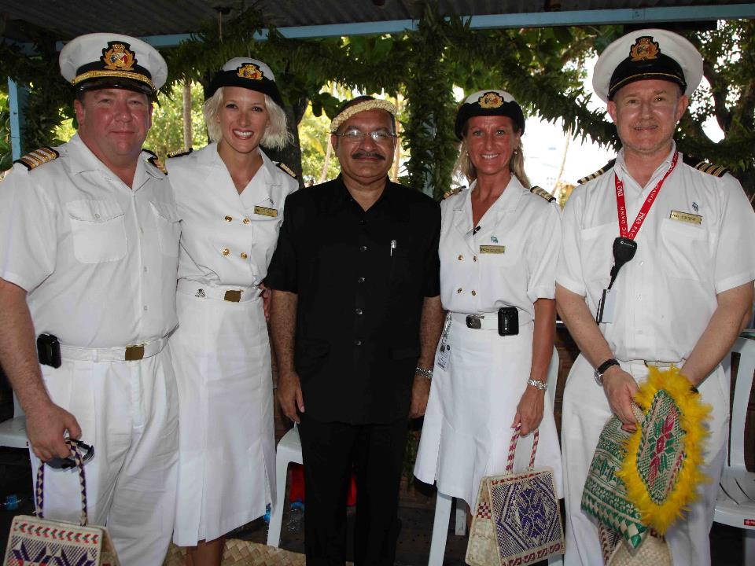
Alotau inaugural call

Slide 13
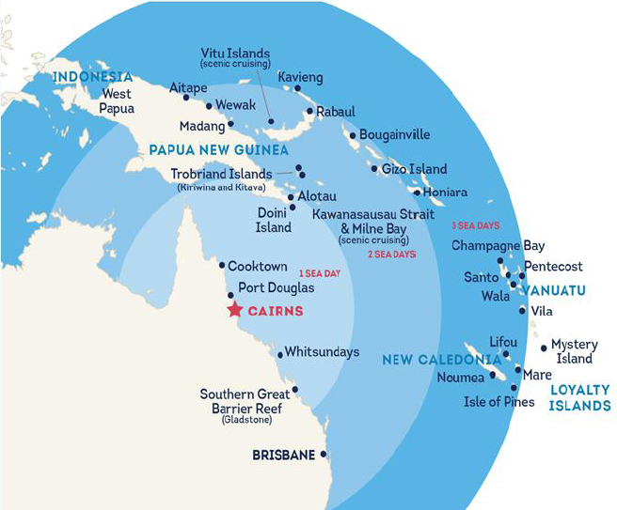
Cairns – new home port
High volume of calls to png and now solomons
Brisbane put solomon islands in range for longer voyages however cairns puts Solomons in range of 7-10 night voyages

Slide 14
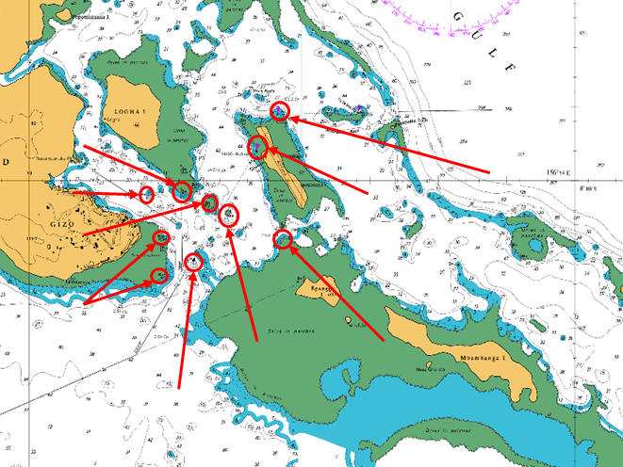
IALA contribution to economic development in gizo

Slide 15
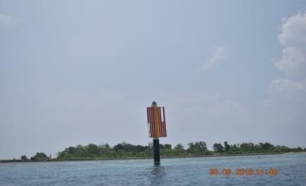
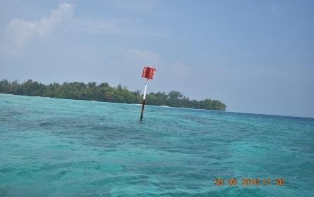
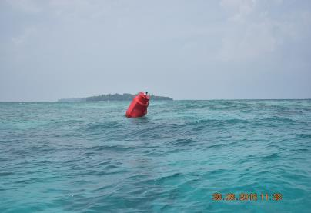
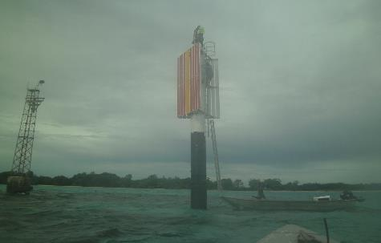

Slide 16
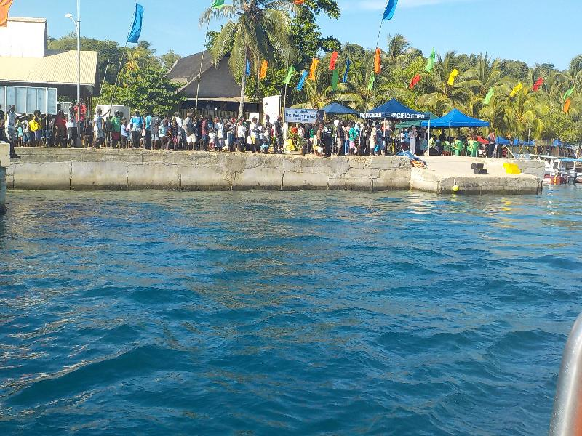
Inaugural call to GIZO, SOLOMON ISLANDS.

Slide 17
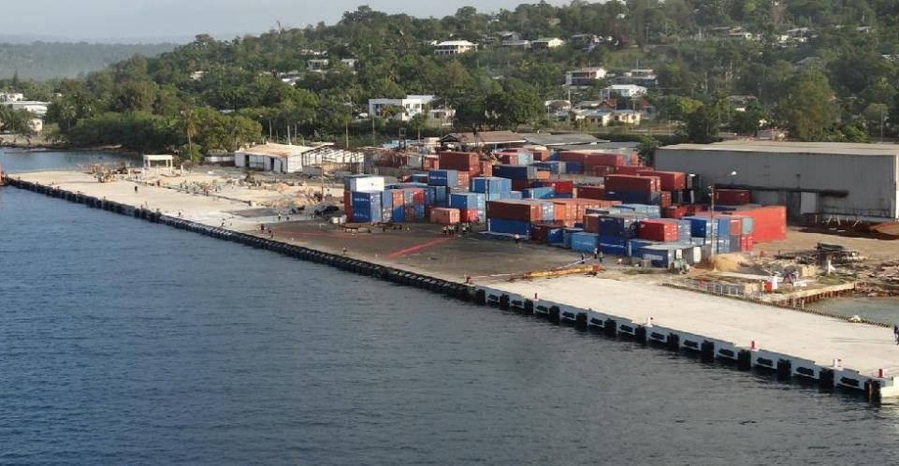
Luganville - new wharf

Slide 18
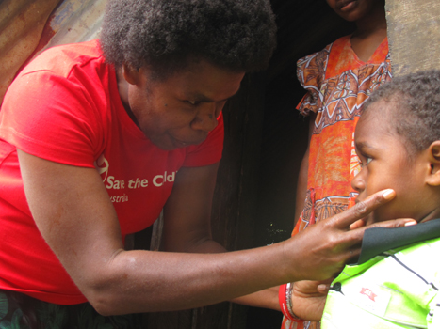
Aid Agency Reports
“Pacific Possible” report- The World Bank
“Assessment of the Economic Impact of Cruise Ships to Vanuatu- Australian Aid and International Finance Corporation”.
( * Per Call - A $ 257,000 average spend to Vanuatu ).

Slide 19
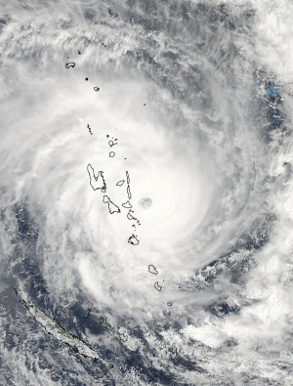
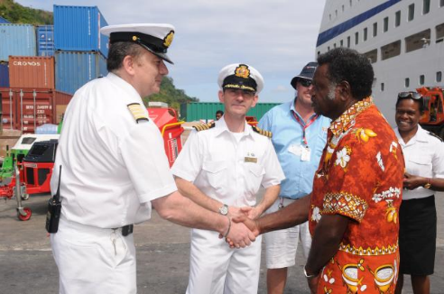
Disaster Relief (pacific Dawn - post Cyclone pAM)
Notes:
These photos show the sheer size of Cyclone Pam, waves were forecast up to 15m.
The Captain meeting with the Deputy PM of Vanuatu on the pier.
And a charity concert that was performed on route to deliver the aid which encouraged passenger donations of an additional $3000

Slide 20
cyclone “pam” aid ( A$ 300,000 donation to NGO partners from Carnival Australia & Carnival Corporation)
75 tents offering shelter to an estimated 450 people
192 tarpaulins, able to cover an area of more than 4600sqm
Pallets of bottled water, childrens toys and cleaning products
Three industrial grade mulchers and 4 chainsaws to help deal with fallen vegetation
Food including tinned tuna, long life milk, rice, sugar and flour
Safety gear including vests, glasses and gloves
Hygiene products including 3500 toothbrushes, 4000 units of toothpaste and 200 cases of shampoo and conditioner
200 sheets of corrugated iron to help repair schools and homes
700 packs of batteries
Notes:
We don’t just take an active role in SAR at sea.
The Pacific Island of Vanuatu experienced the full force of Cyclone Pam last month:
As well as donating $300,000 to our NGO partners Save the Children we have delivered the following aid:
Our passenger

Slide 21
EXAMPLES OF MISSED OPPORTUNITY
ALI ISLAND
ONTONG JAVA
LAUTOKA AS A HOME PORT
TAVANIPUPU
BANKS AND TORRES ISLANDS
LAU GROUP
VANUA BULAVU
TANNA
BELEP
YASAWAS
HAAPAI
SAVAII

Slide 22
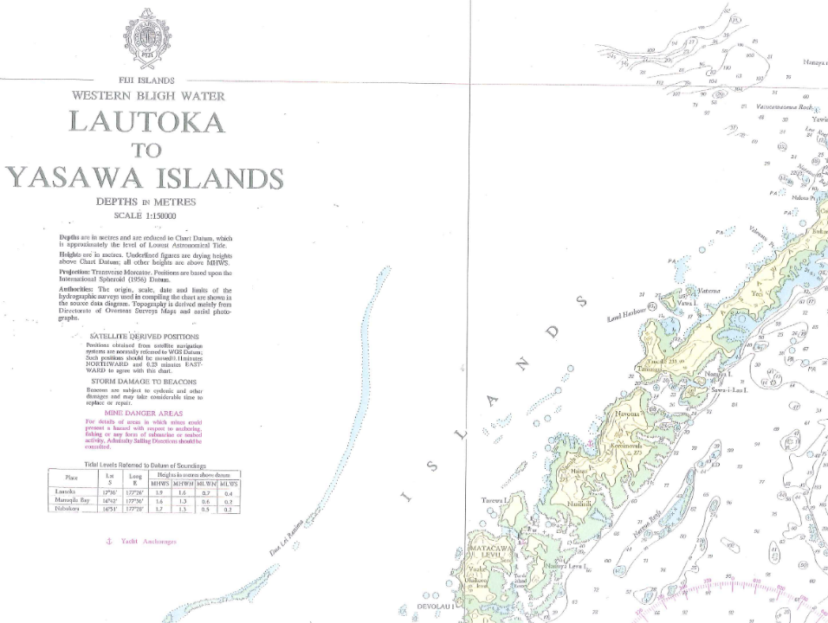
F5
The lack of
adequate charts in
many Pacific Islands is a barrier to considering those islands for ship visits.
Navigational Aids and
Marine Safety
Information is
inadequate.

Slide 23
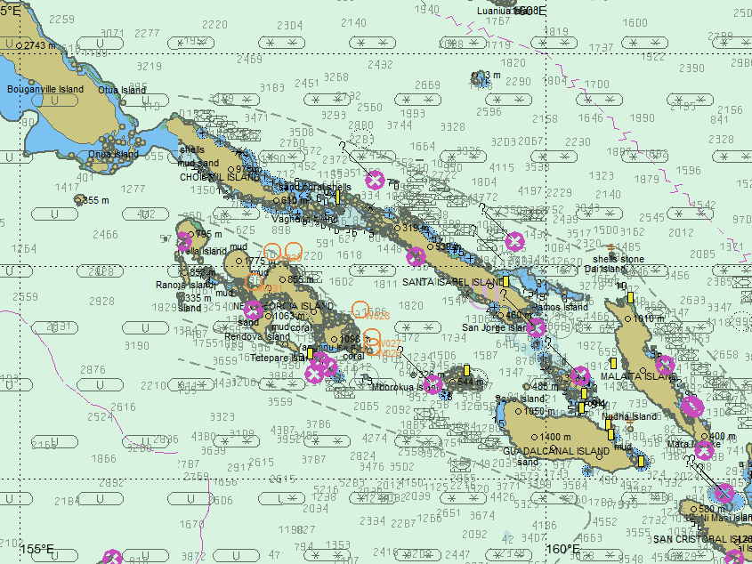
Navigation charts are aids to navigation and are infrastructure
In the same way as roads and bridges

Slide 24
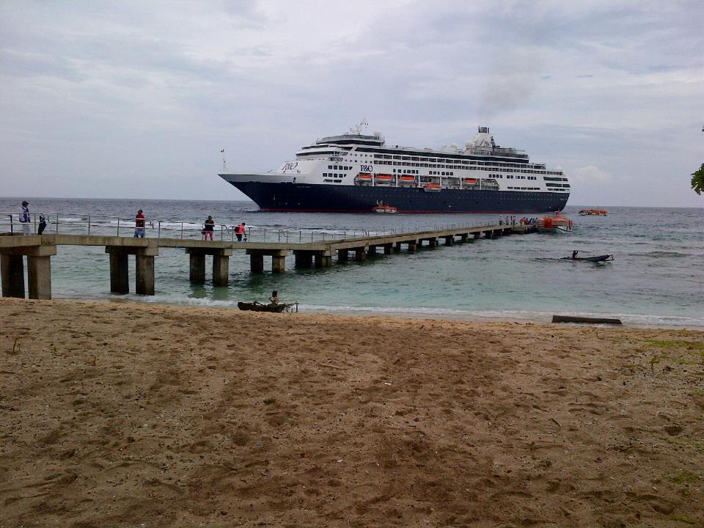
KIRIWINA ISLAND
Marine infrastructure is fundamentally important to pic economies and must be part of national infrastructure projects.

Slide 25
HIGH DENSITY port ENC
For ports with very tight safety margins - simulation studies are carried out using Full Mission Bridge Simulators.
Trials at Smartship have included the use of high density sounding charts alongside the official ENC. (the port of Cairns and Benoa).
A high density ENC uses the official ENC enriched with actual detailed bathymetry, a tidal stream model (provided by Port of Cairns) and enhanced bank effect (validated by Cairns Pilots).
Maintained depths become actual depths with the ability to use depth contours at intervals of 1m.
The trials resulted in identifying a methodology for safe access for larger vessels. (in the meantime lots of lost revenue).

Slide 26
WHY HIGH DENSITY PORT ENC ?
Without the use of high density ENC to consider absolute limits of available safe water, the conclusions of the Cairns simulation would have been more conservative and have ruled out access to some ships, important for the regions economy.
Vessels know exactly where they can and cant go. (“Go/no go areas”)
Pilots often use their own port charts with more up to date port data on their Portable Pilot Units (PPU). This differs from ships ECDIS. To assist with the “shared mental model” important in Bridge Resource Management – the same chart, with best data should available to all.

Slide 27
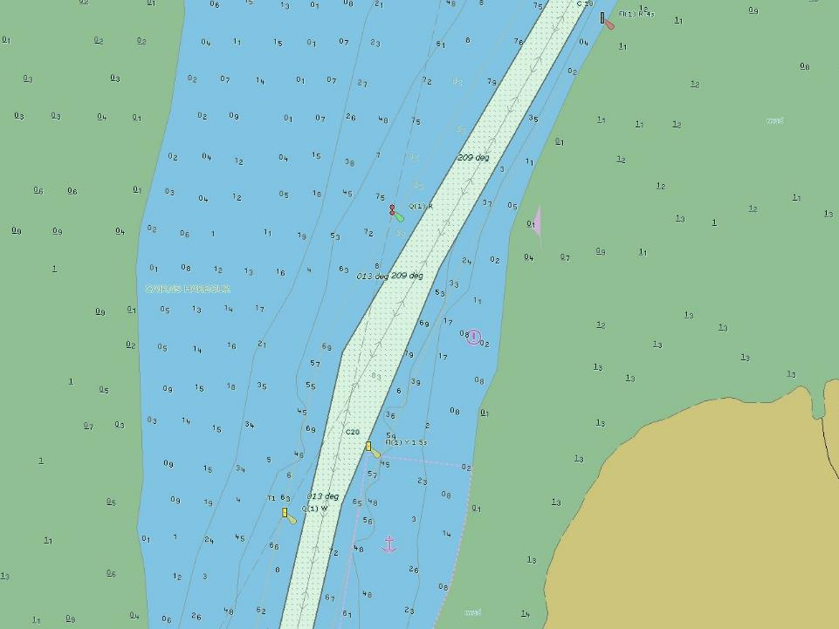
Approaching Cairns showing maintained depth
Standard ENC

Slide 28
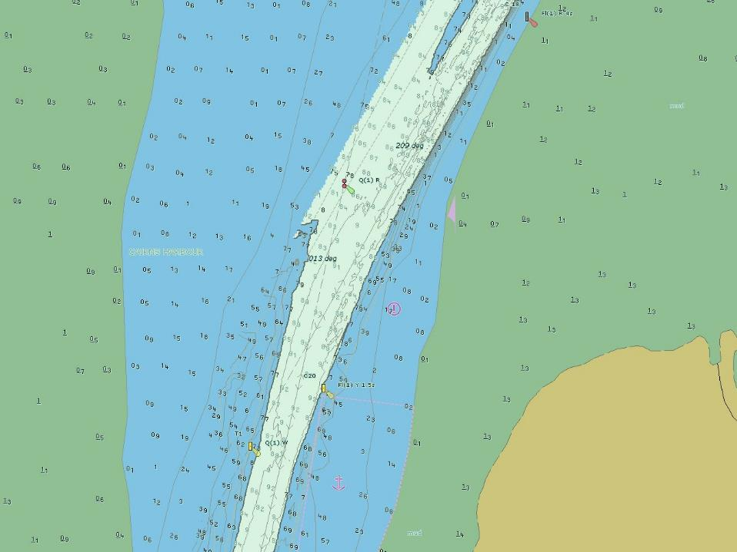
Approaching Cairns showing maintained depth
High density port ENC

Slide 29
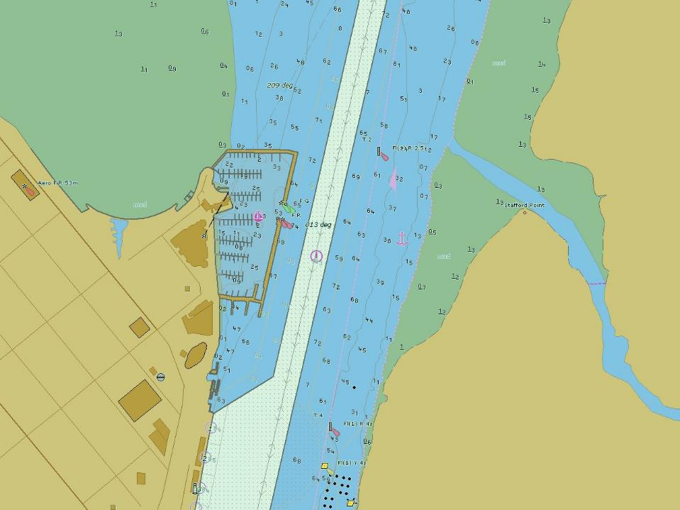
Cairns showing maintained depth only
Standard ENC

Slide 30
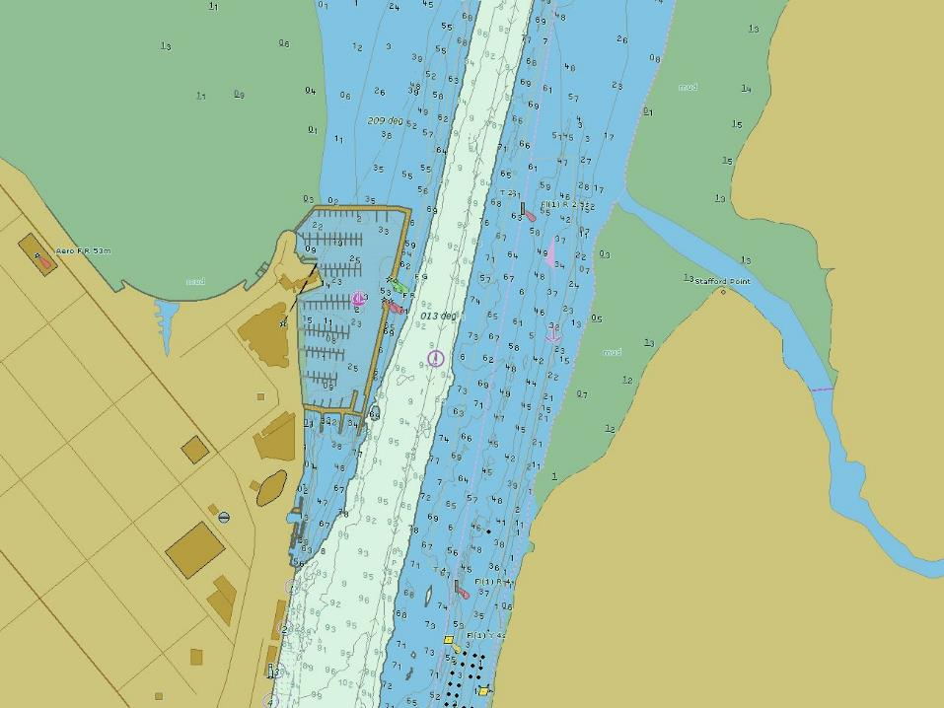
AND NOW THE 8m CONTOUR WITH A WIDER CHANNEL
High density port ENC

Slide 31
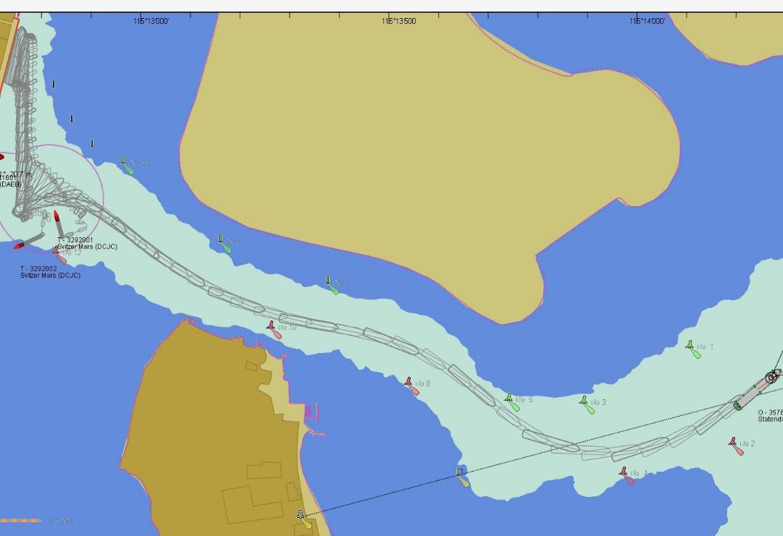
BENOA WITH an 8m CONTOUR

Slide 32
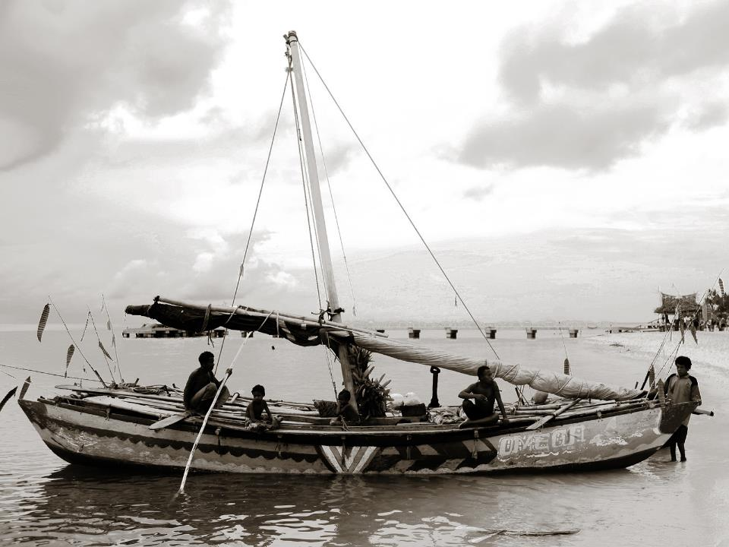
In Summary
LIFESTYLE IMPACT OF TOURISM
Once the access challenge has been overcome, local/remote communities benefit in ways once considered unimaginable:
Standards of education improve.
Employment opportunities increase.
The need to make Government aware of the importance of adequate marine infrastructure (including hydrography) and the flow on economic benefits. Funding is available from Aid Agencies as long as the request comes from Government.

Slide 33
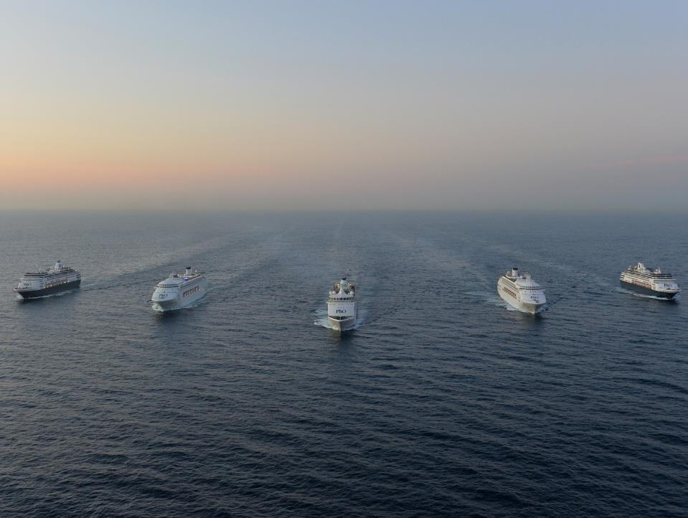
THANKYOU, ANY QUESTIONS?

