Slide 1

15th South West Pacific
Hydrographic Commission Conference
21-22 February 2018
Nadi, Fiji
National Report

Slide 2

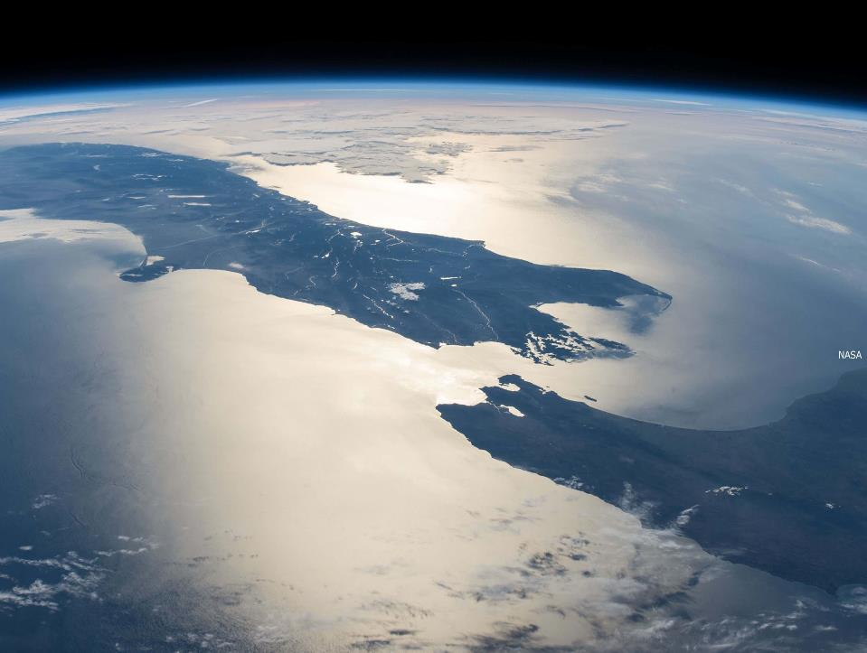

_{Strategy & Stewardship}
_{Location Information}
_{Property}
_{Rights}
_{Crown}
_{Property}
_{Policy & Overseas Investment}
_{Corporate}
Office of Surveyor General/Geographic
_{Board}
_{Registrar General of Land}
_{Office of the Valuer General}
_{Business with Maori}
_{Customer Insights}
_{Organisational Strategy}
_{Positioning and Resilience}
_{Māori}
_{Land Service}
_{Topography}
_{Hydrography}
_{Data Services}
Integrated Property Service & Addressing
_{Operations}
_{Property Rights Advisory}
_{Property Rights Support}
_{Technical Capability}
_{ASaTS}
_{Engagement}
_{Landonline Transition}
_{Crown Property}
_{Canterbury Recovery}
_{Clearances}
_{Legal Services}
_{Crown Engagement}
_{Commissioner of Crown Lands}
_{Residential Red Zone}
_{OIO Operational Policy}
_{Policy & Frameworks}
_{Applications}
_{Enforcement}
_{Finance}
_{Human Resources}
_{Information Technology}
_{EPMO}
Strategic Communications and Digital Services
_{Risk & Assurance}

Slide 3
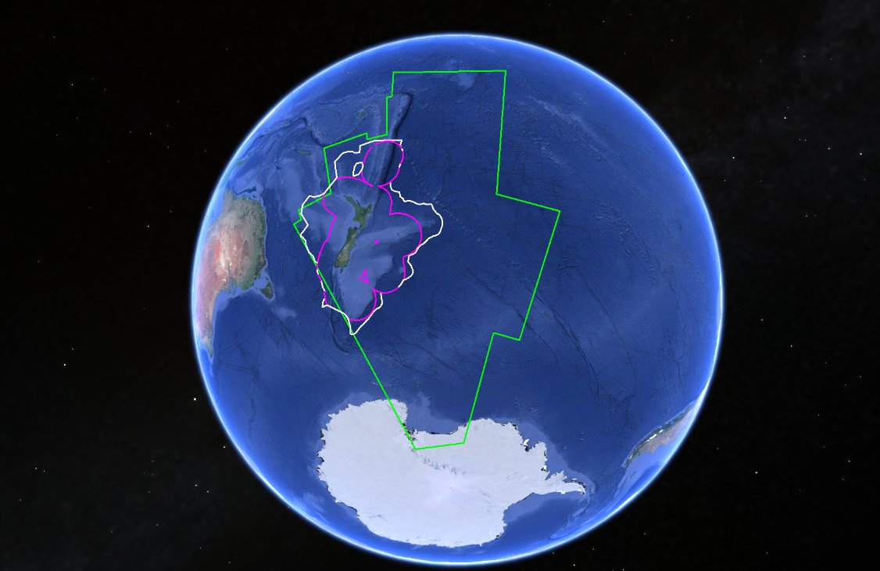
Charting
Coverage
ECS
EEZ
NZ’s Area of Responsibility

Slide 4
15th South West Pacific Hydrographic Commission Conference
Total chart production since SWPHC14
 | ENC |  | Paper
 | NZ | SWP | NZ | SWP
New Charts | 1 | 0 | 1 | 0
New Editions | 39 | 15 | 34 | 1

Slide 5
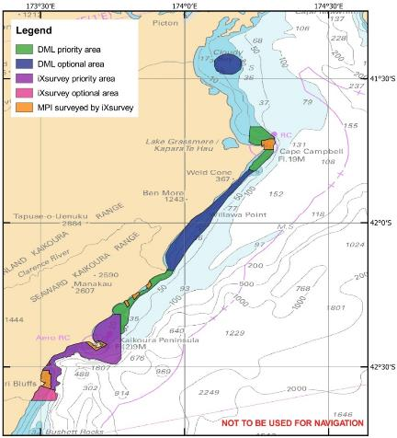
15th South West Pacific Hydrographic Commission Conference
HYPLAN
Supplier Panel for the next 3 years (+3 years)
  iXsurvey/iXblue
  Discovery Marine Ltd. (DML)
FY 17/18 survey Kaikoura to Cape Campbell
  Collaboration with MPI (science deliverables)
  Update charts and detect uplift

Slide 6
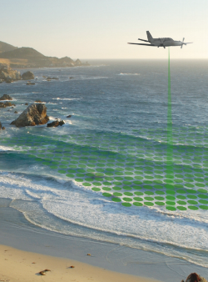
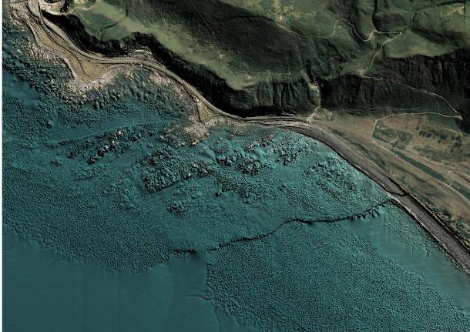
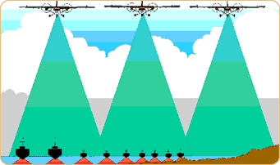
15th South West Pacific Hydrographic Commission Conference
Kaikoura LiDAR (RAN LADS)

Slide 7
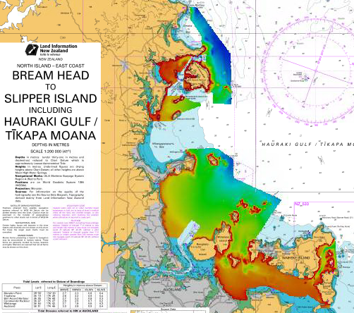
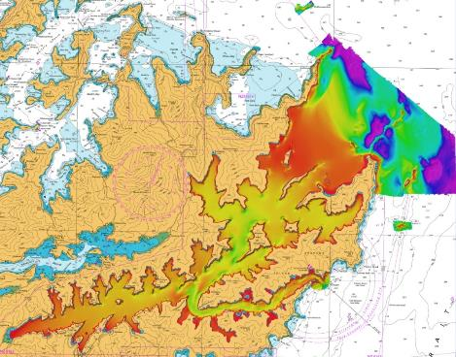
15th South West Pacific Hydrographic Commission Conference
NZ hydrographic surveys since SWPHC14

Slide 8
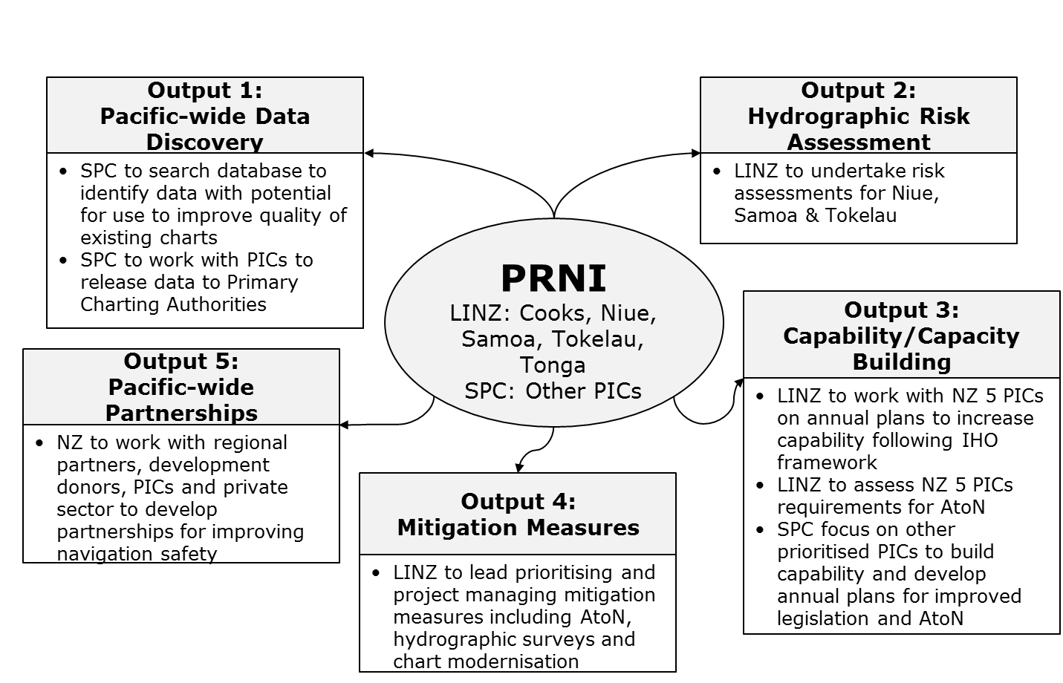
15th South West Pacific Hydrographic Commission Conference
Pacific Regional Navigation Initiative (PRNI)

Slide 9
15th South West Pacific Hydrographic Commission Conference
Planned chart production schedule (SWP)
Nation | Paper Charts |  | ENCs
 | New Edition | New Chart | New Edition | New Chart
Cook Islands | 3 (Jun 18) | - | 2 (Jun 17) 19 (Jun 18) | -
Niue | - | 1 (Mar 19) | 2 (May 18) | 1 (Mar 19)
Samoa | 4 (Feb 18) | 3 (Dec 19)* | 3 (Sep 17) 3 (Feb 18) | 7 (Dec 19)*
Tokelau | 1 (Mar 19) | - | 3 (Mar 19) | -
Tonga | 4 (Aug 19) | 6 (Aug 19)* | 5 (May 19)* | 7 (May 19)

Slide 10
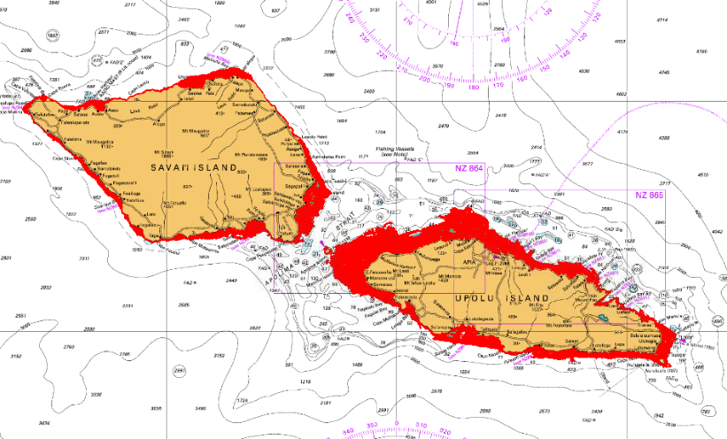
15th South West Pacific Hydrographic Commission Conference
Samoan 2015 LiDAR survey

Slide 11
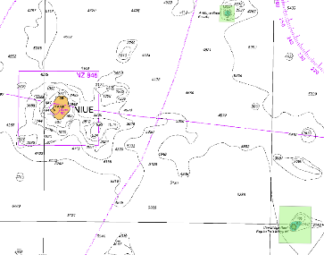
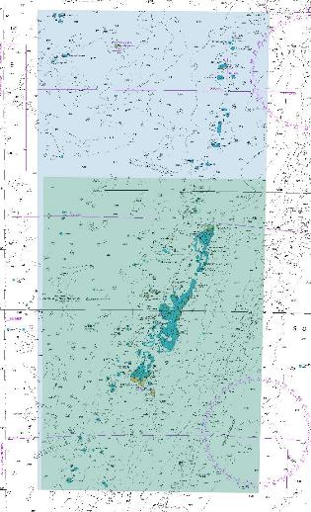
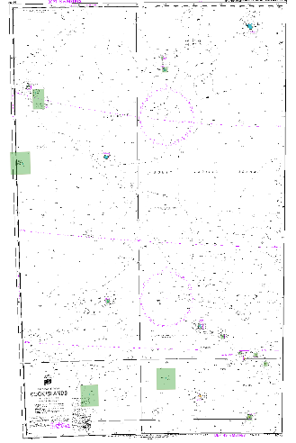
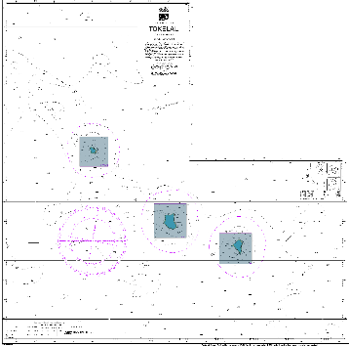
15th South West Pacific Hydrographic Commission Conference
Planned SWP surveys - SDB in Tonga, Niue, Cook Islands and Tokelau

Slide 12
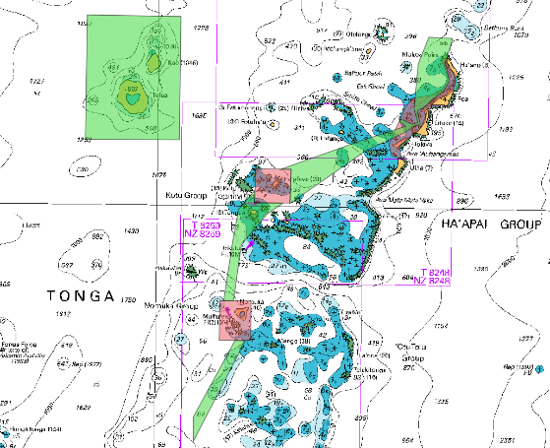
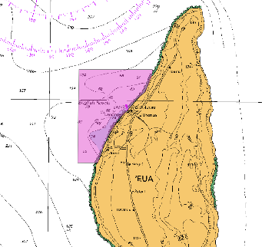
15th South West Pacific Hydrographic Commission Conference
Planned SWP surveys - LiDAR and MBES in Tonga

Slide 13
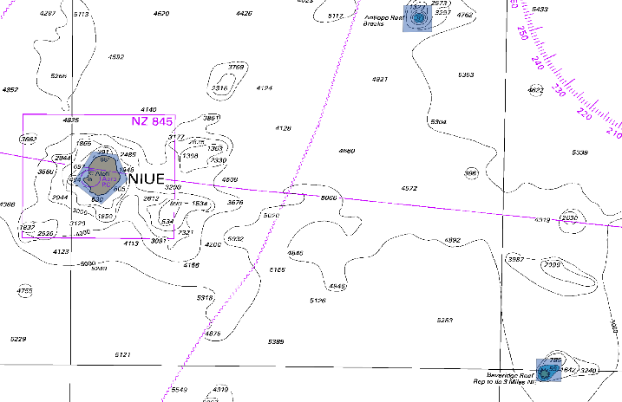
15th South West Pacific Hydrographic Commission Conference
Planned SWP surveys – LiDAR in Niue

Slide 14
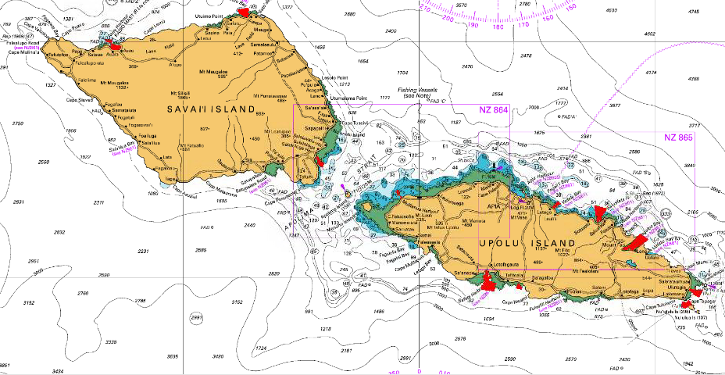
15th South West Pacific Hydrographic Commission Conference
Planned SWP surveys – MBES in Samoa
  Asau
  Matautu Bay
  Salelologa
  Mulifanua
  Vailele Bay
  Saluafata Bay
  Fagaloa Bay
  Aleipata
  Safata Bay
  Siumu Bay
1
2
3
4
5
6
7
9
8
10

Slide 15
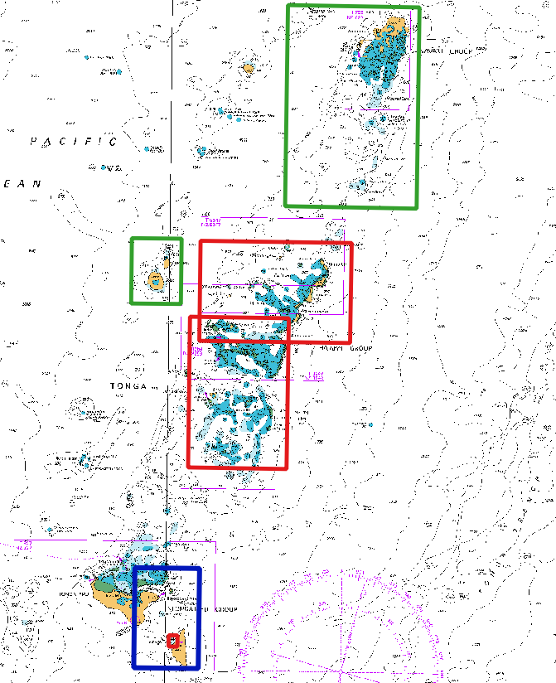
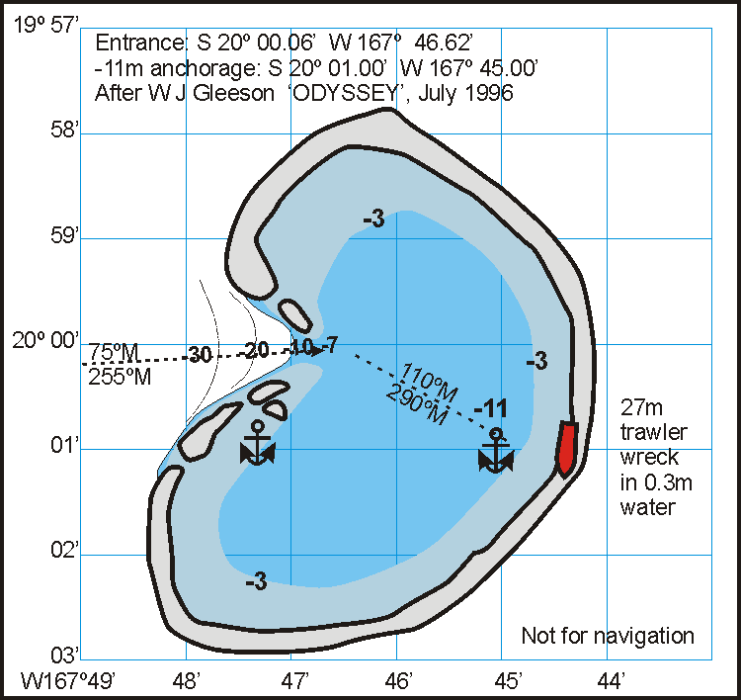
15th South West Pacific Hydrographic Commission Conference
Planned SWP charts
  Tonga
  Niue

Slide 16
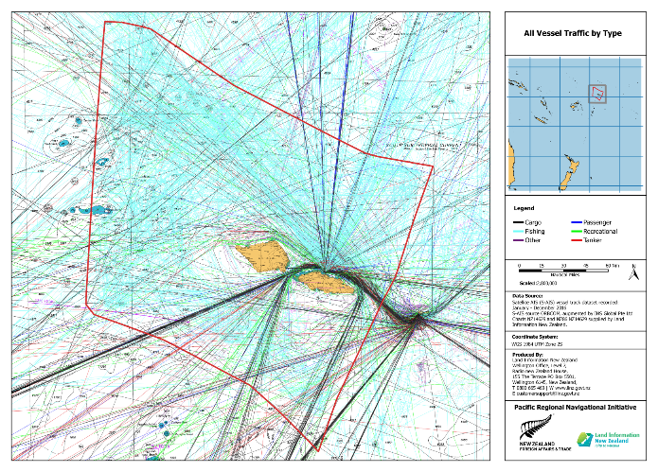
15th South West Pacific Hydrographic Commission Conference
Hydrographic Risk Assessments - Samoa

Slide 17
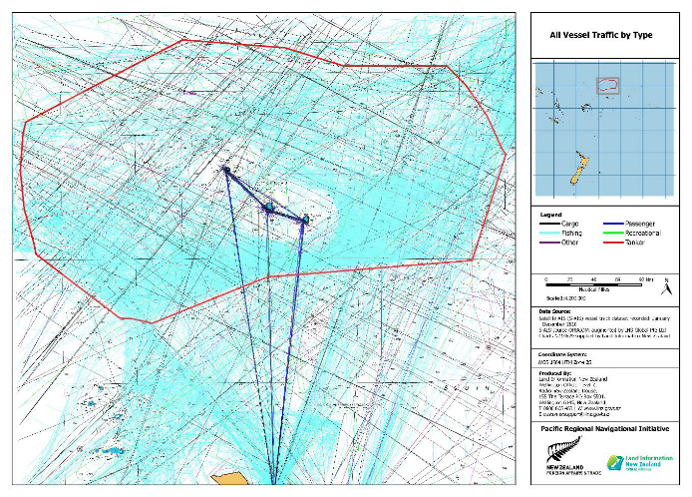
15th South West Pacific Hydrographic Commission Conference
Hydrographic Risk Assessments - Tokelau

Slide 18
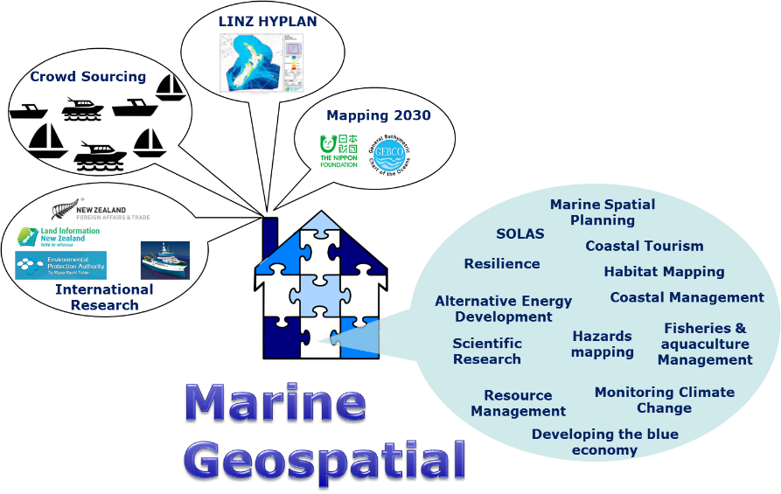
15th South West Pacific Hydrographic Commission Conference

Slide 19
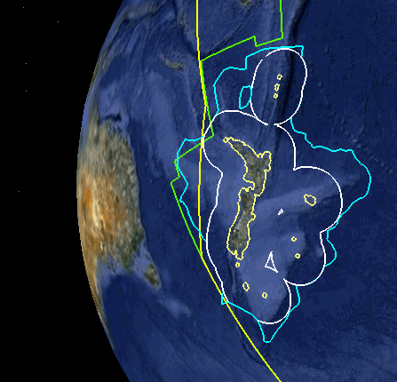
15th South West Pacific Hydrographic Commission Conference
UNCLOS MSR Vessels
LINZ is working across NZ Govt to ensure all ocean data from international marine science research voyage's in NZ EEZ is discoverable and available for the benefit of New Zealander’s

Slide 20
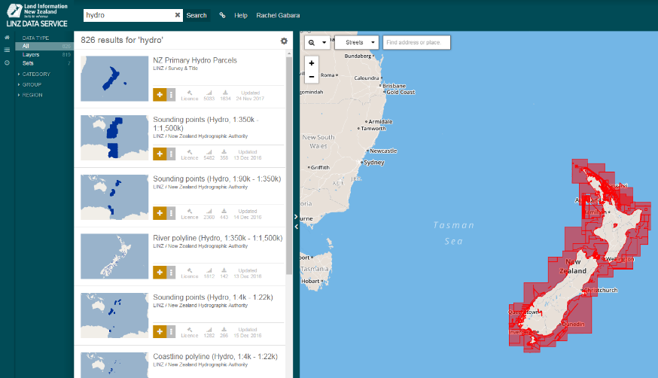
15th South West Pacific Hydrographic Commission Conference
Bathymetry - discoverable, accessible, available

Slide 21

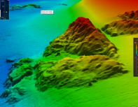
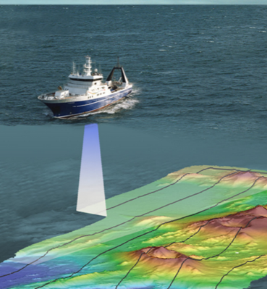
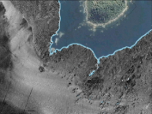
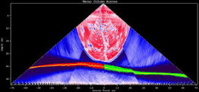
15th South West Pacific Hydrographic Commission Conference
“Bathymetry: the foundation for our sustainable seas, oceans and waterways”
Bathymetry
+
Backscatter
+
Water Column
Notes:
Multibeam bathymetry: provides seafloor depth information and is computed by measuring the time that it takes for the signal to return to the sonar.
Multibeam backscatter is becoming recognized more and more as an invaluable tool. The seafloor backscatter is defined as the amount of acoustic energy being received by the sonar after a complex interaction with the seafloor. This information can be used to determine bottom type, because different bottom types “scatter” sound energy differently. For example, a softer bottom such as mud will return a weaker signal than a harder bottom, like rock.
Water Column Data: Water column sonar data, the acoustic backscatter from the near-surface to the seafloor, are used to assess physical and biological characteristics of the ocean including the spatial distribution of plankton, fish, methane seeps, and underwater oil plumes.
Primary Uses: 3-D mapping of fish schools and other mid-water marine organisms, assessing biological abundance, species identification, and habitat characterization. These data are also useful for mapping underwater gas seeps and remotely monitoring undersea oil spills.

Slide 22
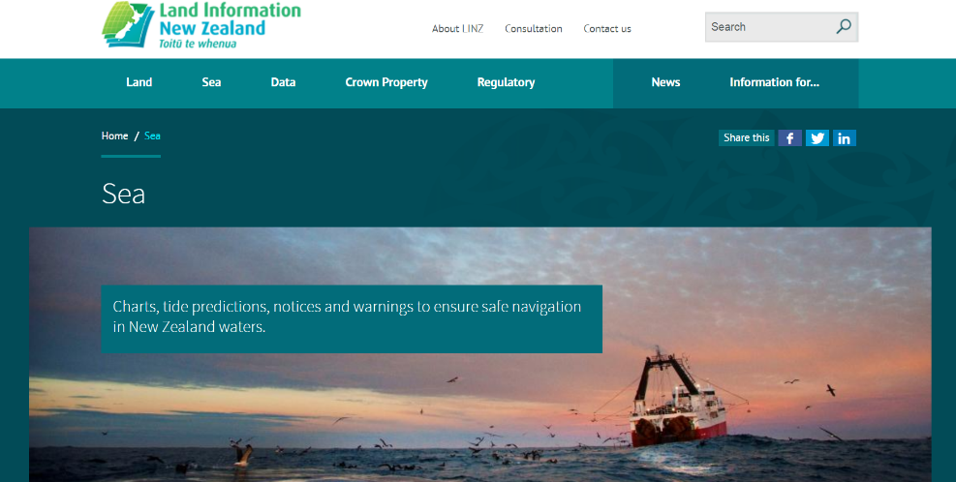
15th South West Pacific Hydrographic Commission Conference
Contact us:
https://www.linz.govt.nz/sea
ntm@linz.govt.nz

