Slide 1

UK National Report
15th South West Pacific
Hydrographic Commission Conference
21st February - 23rd February 2018
Nuku'alofa, Tonga
Submitted by the United Kingdom of Great Britain and Northern Ireland

Slide 2
UK ACTIVITY 2017/18
        Chart Production
        Primary Charting Activity
        Survey Activity
        UK Overseas Territories
        Capacity Building
        UKHO Transformation
        Other activities

Slide 3
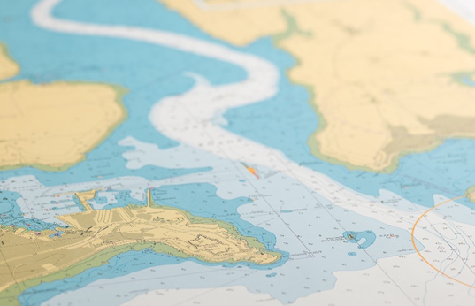
Paper Chart Production
    36 New Editions and New Chart Adoptions

Slide 4
ENC Production
UKHO has published 104 ENC cells in the SWPHC region.
West of 180°
East of 180°

Slide 5
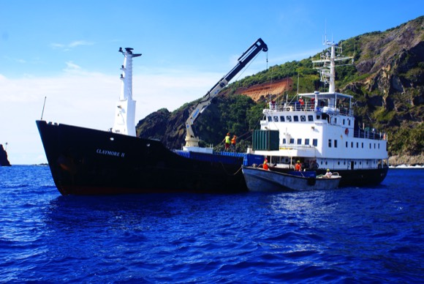
Publications and Products
      Standard Navigation Charts
      Sailing Directions
      Tidal Publications
      Radio Signals
      Lights
Digital products, to support mandation:
Admiralty Digital Publications (ADLL, ADRS, ATT)
E-Nautical Publications

Slide 6
Challenge for all :
Future of the paper chart in SWPHC region
  ECDIS Mandation
  CME Programme
  Since 2017, 620 New Editions & New Charts
  PAGS
  6092 Notice to Mariners published in 2017
  Print on Demand (POD)

Slide 7
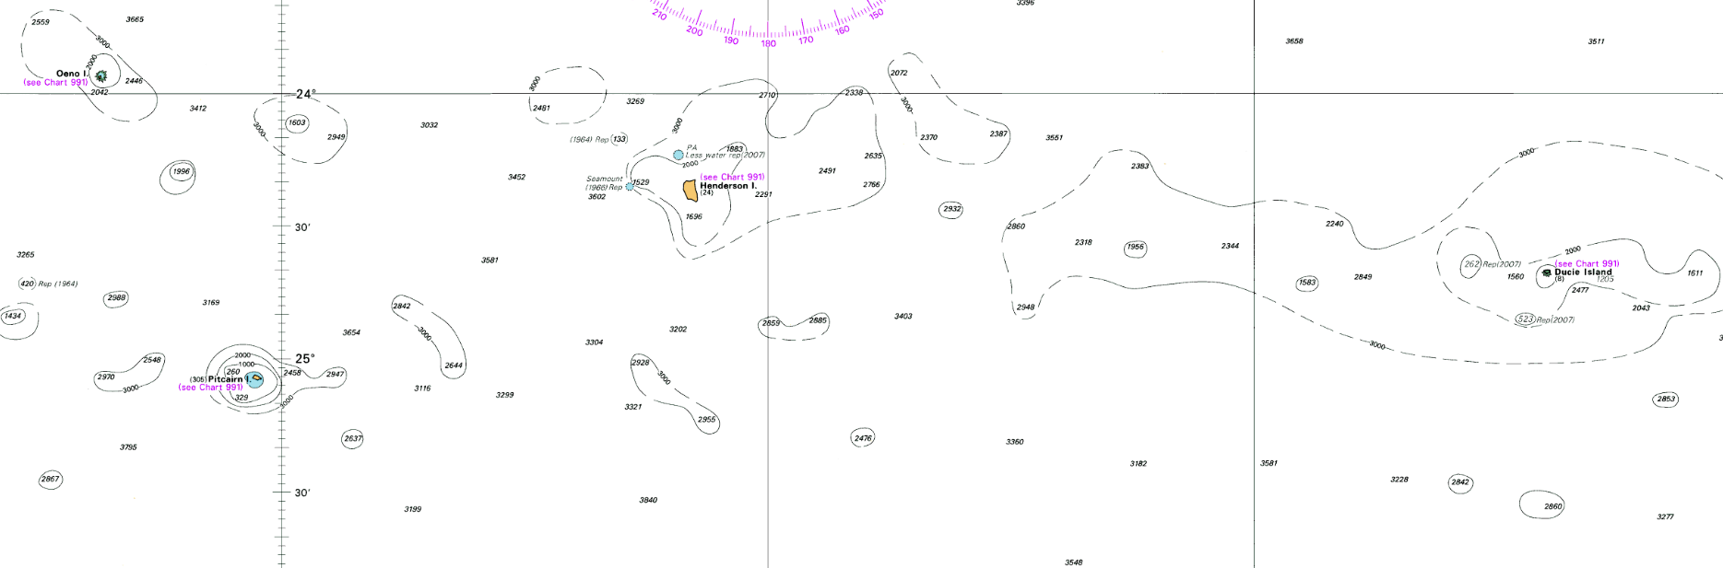
UK Overseas Territories
Oeno Island
Henderson Island
Ducie Island
Pitcairn Island

Slide 8
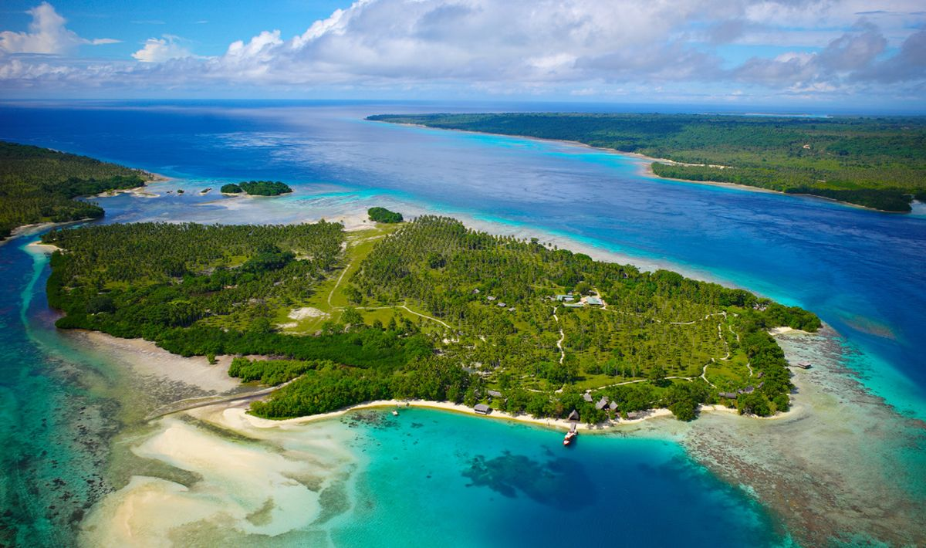
Support to Coastal States

Slide 9
Survey Activity
Commonwealth Marine Economies Programme:
UK Government Funded Programme to support the development of Blue Economies of Commonwealth SIDS
With Focus on using marine science and data to promote economic growth and prosperity
Services and expertise provided by 3 partner organisations – Cefas, NOC and UKHO
SIDS within the Caribbean and Pacific Oceans are in scope
Local projects enabled in conjunction with the Target State
UK led projects combined with capacity building and knowledge transfer

Slide 10
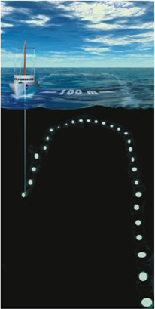
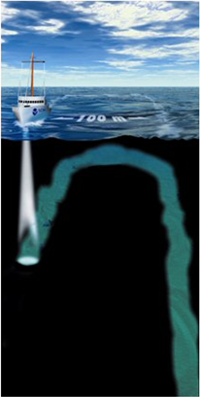
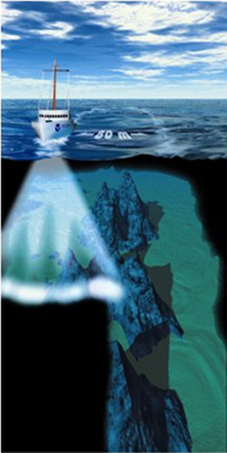
Survey Activity in Tonga
1800s
Today

Slide 11
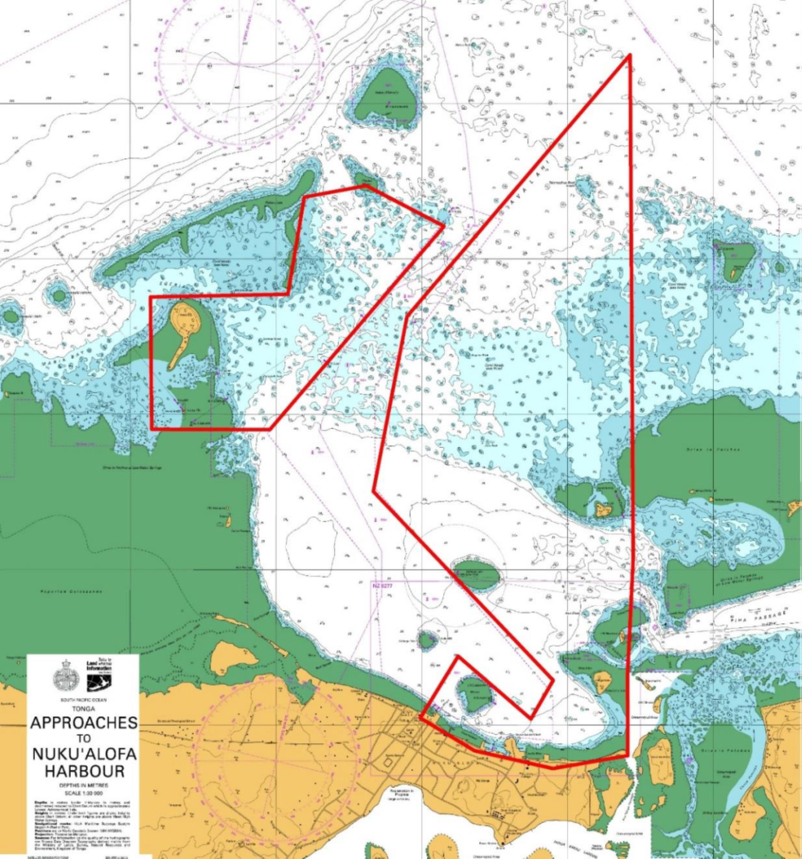
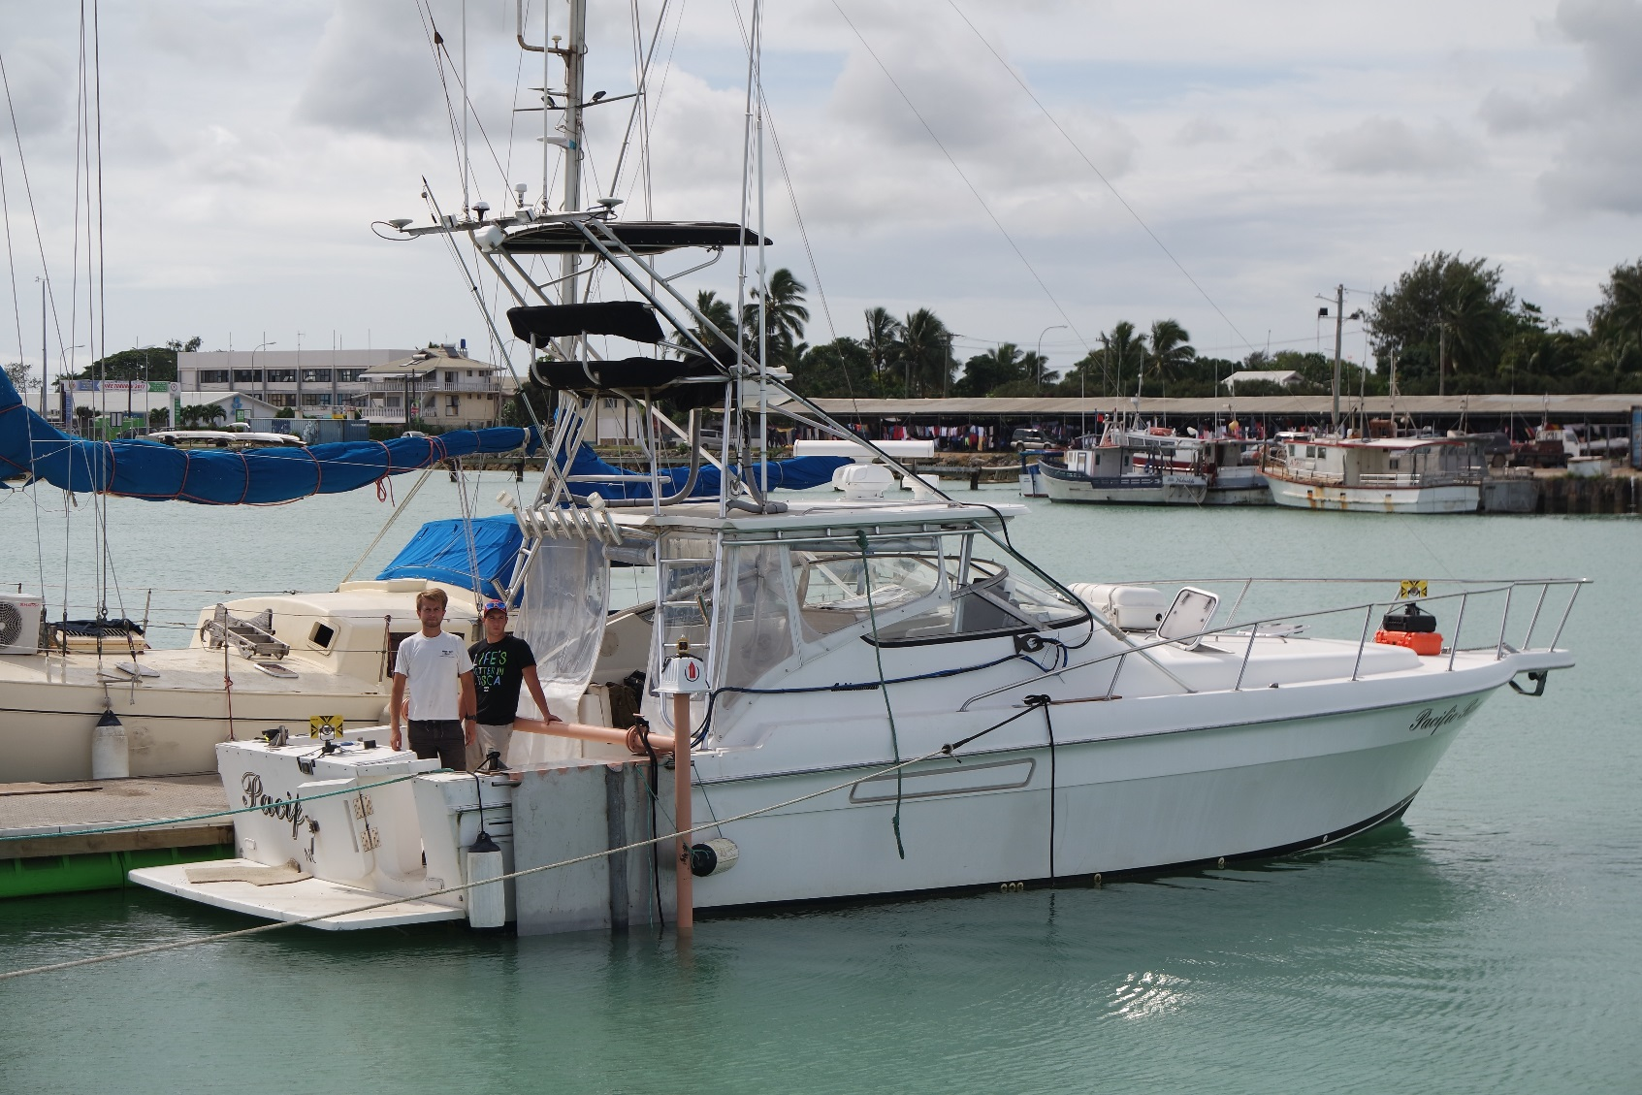
Tonga Survey Areas Overview
(Areas prioritised by UKHO, LINZ, Ministry of Infrastructure and local stakeholders)

Slide 12
Broader UK Government Work
Blue Belt Programme
The Blue Belt Programme will assist the Pitcairn Government with:
Legislation and polices
Marine biodiversity
Sustainable harvests for fisheries
Monitoring and enforcement strategies
Evaluation of threats
Capacity building

Slide 13
Commonwealth Heads of Government Meeting (CHOGM)
  Commonwealth Summit: 16th to 20th April 2018
The CME Programme
RV Endeavor
Endorsement of the principles of the CME programme
A more sustainable, fairer, secure and prosperous future

Slide 14
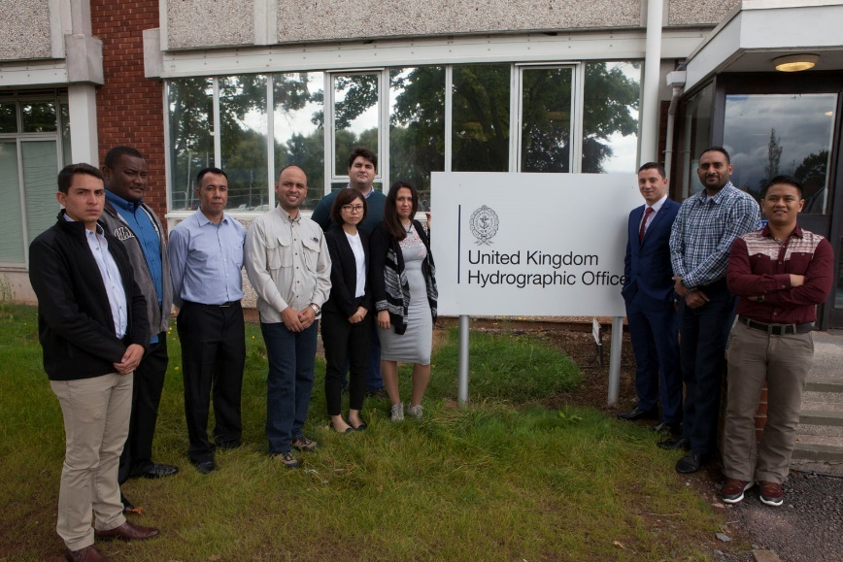
Capacity Building
NIPPON Foundation sponsored course

Slide 15
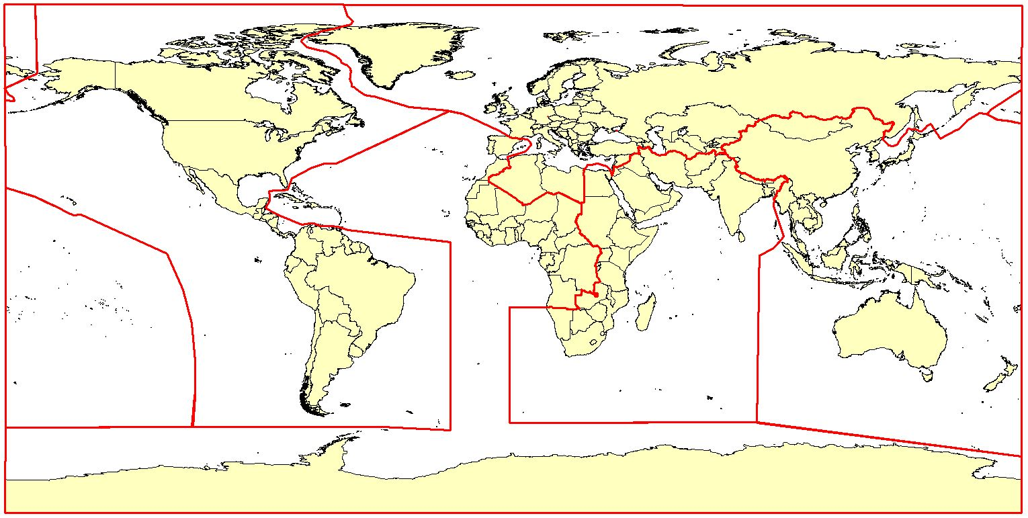
Global Partnering and Engagement

Slide 16
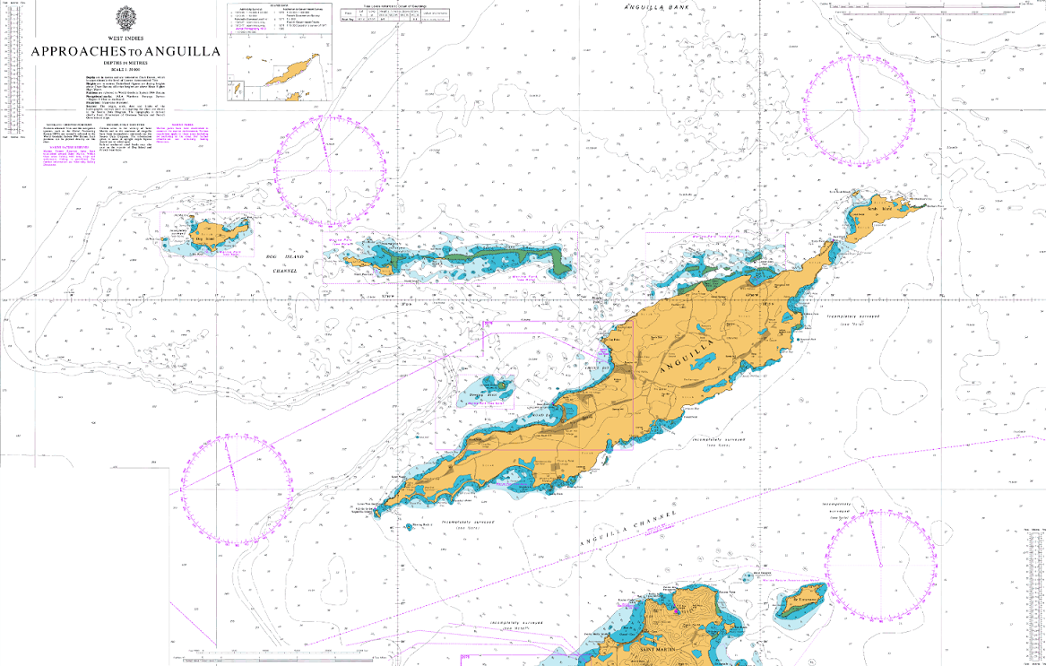

UKHO Transformation
Product focused

Slide 17
UKHO International Programmes and Training Team
Sam Harper
Head of International Programmes and Training
International Training Team
Jeff Bryant
International Training and CB Manager
David Parker
International Hydro Programmes Manager
Ian Davies
International Hydro Programmes Manager
Ken Blagdon
International Trainer
Lucy Fieldhouse
International Trainer
Derek Aldridge
International Trainer
Chris Booth
International Trainer
Hazel Newman
International Hydro Programmes Support Officer
Mel Davis
Training Assistant
International Hydro Projects Team

Slide 18
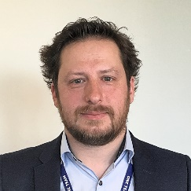
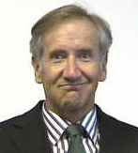
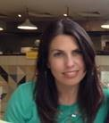
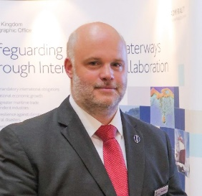
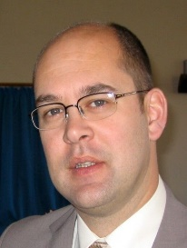
UKHO International Programmes and Training Team
Sam Harper
Head of International Programmes and Training
Jeff Bryant
International Training and CB Manager
Hazel Newman
International Hydro Programmes Support Officer
David Parker
International Hydro Programmes Manager
Ian Davies
International Hydro Programmes Manager

Slide 19
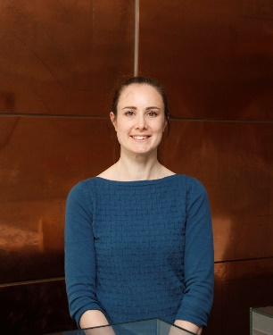
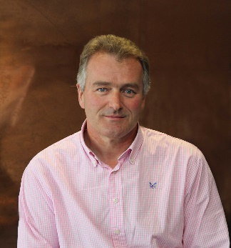
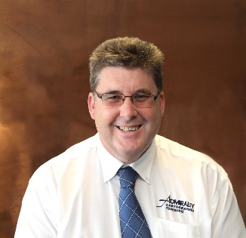
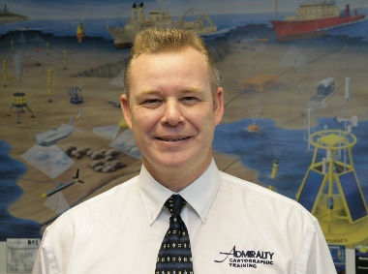
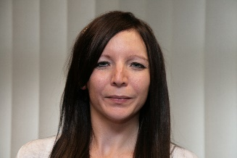
UKHO International Programmes and Training Team
Jeff Bryant
International Training and CB Manager
Ken Blagdon
International Trainer
Lucy Fieldhouse
International Trainer
Derek Aldridge
International Trainer
Chris Booth
International Trainer
Mel Davis
Training Assistant

Slide 20
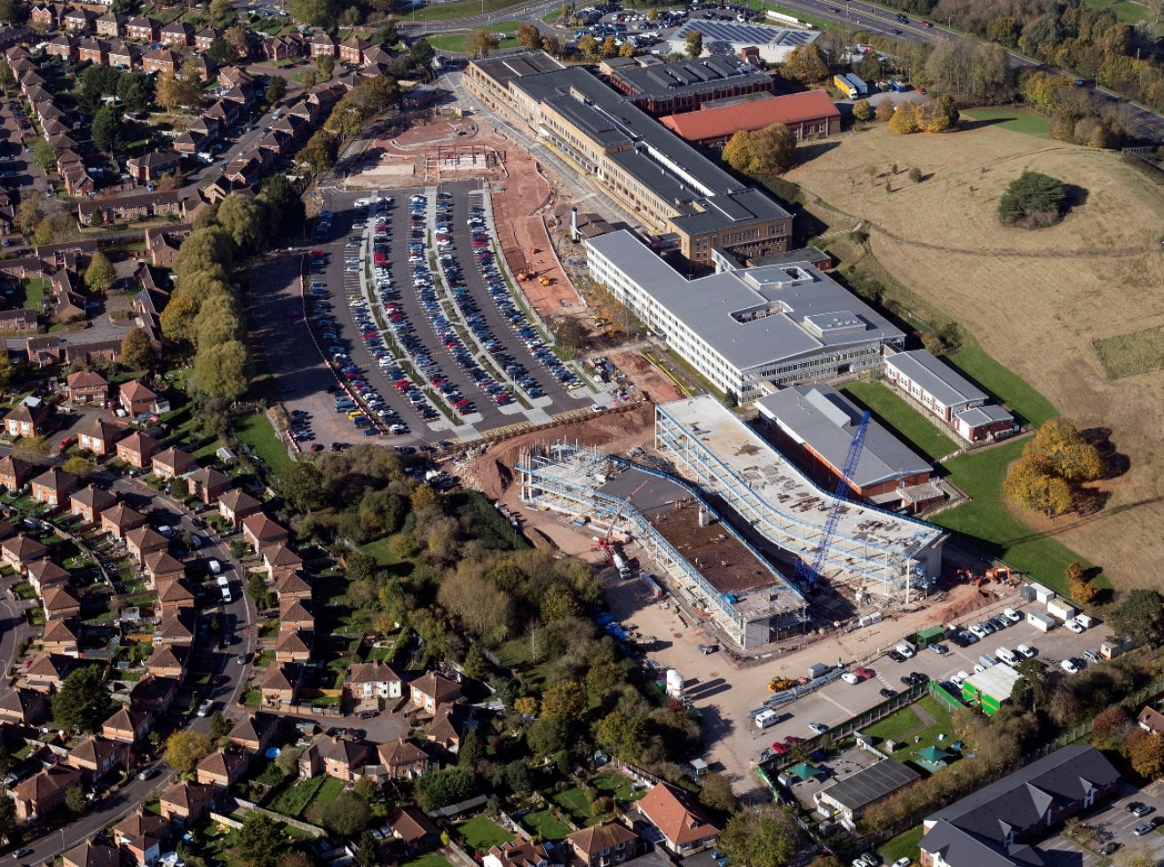

UKHO New Build

Slide 21
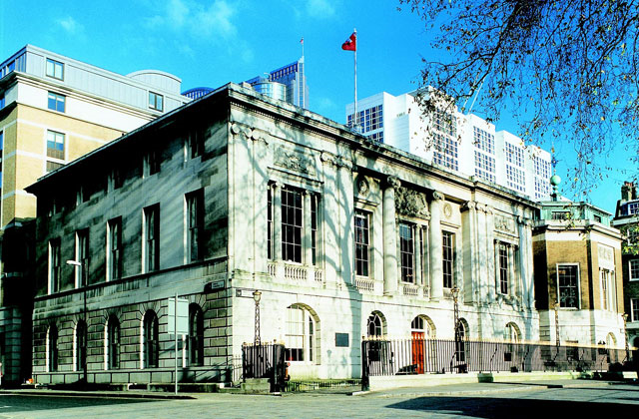
World Hydrography Day 2018
"Bathymetry – the foundation for sustainable seas, oceans and waterways"

Slide 22
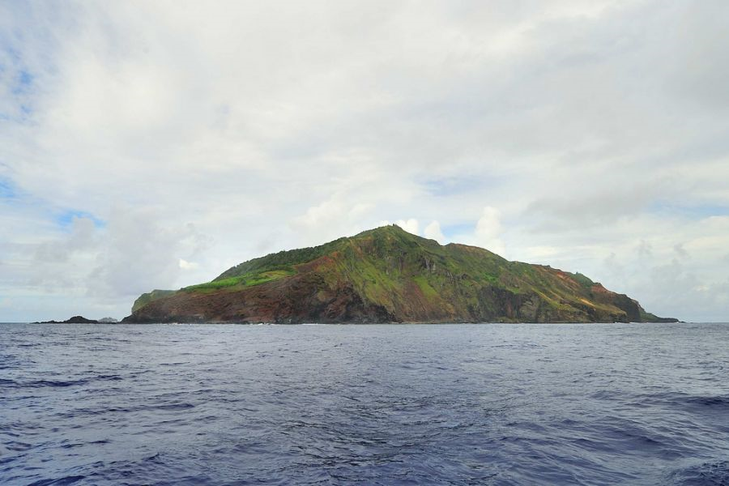
Thank you

