Slide 1
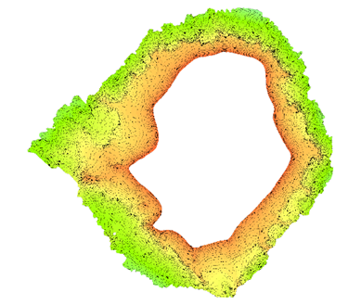
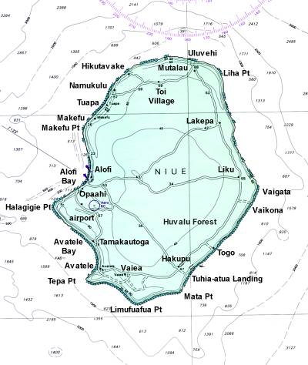
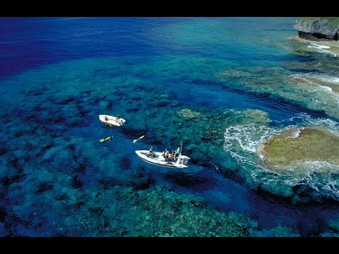
15th South West Pacific Hydrographic Commission Conference 21 – 22 February 2018 Nadi, Fiji
NIUE National Report

Slide 2
15th South West Pacific Hydrographic Commission Conference
CURRENT SITUATION
PCA
* Bilateral arrangement, March 2017
Pacific Safety of Navigation Project
* Gap analysis and needs assessment, November 2017
Pacific Regional Navigation Initiative (PRNI)
* Satellite Derived Bathymetry → Beveridge Reef, Antiope Reef * Airborne Laser Bathymetry → Niue, Beveridge Reef, Antiope
→ New chart of Niue and Beveridge Reef
Marine Spatial Plan
* 40% of EEZ = LSMPA

Slide 3
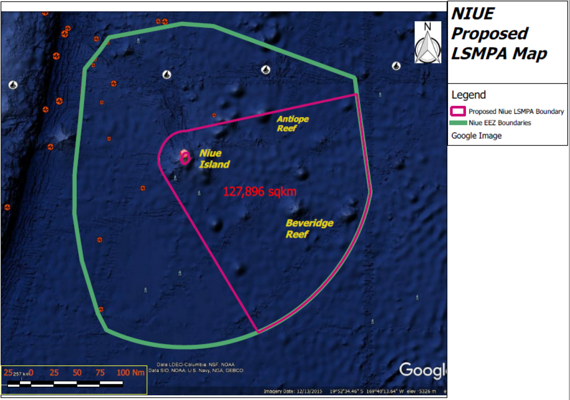
15th South West Pacific Hydrographic Commission Conference

Slide 4
15th South West Pacific Hydrographic Commission Conference
FUTURE FOCUS
Marine Spatial Plan
* Legislation, Compliance Strategies, Sustainable Financing
National Hydrographic Authority and Coordinating Committee
Capacity Building
* Training for National MSI Coordinator
IHO Technical Implementation Visit
Safety of Navigation gap analysis and needs assessment
* Implement recommendations

