Slide 1
IALA World –Wide Academy
Briefing to SWPHC on risk management and the quality of Maritime Management in the Pacific Region

Slide 2
International Obligations: SOLAS V Regulation 13
Chapter V Regulation 13.1 requires a Contracting Government to provide “as it deems practical and necessary” by itself or with other Governments “such AtoN as the volume of traffic justifies and the degree of risk requires”
Ch V Reg 13.2: AtoN should conform to international standards (IALA recommendations and guidelines)
Ch V Reg 13.3 information about AtoN must be given to all concerned (mariners; stakeholders etc.) - MSI

Slide 3
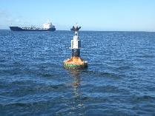
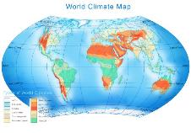
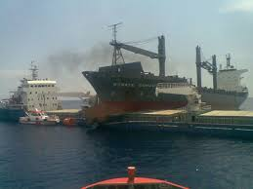
International Standards – IALA Publications
Guideline 1109 on theft and vandalism deterrents
Guideline 1091 on bird deterrents
Guideline G1136 - AtoN services in extremely hot and humid climates
Guideline G1138 on Simplified IALA Risk Assessment – SIRA
www.iala-aism.org/publications

Slide 4
Risk Management
The IALA Risk Management Toolbox

Slide 5
Causality
Hazard
Unwanted scenario
Short or long-term Consequences
Risk =
P
*
C

Slide 6
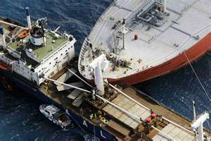
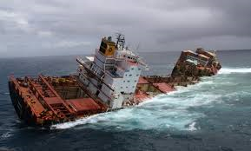
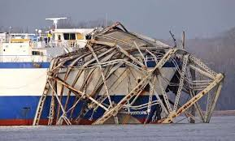
IALA Risk Management Toolbox
PAWSA – 30 experts
IWRAP MkII – calculates statistics
SIRA – a few stakeholders who really care

Slide 7
IWRAP Mk II Video (three days off Suva)

Slide 8
Risk Value Matrix (SIRA G1138 Table 3)
 |  | PROBABILITY OR LIKELIHOOD
 |  | Very Rare (1) | Rare (2) | Occasional (3) | Frequent (4) | Very frequent (5)
CONSEQUENCE OR IMPACT | Catastrophic (5) | 5 | 10 | 15 | 20 | 25
 | Major (4) | 4 | 8 | 12 | 16 | 20
 | Severe (3) | 3 | 6 | 9 | 12 | 15
 | Minor (2) | 2 | 4 | 6 | 8 | 10
 | Insignificant (1) | 1 | 2 | 3 | 4 | 5
ALARP

Slide 9
Risk Control Options (RCO)
RCO for each undesirable incident reduce the risk to a level (As Low As Reasonably Practicable - ALARP) which is acceptable to stakeholders
The Risk Value will determine what action is required (G1138 Table 4)
Risk Value | Risk Category | Action Required
1 - 4 | Green | Low risk. No RCOs unless implemented at low cost
5 - 8 | Yellow | Moderate risk. Reduce to ALARP level through RCOs
9 - 12 | Amber | High risk requiring RCO and significant funding
15 - 25 | Red | Very high and unacceptable risk – immediate action required with major funding. Ports/waterways may need to close until risks are at ALARP level

Slide 10
Quality of Maritime Maturity for AtoN service provision
Meeting international obligations – or not!

Slide 11
Competent Authority
Safety of Navigation
Structure
Processes
Capabilities/ Competences
Resources
Government
Culture
International Req.
Legislation Empowerment
Resources
Reliable & Effective AtoN Service Delivery
Issues:
Maritime legislation
Structure / Organization
AtoN Availability
Risk Management skills
National AtoN Register
Maritime Safety Information
User Consultancy
Competences
AtoN Maintenance
Stakeholders / Users
Expectations Consultation
(Resources)

Slide 12
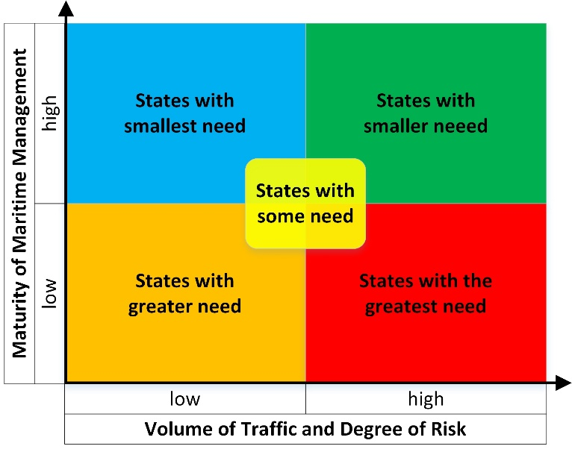
The
The Higher the “Score” the greater the need
Priority Three
Priority Two
Priority One

Slide 13
Maritime Maturity “Score”
12 categories e.g.
Effective Maritime Safety Information
Funding arrangements adequate
National register of AtoN compiled and updated
Stakeholder consultancy effective

Slide 14
Final Quality “Score”
A “perfect” State would score 1. In practice a score of less that 20 forms the “Premier Division”
28 States in the Premier Division
China – score 7
Australia
Brazil
India
Republic of Korea
South Africa
UK
USA etc.

Slide 15
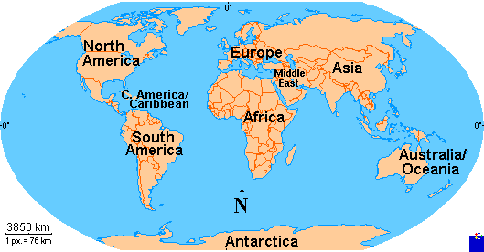
Priority 1 States – Score of 57 or more
Pacific Region
Priority | No. of States | Score | States
1 | 0 | 57+ | none
2 | 4 | 48 - 56 | Fed. States of Micronesia; Palau; Tonga; Vanuatu
3 | 1 | 45 - 47 | Tuvalu (until next Thursday!)

Slide 16
Thank you
Contact: stephen.bennett@iala-aism.org

