Slide 1
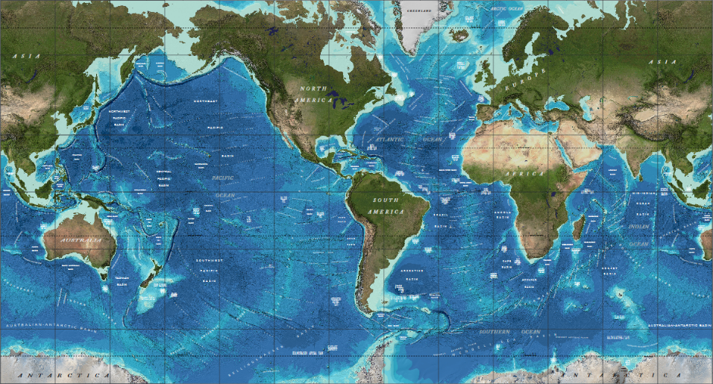
GEBCO and Seabed 2030

Slide 2
What is GEBCO?
GEneral Bathymetric Chart of the Oceans
An international group of experts who work on the development of a range of bathymetric data sets and data products
Aims to provide the most authoritative, publicly-available bathymetric data sets for the world’s oceans
Operates under the auspices of the International Hydrographic Organization (IHO) and the Intergovernmental Oceanographic Commission (IOC) of UNESCO
First GEBCO paper chart series initiated in 1903(!)

Slide 3
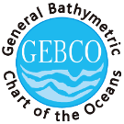
United Nations Educational Scientific and Cultural Organization
International Hydrographic Organisation
Intergovernmental Oceanographic Commission
Guiding Committee
Technical Sub-Committee on Ocean Mapping (TSCOM)
Sub-Committee on Regional Undersea Mapping (SCRUM)
Scientific Committee on Undersea Feature Names (SCUFN)

Slide 4
Regional mapping work
GEBCO has setup the Sub-Committee on Regional Undersea Mapping (SCRUM) to:
Build a closer collaboration with regional mapping efforts and coordinate, as well as encourage, the incorporation of their compilations into GEBCO.
The Global GEBCO grid is continuously updated in part from these regional grids, benefiting greatly from their local knowledge and expertise.
www.gebco.net/regional_mapping/mapping_projects/

Slide 5
GEBCO Products
Gridded Bathymetry (30 arc seconds)
Digital atlas
Maps, Charts, and Viewers
Web Services
Undersea Feature Names
Bathymetry Processing Cookbook
Available at
https://www.gebco.net

Slide 6
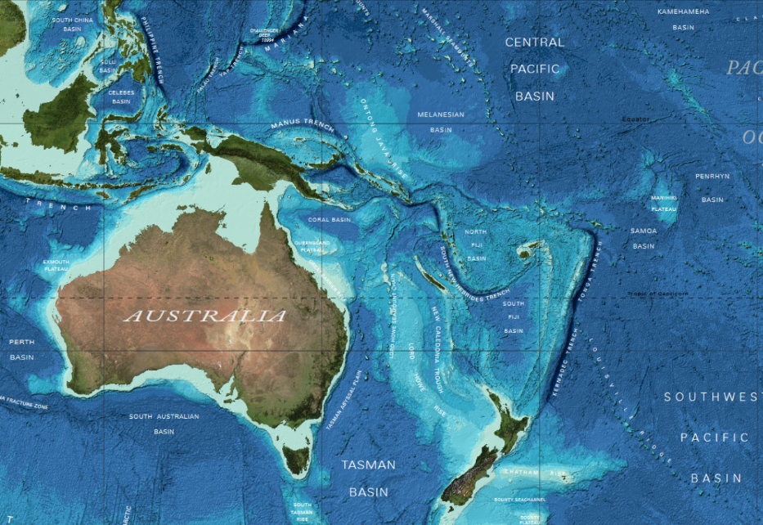

Slide 7
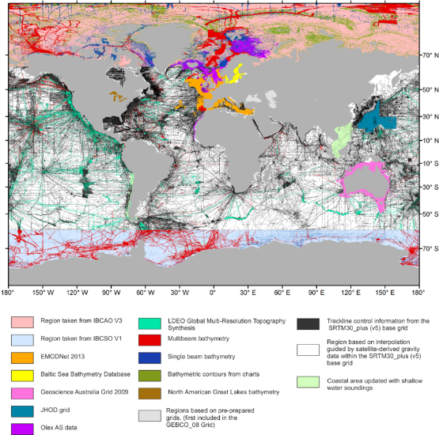
GEBCO’s products: Source Identifier Grid
The GEBCO Source Identifier (SID) Grid:
Shows the source of depth value in each grid cell, i.e. if it is based on trackline data; pre-existing grids or if it is based on interpolation

Slide 8
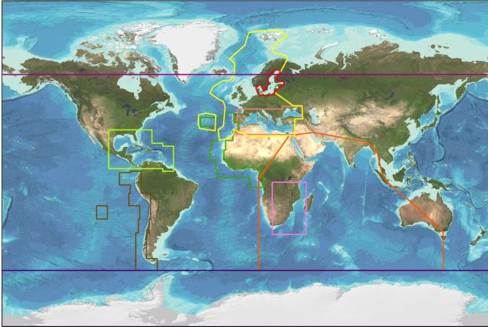
Regional mapping projects
Notes:
International Bathymetric Chart of the Arctic Ocean (IBCAO)
International Bathymetric Chart of the Southern Ocean (IBCSO)
International Bathymetric Chart of the Caribbean Sea & Gulf of Mexico (IBCCA)
International Bathymetric Chart of the Central Eastern Atlantic (IBCEA)
International Bathymetric Chart of the Mediterranean (IBCM)
International Bathymetric Chart of the South Eastern Pacific (IBCSEP)
International Bathymetric Chart of the Western Indian Ocean (IBCWIO)

Slide 9
Seabed 2030
A program to produce the definitive map of the World Ocean floor by 2030 to empower the world to make policy decisions, use the ocean sustainably, and undertake scientific research based on detailed information of the Earth’s seabed.
Supports United Nations Sustainable Development Goal 14: to conserve and sustainably use the world’s oceans, seas and marine resources
SDG14 will be impossible to achieve without a comprehensive map of the world’s ocean floor

Slide 10
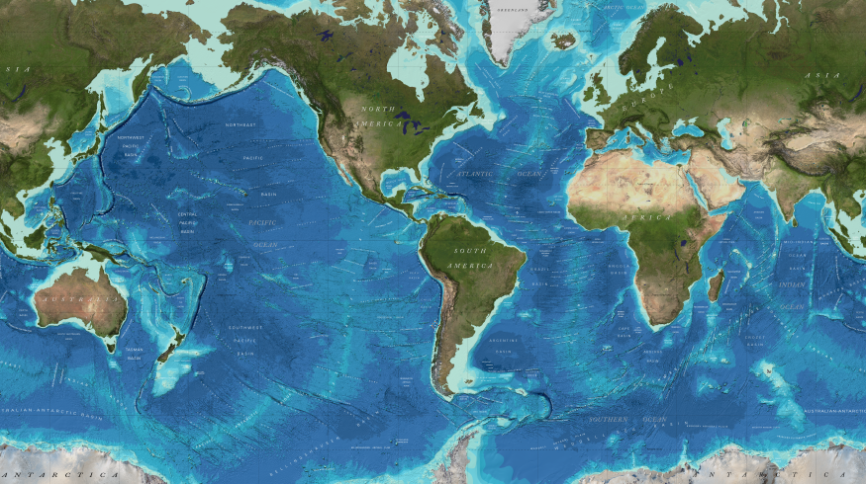
If the World Ocean is divided into 1x1 km blocks (grid cells), about 82% of them do not have depth values. (Based on GEBCO 2014 grid)
1 km

Slide 11
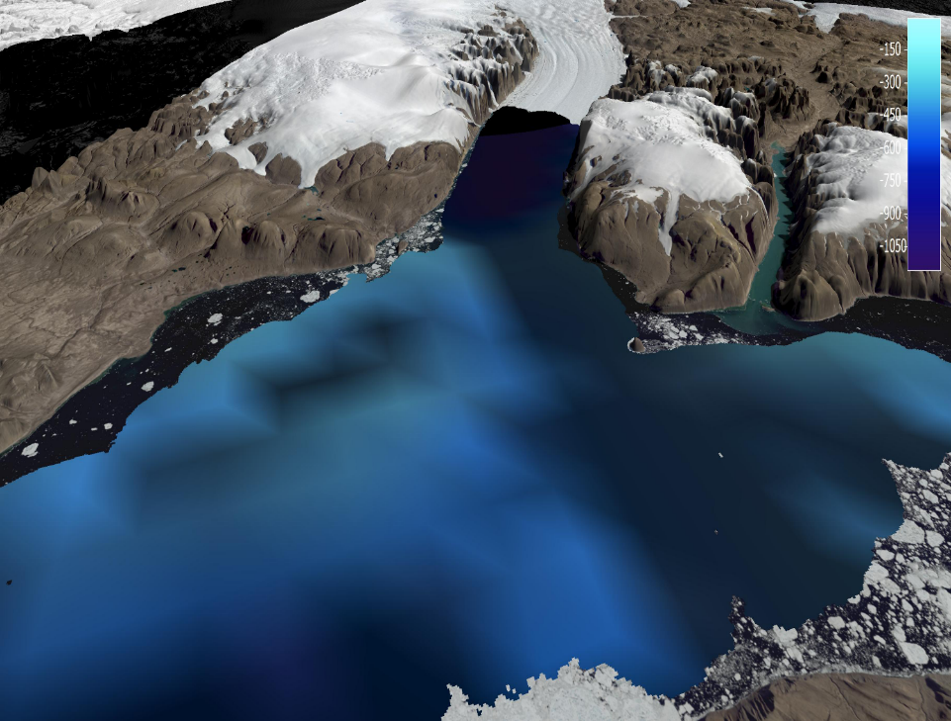
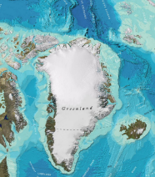
From……

Slide 12
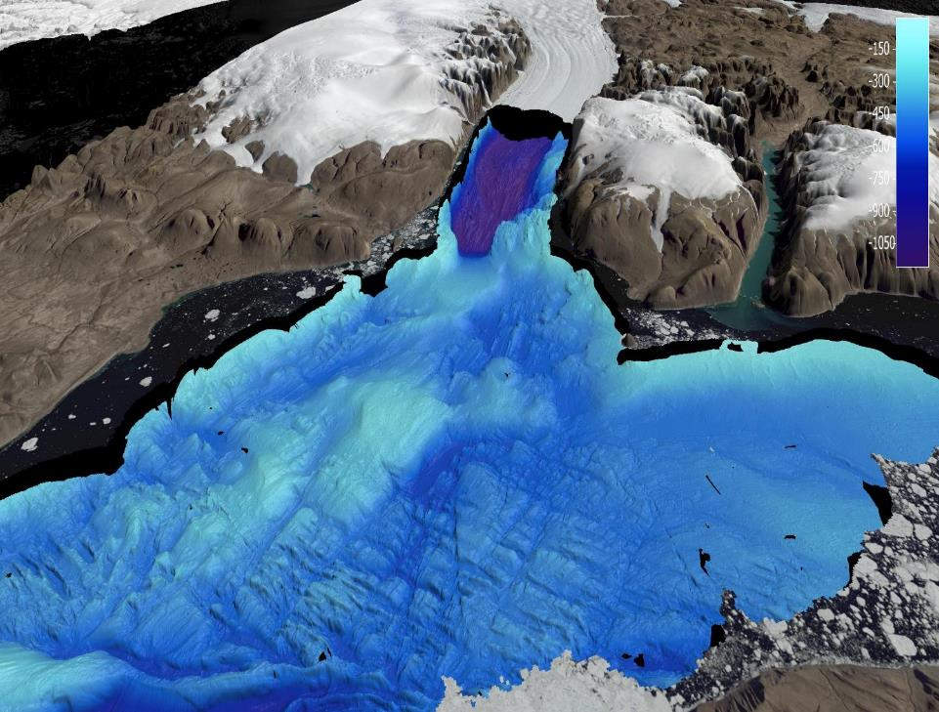
To……

Slide 13
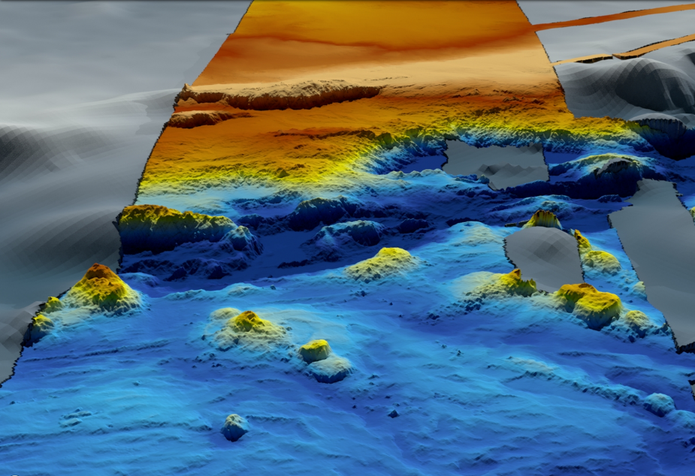

Slide 14
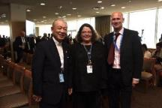
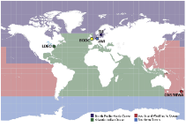
Seabed 2030: How we got here
Mr Sasakawa, Chairman of the Nippon Foundation Proposed ‘…to map 100% of the topography of the World Ocean by 2030’
June 2016
Nippon Foundation - GEBCO Seabed 2030 Project
announced
June 2017
Mr Sasakawa – 1 of 8 IOC-UNESCO “Champions of Global Ocean Science”
Project start
2030 100% of ocean accurately mapped
1st August 2017

Slide 15
Project Plan
WP 1: Gathering, synthesizing, publishing bathymetric data
Merging all available data into the high resolution ocean map
WP 2: Development of standards, data assembly and delivery tools
Developing the tools and systems to facilitate building and using the map.
WP 3: Technology innovation
Identifying and encouraging technical innovation in bathymetric mapping
WP 4: Networking: map the gaps
Future mapping expeditions to increase the coverage
WP 5: Management
Managing the project

Slide 16
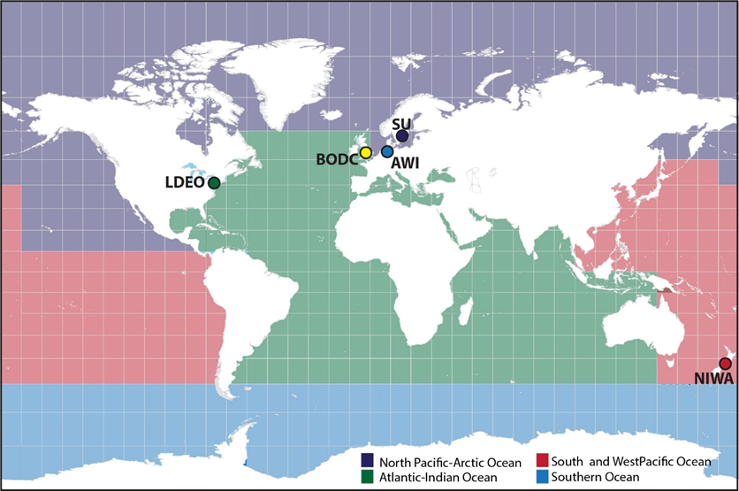
One Global Data Assembly and Coordination Centre (GDACC) and Four Regional Data Assembly and Coordination Centres (RDACC) will be established
shared center
CCOM/JHC

Slide 17
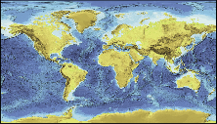
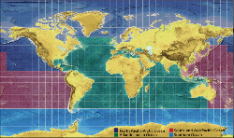
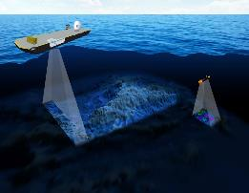
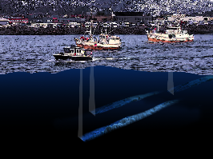
WP 1: Gathering, compiling and publishing bathymetric data
GEBCO-Nippon Foundation Seabed 2030
World Ocean Map
EB
RDACC
Data
Mapping community
EB
GDACC
RDACC
WWW
download
services
EB
RDACC
EB
Data
RDACC
Users
EB=Editorial Board for ocean regions
Seabed 2030 storage of source data in DCDB
WP 2: Development of bathymetric data and assembly tools
WP 3: Technology innovation
WP 4: Mapping the gaps
Gridding tools
Cloud
Bathy
-databases
Data processing

Slide 18
Seabed 2030 project management

Slide 19
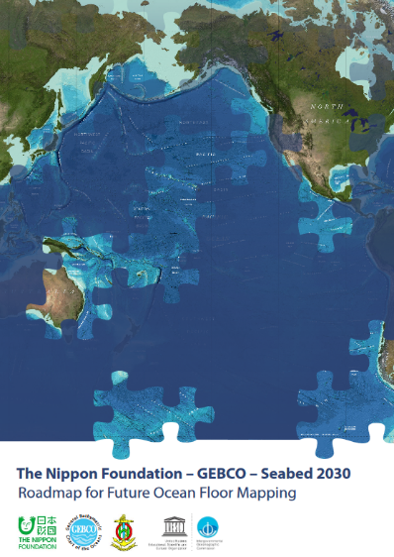
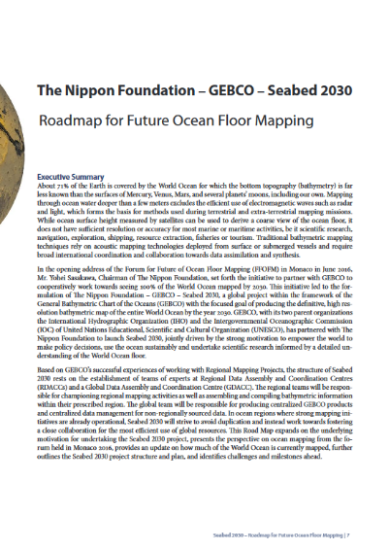
Seabed 2030 Key Documents
https://seabed2030.gebco.net/

Slide 20
Filling the data gaps with bathymetry from ENC data
To more accurately model the shape of the ocean floor in all areas and serve a wider user community, GEBCO is striving to improve its gridded bathymetric datasets in shallower waters
In 2006 a request was made to IHO Member States to provide bathymetry data from ENCs (usage bands 2 and 3) to GEBCO to help update its global model
New request to IHO MS for bathymetry data from ENCs sent out in March 2016 (circular letter 11/2016)

Slide 21
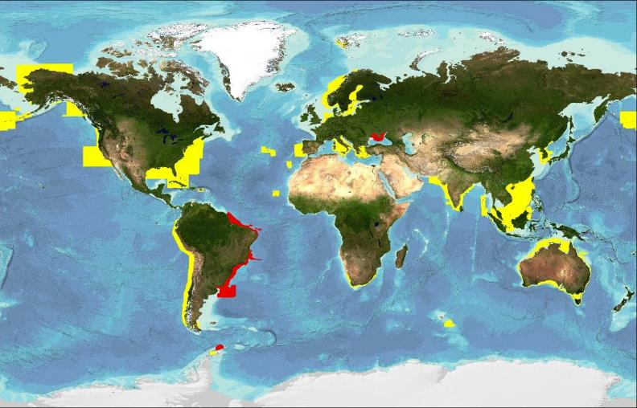
Shallow water bathymetry from ENC data
ENC data coverage (usage bands 2 & 3) provided by IHO MS and organizations, to date, to GEBCO for grid updating work after calls in 2006 (yellow) and 2016 (red),

Slide 22
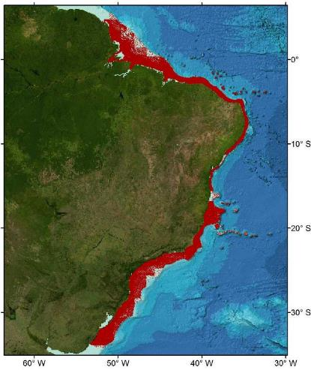
Shallow water bathymetry from ENC data
Data for waters off Brazil
Soundings points extracted from ENCs recently supplied to GEBCO for the waters off Brazil

Slide 23
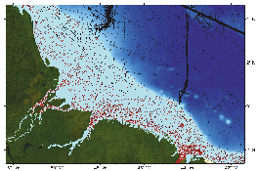
Shallow water bathymetry from ENC data
Data for waters off Brazil

Slide 24
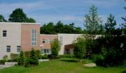
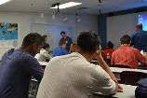
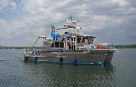
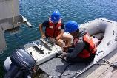
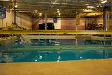
Capacity-building initiative:
The Postgraduate Certificate in Ocean Bathymetry
Designed to train a new generation of scientists and hydrographers in ocean bathymetry
is funded by: The Nippon Foundation of Japan www.nippon-foundation.or.jp/en/
and taught at: The Center for Coastal and Ocean Mapping / Joint Hydrographic Center; University of New Hampshire, USA
SEE CIRCULAR LETTER 13/2017 - 09 February 2017

Slide 25
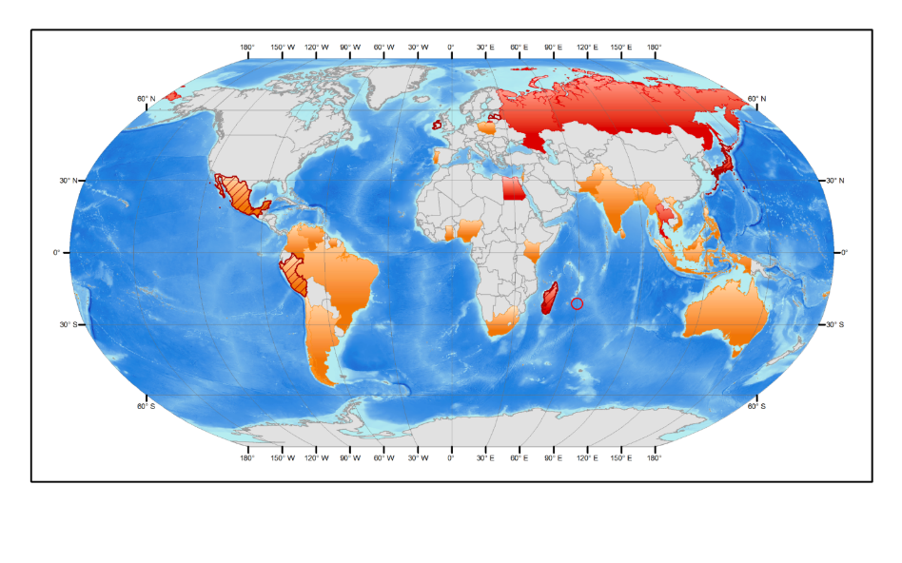
78 scholars from 35 coastal states over last 13 years
with the current class coloured red Add incoming Year 14 class (hatch)
(84 people from 37 coastal states)

Slide 26
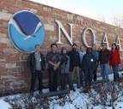
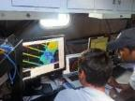
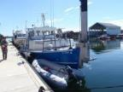
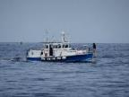
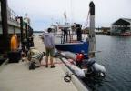
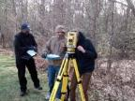
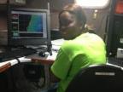
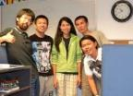
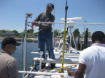
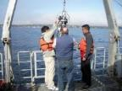
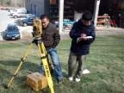
Training Program Content

Slide 27
For more information
GEBCO: https://www.gebco.net
Training: https://www.gebco.net/training/training_programme/
Seabed 2030: https://seabed2030.gebco.net/
Johnathan Kool (GEBCO GGC)
johnathan.kool@ga.gov.au

