Slide 1








The Nippon Foundation – GEBCO
Seabed 2030 programme
Adam Greenland
Land Information New Zealand
New Zealand Hydrographic Authority
Presentation to IHO SWPHC15, Fiji – 22 February 2018

Slide 2


Outline
Resolution / Grid Size
2014: Digital bathymetric model
The Seabed 2030 project
The South and West Pacific Centre
A selection of challenges we face !

Slide 3
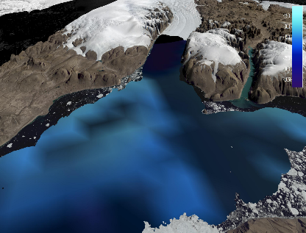
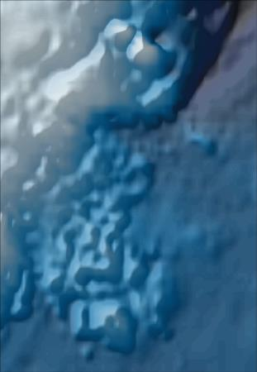
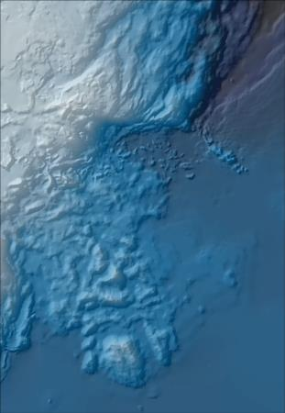
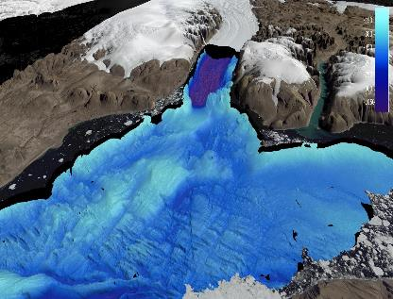


Resolution / grid size
1 km vs 400 m

Slide 4
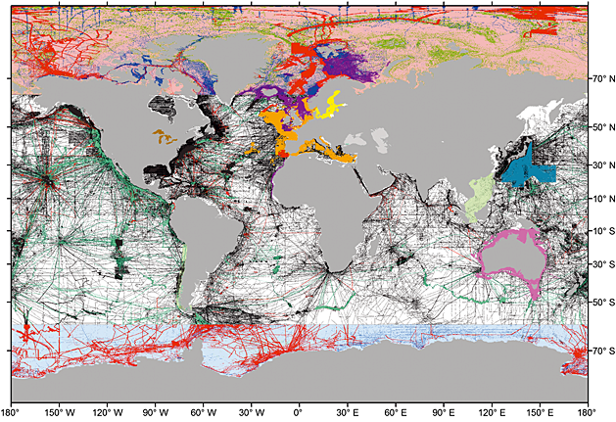
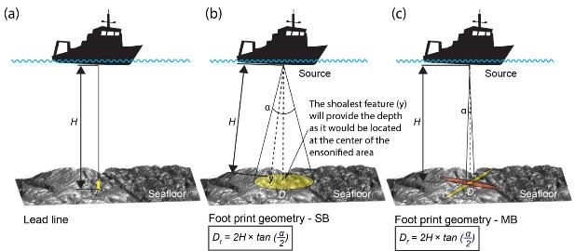
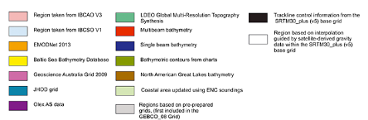
2014: Digital bathymetric model (DTM)
But…
Only 15% of ocean
accurately in-situ mapped
Notes:
Regional compilations and data sets used in GEBCO_2014. The colored grid cells are constrained by soundings or existing grids. The white cells are interpolated from satellite altimetry.

Slide 5
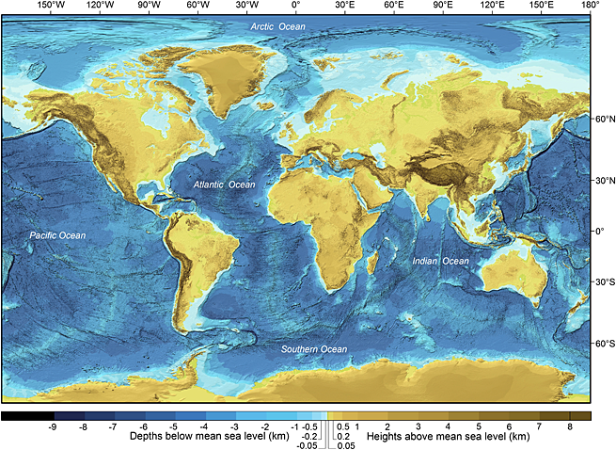
Seabed 2030
Vision: 100% of the World Ocean floor mapped by 2030
Mission: Produce the definitive map of the World Ocean floor by 2030 to empower the world to make policy decisions, use the ocean sustainability and undertake scientific research based on detailed bathymetric information of the Earth’s seabed.
Notes:
GEBCO_2014 grid. The colors denote ocean floor (blues) and land (browns).

Slide 6
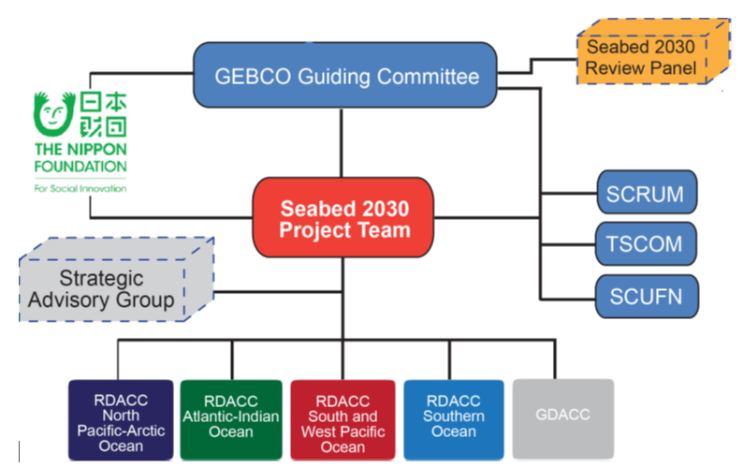
The Nippon Foundation – GEBCO – Seabed 2030
Project Team:
Project Director
RDACC leads (x4)
GDACC Lead
RMC
RMC: Regional Mapping Committee: experts from e.g., hydrographic agencies, research institutes, alumni of the Nippon Foundation/GEBCO
GDACC: Global Data Assembly and Coordination Centre
RDACC: Regional Data Assembly and Coordination Centre
SCRUM: Committee for Regional Undersea Mapping (IOC)n
TSCOM: Technical Sub-Committee on Ocean Mapping (GEBCO)
SCUFN: Sub-Committee on Undersea Feature Names (IHO)n

Slide 7
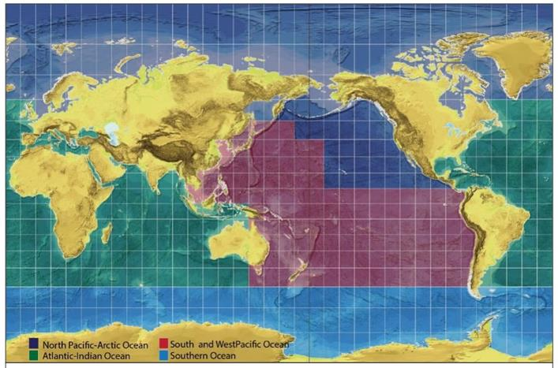

RDACCs & GDACC
Regional Data Assembly and Coordination Centres
Global Data Assembly and Coordination Centres
Assembling regional database and production of a bathymetric grid.
Identify existing data
Develop appropriate metadata and standards
and gridding tools
Identify data gaps and opportunities for
new data collection
Facilitate new mapping endeavors
Coordinate ongoing activities among stakeholders.
Establish Regional Mapping Committees
Work on issue of protected data for reasons of
national security and/commercial protection.
Uni Stockholm
AWI
UNH
BODC
LDEO
NIWA
Notes:
Technology innovation will drive increased rates of mapping
If future mapping activity is more co-ordinated it will improve rate of coverage
‘Championing’ ocean mapping will increase funding and mapping activity
WP 1 Gathering, synthesizing, publishing bathymetric data - Merging all available data into the high resolution ocean map
WP 2 Development of standards, data assembly and delivery tools - Developing the tools and systems to facilitate building and using the map.
WP 3 Technology innovation - Identifying and encouraging technical innovation in bathymetric mapping
WP 4 Networking: map the gaps - Future mapping expeditions to increase the coverage
WP 5 Management Managing the project

Slide 8

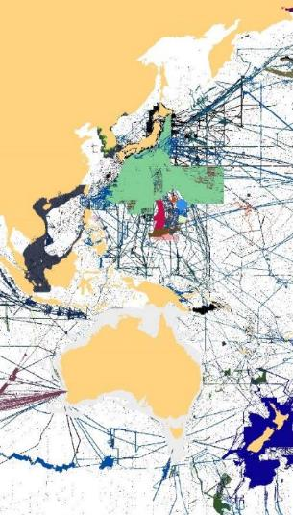
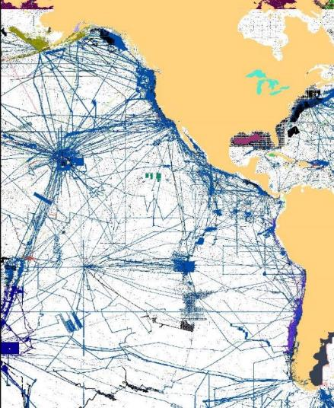

The Seabed 2030 South and West Pacific Centre
39 countries (China → Tonga)
~150,000,000 km²
Southern Ocean
Shallow internal seas
EEZ + ECS
Contested areas
Highly mapped and unknown regions

Slide 9


Seabed2030 South and West Pacific Regional Data Assembly and Coordination Centre South and West Pacific Centre (SaWPac)
Technical
Management Committee
Director
Project Management
Technical Manager
Science staff
Dr Helen Neil, NIWA
Mr Kevin Mackay, NIWA
Dr Vaughan Stagpoole, GNS
Ms Jenny Black, GNS
Mr Adam Greenland, LINZ
Glen Rowe, LINZ
HSE
Seabed2030 Fellow
Comms Outreach
Admin support
Summer Students
Regional Data Contributors
Regional Mapping Committees
Secretariat hosted at NIWA
In country interns

Slide 11
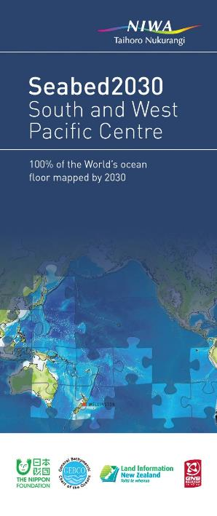
Take home points!
<15% of the ocean floor have been mapped at an acceptable resolution
Seabed 2030 aims at facilitating the complete mapping of the world ocean by 2030
Seabed 2030 will be organised in 4 Regional Data Assembly and Coordination centres and 1 Global centre
Grid-cell size will vary 100x100m; 200x200m; 400;400m
Responsibilities of RDACCs include
  Organizing/facilitating surveys
  Working with countries/industry/public so they provide data
  Identifying and prioritize critical data gaps
  Participating and encourage development of new mapping technologies
  Developing tools to continuously update data coverage

Slide 12


Slide 13
Thank you
https://seabed2030.gebco.net/
SWPHC15

