Slide 1
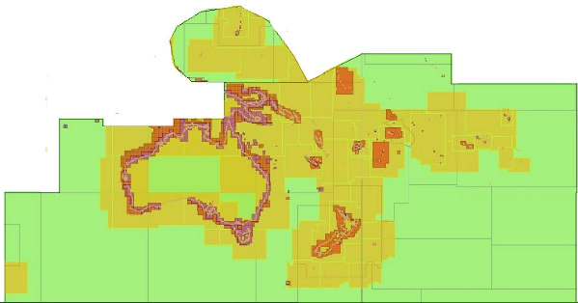
15th South West Pacific Hydrographic Commission Conference February 2018
ICCWG report to SWPHC15

Slide 2
15th South West Pacific Hydrographic Commission Conference
International Chart Coordination Working Group (SWPHC ICCWG)
Current SWPHC ICCWG Members
Australia (chair) Hilary Thompson
France - Ronan Pronost
New Zealand Rachel Gabara
UK Andy Willett
USA Shep Smith

Slide 3
Background
The SWPHC ICCWG was established in 2012 as a subsidiary of the SWPHC. It is made up of Producer Nations who publish Paper chart and ENCs in the SWPHC geographic area.
Its main responsibility is for the coordination of Nautical Charting in the region, ensuring the Paper Chart INT series is comprehensive and current and the ENC coverage is appropriate. The main focus is on paper Charts at 1:500,000 and smaller and ENC nav Purpose 1 and 2 coverage

Slide 4
Current ENC coverage – band 1 &2

Slide 5
Current INT Charts

Slide 6
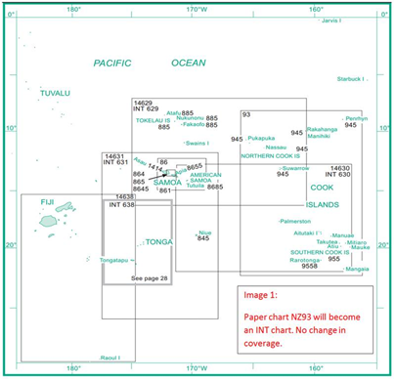
LINZ – NZ93 INT proposal
LINZ plan to withdraw paper chart NZ14630 (INT630) as it has multiple overlaps with various charts. NZ93 INT chart will cover for the withdrawal
Propose to extend the coverage of NZ93 equivalent ENC to cover a gap from NZ14630

Slide 7
IC-ENC Report - ENC Overlaps
Several low severity ENC overlaps exist
PCAs are working to resolve.
Overlap report available from Australia on request

