Slide 1
NZ Primary Charting Authority
IHO SWPHC 1 Day Technical Workshop on Implementing Hydrographic Governance
Nadi, Fiji, 20th February 2018

Slide 2
NZ Primary Charting Authority
Contents
Data collection & management
NZ example
Development project – PRNI
Resourcing requirements

Slide 3
NZ Primary Charting Authority
Data collection & management
Clearly define the requirements - what will the data be used for?
Safety-of-navigation, habitat mapping, managing seafloor resources (minerals etc)
What survey specification is required i.e. accuracy standards (IHO S-44)
Knowing the requirements may define the technology & methodology
LiDAR, multi beam or single beam echo sounder

Slide 4
NZ Primary Charting Authority
Data collection & management
Knowing the requirements will define what data is collected
Bathymetry, seafloor backscatter, water column backscatter, water temperature…
How will the data be managed?
Bathymetry = Megabytes & Gigabytes
Seafloor backscatter = Gigabytes
Water column backscatter = Terabytes
How will the data be made discoverable, accessible and available?
Metadata is key!

Slide 5
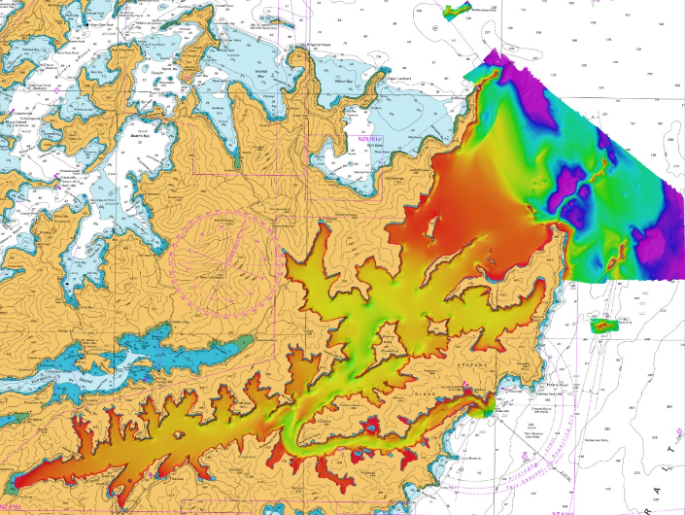
NZ Primary Charting Authority
Data collection & management – NZ example
Bathymetry |  | Backscatter
Raw | Processed | Water column
13 Tb | 914 Gb | 10 Tb
Notes:
Survey contractor has to manage the data
LINZ has to validate the data – taking about 1 month
Computing power required?
LINZ has to store the data
How do we make this data available?

Slide 6
NZ Primary Charting Authority
Development project – Pacific Regional Navigation Initiative
2015 - 5 year, $5 million programme of works
Partnership with MFAT, LINZ and SPC
Focus on navigation-related aspects of maritime safety
Builds on success on SWPRHP – risk assessments in Vanuatu, Tonga and Cook Islands
January 2018 – an additional $2.2 million secured
Programme continues to 2021

Slide 7
NZ Primary Charting Authority
Development project – Pacific Regional Navigation Initiative
Output 1:
Pacific-wide Data Discovery
Output 2:
Hydrographic Risk Assessment
SPC to search database to identify data with potential for use to improve quality of existing charts
SPC to work with PICs to release data to Primary Charting Authorities
LINZ to undertake risk assessments for Niue, Samoa & Tokelau
PRNI
LINZ: Cooks, Niue, Samoa, Tokelau, Tonga
SPC: Other PICs
Output 3:
Capability/Capacity Building
Output 5:
Pacific-wide Partnerships
LINZ to work with NZ 5 PICs on annual plans to increase capability following IHO framework
LINZ to assess NZ 5 PICs requirements for AtoN
SPC focus on other prioritised PICs to build capability and develop annual plans for improved legislation and AtoN
NZ to work with regional partners, development donors, PICs and private sector to develop partnerships for improving navigation safety
Output 4:
Mitigation Measures
LINZ to lead prioritising and project managing mitigation measures including AtoN, hydrographic surveys and chart modernisation

Slide 8
NZ Primary Charting Authority
Development project – Pacific Regional Navigation Initiative
To-date:
Hydrography Risk Assessments for Niue and Samoa have been completed and presented to the respective governments;
an analysis of vessel traffic in and around Tokelau has been completed and passed to SPC for the basis of their Safety-of-Navigation programme;
bilateral arrangements with the Cook Islands and Niue have been signed;
draft bilateral arrangements with Samoa and Tonga are in progress;
chart improvement programmes for the Cook Islands and Tonga have been agreed, and updated ENCs and paper charts published for the Cook Islands;
chart improvement programmes for Niue and Samoa have been agreed, and contract in place to update charts;
hydrographic survey contract awarded November 2017 to undertake Satellite Derived Bathymetry (SDB) throughout Tonga, Beveridge and Antiope Reefs in Niue; Airborne Laser Bathymetry (ALB) in Tonga and Niue; and Multibeam echo sounder (MBES) survey in Tonga.

Slide 9
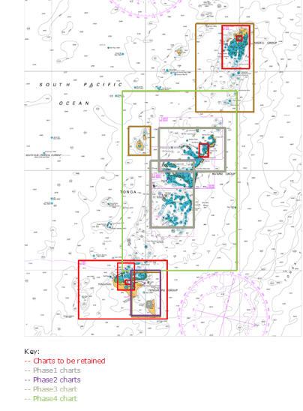
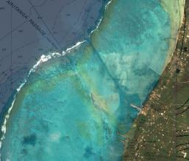
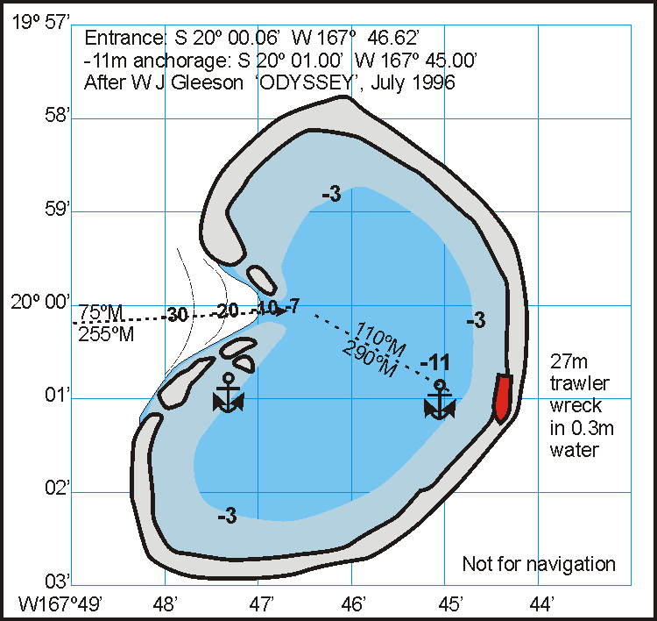
NZ Primary Charting Authority
Development project – Pacific Regional Navigation Initiative
Tonga
Cook Islands
Niue

Slide 10
NZ Primary Charting Authority
Resourcing requirements
Qualified and experienced personnel (Cat-A/B, AHSCP L1/2)
Develop own capability or rely on others i.e. bilateral with PCA
Recruit or develop a career?
Limited access to hydrographer / cartographer course in region
LINZ plans for capacity building
National hydrographic programme
Bilateral arrangements
SWPHC submissions
IHO capacity building opportunities – Phases 2 & 3
Funding available for IHO Member States

Slide 11
NZ Primary Charting Authority
Questions and Discussion

