Slide 1
16th Meeting of the South West Pacific Hydrographic Commission Report by the IHO Secretariat

Slide 2
Operation of the Organization under IHO Convention and its supporting Basic Documents
The chairs of the Regional Hydrographic Commissions are regular IRCC members. They report to IRCC and in turn report back to the Regional Hydrographic Commissions about IRCC issues.
Regional Hydrographic Commissions enjoy the right to report to the Assembly directly. However, the applicable IHO Resolution 2/1997 is under review. The Secretariat proposes to discuss whether this reporting process could be better harmonized with the IRCC Chair who report to the Assembly as well.

Slide 3
Regional States not yet MS of the IHO
UN MS eligible to join IHO without requirement for IHO MS approval:
Kiribati, Nauru, Niue, Palau, Samoa and Solomon Islands
Cook Islands & Niue as non-Member States of the UN, are required to seek the approval of the IHO Member States
Notes:
Solomon had applied before the amendments came into force. Need to apply under the news rules.

Slide 4
INT Chart and ENC Production Coordination - Region L
INT chart scheme for Region G is contained in Edition 3.0.3 of S-11 Part B which was made available in January 2018.
This new edition reports 67 INT charts in the scheme, from which 62 have been produced and published
Note CL11/18 - Adoption of revision 3.1.0 S-11 Part A (Guidance for the Preparation and Maintenance of International (INT) Chart and ENC Schemes)
Note CL19/18 – Adoption of new IHO resolution on the elimination of overlapping ENC data. WENDWG-8 considered the outcome of this resolution and resulting report was endorsed by IRRC.

Slide 5
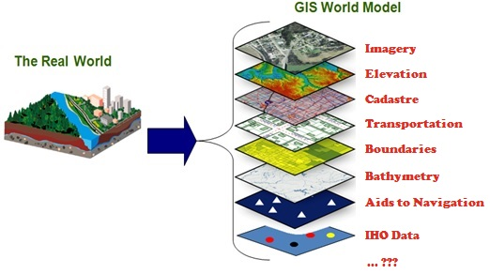
IHO GIS and Databases
avoid duplication of data and inputs
enable data visualisation
enable data fusion and analysis
provide GIS data layers for RHCs and Member States
enable publication and website updates (P-5, C-55, etc.)

Slide 6
IHO GIS and data base developments
Country Information Data base
Is your data up to date in the Yearbook / database ?
“C-55” database
Is your data up to date in the C-55 database ?
Important to liaise with the Primary Charting Authority
Good news!!

Slide 7
Publicity and Outreach
World Hydrography Day 2019:
“Hydrographic information driving Marine knowledge”
International Hydrographic Review
IHO Centenary Celebrations (IHO-100)

Slide 8
Actions requested of SWPHC:
to note this report
Consider the recommendations on Council/Assembly interactions as presented in Paragraph 3
Discuss how the SWPHC reporting towards the Assembly could be better harmonized with the respective IRCC Chair report.
Consider the recommendations on Charting as presented in Paragraph 11
providing regional CATZOC practices to the DQWG;

Slide 9
Actions requested of SWPHC (cont.):
Consider the recommendations on MSI as presented in Paragraph 13
maintain regular communication with the regional NAVAREA Coordinator(s) and inform of any change of personnel or contact details;
use and follow the guidance provided in S-53 – Joint IMO/IHO/WMO Manual on Maritime Safety Information; and
Request National Coordinators to review the contents of the relevant Annexes of the GMDSS Master Plan (GMDSS.1/Circ.21 31May 2017 refers) and to use the annexed questionnaire for electronic submission, whilst also cross checking the details submitted for inclusion in IHO publication C-55 for consistency.
Consider the recommendations on Capacity Building in Paragraph 16
SWPHC members are invited to identify opportunities in national or regional funding agencies to incorporate hydrographic development in the broader projects supporting developing countries.

Slide 10
Actions requested of SWPHC (cont.):
Consider the recommendations on Crowd Sourced Bathymetry in Paragraph 19
SWPHC members are invited to identify further potential sources of bathymetric measurements and survey data providers to be facilitate the further completion of the DCDB data holdings.
Consider the recommendations on Seabed 2030 collaboration in Paragraph 22
SWPHC members are invited to consider the future invitation of Seabed 2030 project representatives to SWPHC meetings to discuss options for deepened cooperation and support.

Slide 11
Actions requested of SWPHC (cont.):
Review entries related to IHO C-55 and P-5 (Yearbook) at least annually (Paragraph 28)
Countries in the SWPHC Region are invited to review their entry in the IHO Yearbook and C-55 and to provide the IHO Secretariat with the appropriate updates or to report no change.
Consider submitting papers for publication in the International Hydrographic Review (Paragraph 38)
Take any other actions as considered appropriate

Slide 12
IHO Secretariat, here to help you! www.iho.int abri.kampfer@iho.int

