Slide 1
16th South West Pacific Hydrographic Commission Conference 13th February 2019
Fiji Hydrographic Services
NATIONAL REPORT 2018-19

Slide 2
1
FHO Overview
2
2018 Performance Overview
3
Future Plans
4
Questions and Answers

Slide 3
1
FHO Overview

Slide 4
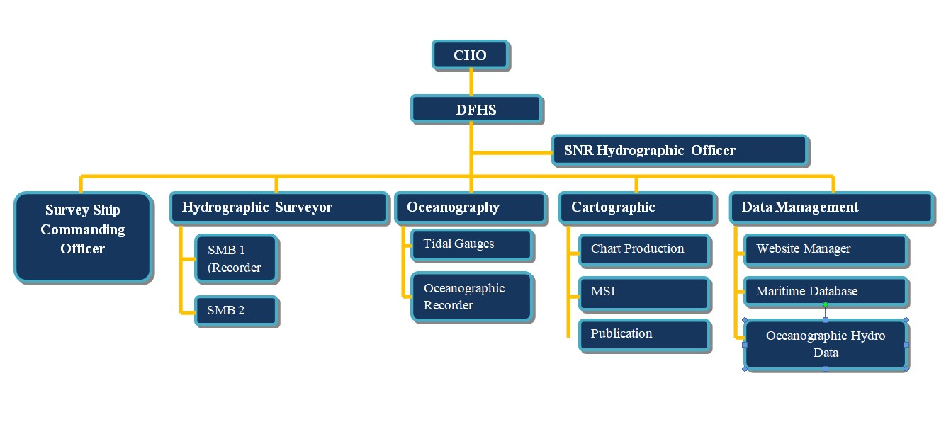
1. Organization Chart
FHO SET UP
FHO Current Status
2

Slide 5
1. FHO Overview
FHO Manning
FHO Current Status
FHO current human resource statistics – 32 personnel (Hydrographers and Nautical Cartographers)
03 x IHO Accredited Category A surveyors
08 x IHO Accredited Category B surveyors
04 x Category B Nautical Cartographers
17 x Surveyor Recorders
2

Slide 6
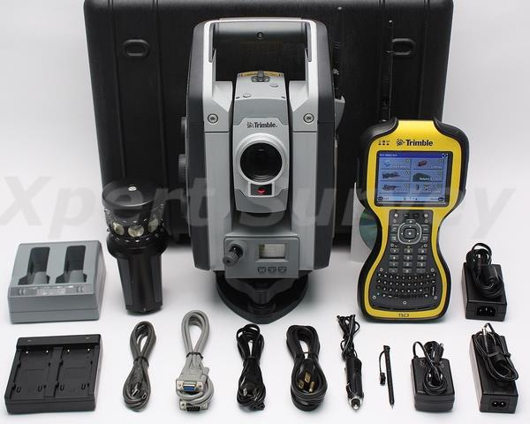
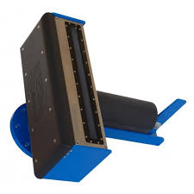
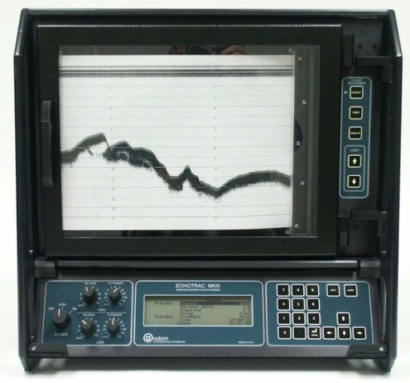
1. FHO Overview
Capability
Equipments
Data Acquisition
01 x R2Sonic 2020 & 01 x R2Sonic 2024 MBES
01 x Nobit MBES with SSS and SBP.
01 x Odom MK III SBES
Trimble SPS DGPS
Trimble R-8 GPS Sets
Trimble S-7 Total Station
01 x SMB
Acquisition software and processing – HYPACK, CARIS Hips & Sips , Base Editor
02x HP Tough book Laptop
2

Slide 7
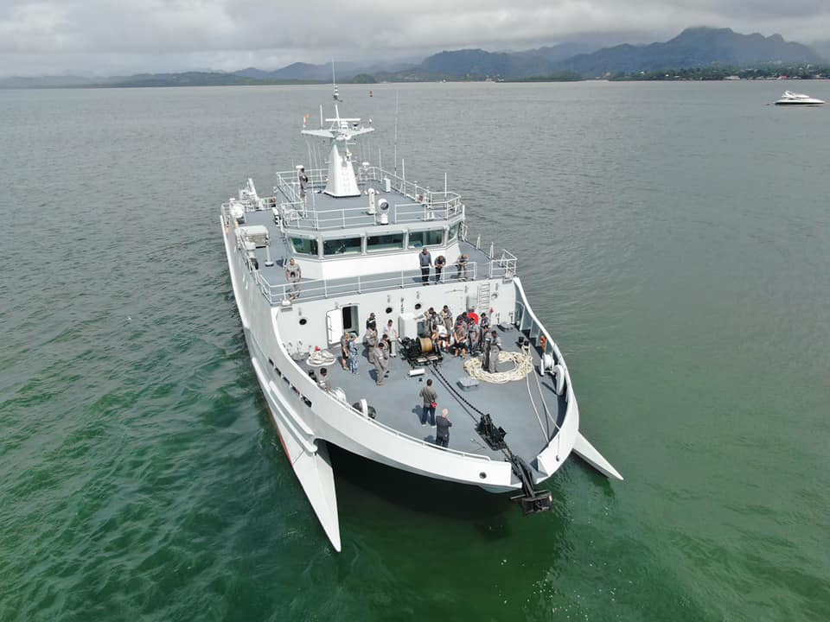
1. FHO Overview
Capability
Survey Platform
RFNS Kacau, recently
donated by the Peoples Republic of
China will boost the capability of FHS
in the conduct of hydrographic Surveys.
2

Slide 8
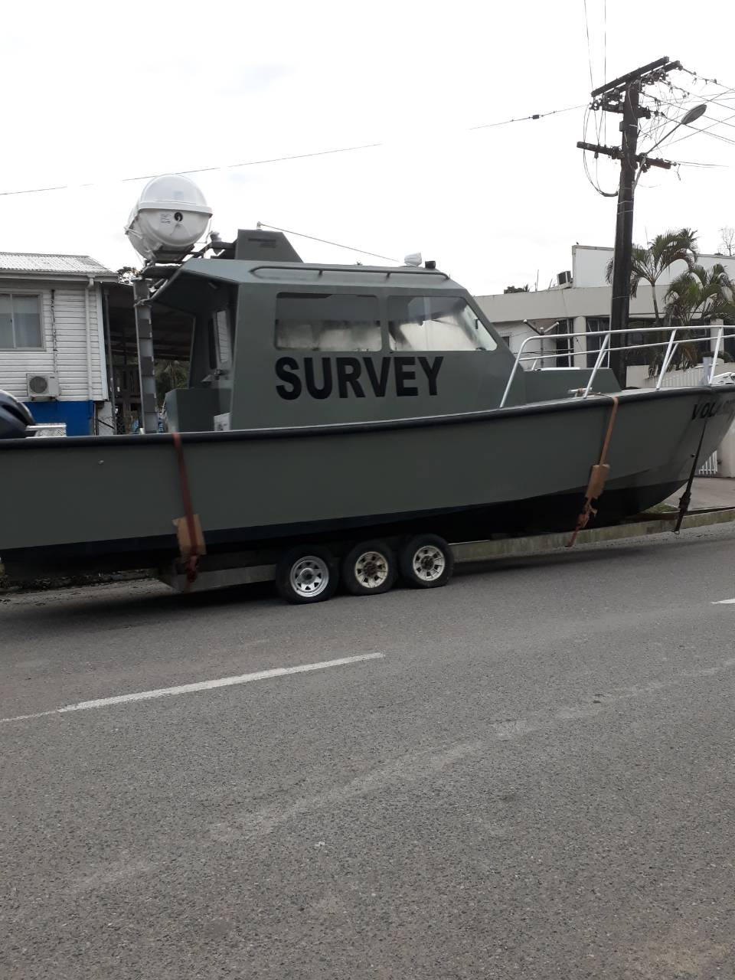
1. FHO Overview
Capability
Survey Platform
SMB Ika Vuka, acquired in 2018.
Supports Deployable Survey Team with fittings for MBES and SBES.
2

Slide 9
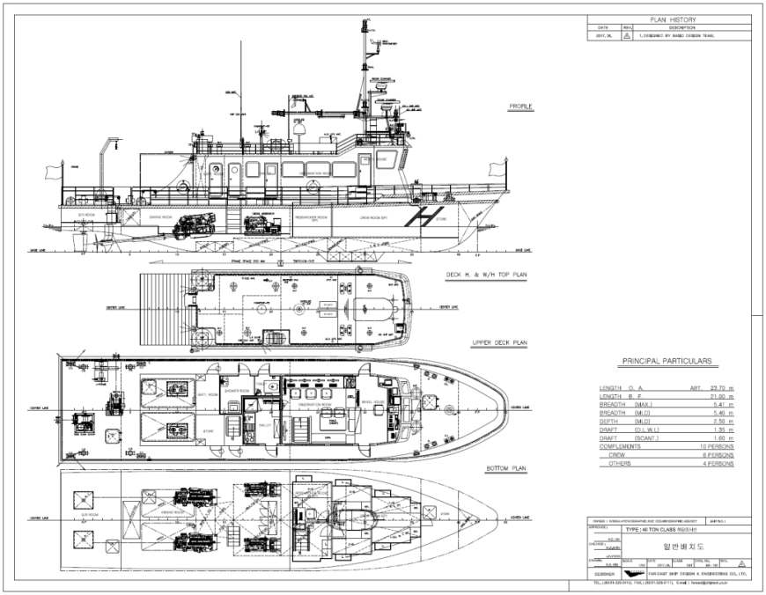
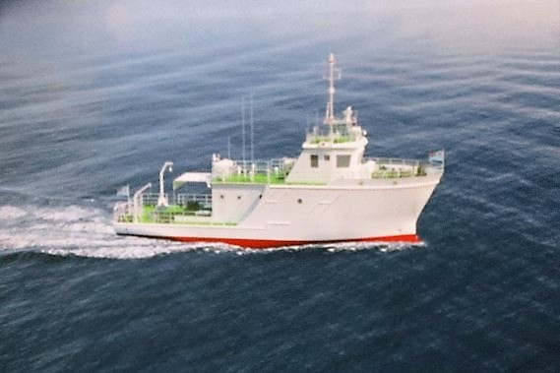
3. FHO Overview
Future Capability
Research Vessel – ROK ODA Project
Purpose of Ocean Research Vessel:
Carry out hydrographic surveys to comply with IHO S44 Standards.
Acquisition of tidal, current, bottom sediment and water column data.
Conduct operations in support of maritime scientific studies (Oceanography).
Provide foundation to accurately chart nations maritime zones in support of providing safer passages for navigation.
14

Slide 10
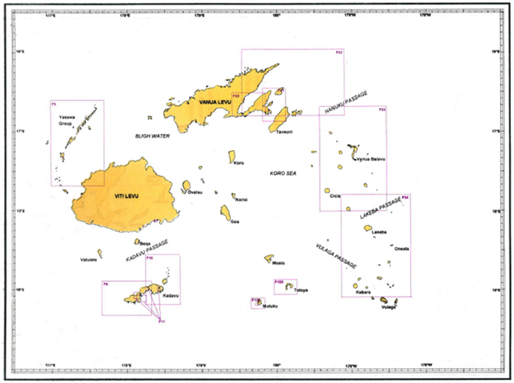
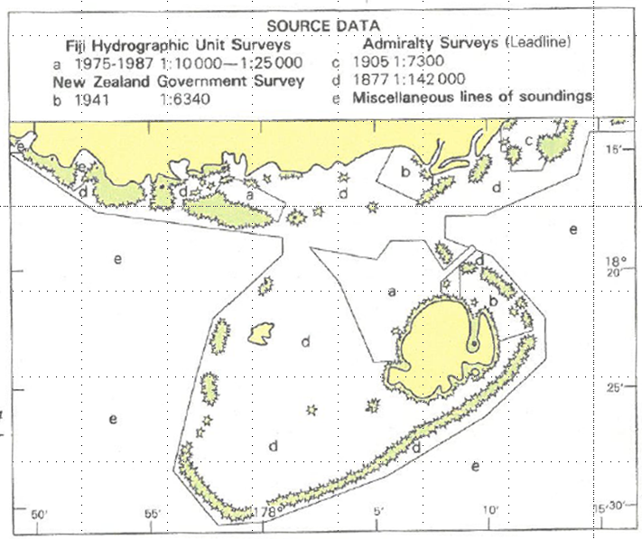
1. FHO Overview
Nautical Charting
Fiji Nautical Chart Index
2

Slide 11
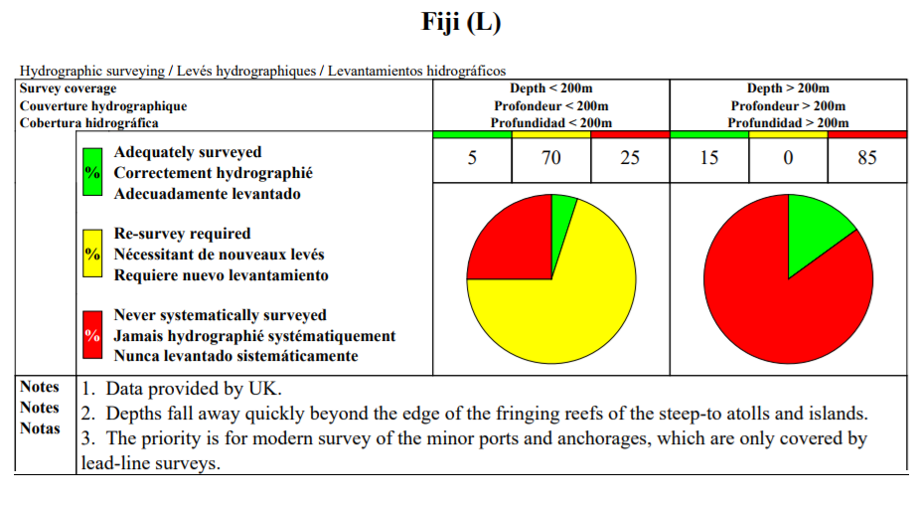
1. FHO Overview
Nautical Charting
Status of Hydrographic Surveying (Previous)
Coverage of Hydrographic Surveying at Depths <200m / >200m (IHO Publication C55 23 Aug. 17)
3

Slide 12
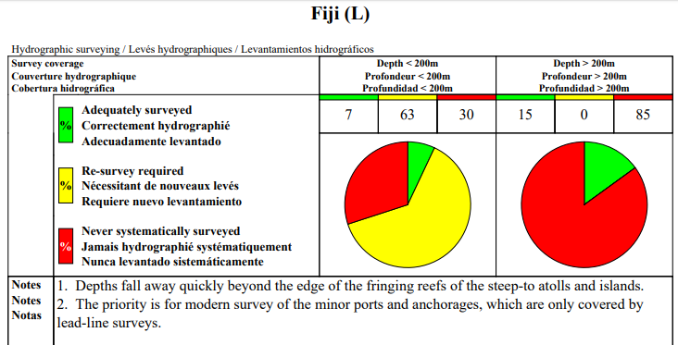
1. FHO Overview
Nautical Charting
Status of Hydrographic Surveying (Current)
Coverage of Hydrographic Surveying at Depths <200m / >200m (IHO Publication C55 26 Nov 18)
3

Slide 13
2
2018 Performance Overview

Slide 14
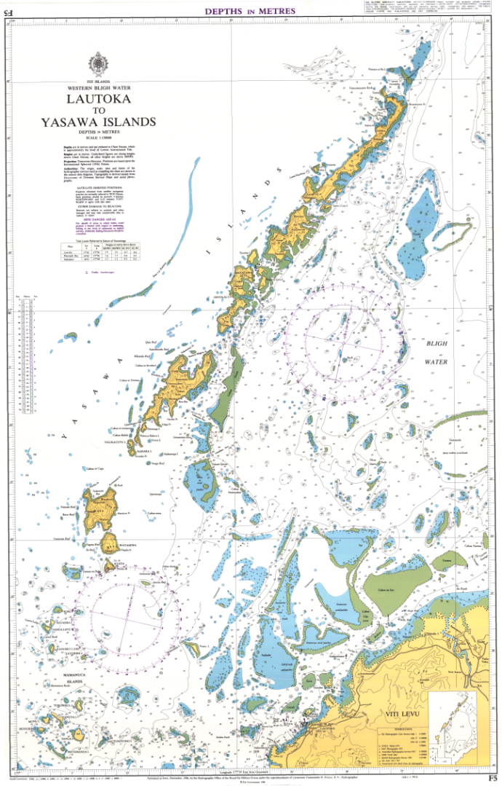
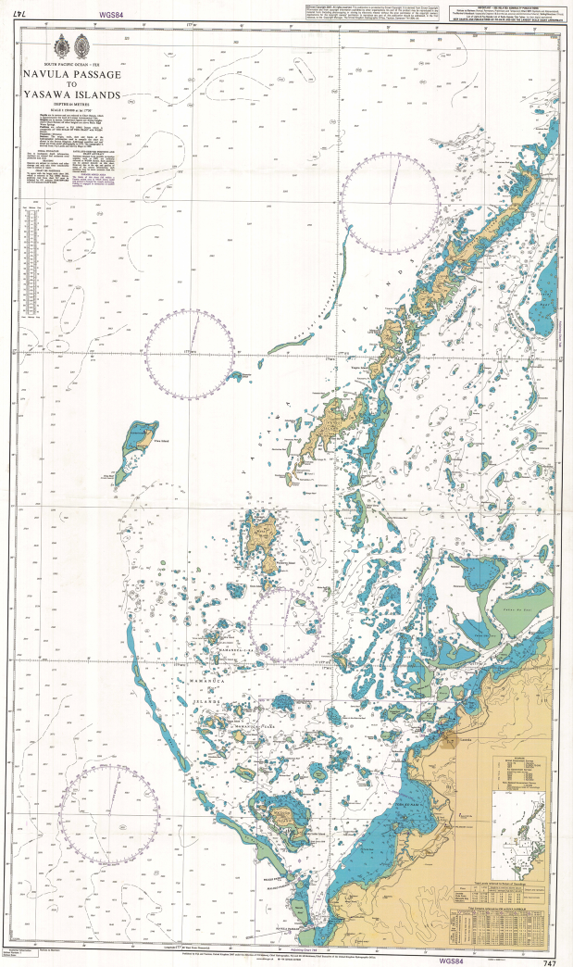
2. 2018 Performance Overview
Nautical Charting
Publication of New Chart BA 747(Joint Project UKHO & FHS )
8

Slide 15
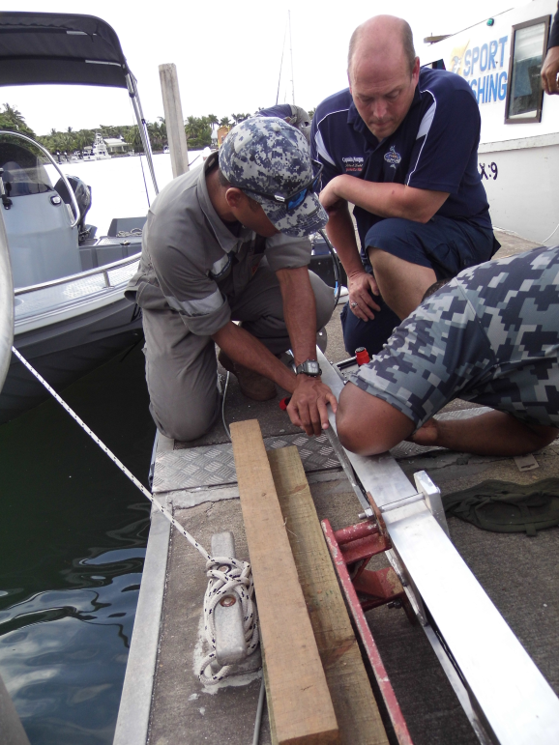
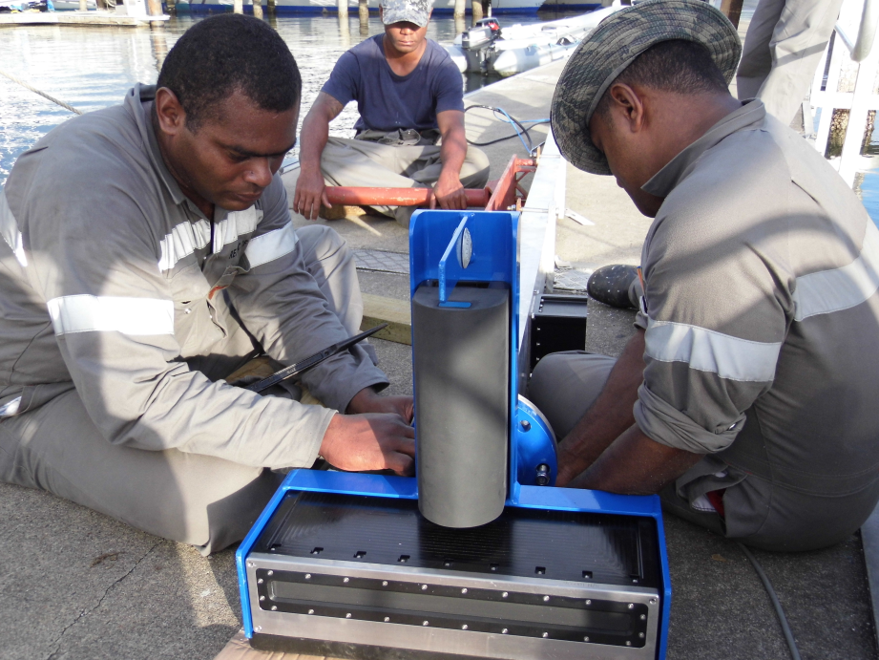
2. 2018 Performance Overview
Capacity Building
R2Sonic Multibeam bathymetric survey and training ( 22 May – 1 June)
.
8

Slide 16
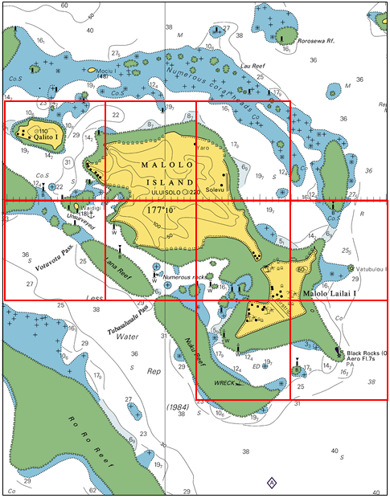
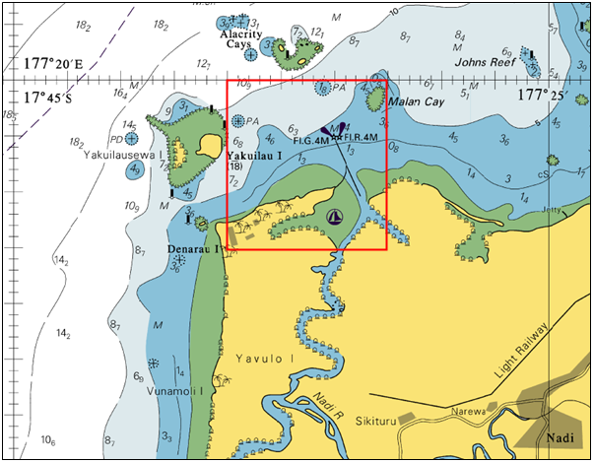
2. 2018 Performance Overview
Nautical Charting Survey
Multibeam bathymetric survey and training ( Malolo Islands / Denarau Port)
8

Slide 17
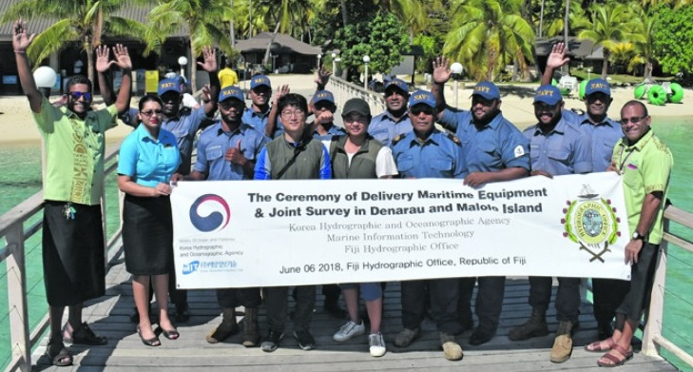
2. 2018 Performance Overview
Nautical Charting Survey
Multibeam bathymetric survey and training ( Malolo Islands / Denarau Port)
8

Slide 18
3
Future Plans

Slide 19
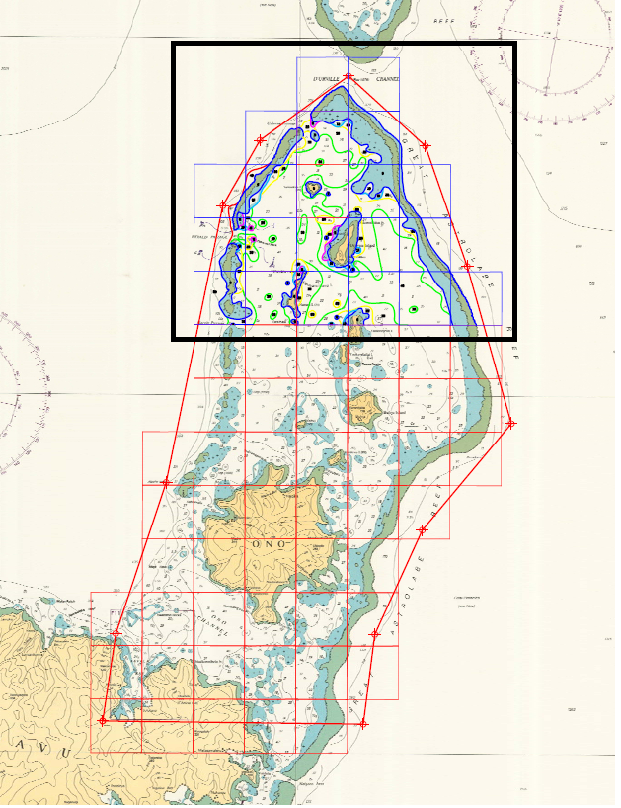

Slide 20
3. Future plans
Future plans
FHO Future Plans
Installation of MBES to ensure full bottom coverage during hydrographic surveys.
Reduction of ping to chart down time.
Installation of permanent tide gauges in secondary ports in support of sea level rise monitoring and tidal modeling.
Acquiring of MBES/SSS processing software.
Up skilling of current FHO staff.
Acquisition of suitable survey vessel.
Conduct of Hydrographic survey in priority unsurveyed areas.
Geospatial Marine Database
15

Slide 21
THANK YOU

