Slide 1
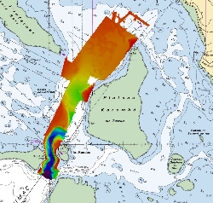
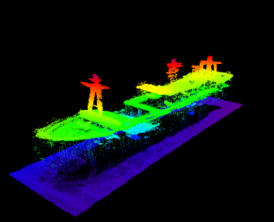
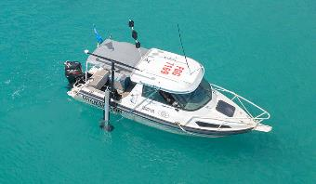
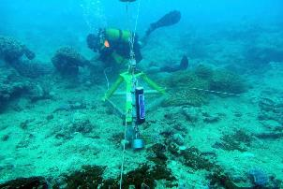
16th South West Pacific Hydrographic Commission Conference France National Report
Alofi - Niue

Slide 2
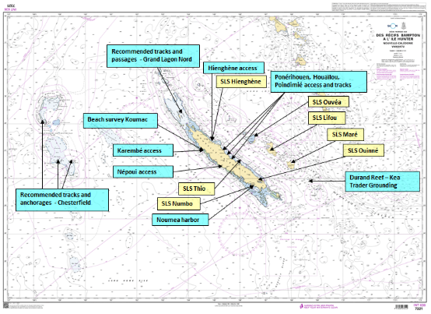
new surveys – New Caledonia
Survey scheme overseen by the hydrographic commission of New Caledonia and executed by Shom’s Pacific survey unit (GOP)
Main focus : opening new routes in unsurveyed areas + control surveys in support to maritime surveillance, commercial and cruise activities
Beach survey in support to Croix du Sud 2018 multinational exercise (short notice)
Hydrographic support after Kea Trader grounding
Maintenance of Sea Level Stations (SLS)

Slide 3
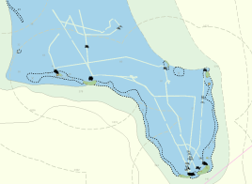
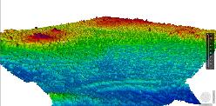
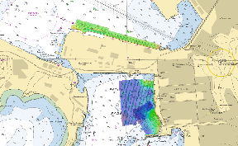
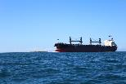
new surveys – New Caledonia
Support to maritime surveillance
New tracks : Grand Lagon Nord, Chesterfield, East Coast
Use of external surveys for AML production
Support to commercial shipping
Karembé : new allowable draught (+3 m, from 10 to 13 m)
Control surveys in Nouméa harbour (incl. cruise ships)

Slide 4
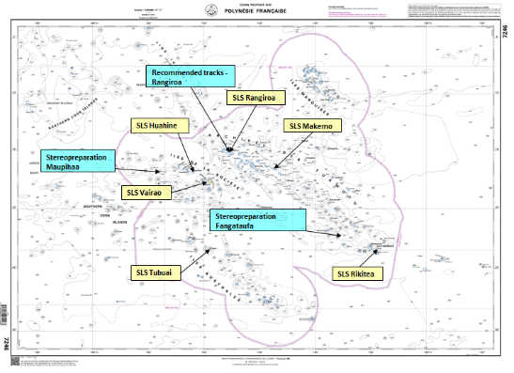
new surveys – French Polynesia
Survey scheme validated by the sub-committee for hydrography of French Polynesia and executed by Shom’s Pacific survey unit (GOP)
New tracks in the lagoon of Rangiroa (in support of maritime surveillance)
Spatiopreparation (field survey in support to SDB) & Stereopreparation (field survey for exploitation of aerial images) in Fangataufa, Maupihaa and Rangiroa
Maintenance of Sea Level Stations (SLS)

Slide 5
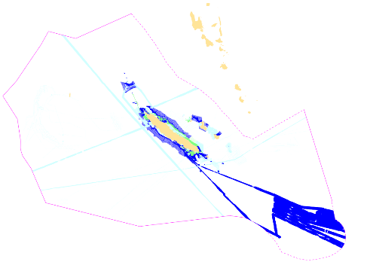
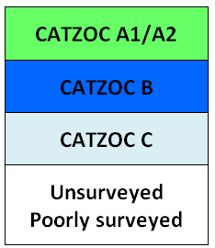
Status of hydrographic surveys & survey plan 2019-2021
Survey status |  | Depth < 200m |  |  | Depth > 200m
 |  | A | B | C | A | B | C
L | Nouvelle Calédonie | 7.9 | 20.6 | 71.5 | 15.5 | 2.6 | 81.9
New Caledonia
Prioritized survey works defined by the hydrographic commission of New Caledonia:
see New-Caledonia Hydrographic master plan (updated annually)
And Shom’s 2017-2020 national hydrographic survey programme
N/O L’Atalante will be deployed in the area in 2019
http://www.shom.fr/fileadmin/data-www/01-LE_SHOM/01-PRESENTATION_GENERALE/06-LE_PROGRAMME_ANNUEL/PNH_2017-2020_WEB_BD.pdf

Slide 6
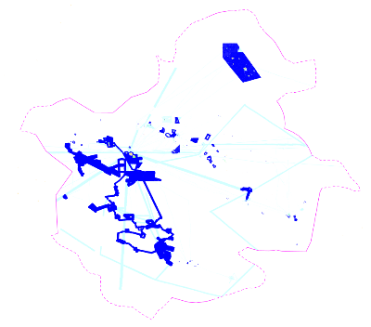
Status of hydrographic surveys & survey plan 2019-2021
French Polynesia
Survey status |  | Depth < 200m |  |  | Depth > 200m
 |  | A | B | C | A | B | C
L | Polynésie française | 7.5 | 16.2 | 76.3 | 13.3 | 4.8 | 81.9
Prioritized survey works defined by the sub-committee for hydrography of French Polynesia:
see French Polynesia hydrographic master plan (updated annually)
And Shom’s 2017-2020 national hydrographic survey programme
Airborne Lidar survey project (tbc)
N/O L’Atalante will be deployed in the area in 2019
http://www.shom.fr/fileadmin/data-www/01-LE_SHOM/01-PRESENTATION_GENERALE/06-LE_PROGRAMME_ANNUEL/PNH_2017-2020_WEB_BD.pdf

Slide 7
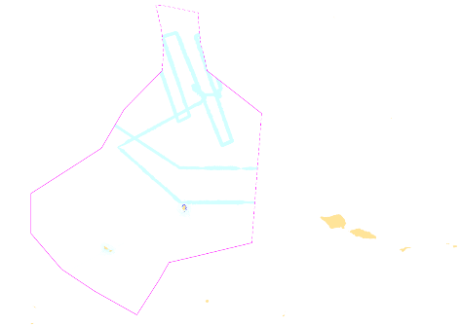
Status of hydrographic surveys & survey plan 2019-2021
Wallis & Futuna
Survey status |  | Depth < 200m |  |  | Depth > 200m
 |  | A | B | C | A | B | C
L | Wallis et Futuna | 7.9 | 20.6 | 71.5 | 15.5 | 2.6 | 81.9
Survey works in lagoon waters (using deployable equipment) and opportunity surveys
See Shom’s 2017-2020 national hydrographic survey programme
N/O L’Atalante will be deployed in the area in 2019
http://www.shom.fr/fileadmin/data-www/01-LE_SHOM/01-PRESENTATION_GENERALE/06-LE_PROGRAMME_ANNUEL/PNH_2017-2020_WEB_BD.pdf

Slide 8
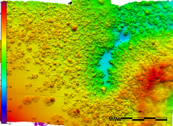
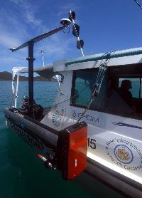
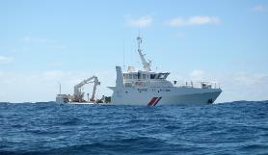
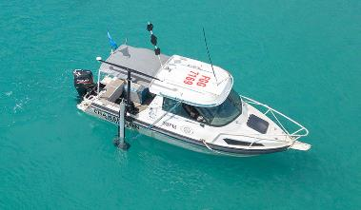
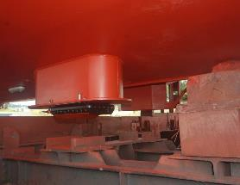
GOP improved survey capability
NEW MULTIBEAM ECHOSOUNDER
Deployable MBES (Kongsberg 2040P)
800 soundings/ping (High density – dual swath)
Depth range : 1-400 meters
1 MBES installed on hull: Louis-Hénin (NC- December 2018)
2 MBES installed on pole: Chambeyron (NC- February 2018) & BHPF.1 (PF - 2019)

Slide 9
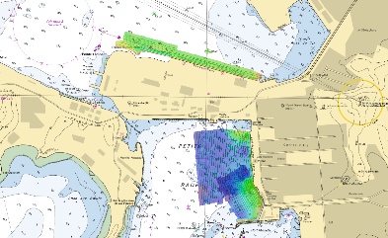
GOP improved survey capability
NEW MULTIBEAM ECHOSOUNDER
Improved efficiency compared to singlebeam + sidescan sonar
(data collection and postprocessing)
Improved accuracy, especially for fairways in coral reef environment
e.g. Karembé access channel : new allowable draught (+3 m, from 10 to 13 m)
All passes and fairways can be reassessed – huge impact for safety, local economy and commercial shipping

Slide 10
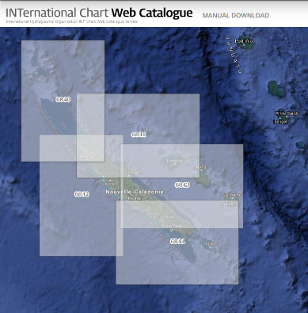
Charting – region L
INT charts
3 new INT charts produced
(2 publications INT6840-6841 & 1 new edition INT6882)
2 new INT charts planned in 2019-2020
(INT6843 & INT6844)
Notes:
All INT charts already approved by the Region L ICC-WG

Slide 11
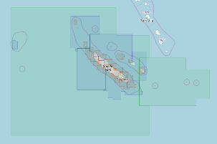
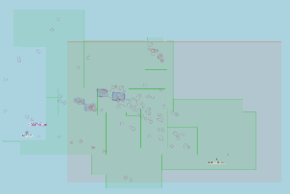
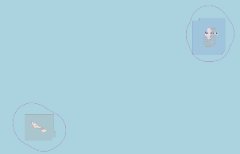
Charting – region L
ENC
48 new cells published since the last conference
=> Full coverage of New Caledonia waters achieved in 2018
52 new cells planned in 2019
Notes:
Beaucoup de cartouches dans les 48 nouvelles cellules

Slide 12
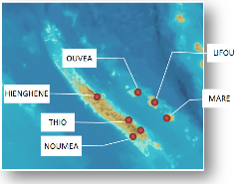
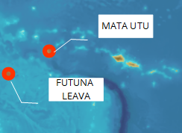
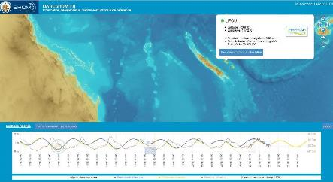
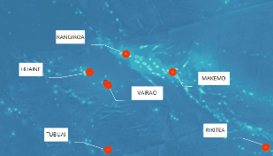
Sea level observation
Maintenance of the existing tide gauges operated by Shom on yearly basis
Funding remains a challenge, but now sorted for next 3-5 years
Contribute to PTWS, monitoring of sea level rise & storm surge
http://data.shom.fr/#donnees/refmar
Notes:
In French Polynesia : Maintenance operations have been limited in 2018 due to temporary funding issue

Slide 13
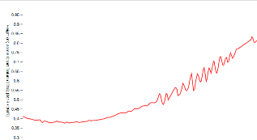
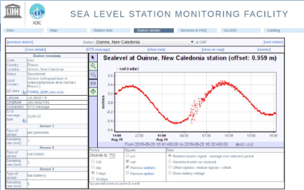
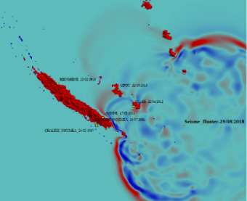
Marine disaster
Prevention
Permanent Sea Level stations contribute to the PTWS
New Caledonia
29th august 2018 : Earthquake Magnitude 6.6
5th december 2018 : Earthquake Magnitude 7.7 – 10km depth
SLS observations used for
- real time risk assessment (tsunami de-alert)
- post-event analysis and improve models

Slide 14
Marine disaster
Assistance
Shom can provide hydrographic support in case of emergency in the SWPHC region
Rapid response hydrographic team available in Nouméa and Papeete
Shom PoC: head of the maritime safety information division, 24/7 by fax +33 298 221 665 or email coord.navarea2@shom.fr.

Slide 15
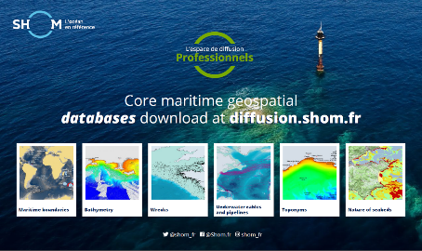
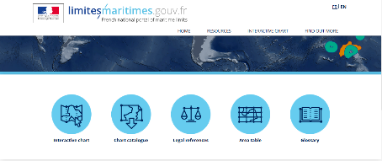
Msdi developments
Shom’s portals
Data.shom.fr
Diffusion.shom.fr
&
limitesmaritimes.gouv.fr
Distributed under Creative Commons « CC-BY-SA 4.0 » licence
Regularly updated with new data and products !

