Slide 1
South-West Pacific
Hydrographic Commission
United States of America National Report
National Oceanic and Atmospheric Administration
Naval Meteorology and Oceanography Command
National Geospatial-Intelligence Agency
Rear Admiral Shepard M. Smith, NOAA
16th Conference - Alofi, Niue
February 2019

Slide 2
U.S. Hydrographic Leadership
NOAA
Director of Coast Survey
Rear Admiral Shepard M. Smith
NGA
Senior GEOINT Authority, Maritime
John Lowell
Director of Maritime Safety Office
Captain Richard Kennedy
Navy
Commander Naval Meteorology and Oceanography Command, Oceanographer of the Navy, Hydrographer of the Navy, and Navigator of the Navy
Rear Admiral John Okon
Acting Deputy Hydrographer of the Navy
Matthew Borbash

Slide 3
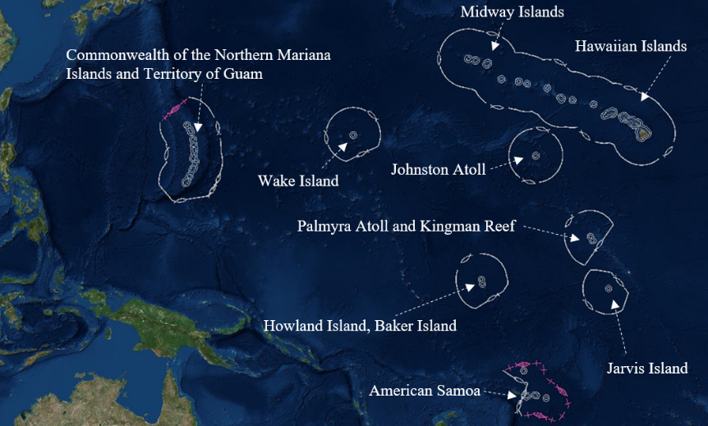
U.S. Pacific Maritime Areas

Slide 4
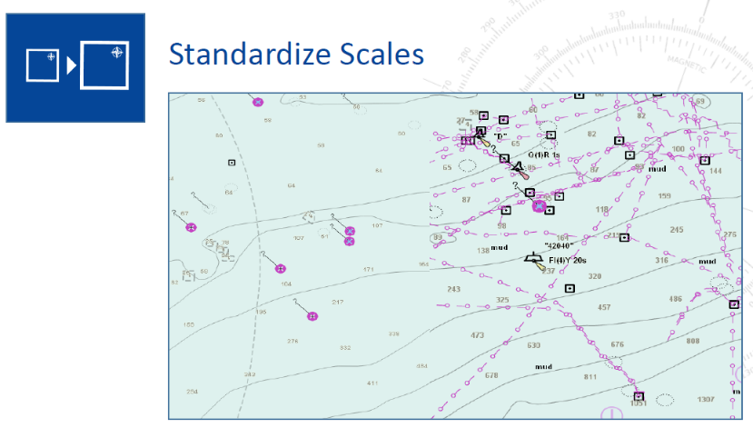
National Charting Plan

Slide 5
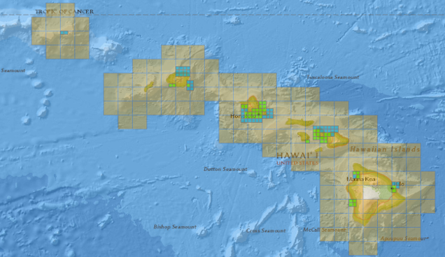
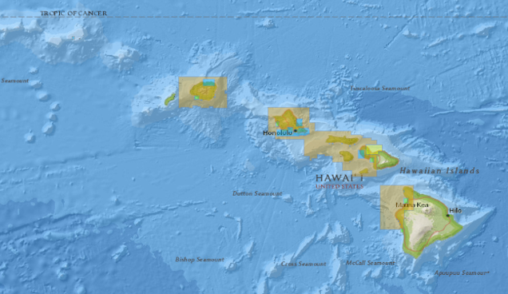
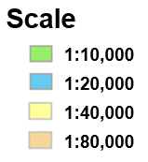
National Charting Plan
Create an Orderly Layout

Slide 6
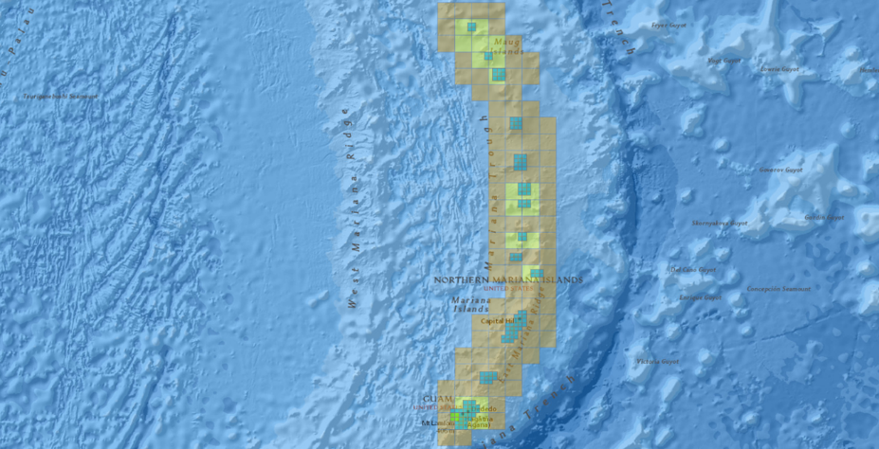
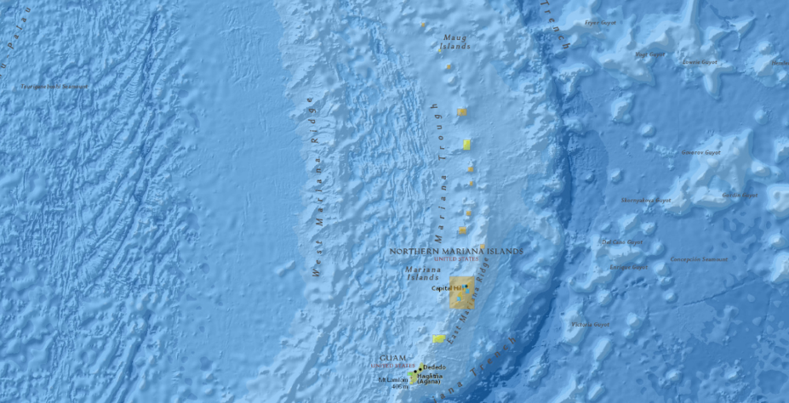
National Charting Plan
Create an
Orderly Layout

Slide 7
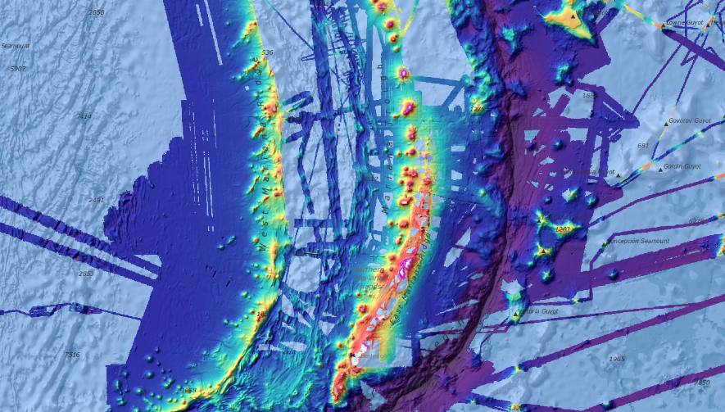
External Source Data

Slide 8
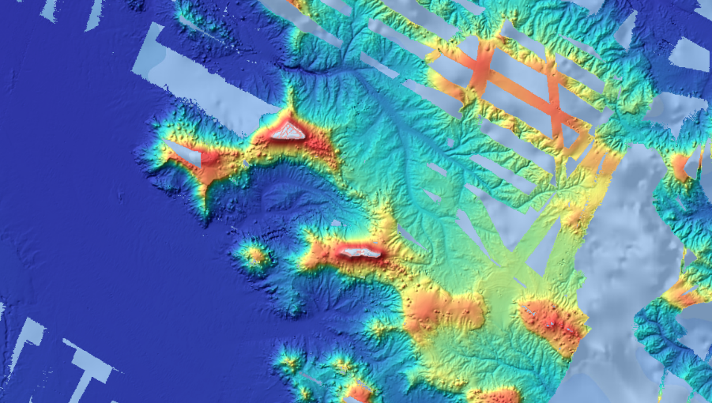
Data Under Review
KINGMAN
REEF
PALMYRA ATOLL

Slide 9
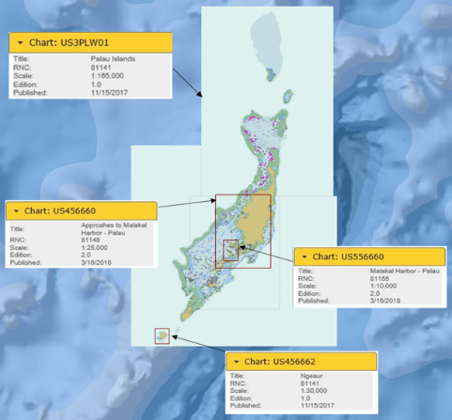
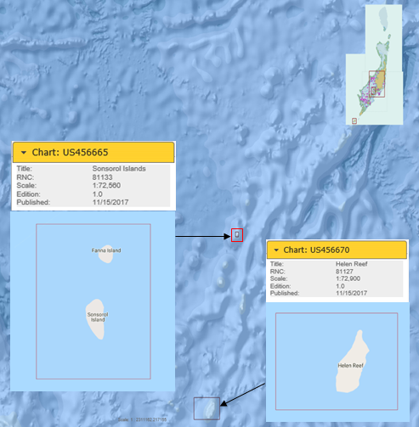
Chart and Publication Updates
NGA continues to maintain 6 ENC cells for the Palau Islands

Slide 10
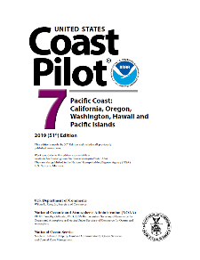
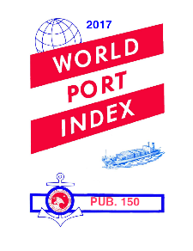
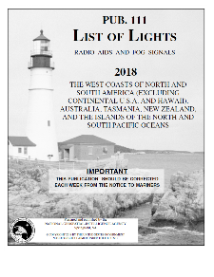
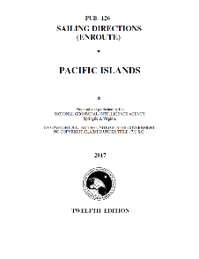
Chart and Publication Updates
https://msi.nga.mil/NGAPortal/MSI.portal
https://nauticalcharts.noaa.gov/publications/coast-pilot/index.html

Slide 11
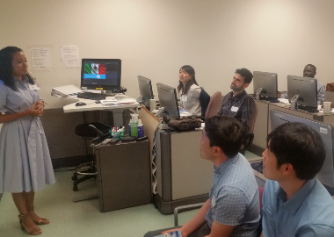
Capacity Building
Cat-A S-5 programs
University of New Hampshire
University of Southern Mississippi
Cat-B programs
NGA S-8
Navy S-5
NOAA S-8
Includes one opening for an international student
Contact Shachak.Peeri@noaa.gov
Chart Adequacy Workshop 23-25 July 2019
Two openings available, travel costs sponsored
Announcement forthcoming

Slide 12
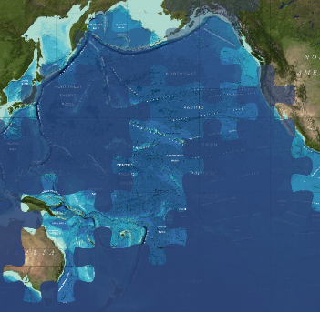
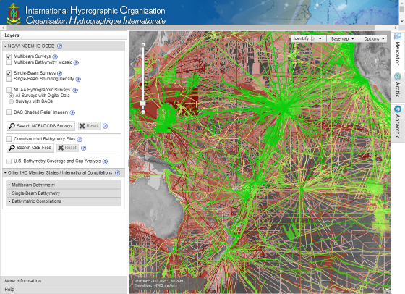
Global Collaboration
GEBCO
Seabed 2030
Crowdsourced Bathymetry
https://seabed2030.gebco.net/
https://maps.ngdc.noaa.gov/viewers/iho_dcdb/

Slide 13
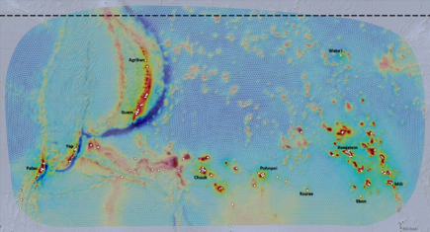
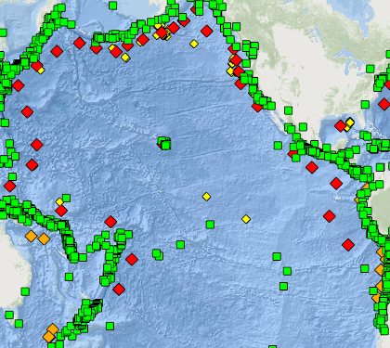
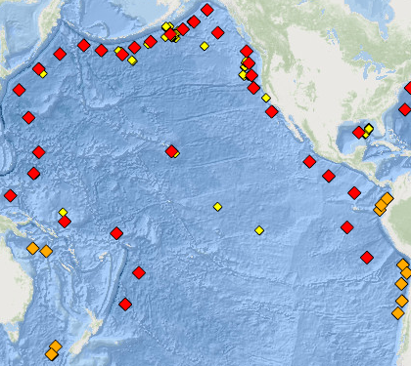
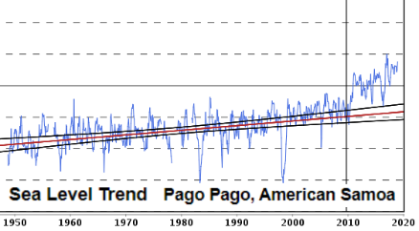
Regional Resiliency
Tsunami Warning System
Extratropical Surge and Tide Operational Forecast System
Tide Gauge Network
https://www.ndbc.noaa.gov/dart.shtml
https://tidesandcurrents.noaa.gov/
https://www.nco.ncep.noaa.gov/pmb/products/estofs/

Slide 14
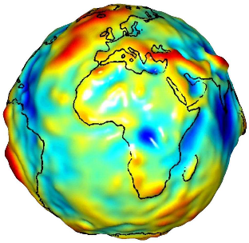
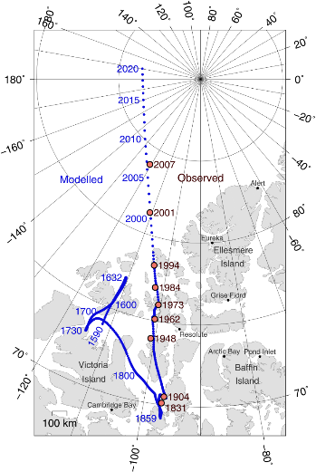
Updated Models
New Earth Gravity Model (EGM)
Planned release 2020
New World Magnetic Model (WMM)
Recently released

Slide 15
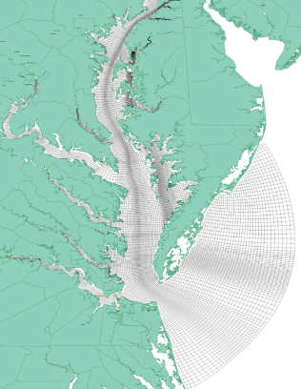
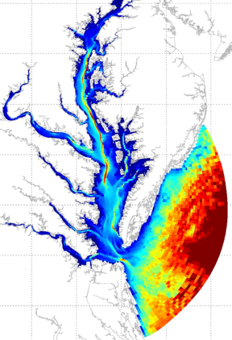
Future Developments
Surface Current Data for e-Navigation
NOAA converting real-time surface current forecasts into S-111 format for ENC application and display in future e-Navigation systems
Pilot project with Chesapeake Bay Operational Forecast System

Slide 16
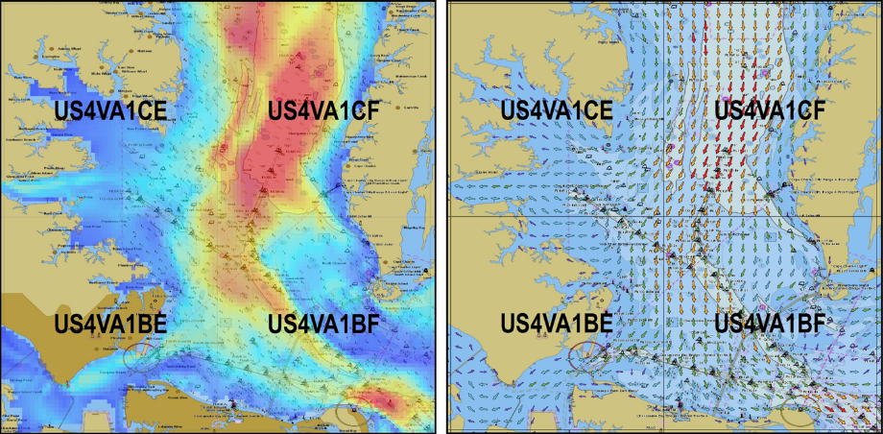
Future Developments
Surface Current Data for e-Navigation
https://tidesandcurrents.noaa.gov/ofs/cbofs/cbofs.html

Slide 17
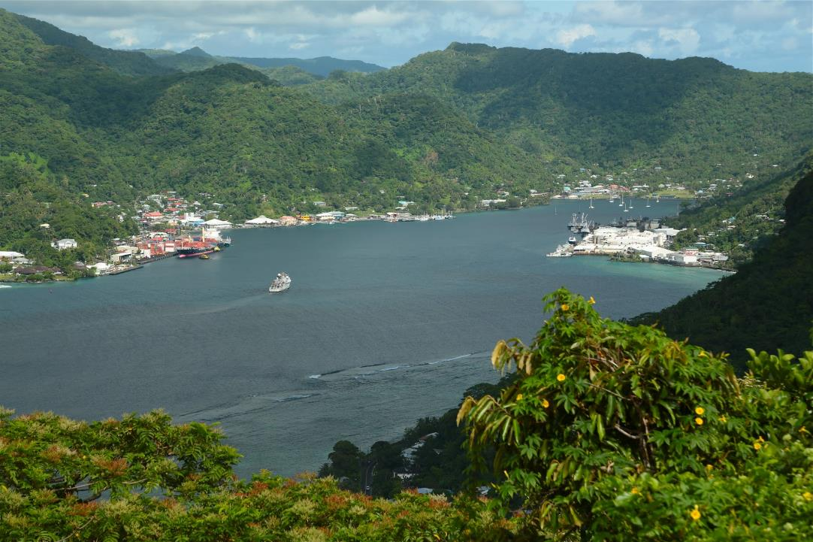
THANK YOU
NOAA Ship Hi’ialakai arriving in Pago Pago Harbor, American Samoa

