Slide 1
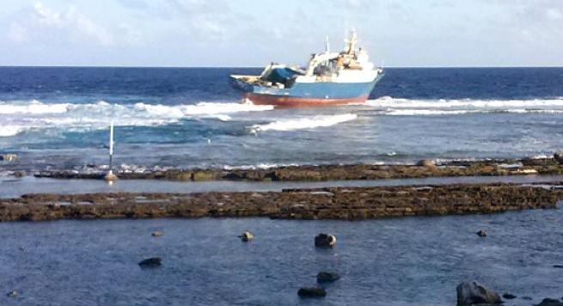
16th Meeting of the South West Pacific Hydrographic Commission
Niue
13-15 February 2019
COOK ISLANDS

Slide 2
Contents:
Main achievement
Challenges
Progress on Surveys, Charting and MSI
Contribution to the IHO DCDB and GEBCO
Progress on MSDI
Plans affecting the region
Lesson learned
Success stories to share

Slide 3
Main achievements during the year
Cook Islands National Hydrographic Office completed
Recruitment of a cadastral Surveyor and GIS officer
Appointment of new MSI officer
Maritime (Hydrographic and AIDS to Navigation Standards and Requirements) Rules, 2017 No.1

Slide 4
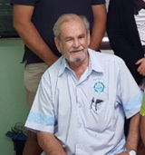
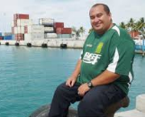
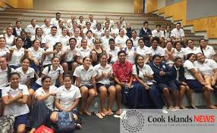
Main challenges and/or obstructions
Resignation former MSI Officer Steve Simpson
Delayed progress of the Maritime (Hydrographic and AIDS to Navigation Standards and Requirements) Rules, 2017 No.1
New Head of Ministries appointed
Lack of knowledge importance of hydrography
Lack of interest from College students career in Hydrography and Cartography
Lack of funding commitment from Government

Slide 5
Progress on surveys, charting and MSI
Surveys:
No significant surveys done

Slide 6
Progress on surveys, charting and MSI
Charts:
Chart | Plan | ENC Published | Paper Charts Published
NZ 945 | Rakahanga | 8/12/2018 | Expected to be published by 25/1/19
 | Nassau
 | Manihiki
NZ 955 | Mauke | Expected to be published by 25/1/19 | Expected to be published mid February
 | Palmerston
 | Mangaia
 | Mitiaro
 | Manuae
 | Takutea

Slide 7
Progress on surveys, charting and MSI
MSI:
1. Maritime Area
RCC New Zealand covers the Cook Islands waters including the 200 nautical mile Exclusive Economic Zone (EEZ)
2. Operational Points of Contact for National Coordinator
INSTITUTION | TELEPHONE | FACSIMILE | EMAIL
Ministry of Transport | +682 28810 | +68228816 | saungaki.rasmussen@cookislands.gov.ck
3. NAVTEX Coverage
Cook Islands does not broadcast coastal warning via NAVTEX
4. Operational Issues
Receiving and transmitting becomes difficult the further you are away from the main islands, sometime very difficult to hear.

Slide 8
Progress on surveys, charting and MSI
MSI:
6. Contingency Planning
Navigational warning affecting SOLAS ships are sent to the NAVAREA XIV Coordinator.
7. Capacity Training
Ministry of Transport and Cook Islands National Hydrographic office has participate in the past MSI training.
6-10 August 2018, Cook Islands attended and MSI training course hosted by LINZ and funded through the South West Pacific Hydrographic Commission (SWPHC) Capacity Building Committee work programme other Pacific Island countries under New Zealand (NAVAREA XIV) also attended the MSI training..
8. Other Activities
Ministry of Transport (MSI) provide assistance and supports the Cook Islands Rescue Coordination Centre (RCC) for Search and Rescue (SAR) purpose.

Slide 9
Progress on surveys, charting and MSI
MSI:
9. Recommendations
It is strongly recommended that the Capacity Building Fund provides assistance in dispatching necessary experts to Cook Islands for conducting a feasibility study for the provision of GMDSS equipment for broadcasting of MSI under NZ guidance.
10. Summary
Cook Islands is very actively involved in providing MSI services to the maritime industry locally including local operations and RCC New Zealand and LINZ

Slide 10
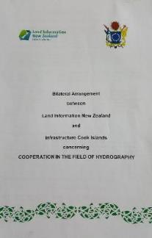
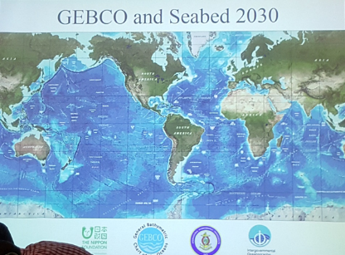
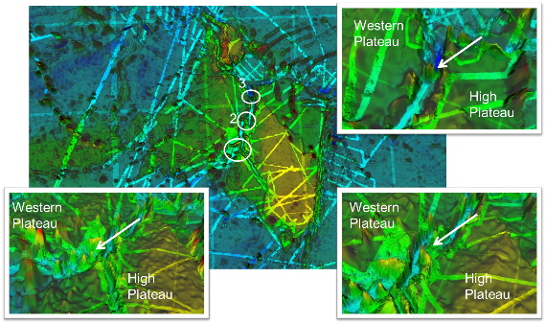
Contributions to the IHO DCDB and GEBCO
Cook Islands Contributions
Not at this stage
Multibeam and Single beam survey of the Manihiki Plateau by research institutions
Support Cook Islands ECS claim with Limit of Continental Shelf Commission

Slide 11
Progress on MSDI
CookGeo
An open access geospatial data repository for the Cook Islands providing premier geophysical, geodetic and marine spatial data sets.
251 layers
17 Users

Slide 12
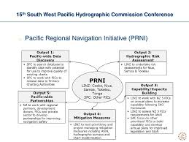
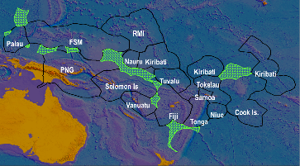
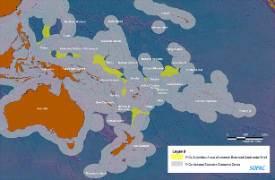
Plans that affect the region
Pacific Regional Navigation Initiative (PRNI)
Ridge 2 Reef
Pacific Maritime Boundaries
Extended Continental Shelf
Manaatua Cable

Slide 13
Lessons learned to share
National Government support Hydrography
Established NHCC to drive Hydrography in country
NAVAREA to update progress PRNI project
National Government to support IHO membership

Slide 14
Success stories to share
CINHCC still active
Cook Islands ENC charts PRNI project in progress

Slide 15
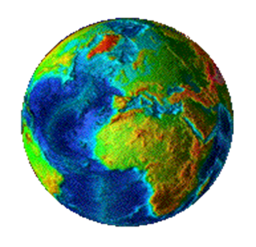
Meitaki ma’ata

