Slide 1
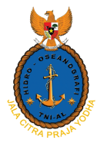
16th Meeting of the South West Pacific Hydrographic Commission National Report by Indonesia

Slide 2
Main achievements during the year of 2018
The main achievements during the year of 2018, Pushidrosal had conducted
a. Hydrographic re-survey for ± 54,000 km²
b. Update 86 numbers of Nautical Charts
c. Update 520 cells of ENC
d. Publish Notice to Mariners
e. Publish Navigational Warning
f. Participated on SAR and natural disaster relief and mitigation
- Toba Lake ferry accident;
- Palu Bay and Sunda Strait, earthquake and Tsunami;
- Lion Air - JT610 in North of Tanjung Karawang (Java Sea))

Slide 3
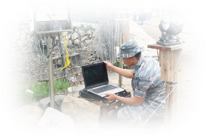
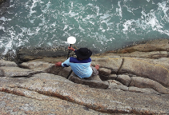
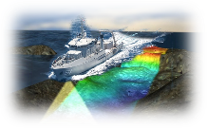
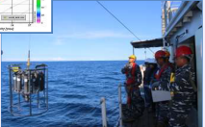
Progress on surveys and charting
SURVEY ACTIVITIES
Conduct Hydrographic Survey
± 53 survey areas
covering ± 54.000 km²,
less then 1% of all Indonesian waters
Priorities Area :
Channel;
Ports;
Archipelagic Sea Lanes;
Busiest water; and
Straits;
CATZOC C - D area
Identification of Under water Pipeline and Cable

Slide 4
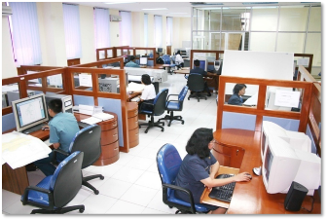
Progress on surveys and charting
Charting Activities
PRODUCTION
20 Cartographers on Paper Chart
150 Numbers of Paper Charts (Reprints and New Editions)
8 Cartographers on ENC
50 Cells annually (New Cells and New Editions)
SOFTWARE
CARIS GIS 4.4
SevenCs ENC Tools
D’Kart Inspector
CARIS HOM and S57 Composer (HPD ongoing)
ECS Orca Master
ECDIS MARIS
Progress On Charting 2018
ENC Coverage 520 Cells
Paper Chart in 2018 Update 86 numbers from the total 580 numbers of paper chart, consist of:
47 Numbers of Chart - Port & Channel
15 Numbers of Chart - Archipelagic Sea Lanes
24 Numbers of Chart - Busies water

Slide 5
Progress on surveys and charting
MARINE SAFETY INFORMATION
Directorate General of Sea Transportation (DGST) is responsible for MSI in Indonesia water.
Navtex Station under DGST are 4 Stations (Jakarta; Makassar; Ambon and Jayapura)
Pushidrosal (HO) support the information from hydrographic Notes on providing navigational warning.
Hydrographic Data Center (IMAGIC) as MSDI provide also navigational warning (E - Navigational Dashboard)
Pushidrosal published NtMs weekly (52) ;
Navigational Warning & Hydro-Indonesia published due to urgent information of ships collision; natural disaster; SAR; under water cable & pipes installation etc TO all mariners by Coastal Radio Station.

Slide 6
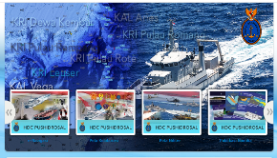
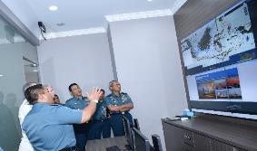
DEVELOPMENT INDONESIAN MARINE GEOSPATIAL INFORMATION CENTER (IMAGIC)
AS IMPLEMENTATION OF MSDI
I
M
A
G
I
C
P
O
R T A L
PUSHIDROSAL INDONESIA HAD DEVELOPED THE HYDROGRAPHIC DATA CENTRE AS IMPLEMENTATION OF MARINE SPATIAL DATA INFRASTRUCTURE IN INDONESIA (IMAGIC).
THIS DATA ARE OPENED AS WELL AS SAFETY OF NAVIGATION, MARINE ENVIRONMENT PROTECTION, INTEGRETED COASTAL ZONE MANAGEMENT, MARINE RESEACH, EXPLOITATION AND EXPLORATION OF MARINE RESOURCES.
HYDROGRAPHIC DATA CENTRE PORTAL CONNECT TO OTHER PORTAL IN INDONESIA AND COULD USE BY ONLINE.
INDONESIA GOVERNMENT BUILD NATIONAL MARITIME PORTAL “NATIONAL OCEAN DATA CENTER” WHICH INTEGRATE MARITIME PORTAL FROM ALL NATIONAL MARITIME AGENCY
http://hdc.pushidrosal.id

Slide 7
REGIONAL CB ON EAHC TRAINING IN 2018
Capacity Building Activities
Jakarta – GNSS for tide correction (18 participants)
Shanghai – Carto Production Database System Development
PARTICIPATING IN INTERNATIONAL COURSE
Oceanography Course in India
Hydrographic Course Cat – B Japan
Long Hydrography Course in India
10th Course in Marine Cartography and Data Assessment – MCDA (FIG-IHO-ICA-Cat B) in UK – 2 persons in 2018
Hydrographic Course in Australia (2019) – one candidate (just finished Advance English Course in DITC – Laverton Victoria Australia - Dec 2018)
International Hydrography Management and Engineering Program in Mississippi US - 2019 (19 February – 22 August 2019) – one candidate
INTERNATIONAL WORKSHOP AND SEMINAR
Workshop International Delimiting Maritime Boundaries Challenges and Outlook 2018 in Paris
Workshop Satellite Derived Bathymetry (Remote Sensing Technology in Bathymetry) - 2018 University of Ottawa Canada
Hydrographic Survey Cat B & A
Cat B Hydrographic Survey Course (IDN Navy Hydrographic School)
Cat A Hydrographic Survey Course (Institute of Technology Bandung)

Slide 8
Participate in IHO WG, RHC, and others
NO. | MEETING | MEMBER/ASOCIATE | REMARKS
1. | Hydrographic Service and Standards Committee (HSSC) | M
2. | Nautical Cartography Working Group (NCWG) | M
3. | Data Quality Working Group (DQWG) | M
4. | Marine Spatial Data Infrastructures Working Group (MSDIWG) | M
5. | S-100 Working Group (S100WG) | M
6. | Nautical Information Provision Working Group (NIPWG) | M
7. | Tides, Water Level And Currents Working Group (TWCWG) | M
8. | ENC Standards Maintenance Working Group (ENCWG) | M
9. | Hydrographic Dictionary Working Group (HDWG) | M
10. | East Asia Hydrographic Commission (EAHC) | M | Vice Chair
11. | North Indian Ocean Hydrographic Commission (NIOHC) | M
12. | South West Pacific Hydrographic Commission (SWPHC) | A
13. | FIG/IHO/ICA – International Board on Standards of Competence for Hydrographic Surveyor and Nautical Cartographers
14. | GEBCO Sub Committee on Undersea Feature Names (SCUFN)
15. | IHO Council | M
16. | Malacca and Singapore Straits (MSS) ENC | M | Coordinator

Slide 9
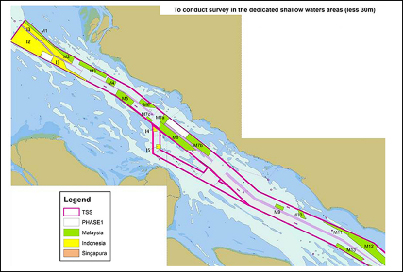
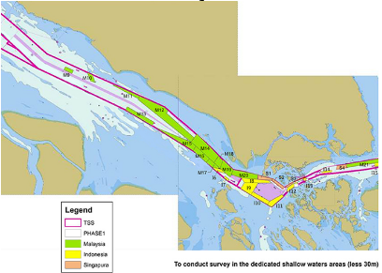
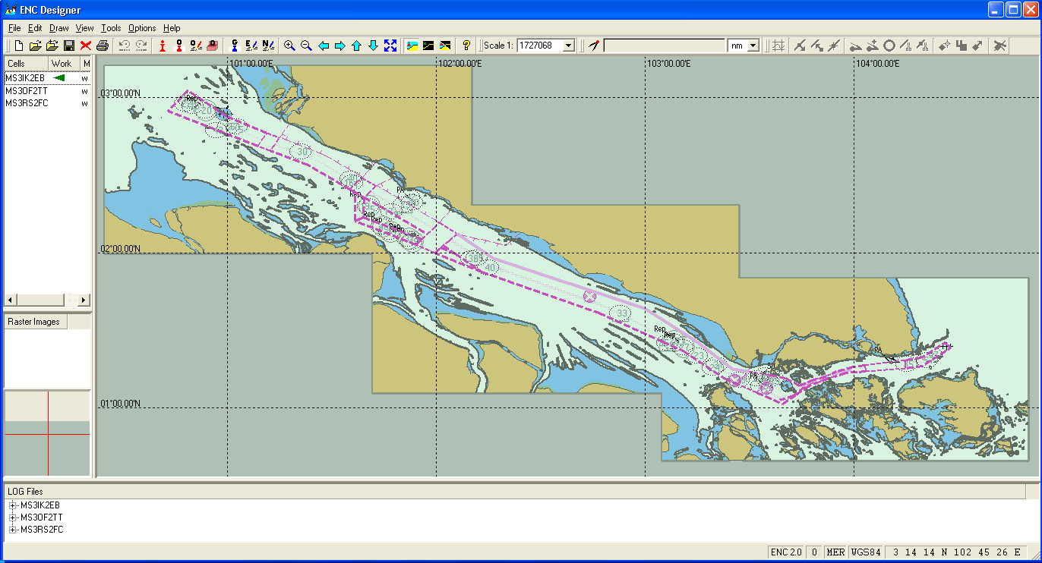
Lesson learned to share
MALACCA SINGAPORE STRAIT
ELECTRONIC NAVIGATIONAL CHART (MSS ENC)
Joint hydrographic survey will cover the shallow area (less than 30m depth) in TSS (2017 – 2020)
MS3OF2TT
CHART 350
MS3RS2FC
CHART 351
MS3IK2EB
CHART 352
CHART 349
CHART 348
MS4NS2EB
MS4BR2JS
The hydrographic data acquired will be processed and high density electronic navigational charts (ENCs) will be produced for the safety of navigation.
MS4IK2RL
MSS ENC COVERAGE
CHART 347

Slide 10
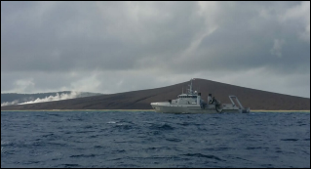
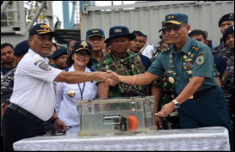
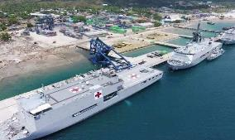
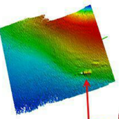
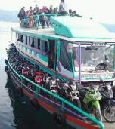
Lesson learned to share
PARTICIPATE ON DISASTER RELIEF AND MITIGATION
SAR on MV Sinar Bangun sinking in Toba Lake
Participate on Palu – Donggala Earthquake and Tsunami
SAR JT610 (Lion Air Crash) in North of Tanjung Karawang – Java Sea.
Participate on Sunda Strait Tsunami effect – Disaster Relief, Search and Rescue

Slide 11
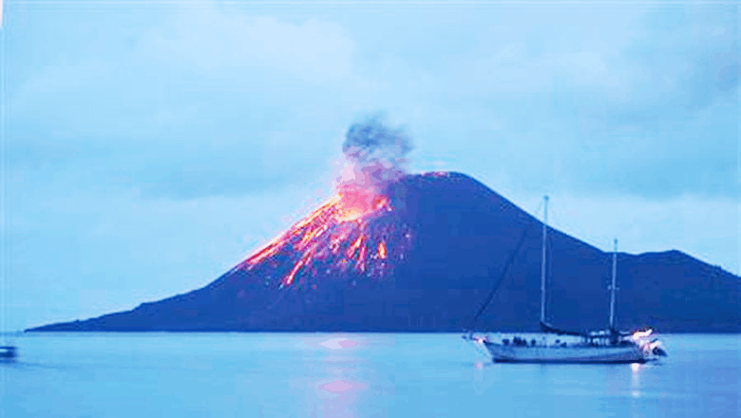
SUNDA STRAIT | IMPACT OF KRAKATAU ERUPTION
MOUNT KRAKATAU
Eruption Dec 2018
Minor impact to navigation activities
Landslide of Seabed away from the IASL-I and the proposed TSS
Continuously Observed & Monitored
SOUTH
ENTERANCE
OF THE
PROPOSEDTSS
23 NM AT 247⁰
± 1 NM
MT. ANAK
KRAKATAU
IASL - I
12 NM AT 118⁰
11
11

Slide 12
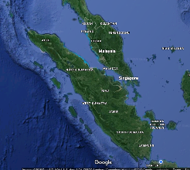
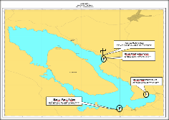
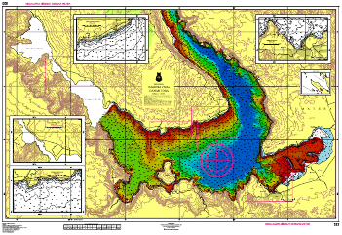
Success stories to share
Hydrographic Survey & Charting in Toba Lake
H = 903 m from MSL
Safety Navigation Purposes provide inland waterways chart in Toba Lake
9 local port for local transport
Hydrographic Survey
Full Cover MBES - 60% Area
Max Depth : 504 m
Continue on 2019 program
IHO Publication : S-4, specifies regulations of the IHO for international (INT) charts and chart specifications of IHO,
• B-350.4 : Navigable rivers, lakes and canals should be shown as completely as possible on the larger scales;
• B-353 : land drainage: rivers, lakes, glaciers

Slide 13
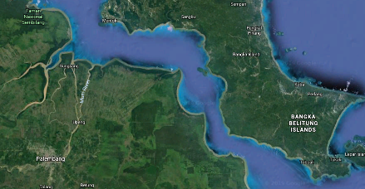
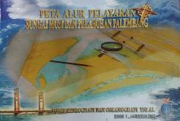
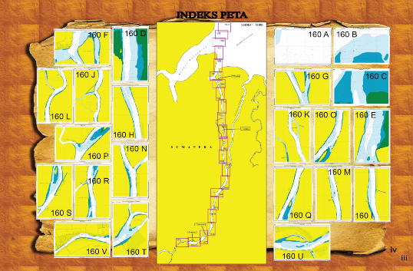
Success stories to share
PORT ENC PALEMBANG
AND INLAND WATERWAYS CHARTS, MUSI RIVER
Bangka Strait
Launching in 2017
Musi River in South Sumatera (hydrographic survey 2013 – 2015) – depth average 3 – 10 m.
The distance from the estuary to the harbor is 100 km. And river width between 270 m to 2.5 km,
Book Chart of Musi River has 22 paper chart (Scale 1 : 10.000)
ENC 22 cell
Next project of Book Chart (ongoing process) is the channel of Muara Pegah – Palaran Samarinda East Kalimantan (Mahakam river)
Musi River
Palembang
SUMATERA

Slide 14
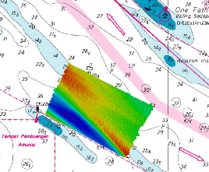
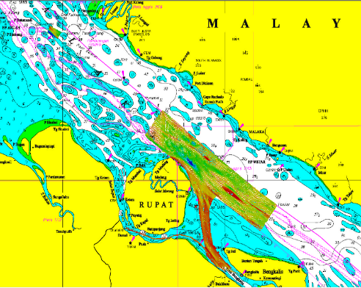
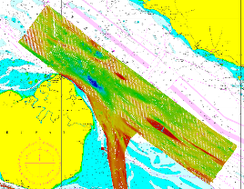
Lesson learned to share
Sandwaves in the Strait of Malacca
One-Fathom Bank
North of Rupat TSS (DW)
One-Fathom Bank
Surveyed 2016
KRI Rigel
North of Rupat TSS (DW)
Surveyed 2017
KRI Spica

Slide 15
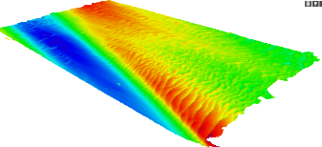
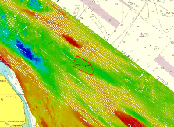
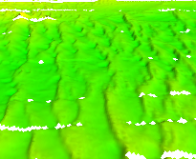
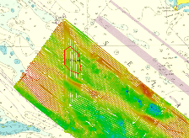
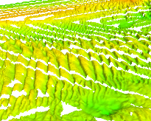
Lesson learned to share
SANDWAVES
IN THE STRAIT OF MALACCA
One-Fathom Bank
Water depth 20 – 40m
Amplitude 1-5m
Spacing 100-200 m
SUMMARY AND RECOMMENDATION :
Sandwaves were detected to be in/near TSS
Sandwave is fluid hence periodic survey may be needed.
Research on Sandwave
4,99 sq mi
Rupat island vicinity
Depth 50-70 m
Amplitude 1-6 m
Spacing 100-200m
6,58 sq mi
Rupat island vicinity
Depth 40-60 m
Amplitude 3-9 m
Spacing 100-300m
DW south-bound

Slide 16
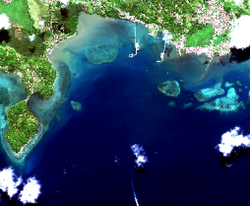
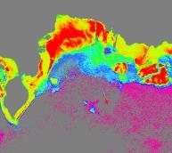
Lesson learned to share
Satellite Derived Bathymetry (SDB) Program
Joint research with the National Institute of Aeronautics and Space (LAPAN)
Joint Research areas:
Sabang Island 2016
Halong Bay 2016
Bawean Islands 2017
Gili Mantra 2018
Setokok 2018
Methods:
Semi Parametric w/ Independent Depth Variable (TNP) by Kanno et al (2011)
Random Forest (RF) by Manessa et al (2016)
Imageries:
Worldview2
SPOT-6/7
Worldview2
Worldview2

Slide 17
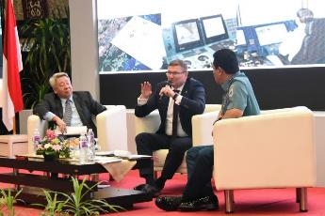
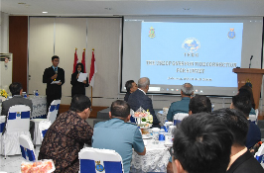
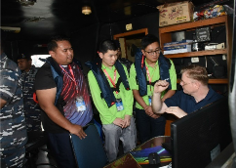
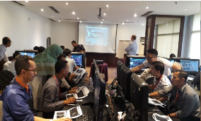
Plans that affect the region
IHO CB – EAHC TRDC-BoD Program 2019 (on Marine Safety Information)
Indonesia Golden Jubilee 2020 – International Hydrographic Seminar 2020
International Hydrographic
Seminar 2018
IHO CB – EAHC TRDC program 2018 – GNSS for Tide Correction

Slide 18
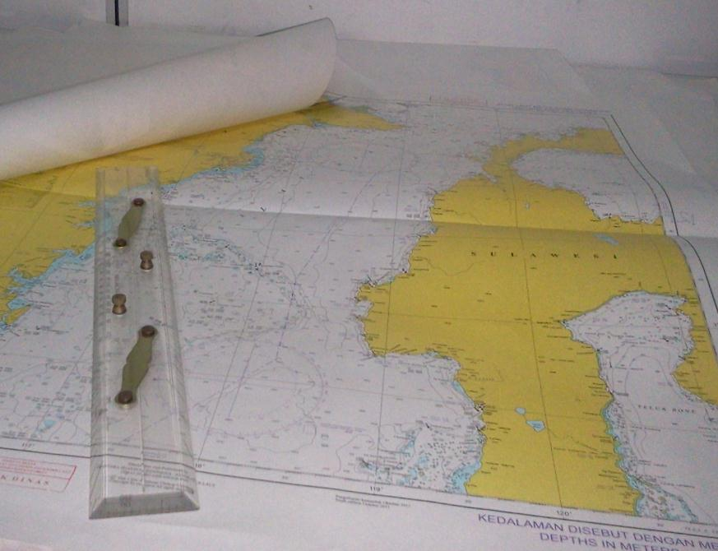
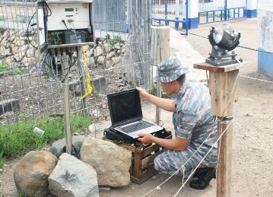
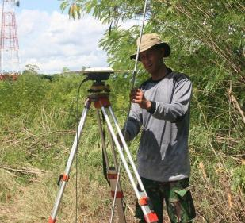
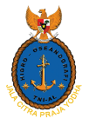
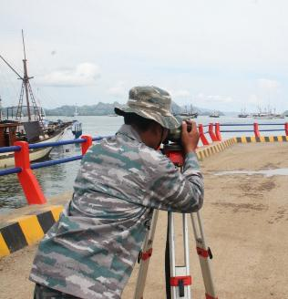
TERIMA KASIH
Thank You
JL. PANTAI KUTA V/1 ANCOL TIMUR
JAKARTA UTARA 14430
Phone. (62) (21) 64714810,64714819 Fax : (62) (21) 64714809, 64714819
Website: www.dishidros.go.id
e-mail : infohid@dishidros.go.id
18
18

