Slide 1
16th Meeting of the South West Pacific Hydrographic Commission
Pacific Regional Navigation Initiative (PRNI)

Slide 2
Pacific Regional Navigation Initiative (PRNI)
2015 - 5 year, $5 million programme of works
Partnership with MFAT, LINZ and SPC
Focus on navigation-related aspects of maritime safety
Builds on success on SWPRHP – risk assessments in Vanuatu, Tonga and Cook Islands
January 2018 – an additional $2.2 million secured
Programme continues to 2021
Investigating activities beyond 2021

Slide 3
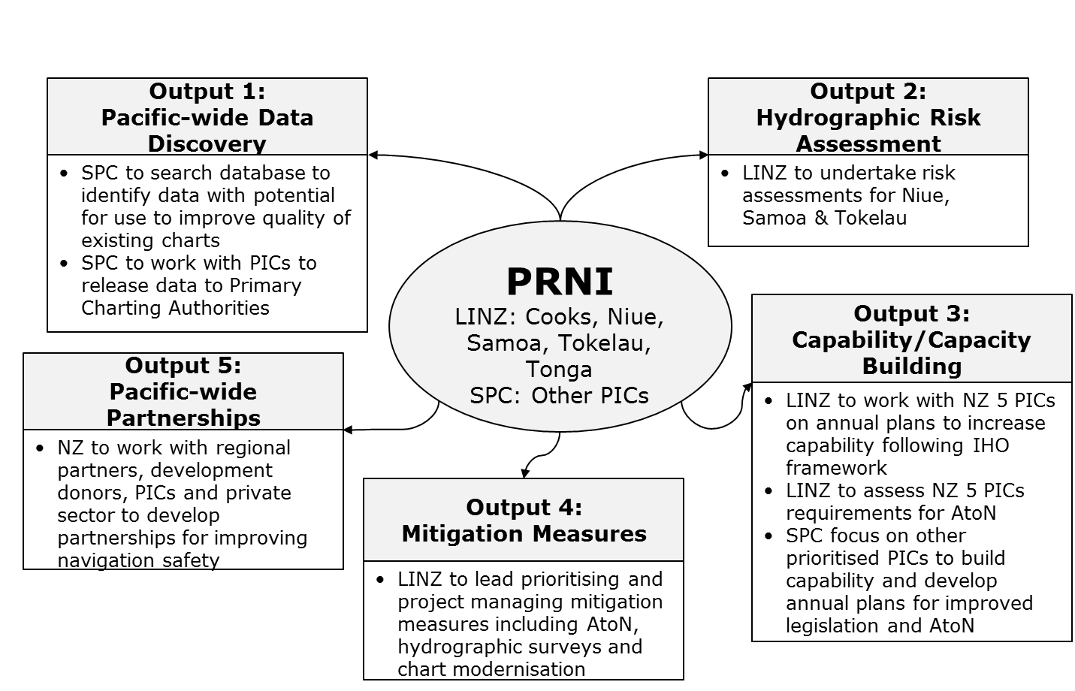
Pacific Regional Navigation Initiative (PRNI)
Notes:
Output 1: data received from SPC for Cooks, Niue, Samoa and Tonga. Assessment made and some used for updating charts
Output 3: Capability / Capacity building component – to get to Phase 1. Includes in-country MSI training
Recognise there are a number of visits from others – IALA, SPC and PMSP as part of other regional programmes.
A real need to be joined up and better at sharing planned visits, particularly where LINZ and SPC have cross-over in terms of AtoN.
Under Output 3 LINZ to assist with working through IALA/SPC recommendations wrt AtoN i.e. AtoN register

Slide 4
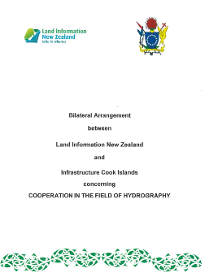
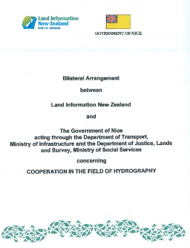
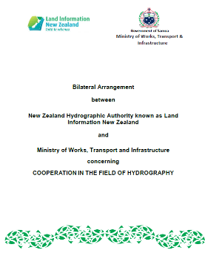
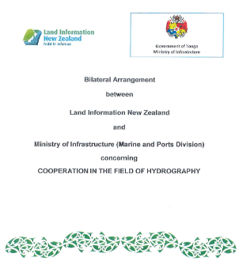
Bilateral Arrangements
Notes:
Bilateral arrangements with the Cook Islands, Niue, Samoa and Tonga (signed Jan 2019)

Slide 5
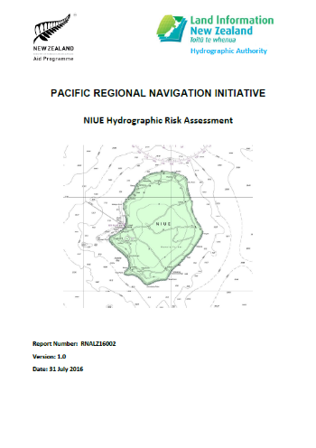
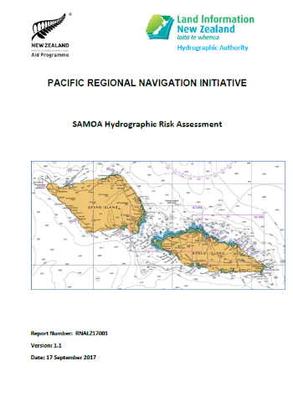
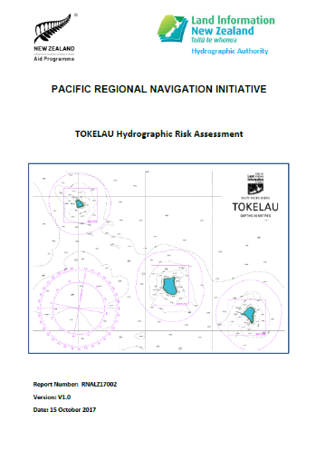
Hydrographic Risk Assessments
Notes:
Risk assessments for Tonga and Cook Islands were completed under a previous NZ Aid programme
Risk assessments for Niue and Samoa, and a traffic analysis of Tokelau completed under PRNI
All are available on the IHO website

Slide 6
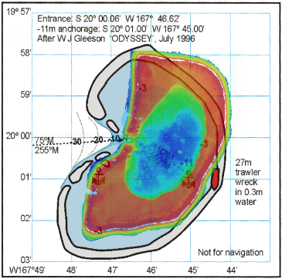
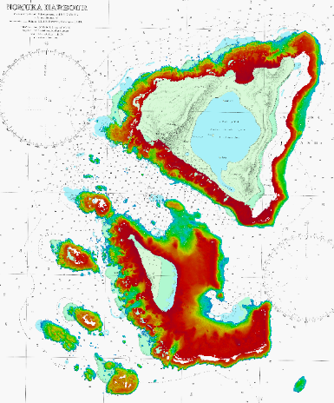
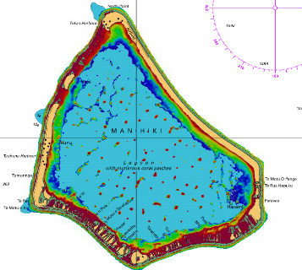
Surveys
Satellite Derived Bathymetry (SDB)
Nomuka, Tonga
Manihiki, Cook Islands
Beverideg Reef, Niue

Slide 7
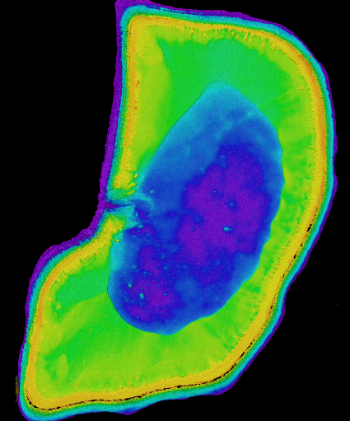
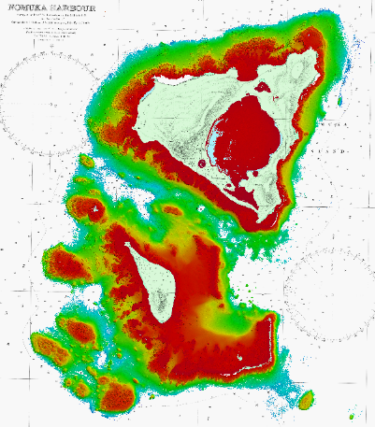
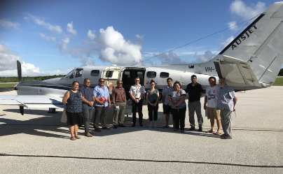
Surveys
Airborne Laser Bathymetry (ALB)
Beveridge Reef, Niue
Nomuka, Tonga
Notes:
After the SDB was delivered, the ALB areas were reviewed.
This required referencing the fathoms chart to match the SDB and imagery, then refining the ALB areas

Slide 8
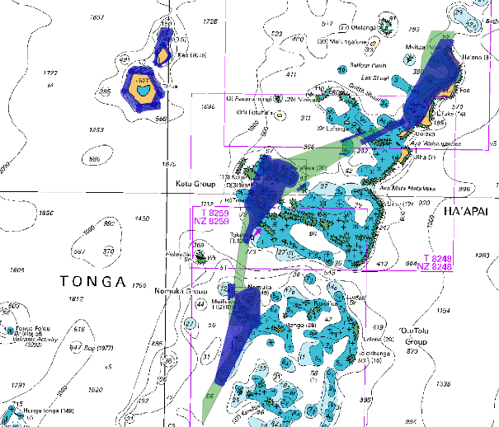
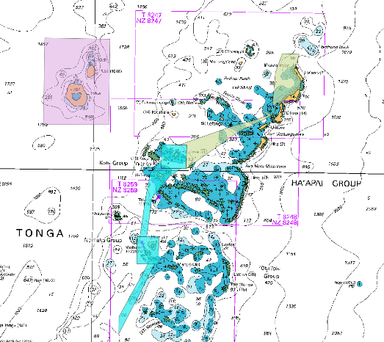
Surveys
Surveys: planning (PRNI)
Initial ALB & MBES survey areas
Final ALB & MBES survey areas

Slide 9
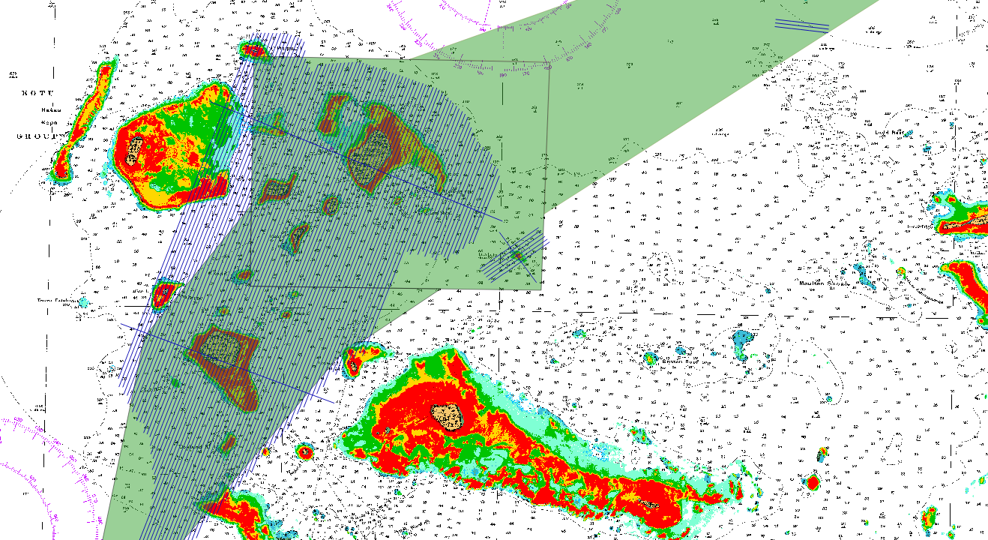
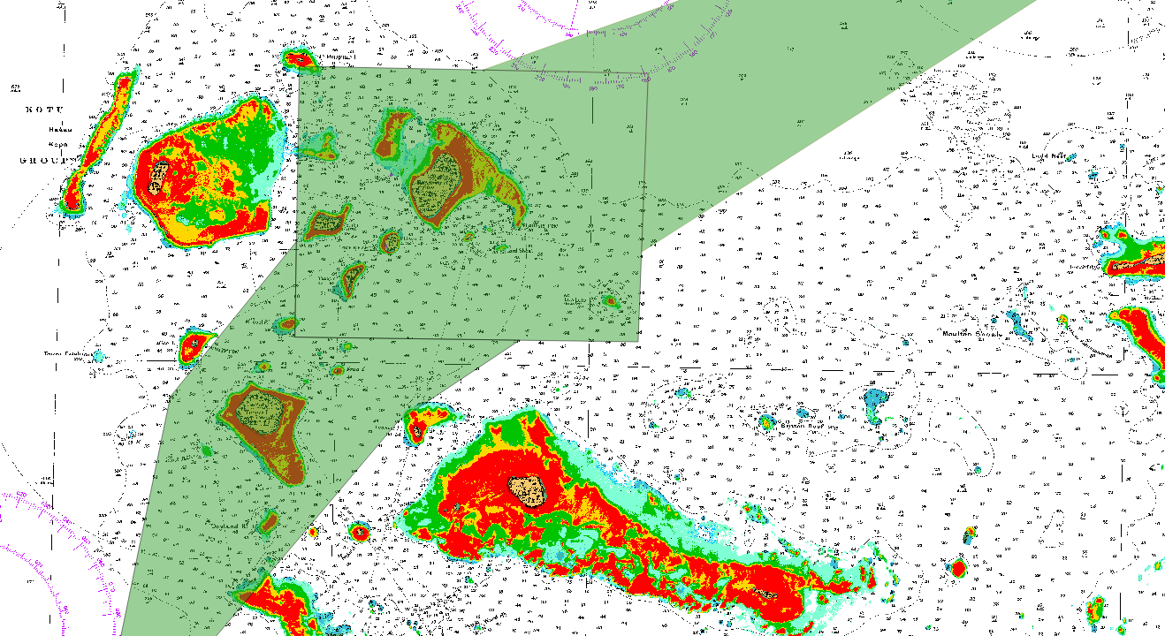
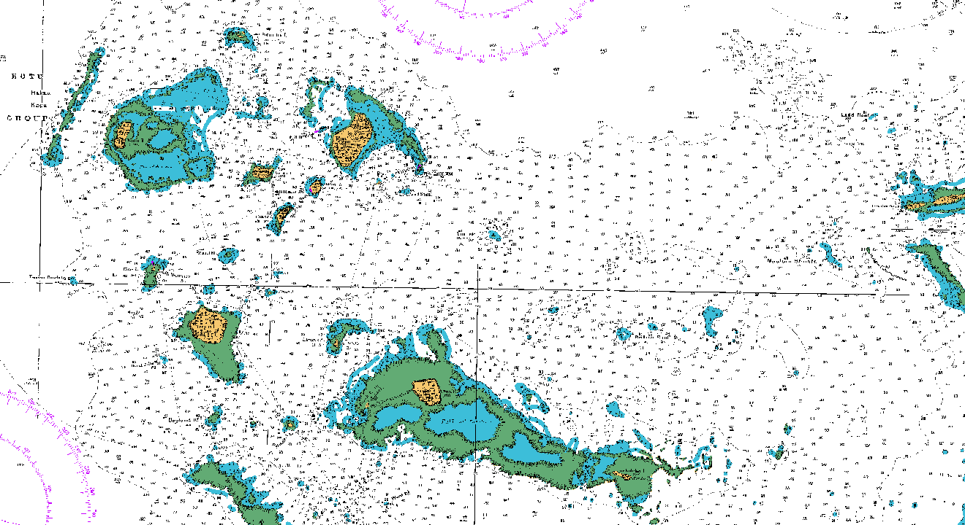
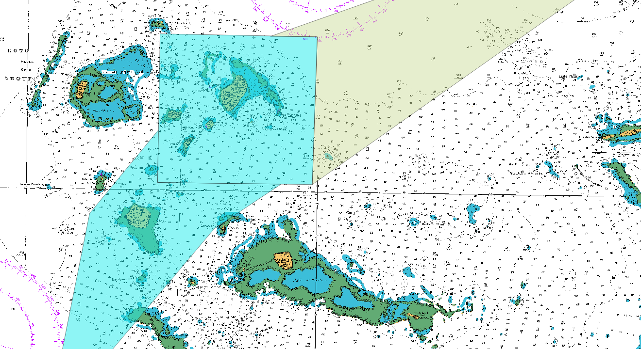
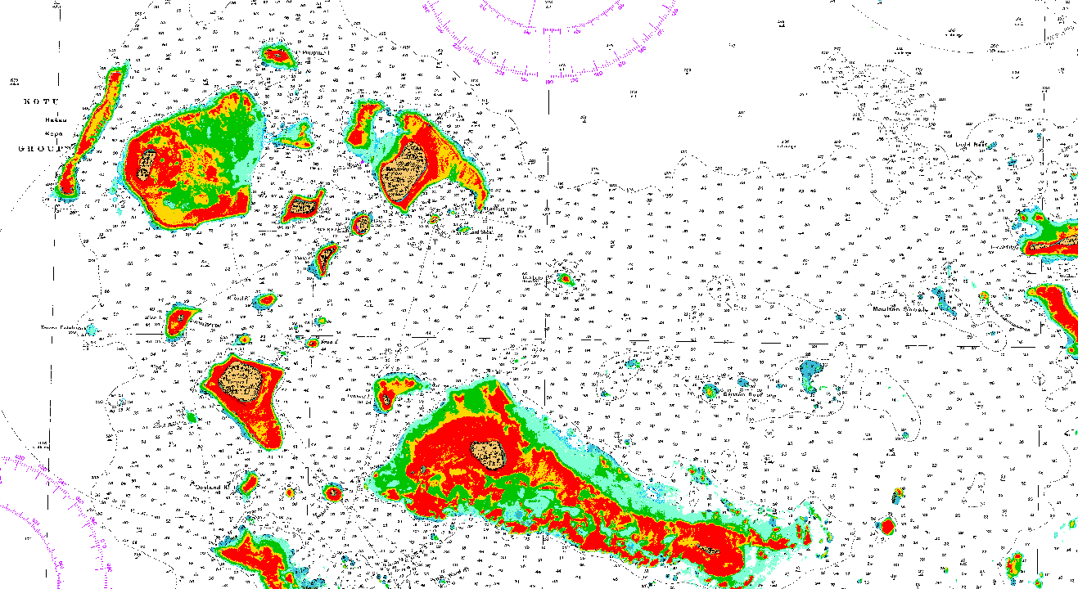
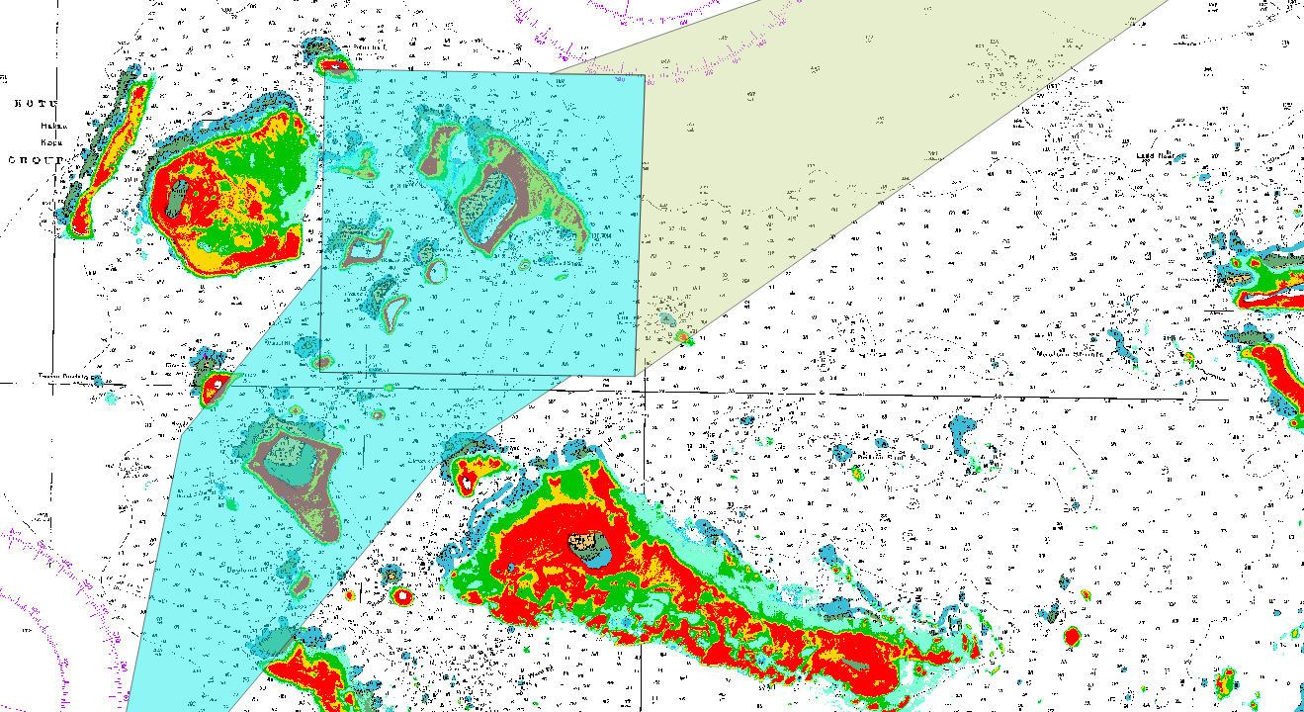
Progress on surveys, charting and MSI
Notes:
Using the SDB and satellite images, the fathom charts were referenced to WGS84
The initial ALB survey extents were then reviewed and refined, to cover features that were identified by the SDB
A similar process was carried out for the MBES survey extents

Slide 10
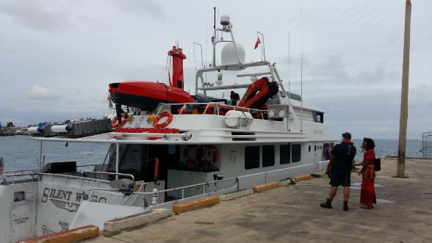
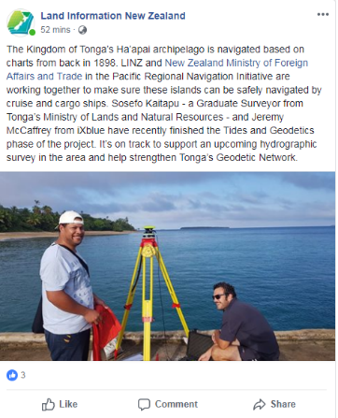
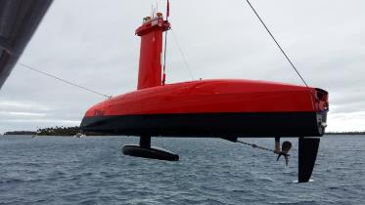
Surveys
Multi-Beam Echo Sounder (MBES)
Notes:
Before the LiDAR fieldwork started, a number of tide stations were installed along with benchmarks.
A surveyor from Tonga’s Ministry of Lands and Natural Resources joined the survey team to assist with this phase.
Having someone with local knowledge who could liaise with local communities was important to ensure the work went smoothly

Slide 11
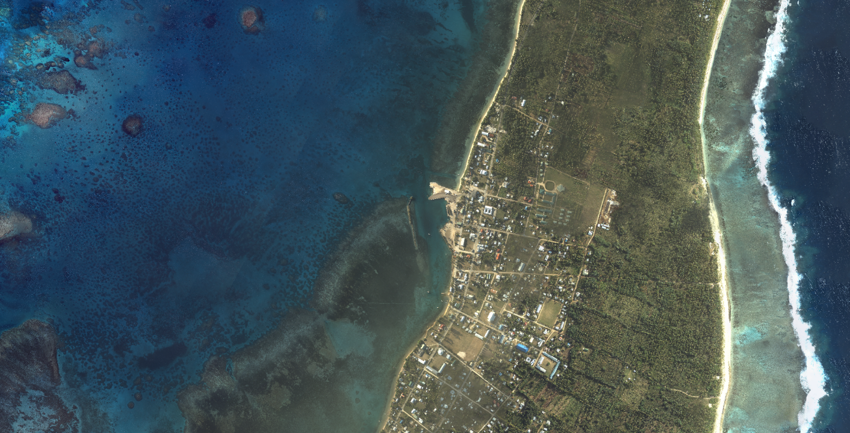
Progress on surveys
More than bathymetry
Notes:
But it’s not just bathymetry that’s been collected. In Tonga where the planes flight path took them over land, topographic LiDAR and imagery was collected
This can be used to assist with determining land use and tsunami inundation modelling
All the data collected will be provided too each country

Slide 12
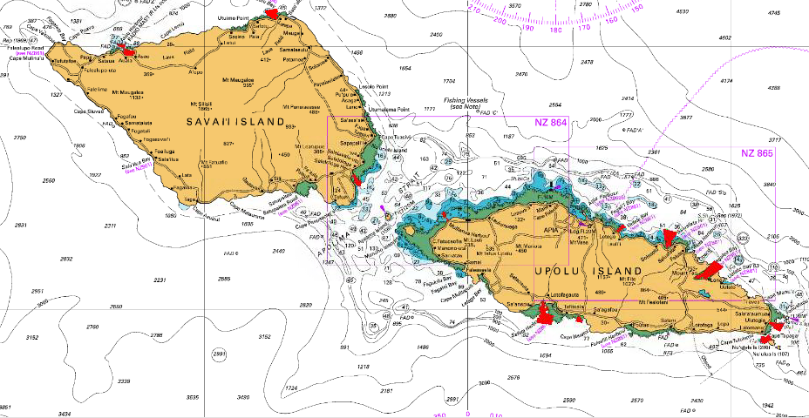
Future surveys
Samoa MBES
Asau
Matautu Bay
Salelologa
Mulifanua
Vailele Bay
Saluafata Bay
Fagaloa Bay
Aleipata
Safata Bay
Siumu Bay
1
2
3
4
5
6
7
9
8
10

Slide 13
Chart publication schedule
Nation | Paper Charts |  | ENCs
 | New Edition | New Chart | New Edition | New Chart
Cook Islands | 1 (Jun 18) 2 (Feb 19) | - | 19 (Jun 18) 3 (Nov 18) 6 (Jan 19) | -
Niue | - | 1 (early 2020) | 2 (May 18) | 3 (early 2020)
Samoa | 4 (Feb 18) 2 (Jun 2021) | 4 (Jun 2021)* | 2 (Jun 2021) | 7 (Jun 2021)*
Tokelau | 1 (Mar 19) | - | 4 (Mar 19) | -
Tonga | 3 (Jan 19) 2 (Apr 19) 1 (May 19) 2 (Jun 2021) | 5 (Jun 2020)* 1 (Jun 2021) | 1 (Nov 18) 4 (Dec 18) 1 (April 19) 2 (Jun 2021) | 6 (Jun 2020)* 2 (Jun 2021)
INT Chart | - | 1 (Jul 19) | - | 1 (Jun 19)
* New Charts will replace current fathoms/non-WGS84 charts, enabling production of large scale ENC for the first time.

Slide 14
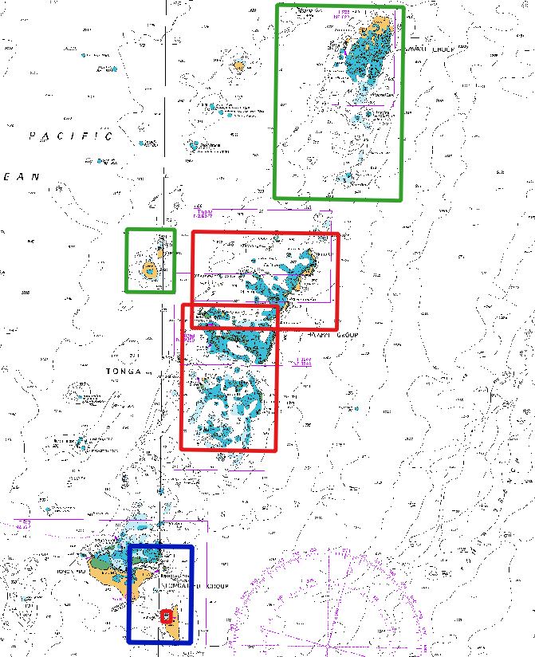
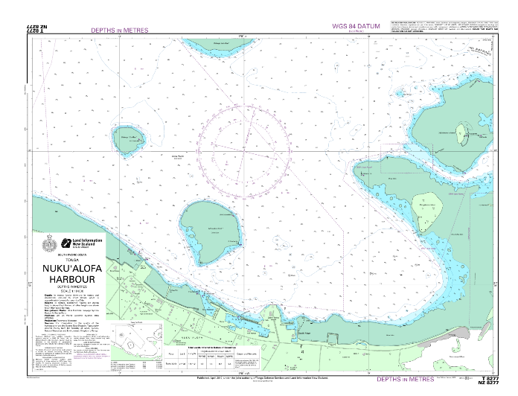
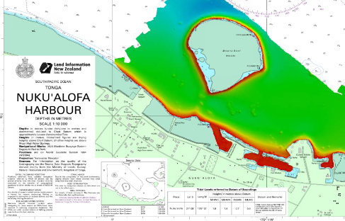
Charting
Notes:
Proposed new charts for Tonga
And new edition of Nuku’alofa Harbour chart incorporating SDB data and the UKs CME MBES survey of March 2018.
This chart was published January 2019 and shows the new Domestic ferry wharf
Further chart updates will continue following receipt of the SDB, ALB and MBES

Slide 15
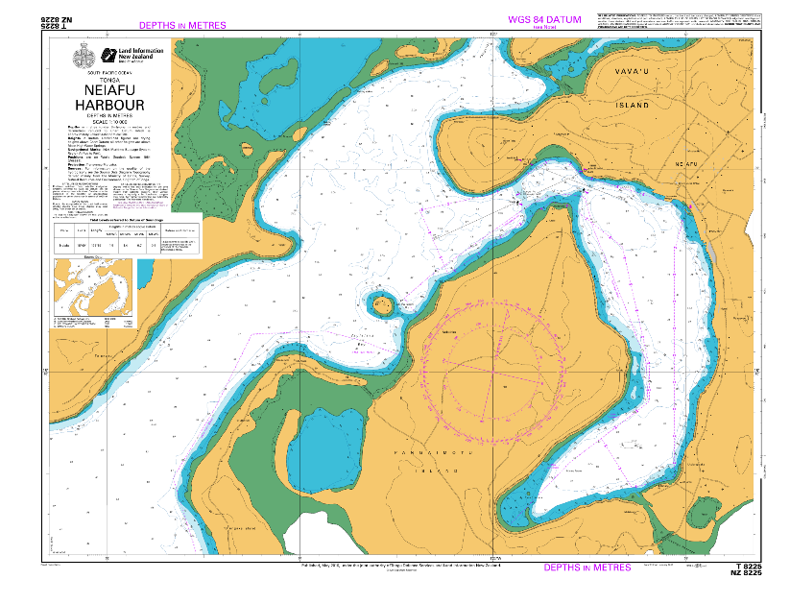
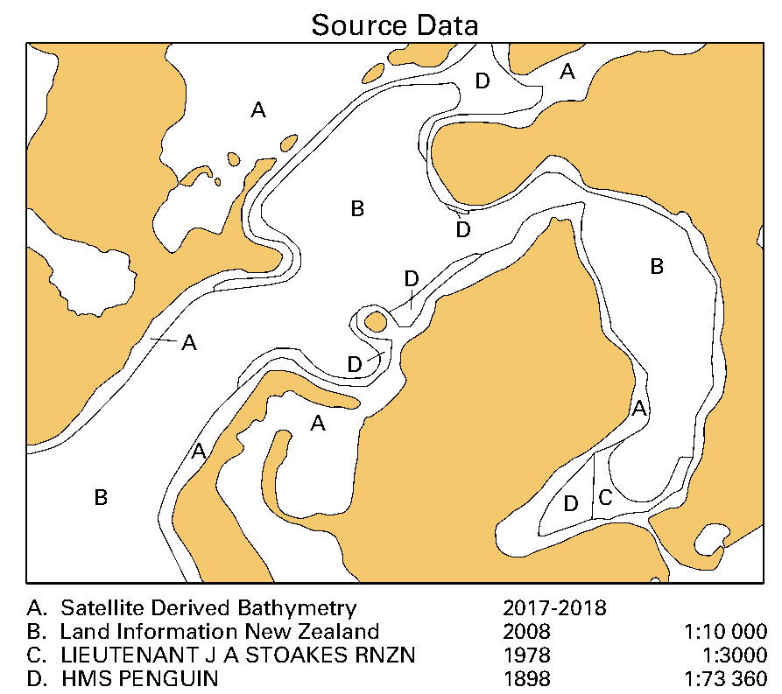
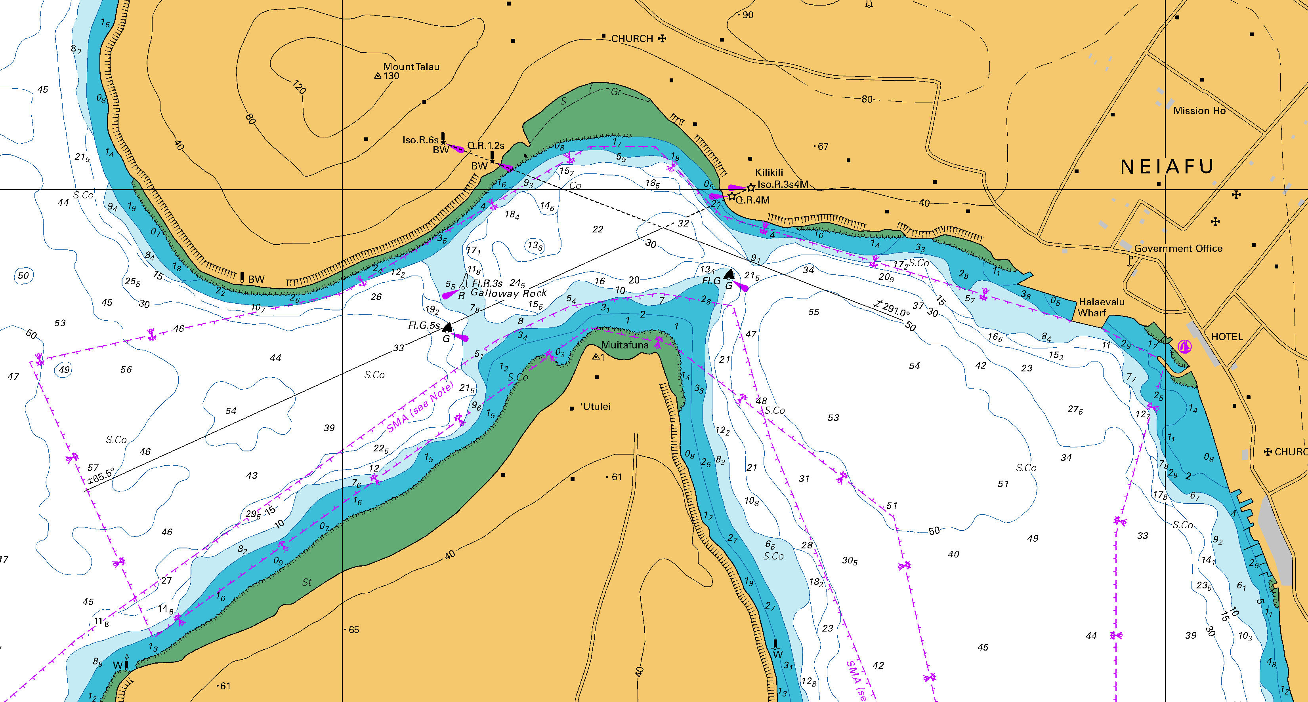
Charting
Notes:
SDB included on charts
Reviewed how to depict SDB on the chart – UKHO, SHOM, NOAA
Following UKHO process, indicating area on SDD plus a note on the face of the chart
Aware that the UK presented a paper for consideration at the NCWG in Nov 2018 - Depiction of Satellite Derived Bathy
Conclusion: To ensure efficiency for chart production and maintenance, a standard depiction for SDB should be provided to prevent retrospective change in future. Future S-4

Slide 16
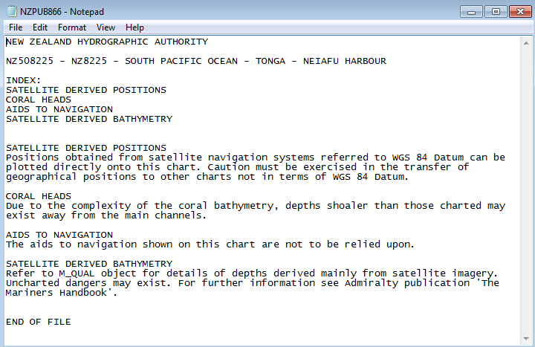
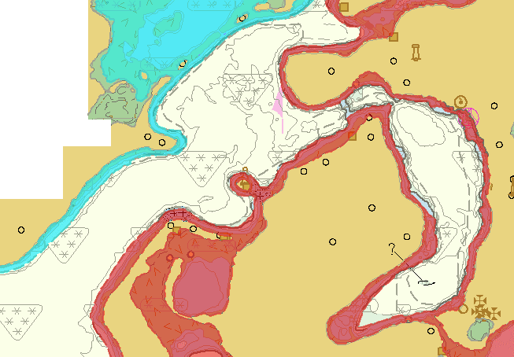
Charting
Notes:
SDB included on charts
CATZOC C
Max depth 15m
M_NPUB note

Slide 17
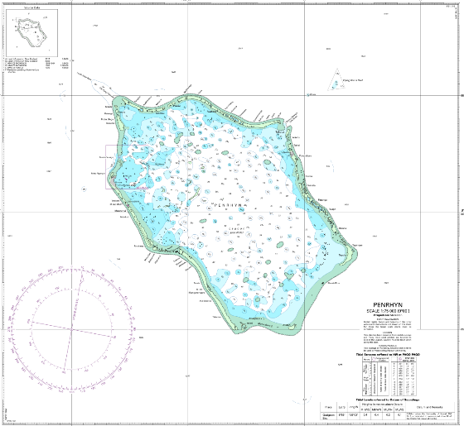
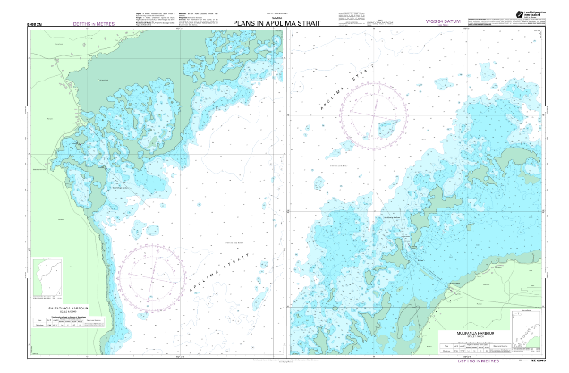
Charting
Notes:
During the workshop we looked at data discovery and the importance of making the data available to chart updates
As an example, these two charts have been updated with data from other sources.
The chart of Penrhyn now includes data held by SPC on behalf of the Cook Islands, as well as data collected by the RNZN during a deployment in 2017.
The chart of the Apolima Strait in Samoa, now includes LiDAR data collected for a ridge-to-reef project in 2015.

Slide 18
Charting
To-date, 35 ENCs & 8 paper charts published incorporating new data (SDB, ALB and MBES) for the Cook Islands, Niue, Samoa, Tokelau and Tonga
In total, 63 ENCs & 30 paper charts will be published
Including 19 new ENCs & 12 new paper charts, replacing current fathoms charts

Slide 19
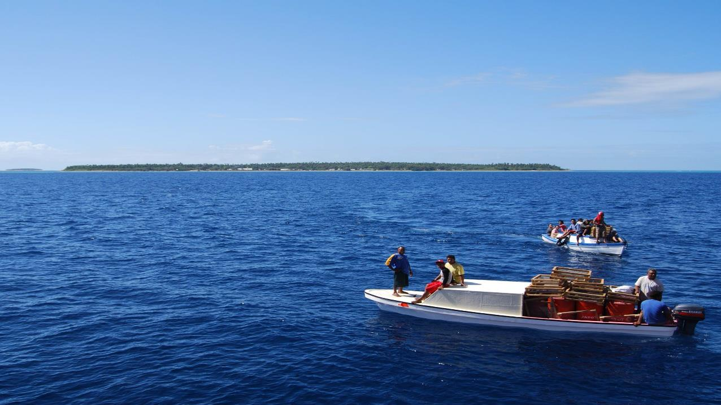
Fakaaue lahi Thank you

