Slide 1
SOUTH WEST PACIFIC
This story takes you on a journey to the South West Pacific, where in 2018, LINZ mapped the seafloor to update nautical charts. The expedition revealed, in unprecedented detail, beautiful atolls, coral reefs and underwater volcanoes!

Slide 2
Much of Tongan waters have charts that have not been updated since the late 1800's. With fresh eyes and the latest in seafloor mapping technology, LINZ, EOMAP, GDS and iXblue, are mapping the seabed to make navigation safer and chart undocumented features on the seafloor.

Slide 3
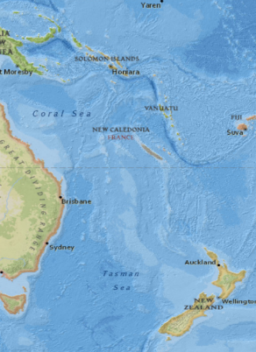
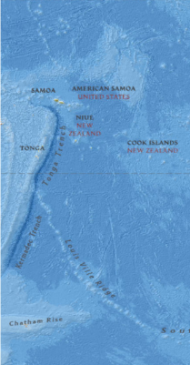
Pacific Regional Navigation Initiative LINZ HI 60, 61, 62 & 63
Multi-sensor Approach
HS60 (Tonga) SDB, ALB, MBES
HS61 (Cook Islands) SDB only
HS62 (Niue) SDB and ALB
HS63 (Tokelau) SDB only
Tide gauge install & datum computations
Requirement: LINZ-1 Standard (<40m), LINZ-2 (>40m)
Survey Contractors: EOMAP, Geomatics Data Solutions and iXblue
Notes:
iXBlue Project for LINZ

Slide 4
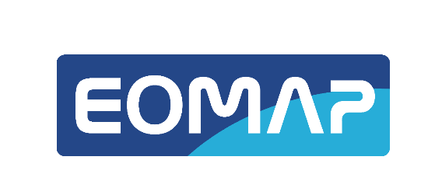
Satellite Derived Bathymetry
Cost effective solution to obtain tightly georeferenced imagery, topography and shallow water bathymetry over large areas
Ideally suited to the SW Pacific where water clarity is high and the area is characterized by hundreds of small islands/atolls and reefs over a large area
Ideal tool to plan higher resolution/higher cost surveys. Has already been used by LINZ to reposition islands, atolls and reefs with SDB data
Notes:
iXBlue Project for LINZ

Slide 5
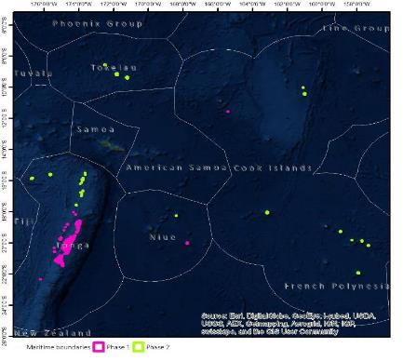
SDB coverage
Notes:
iXBlue Project for LINZ

Slide 6
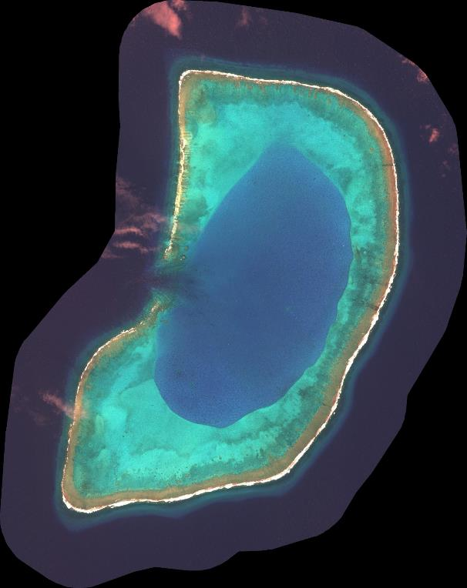
Satellite-Derived Bathymetry Beveridge Reef Niue
RGB
SDB

Slide 7
SDB Beveridge Reef Niue

Slide 8
Airborne Lidar Bathymetry
Cost effective solution to obtain tightly georeferenced imagery, topography and shallow water bathymetry over large areas
Ideally suited to the SW Pacific where water clarity is high and the area is characterized by hundreds of small islands/atolls and reefs over a large area
Latest generation systems have sufficient data density to reliably meet the LINZ-1 feature detection requirement to 20m
Excellent sensor solution to remove a huge amount of navigational risk for any vessel mounted survey campaign
Provides a host of other valuable information that can be used for many purposes other than safety of navigation

Slide 9
ALB/MBES planned coverage
Notes:
iXBlue Project for LINZ

Slide 10
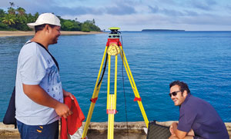
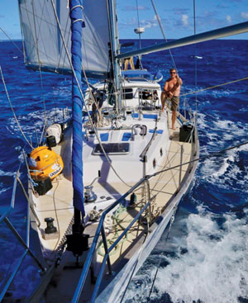
Tides and Geodetics
Notes:
iXBlue Project for LINZ

Slide 12
TTechnical note:
GDS used the Shallow water, high resolution Leica Chiroptera system and chose not to also use the deeper water HawkeEye system.
Feature detection survey so whilst the bathymetry from the HawkeEye system might have been interesting, it would have been wasted time and money.
First time that the Leica Chiroptera 4x system had been used on a large commercial survey project. Unprecedented sounding density.

Slide 13
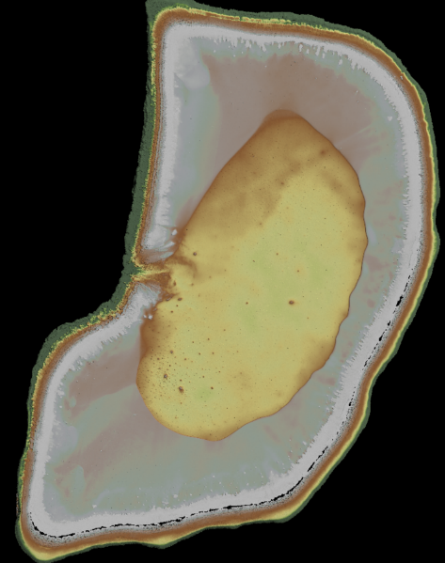
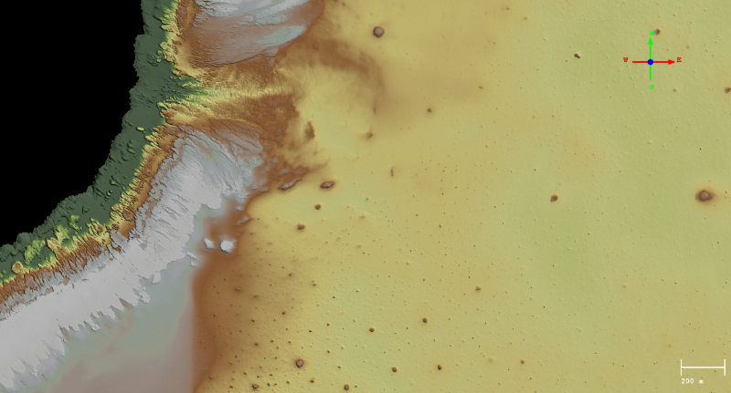
Airborne LiDAR Bathymetry
Beveridge Reef, Niue

Slide 14
Multi-beam Bathymetry
Multi-vessel solution
First time iXblue has used an unmanned survey vessel on a contract survey
MBES to be used in >18m water (due to ALB)
USV shows promise to reduce the time on task and cost of large area surveys
Notes:
iXBlue Project for LINZ

Slide 15
Vessel Mobilisation - NZ
Notes:
iXBlue Project for LINZ

Slide 16
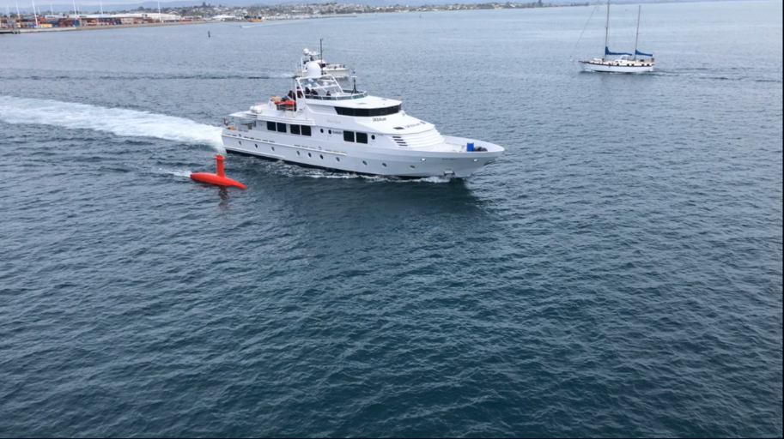
Mothership – MV SILENT WINGS
Note: movie removed due to the size
Notes:
iXBlue Project for LINZ

Slide 17
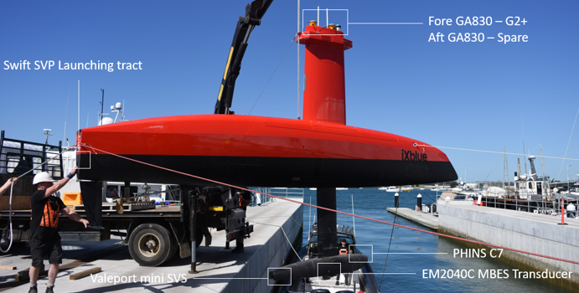
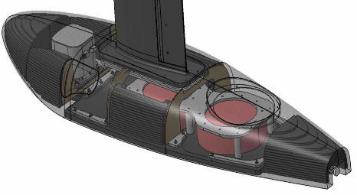
DriX Survey System
INS iXblue PHINS C7
MBES Kongsberg Em2040C dual swath/FM Chirp
GNSS Trimble SPS855 & Septentrio AsterX-U
SVS Valeport miniSVS
CARIS Onboard
Notes:
iXBlue Project for LINZ

Slide 18
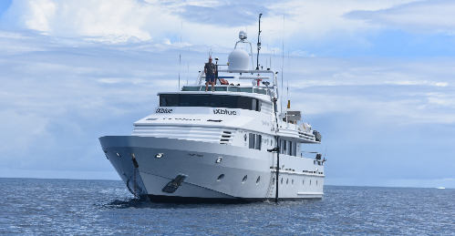
SILENT WINGS Survey System
INS iXblue ROVINS (x2)
MBES Kongsberg Em2040C dual swath/FM Chirp
SBES Odom 200/33 kHz
GNSS Fugro MarineStar 9205 (G2+)
SVS Valeport miniSVS, RapidSVT, SWIFT
Teledyne OceanScience SVP winch
QPS QINSy
CARIS HIPS
Notes:
iXBlue Project for LINZ

Slide 19
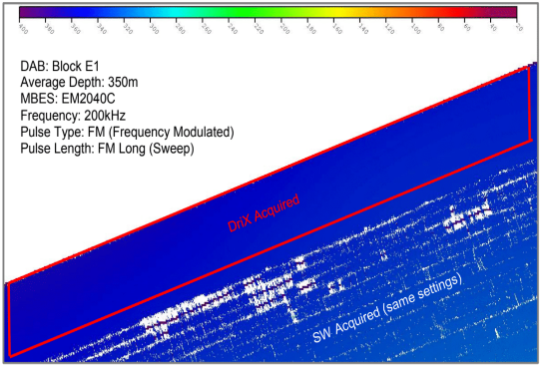
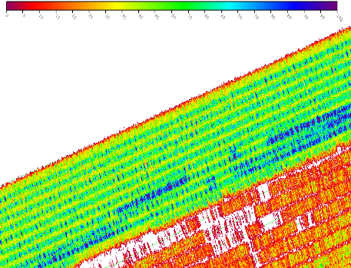
RESULTS
DriX acoustically quiet
45dB Stopped, engines off
(+1dB @12Kts)
Loss of seabed acoustic return
at 320m for SW
100% coverage at 380m for DriX
Improved bathymetric quality results
for backscatter interpretations and WC
analysis
Notes:
iXBlue Project for LINZ

Slide 20
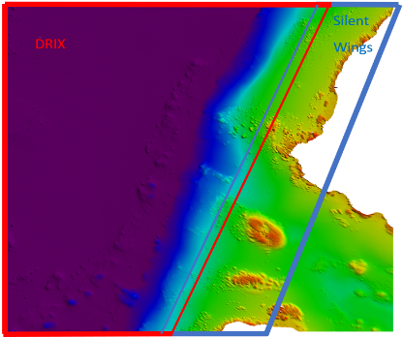
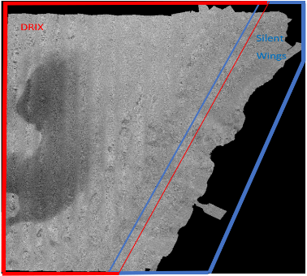
RESULTS
Complimentary datasets
Average mean depth difference of 1.3cm
between SW and DriX on overlapping
surfaces
Complete merging of backscatter data
Notes:
iXBlue Project for LINZ

Slide 21
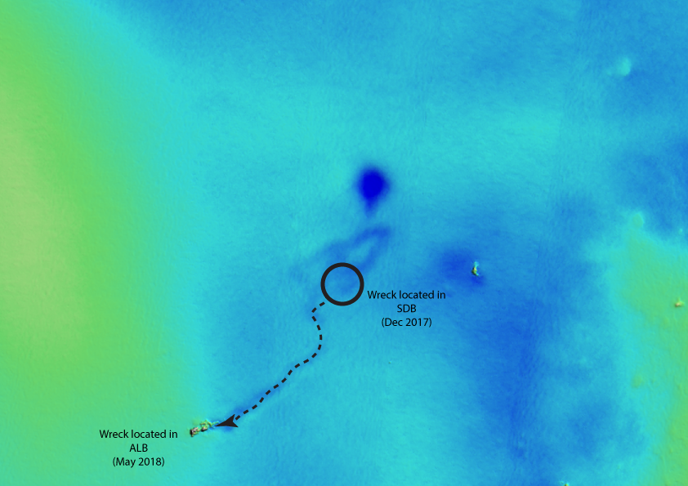
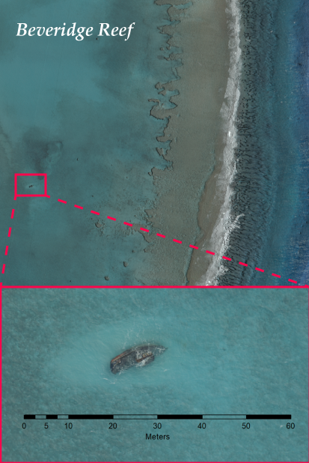
The case of the missing shipwreck
SDB: Dec 2017
ALB: May 2018

Slide 22
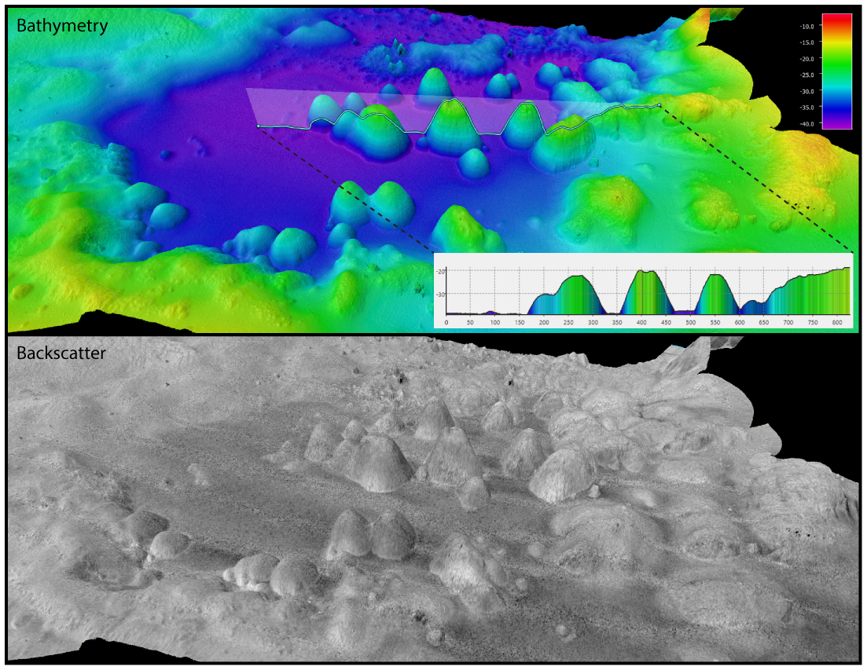
Multibeam Data

Slide 23
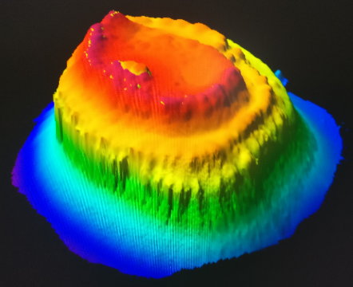
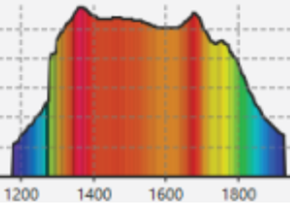
Reminder of the utility of hydrographic survey for safety of navigation. From 300m to 6m deep!

Slide 25
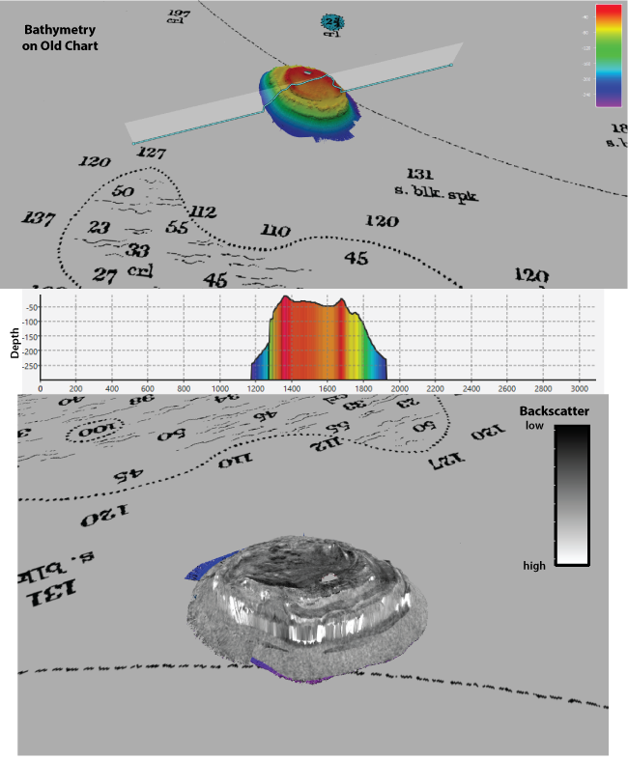
Coral Reefs

Slide 26
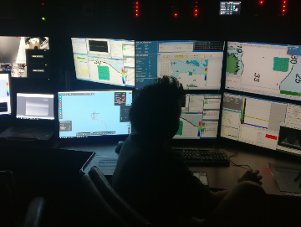
Underwater Volcanoes

Slide 27
Survey Summary | DriX | Silent Wings
Overall Line km | 7,450
Line km | 2,360 | 5,090
% of total line km | 32% | 68%
Effective survey time (Hours) | 166 | 358
Total use (days) | 18 | 38
Average survey speed (knots) | 7.6 | 7.6
Average transit speed (knots) | 10 | 10
Endurance at average survey speed (days) | 5 | 7
Fuel consumption at average survey speed (Litres/day) | 50 | 3,600
The optimal solution

Slide 28
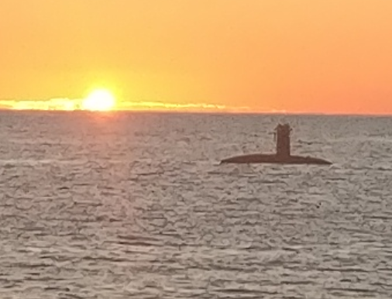
Update – What’s next?
The optimal solution ALB data final stages of cleaning
MBES data will be cleaned in the coming weeks
Merge ALB and MBES
Compile and render ROS (Q2 2019)
Analyse SDB, ALB and MBES datasets to better understand performance of each
Possibility to revisit the SDB data after it has been ground truthed to see if it can be further refined

Slide 29
Project highlights:
Series of firsts:
First time in the world a multi-sensor survey of this scale had been attempted
First time the Chiroptera 4x ALB had been used on large area survey
First time iXblue DriX USV used on contract survey

Slide 30
Multi-sensor Approach
The optimal solution The optimal solution for survey in SW Pacific SDB, ALB, USVs deliver data quicker cleaner cheaper
for a safer maritime environment

Slide 31
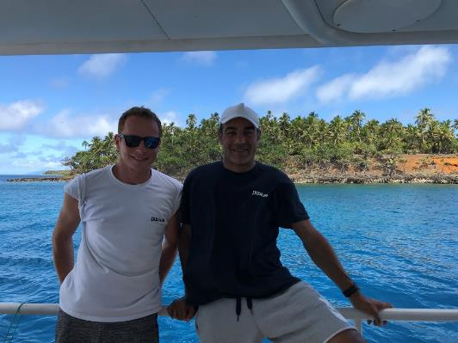
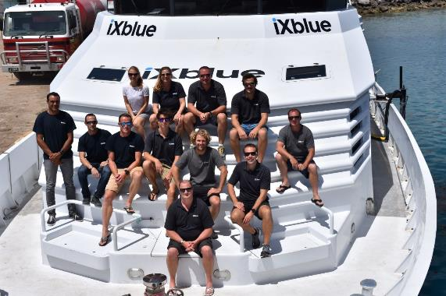
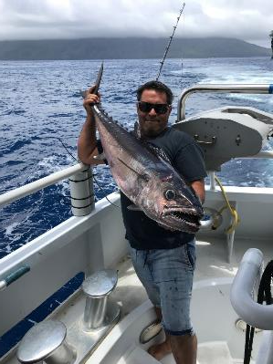
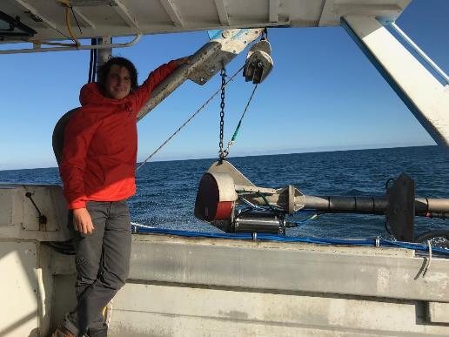
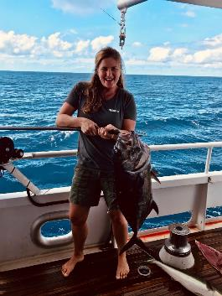
We LOVE what we do!

Slide 32
Acknowledgements:
Mr Adam Greenland (LINZ National Hydrographer)
Dr Magnus Wettel (EOMAP)
Ms Carol Lockhart (GDS)
Tongan Officials

Slide 33
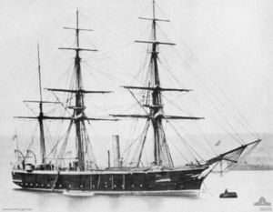
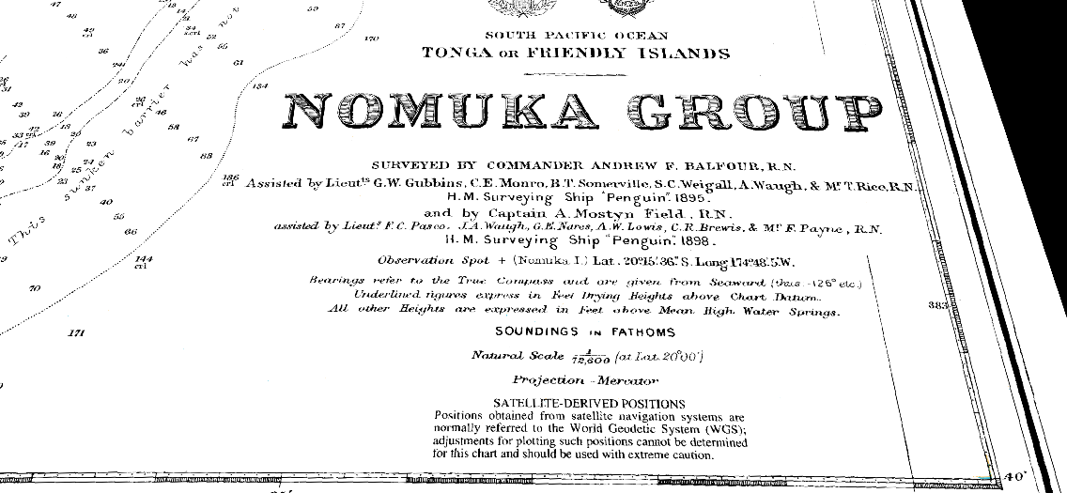
Acknowledgements:
SBES invented in 1913

Slide 34
Thank You

