Slide 1
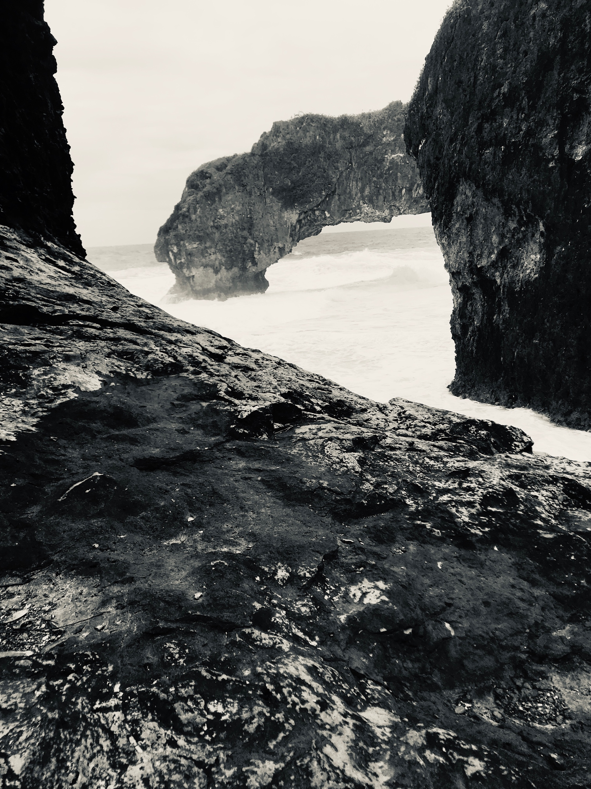
Notes on Emergency Hydrographic Response
United States of America-NOAA

Slide 2
Preparation
Regular meetings with regional interagency groups
Included in FEMA national response plans
Ensure operations resources are available
Equipment at high availability during the hurricane season
Establish charting datum models referenced to ellipsoid in coastal areas

Slide 3
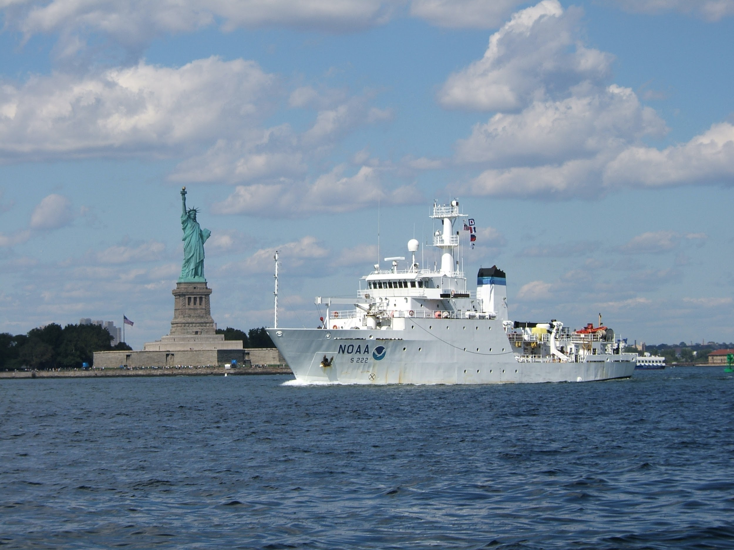
Hydrographic Capabilities
Ships (subject to location and availability)
Navigation Response Teams (trailerable boats)
Portable multibeam and sidescan systems
Lidar and imagery-capable aircraft
8 contractors
Coordinate with US Army Corps of Engineers (in ports, often affected by event)
Reserve response funds for operations

Slide 4
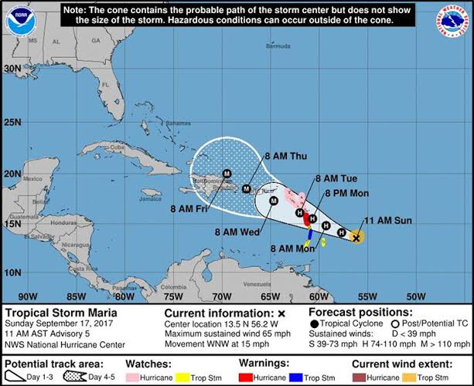
Hurricane Predicted
Coordinate with local and federal authorities
Pre-position NRTs, ships, aircraft
Quick-look Tide gage network, to monitor storm surge.

Slide 5
Immediate Response
Overflights for damage assessment
Harbor and channel surveys
Shoaling in channels
If overland flooding, sidescan and multibeam
Issue NTM, update ENCs (24 hr ping to publish)
Provide salvage packages

Slide 6
Recovery
Systematic updates to shoreline and SLCONS
Systematic Hydrographic surveys
Marine Debris recovery
Repair and harden tide gage network

Slide 7
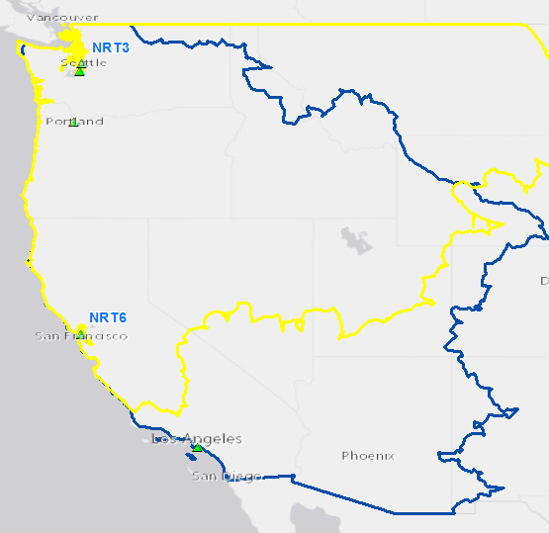
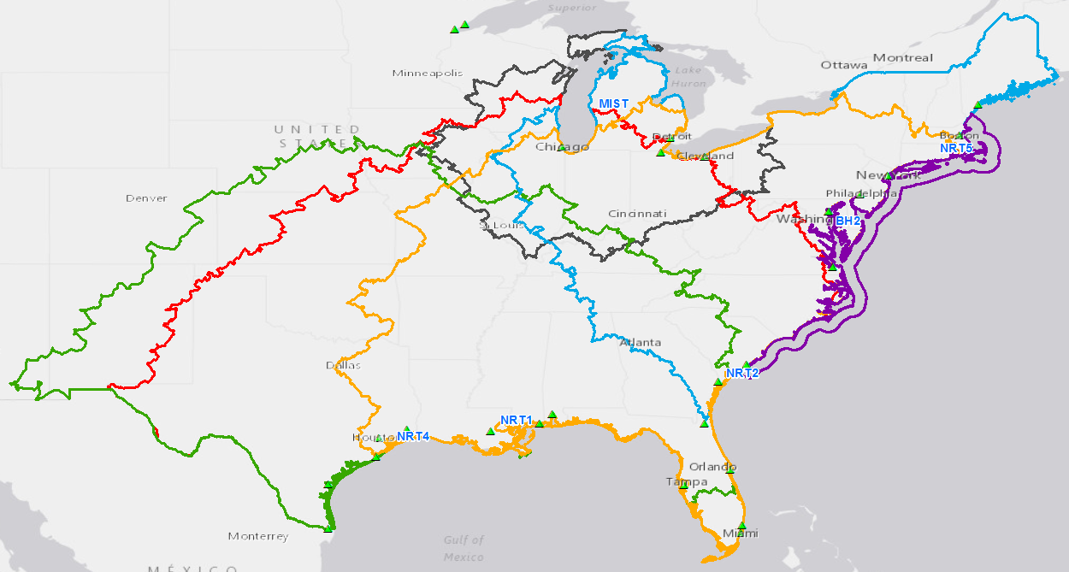
48 Hour Response Coverage
Complete coverage with nearly 100% backup
within 48 hrs on the West Coast.
MIST available for additional Great Lakes support.
Complete coverage with 200-300% backup within 48 hrs on Gulf & Atlantic coasts, except northern Maine & parts of the Great Lakes.

Slide 8
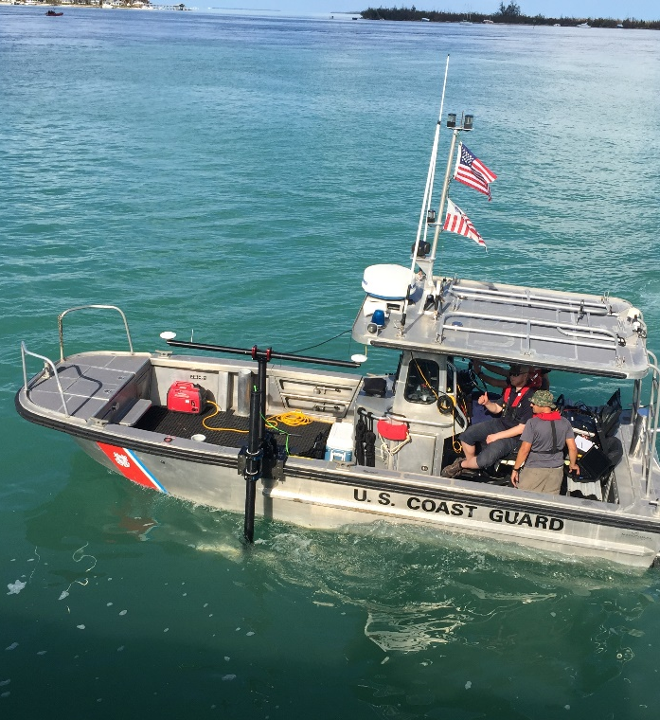
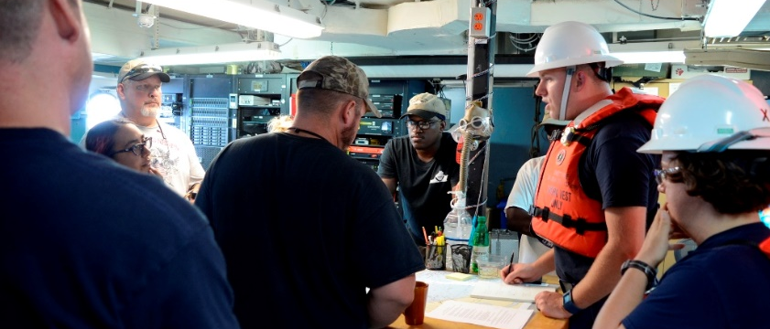
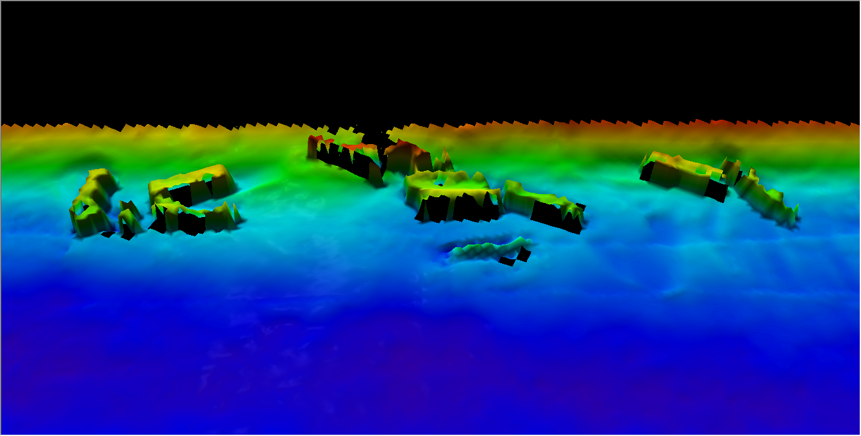
Response Surveys, 2017
Notes:
Image (top left): NRT 2 crew at Corpus Christi incident command center with USCG Commandant
Image (top right): NOAA NRR2 at the Corpus ICC, before heading out to work on the water around Port Aransas Pass.
Image (bottom left): NRT 4 surveying in the Galveston Ship Channel and Bolivar Anchorages.
Image (bottom right): MIST kit onboard the vessel of opportunity – FGBNMS R/V Manta

Slide 9
Coastal Imagery

Slide 10
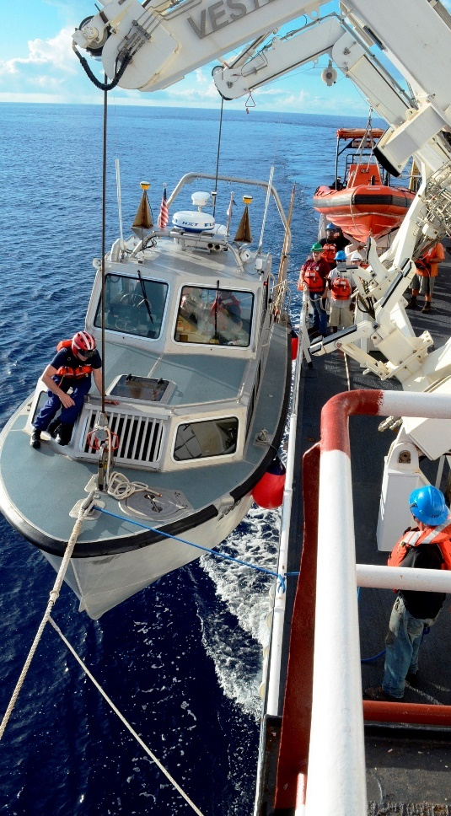
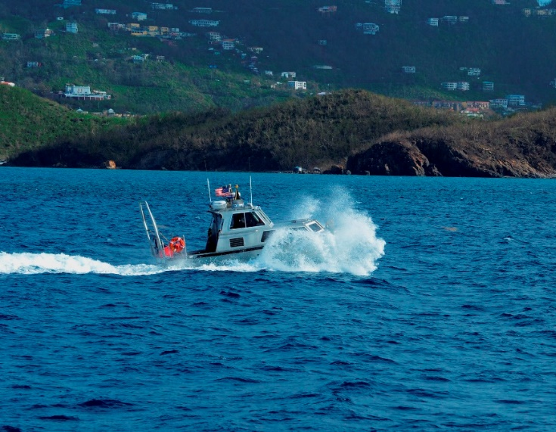
Hurricane Maria Response
^{Office of Coast Survey}
National Oceanic and Atmospheric Administration
Notes:
Most hydrographic acquisition was conducted by survey launches 2903 and 2904.
For 20 days the ship sustained the crew and support staff and provided facilities for planning and processing data independent from local infrastructure.

Slide 11
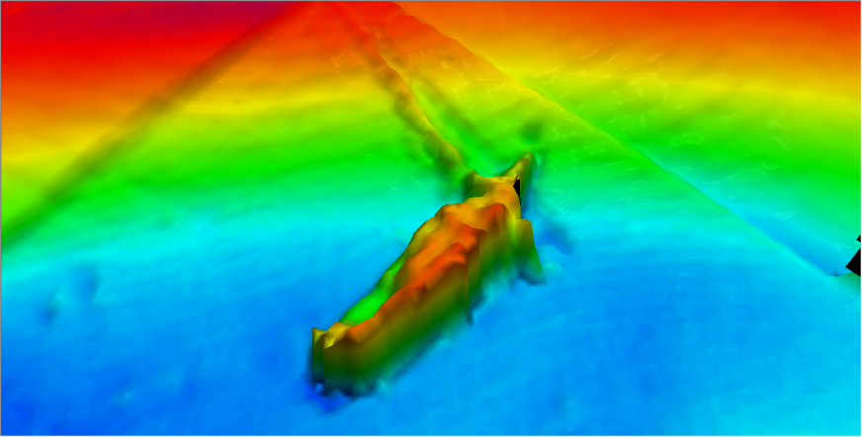
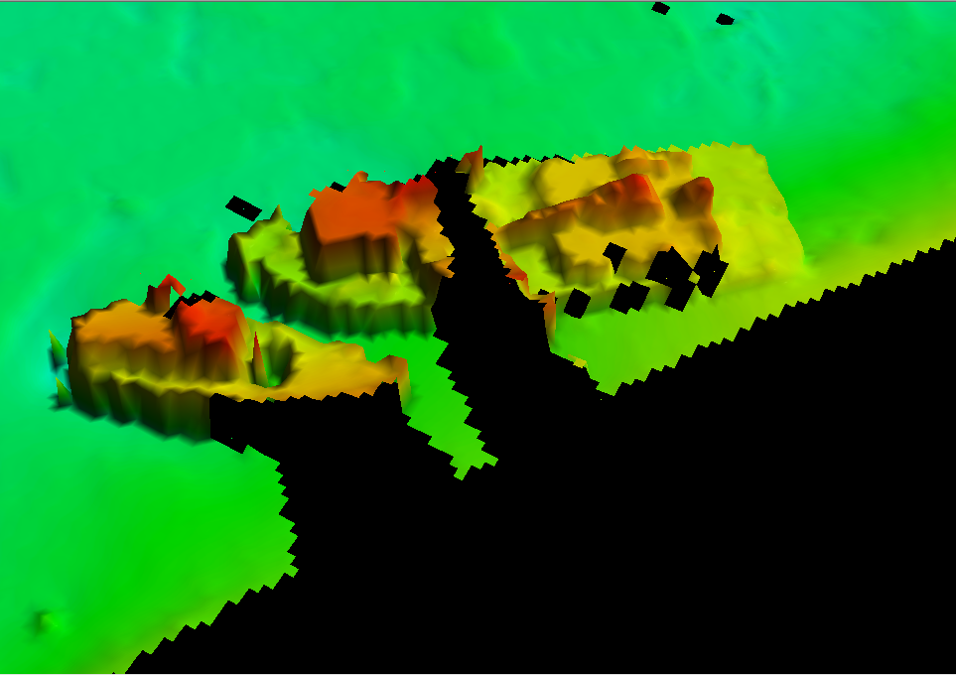
Hurricane Maria Response
Wreck, Redhook Bay, St Thomas, USVI
Wreck, Charlotte Amalie, St Thomas, USVI
Wrecks, Charlotte Amalie,
St Thomas, USVI
Containers, Limetree Bay, St Croix
^{Office of Coast Survey}
National Oceanic and Atmospheric Administration
Notes:
Some Obstructions found in the multibeam and sidescan sonar data.

